Slide 1
HospitalHelper
Tommy Madden

Slide 2

Hospital System
Way Behind Technologically
Most doctors frustrated with EMR System Available
CHOC Hospital

Slide 3
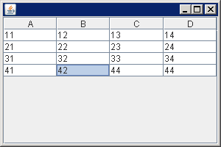
Solution to Problem
Java Swing Application
Connects to MySQL Database
Show data graphically
Help hospitals view/manipulate/engage with data easier

Slide 4
Phase 2 Features
Ideally it would show more elaborate depictions and visualizations of data
Graph it in relation to other variables
Use artificial intelligence to compare each patient to data nationwide, show basic statistics as well
DocTerms

Slide 5
