Slide 1
Tele-HealthCare

Slide 2
Problem statement
The key issue here is how to decrease the cost of the organization, while maintaining and providing an improved and end – to – end healthcare platform.
THERE IS A HUGE TECHNOLOGY DEFICIT AND A LACK OF DATA AVAILABILITY IN THE HEALTHCARE INDUSTRY
Patient health records are not centralized and therefore not accessible to hospitals across the country.
Patients have to visit the hospital to collect their prescription.

Slide 3
Solution
To create a healthcare provider service where the patients do not need to visit the hospital, except for emergencies or surgeries, and get a diagnosis directly via skype chat conferencing.
The patients, once registered by an enterprise hospital, can book an appointment with the doctor, who can send the prescription directly to the patient through an e-mail with an authenticated barcode after diagnosis.
if the patient moves to some other city or state, The same enterprise across different states can access their patient’s medical records using the centralized database available.

Slide 4
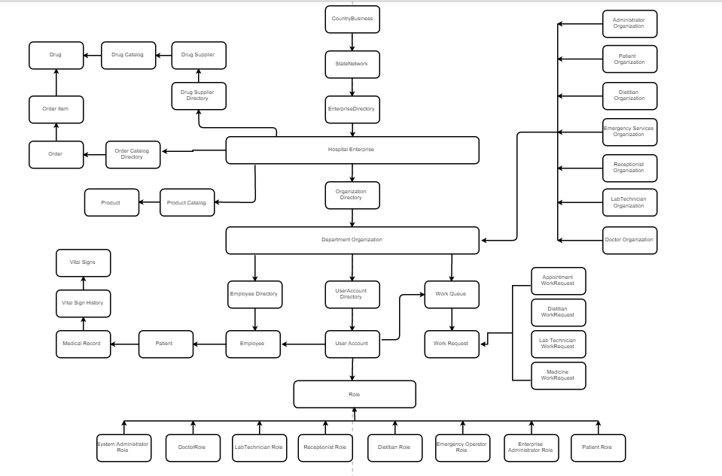
Object model

Slide 5
Key roles
System Administrator: Add and manage different enterprises and their employees. To keep a check on the types of allergies and types of operations performed in a given state.
Administrator: Add and manage employees in the organization. Keep a check on which is the most popular medicine being ordered. Who is most popular doctor with most patients. And also have a central database which keeps him connected to other enterprises.

Slide 6
Key roles
Doctor: Diagnose a patient, send an e-mail with the barcode attached for authenticated prescription. Order tests for lab technician and dietitian. Generate a medical report.
Patient: Create his profile in a hospital enterprise. Book an appointment with a doctor

Slide 7
Key roles
Lab Technician: Work on requests assigned by the doctor. Update the medical report for a patient with their vital signs.
Dietitian: Work on requests assigned by the doctor. Complete the diet chart for the patients looking at the vital signs and add it to the medical record.

Slide 8
Key roles
Emergency Operator: Check alerts for post-operative and elderly patients from the IOT devices and respond if any of the vital signs are abnormal after discharge.
Receptionist: Discharge the patient once the doctor has updated the medical record and deemed the patient ready for work.

Slide 9
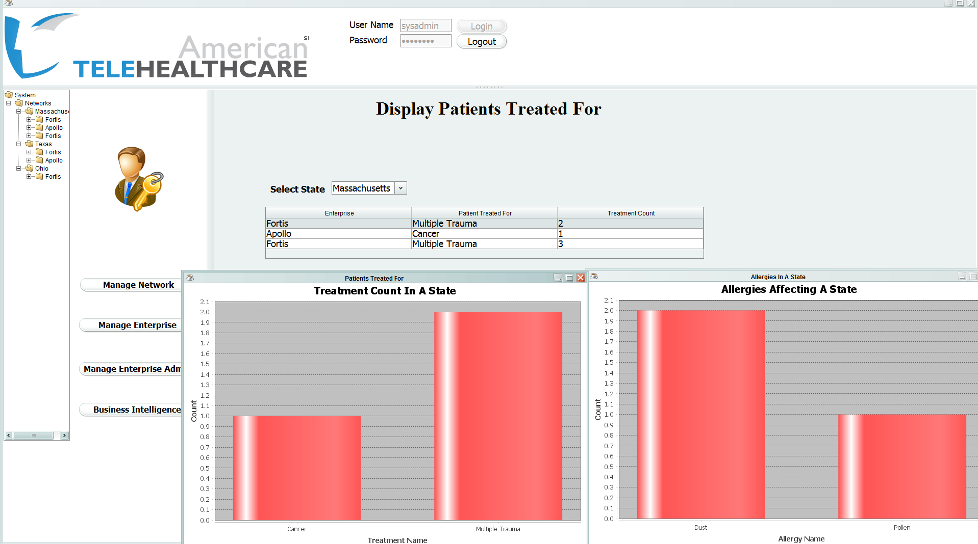
Key screenshots System Admin keeping a check on allergy and types of operation count

Slide 10
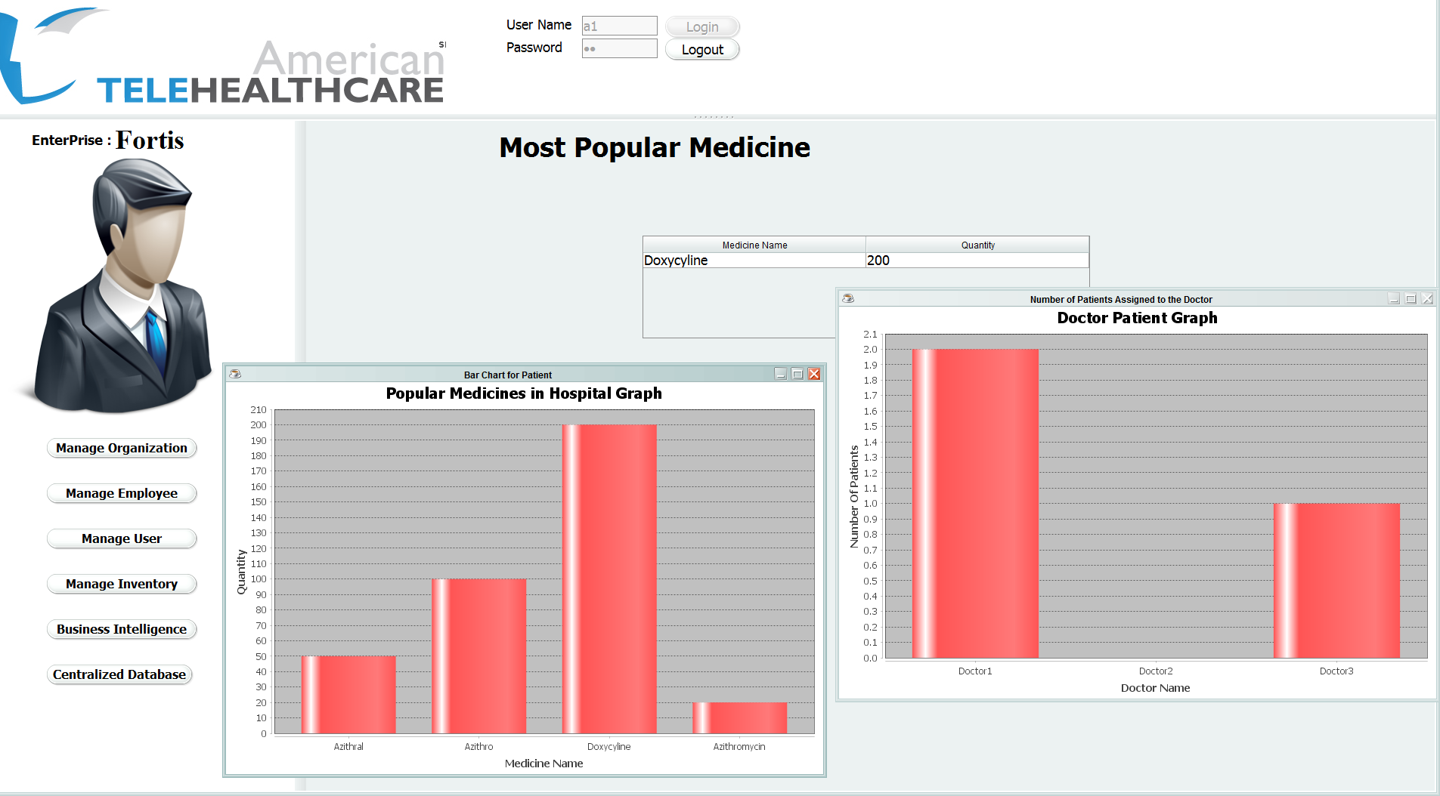
Key screenshots Admin keeping a count of the most popular medicines and doctors

Slide 11
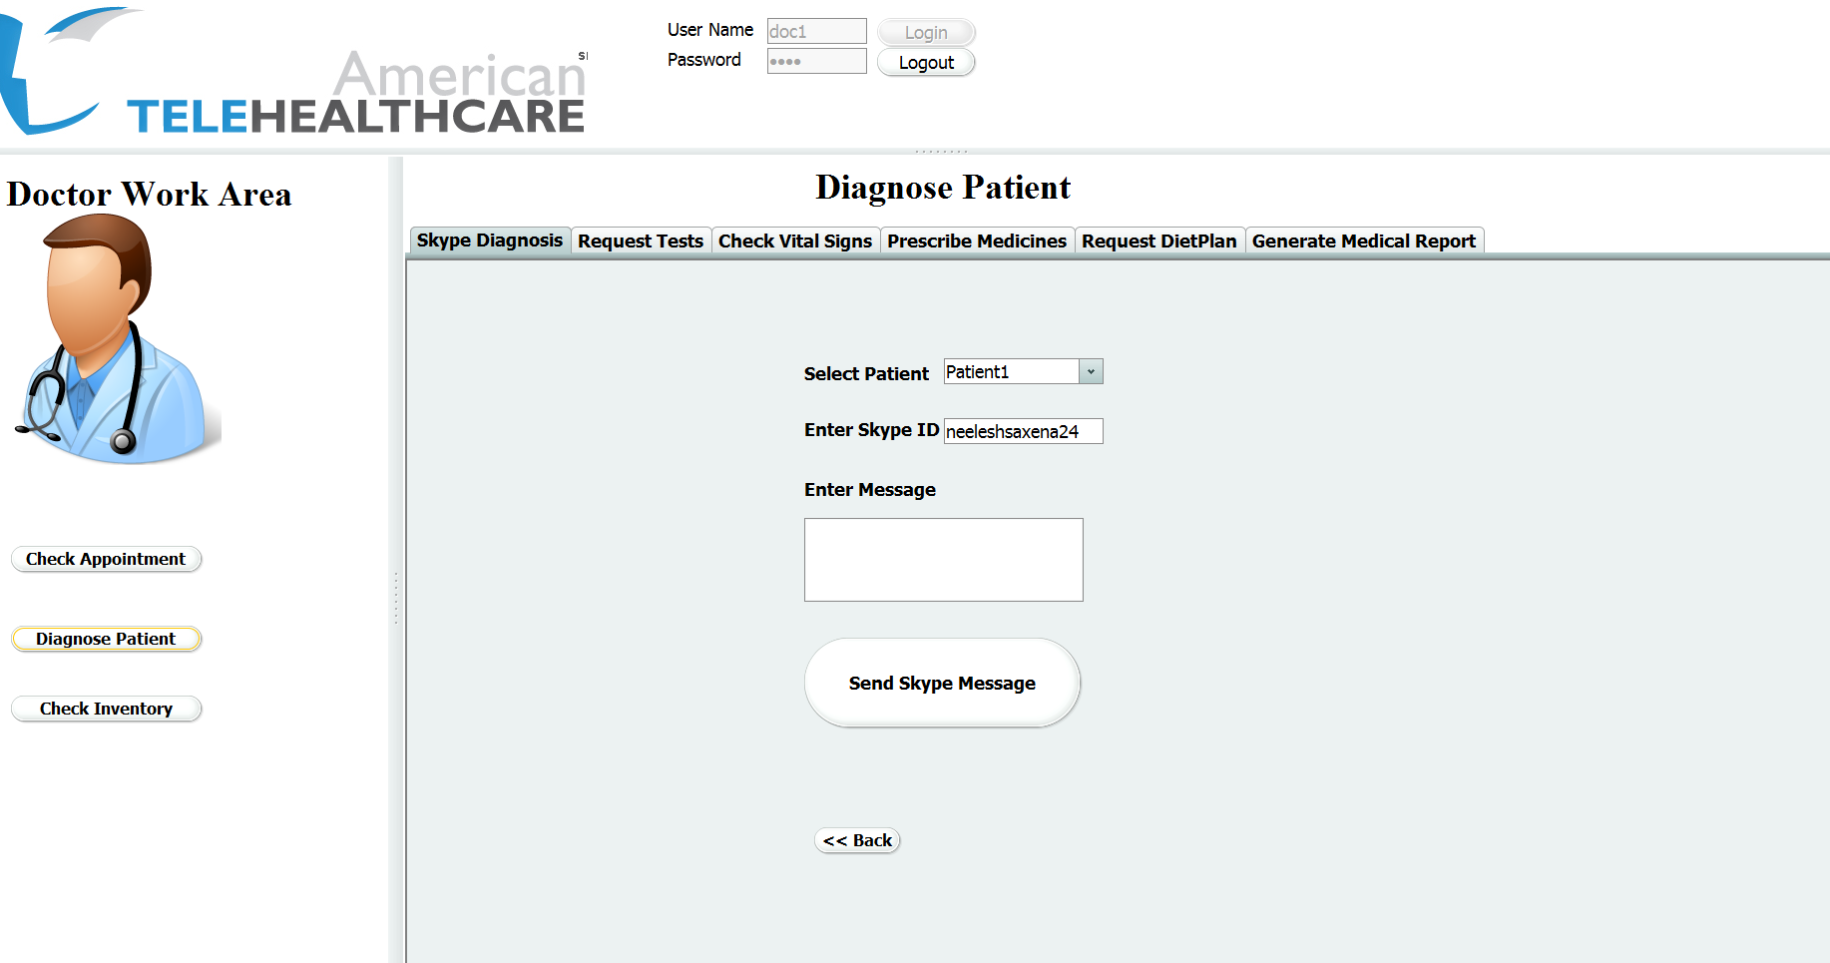
Key screenshots Doctor Diagnosis area

Slide 12
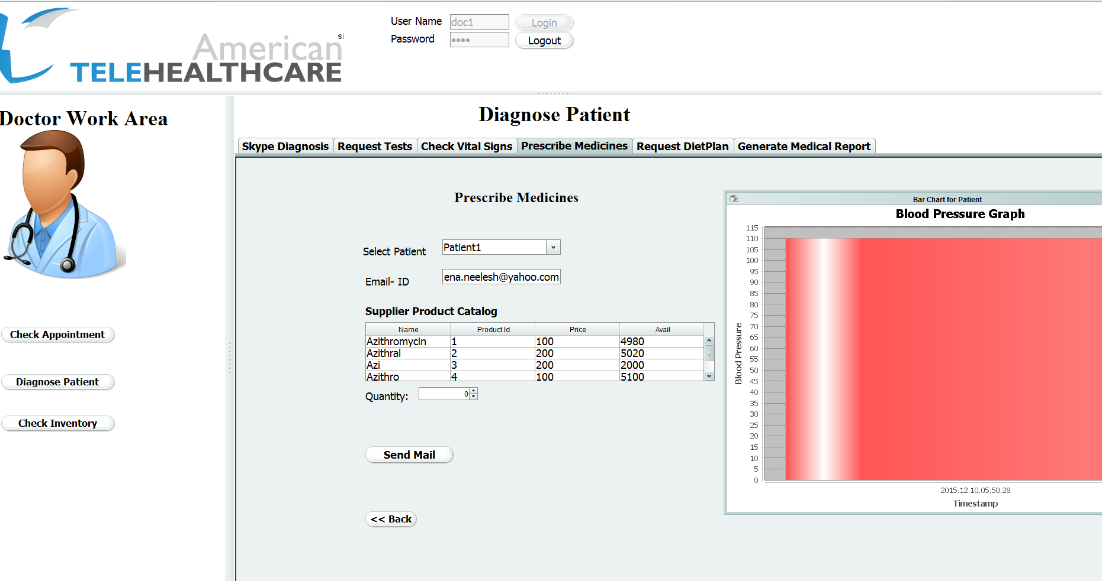
Key screenshots Doctor sends a mail to the patient and keeps a check on the reports

Slide 13
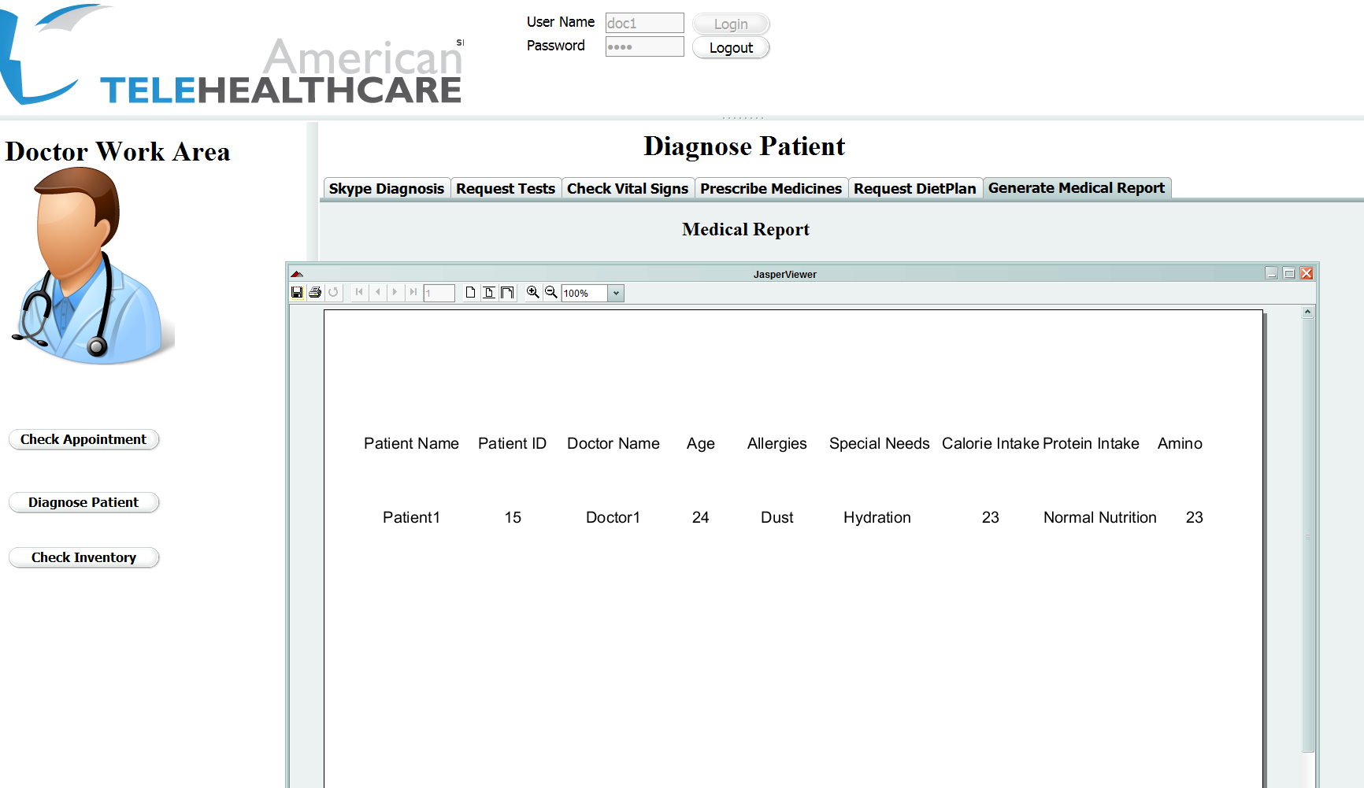
Key screenshots Generates a Xml medical report after the tests are conducted

Slide 14
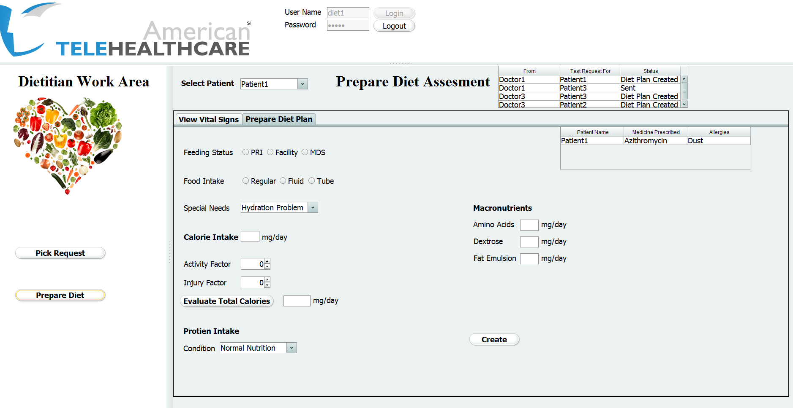
Key screenshots Dietitian prepares the diet chart keeping a check on the medicines prescribed and the allergies

Slide 15
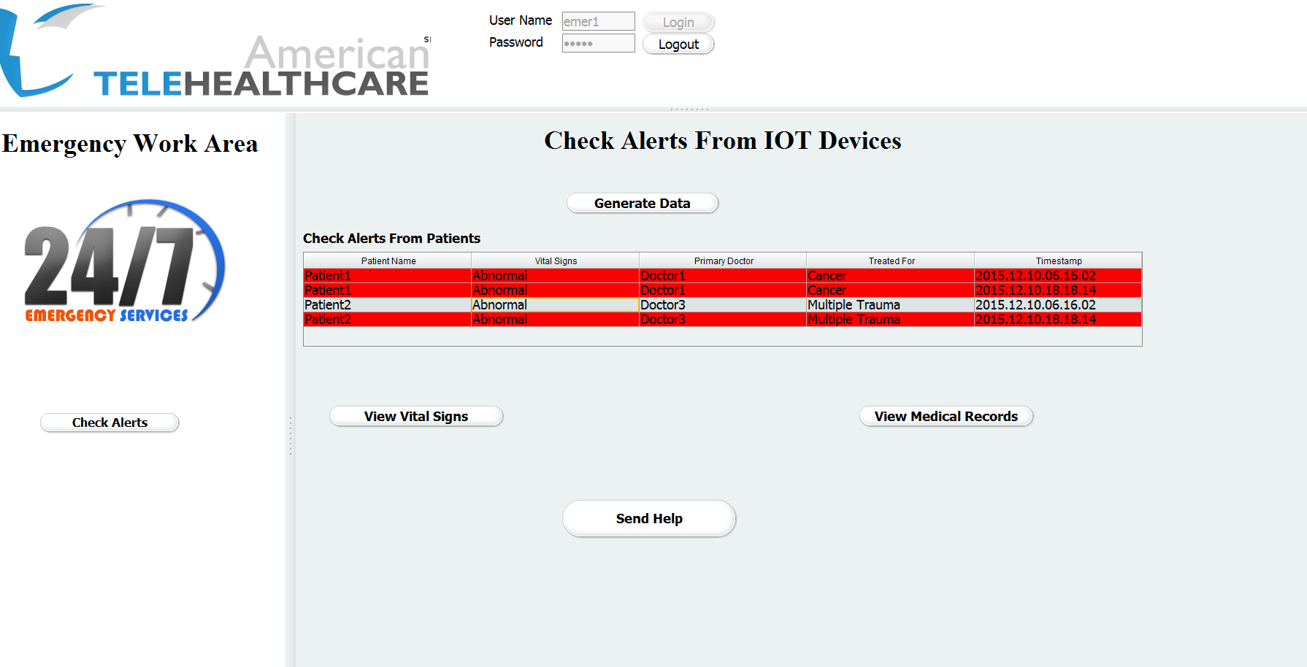
Key screenshots Emergency operator keeps a check on post-op and elderly patient’s vital signs for any abnormal activity from the IOT devices.

Slide 16
Extra features
An initial diagnosis is made on the basis of a skype chat service, using skype api.
The prescription is sent across to the patient through an e-mail, attached with the barcode for authentication purposes.
After the tests are completed, the doctor generates the complete medical report through jasper reports.

