Slide 1
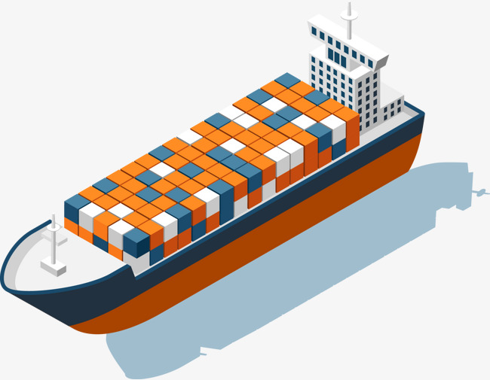


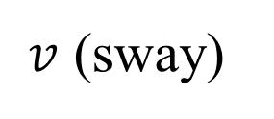

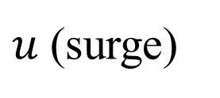
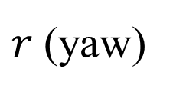

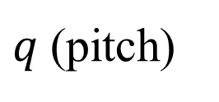

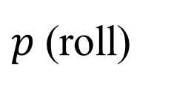
$$y_{b}$$
$v$ (sway)
$q$(pitch)
$$o_{b}$$
CoG
$r$(yaw)
$p$(roll)
$w$ (heave)
$u$(surge)
$$z_{b}$$
$$x_{b}$$

Slide 2
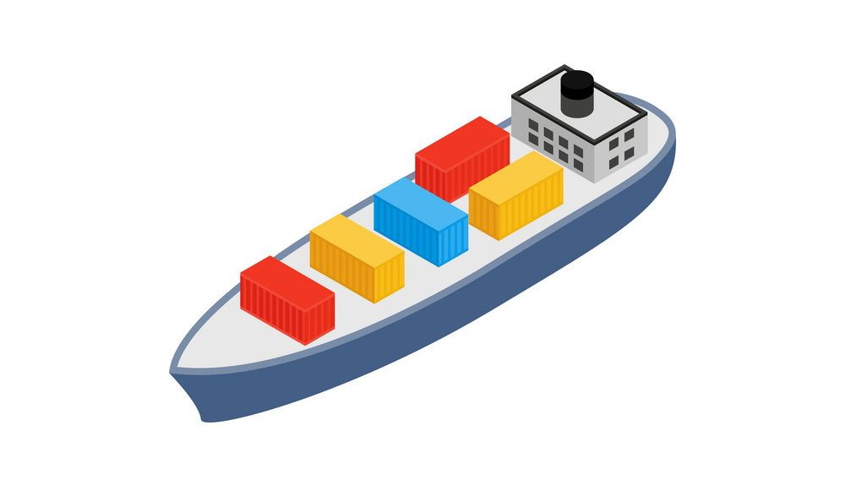
$$L$$
$$α$$
$$d$$
CoG
$$Δθ$$

