Slide 1








$$n_{x}$$
$$t_{x}$$
$$x(s,d)$$
$$n_{r}$$
$$t_{r}$$
$$d(t)$$
$$s(t)$$
trajectory
$$r(t)$$
reference line

Slide 2

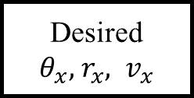
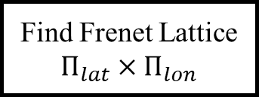
Waypoints smoothing
Spline
Reference line
State estimation
Cart2Frenet
Frenet state
Find Frenet Lattice $Π_{lat}×Π_{lon}$
Frenet2Cart
Cartesian Lattice
Collision Checking
Thrust allocation
Find minimum cost trajectory
controller
Desired $θ_{x}, { r}_{x}, v_{x}$

