Slide 1
term：“b”
“b”的ASCII
length
文档号、词频
position、payload、offset
ByteBlockPool的buffers[ ][ ]
1 | 98 | 0 | 0 | 0 | 0 | 16 | 0 | 0 | 0 | 0 | 16
0
1
2
3
4
5
6
7
8
9
10
11
12
13
14
15
16
17

Slide 2
term：“b”
position、payload
offset
ByteBlockPool的buffers[ ][ ]
0 | 0 | 0 | 0 | 16 | 0 | 0 | 0 | 0 | 16
0
1
2
3
4
5
6
7
8
9
10
11
12
13
14
15
16
17

Slide 3
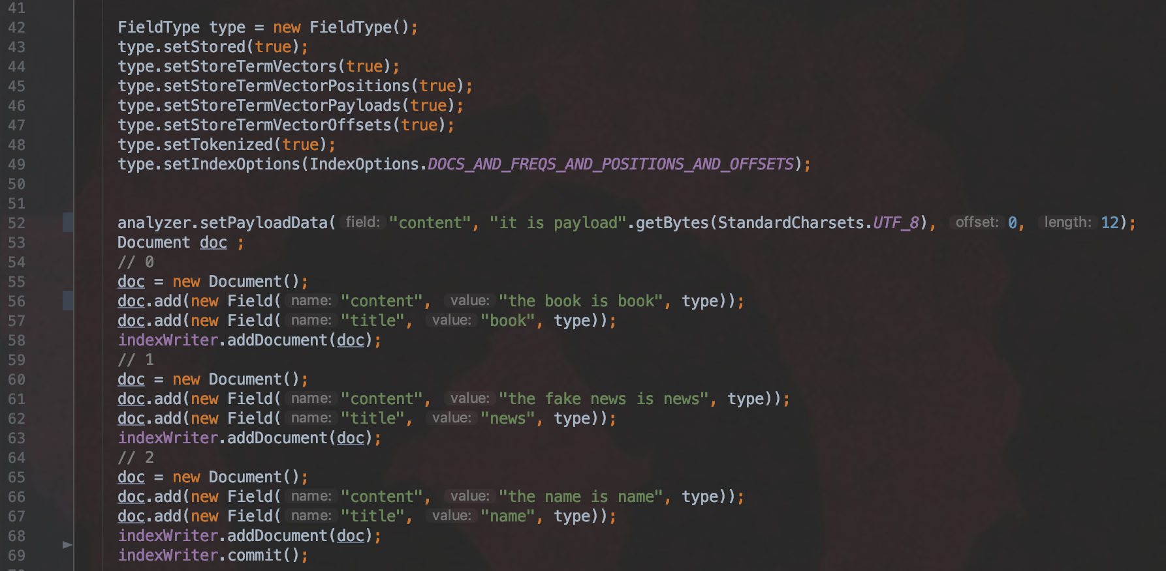

Slide 4


Slide 5
文档0，域名：“content”，域值：“the book is book”
position
offset
length
level
level
ByteBlockPool的buffers[ ][ ]
0 | 0 | 0 | 0 | 16 | 0 | 3 | 0 | 0 | 16 | 0 | 0 | 0 | 0 | 0 | 0
“content”
0
1
2
3
4
5
6
7
8
9
10
11
12
13
14
15
“title”
term | termId | color
the | 0
term | termId | color
freq [ ]
1
freq [ ]
0
1
2
3
0
1
2
3
lastOffsets [ ]
3
lastOffsets [ ]
0
1
2
3
0
1
2
3
lastPositions [ ]
0
lastPositions [ ]
0
1
2
3
IntBlockPool的buffers[ ][ ]
1 | 7
0
1
2
3
textStarts [ ]
0
0
1
textStarts [ ]
0
1
2
3
0
1
2
3
intStarts [ ]
0
intStarts [ ]
0
1
2
3
0
1
2
3

Slide 6
文档0，域名：“content”，域值：“the book is book”
position
offset
length
position
index
offset
level
level
ByteBlockPool的buffers[ ][ ]
0 | 0 | 0 | 0 | 16 | 0 | 3 | 0 | 0 | 16 | 3 | 0 | 0 | 0 | 20 | 4
“content”
0
1
2
3
4
5
6
7
8
9
10
11
12
13
14
15
“title”
term | termId | color
the | 0
book | 1
length
length
i
t
空格
i
s
空格
p
a
y
index
term | termId | color
level
4 | 0 | 0 | 16 | 13 | 105 | 116 | 32 | 105 | 115 | 32 | 112 | 97 | 121 | 0 | 0
16
17
18
19
20
21
22
23
24
25
26
27
28
29
30
31
freq [ ]
1 | 1
index
l
o
a
d
freq [ ]
0
1
2
3
0 | 34 | 108 | 111 | 97 | 100 | 0 | 0 | 0 | 0 | 0 | 0 | 0 | 0 | 0 | 0
0
1
2
3
lastOffsets [ ]
3 | 8
lastOffsets [ ]
0
1
2
3
32
33
34
35
36
37
38
39
40
41
42
43
44
45
46
47
0
1
2
3
lastPositions [ ]
0 | 1
level
lastPositions [ ]
0
1
2
3
0 | 0 | 0 | 0 | 0 | 18 | 0 | 0 | 0 | 0 | 0 | 0 | 0 | 0 | 0 | 0
0
1
2
3
textStarts [ ]
0 | 14
textStarts [ ]
0
1
2
3
48
49
50
51
52
53
54
55
56
57
58
59
60
61
62
63
0
1
2
3
intStarts [ ]
0 | 2
intStarts [ ]
0
1
2
3
IntBlockPool的buffers[ ][ ]
1 | 7 | 38 | 17
0
1
2
3
0
1
2
3

Slide 7
文档0，域名：“content”，域值：“the book is book”
position
offset
length
position
index
offset
level
level
ByteBlockPool的buffers[ ][ ]
0 | 0 | 0 | 0 | 16 | 0 | 3 | 0 | 0 | 16 | 3 | 0 | 0 | 0 | 20 | 4
“content”
0
1
2
3
4
5
6
7
8
9
10
11
12
13
14
15
“title”
term | termId | color
the | 0
book | 1
is | 2
length
length
i
t
空格
i
s
空格
p
a
y
index
term | termId | color
level
4 | 0 | 0 | 16 | 13 | 105 | 116 | 32 | 105 | 115 | 32 | 112 | 97 | 121 | 0 | 0
16
17
18
19
20
21
22
23
24
25
26
27
28
29
30
31
freq [ ]
1 | 1 | 1
index
l
o
a
d
freq [ ]
0
1
2
3
0 | 34 | 108 | 111 | 97 | 100 | 0 | 0 | 0 | 0 | 0 | 0 | 0 | 0 | 0 | 0
0
1
2
3
lastOffsets [ ]
3 | 8 | 11
lastOffsets [ ]
0
1
2
3
32
33
34
35
36
37
38
39
40
41
42
43
44
45
46
47
0
1
2
3
lastPositions [ ]
0 | 1 | 2
position
offset
length
lastPositions [ ]
level
level
level
0
1
2
3
0 | 0 | 0 | 0 | 0 | 18 | 4 | 0 | 0 | 0 | 16 | 9 | 2 | 0 | 0 | 16
0
1
2
3
textStarts [ ]
0 | 14 | 63
textStarts [ ]
0
1
2
3
48
49
50
51
52
53
54
55
56
57
58
59
60
61
62
63
0
1
2
3
intStarts [ ]
0 | 2 | 4
intStarts [ ]
0
1
2
3
0
1
2
3
IntBlockPool的buffers[ ][ ]
1 | 7 | 38 | 17 | 55 | 61
0
1
2
3
4
5

Slide 8
文档0，域名：“content”，域值：“the book is book”
position
offset
length
position
index
offset
level
level
ByteBlockPool的buffers[ ][ ]
0 | 0 | 0 | 0 | 16 | 0 | 3 | 0 | 0 | 16 | 3 | 0 | 0 | 0 | 20 | 4
“content”
0
1
2
3
4
5
6
7
8
9
10
11
12
13
14
15
“title”
length
term | termId | color
the | 0
book | 1
is | 2
offset
length
length
i
t
空格
i
s
空格
p
a
y
index
term | termId | color
level
4 | 4 | 4 | 16 | 13 | 105 | 116 | 32 | 105 | 115 | 32 | 112 | 97 | 121 | 0 | 0
16
17
18
19
20
21
22
23
24
25
26
27
28
29
30
31
position
index
l
o
a
d
length
i
t
空格
i
s
空格
p
a
freq [ ]
1 | 2 | 1
freq [ ]
0
1
2
3
0 | 34 | 108 | 111 | 97 | 100 | 5 | 13 | 105 | 116 | 32 | 105 | 115 | 32 | 112 | 97
0
1
2
3
lastOffsets [ ]
3 | 16 | 11
lastOffsets [ ]
0
1
2
3
32
33
34
35
36
37
38
39
40
41
42
43
44
45
46
47
0
1
2
3
lastPositions [ ]
0 | 3 | 2
y
l
o
a
d
position
offset
length
lastPositions [ ]
level
level
level
0
1
2
3
121 | 108 | 111 | 97 | 100 | 18 | 4 | 0 | 0 | 0 | 16 | 9 | 2 | 0 | 0 | 16
0
1
2
3
textStarts [ ]
0 | 14 | 63
textStarts [ ]
0
1
2
3
48
49
50
51
52
53
54
55
56
57
58
59
60
61
62
63
0
1
2
3
intStarts [ ]
0 | 2 | 4
intStarts [ ]
0
1
2
3
0
1
2
3
IntBlockPool的buffers[ ][ ]
1 | 7 | 53 | 19 | 55 | 61
0
1
2
3
4
5

Slide 9
文档0，域名：“title”，域值：“book”
IntBlockPool的buffers[ ][ ]
position
offset
length
position
index
offset
level
level
1 | 7 | 53 | 19 | 55 | 61 | 65 | 71
0 | 0 | 0 | 0 | 16 | 0 | 3 | 0 | 0 | 16 | 3 | 0 | 0 | 0 | 20 | 4
0
1
2
3
4
5
6
7
ByteBlockPool的buffers[ ][ ]
“content”
0
1
2
3
4
5
6
7
8
9
10
11
12
13
14
15
“title”
length
term | termId | color
the | 0
book | 1
is | 2
offset
length
length
i
t
空格
i
s
空格
p
a
y
index
term | termId | color
book | 0
level
4 | 4 | 4 | 16 | 13 | 105 | 116 | 32 | 105 | 115 | 32 | 112 | 97 | 121 | 0 | 0
16
17
18
19
20
21
22
23
24
25
26
27
28
29
30
31
position
index
l
o
a
d
length
i
t
空格
i
s
空格
p
a
freq [ ]
1 | 2 | 1
freq [ ]
1
0
1
2
3
0 | 34 | 108 | 111 | 97 | 100 | 5 | 13 | 105 | 116 | 32 | 105 | 115 | 32 | 112 | 97
0
1
2
3
lastOffsets [ ]
3 | 16 | 11
lastOffsets [ ]
4
0
1
2
3
32
33
34
35
36
37
38
39
40
41
42
43
44
45
46
47
0
1
2
3
lastPositions [ ]
0 | 3 | 2
y
l
o
a
d
position
offset
length
lastPositions [ ]
0
level
level
level
0
1
2
3
121 | 108 | 111 | 97 | 100 | 18 | 4 | 0 | 0 | 0 | 16 | 9 | 2 | 0 | 0 | 16
0
1
2
3
textStarts [ ]
0 | 14 | 63
textStarts [ ]
106
0
1
2
3
48
49
50
51
52
53
54
55
56
57
58
59
60
61
62
63
0
1
2
3
intStarts [ ]
0 | 2 | 4
position
offset
length
intStarts [ ]
6
level
level
0
1
2
3
0 | 0 | 0 | 0 | 16 | 0 | 4 | 0 | 0 | 16 | 0 | 0 | 0 | 0 | 0 | 0
0
1
2
3
64
65
66
67
68
69
70
71
72
73
74
75
76
77
78
79

