Slide 1


Trading System OOSD Coursework Level I Liverpool Hope University
Noyal Babu-20209749@hope.ac.uk
Brandon
Shaun Wong

Slide 2
BSN Trading Project
This presentation is all about the:
BSN application
UML diagrams
Functions and methods that aided the development of BSN
Challenges we faced
Future scope of this application
Acknowledgment done by each member.

Slide 3
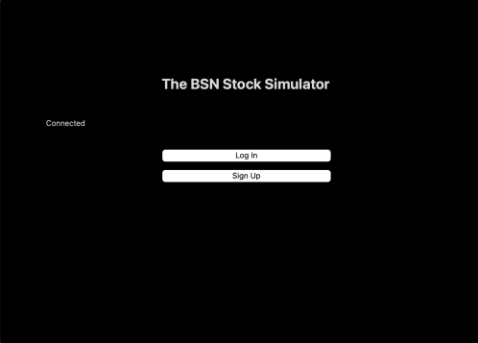
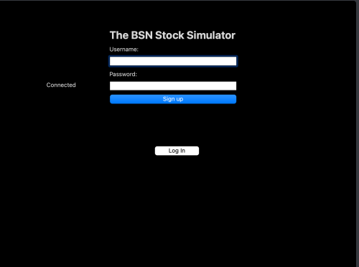
An overview of BSN application
An application that depicts the price movement of a stock.
Allowing the clients to buy and sell stocks with help of this application.
It uses virtual money. An amount of $50,000 is given to new users.
It is a 4 window application.
Main window
Sign Up page

Slide 4
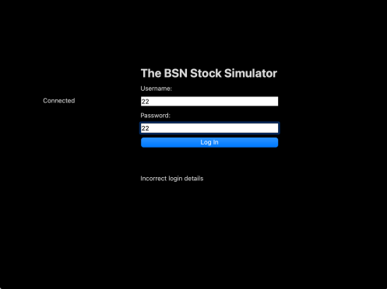
Login window
Customers sign up using username and password, which get stored in the db database.
User login with same username and password.
Login window leads to the homepage.

Slide 5
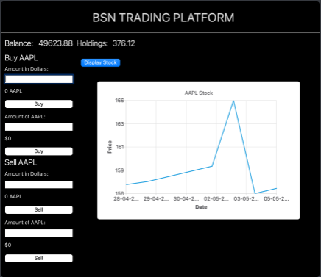
Present account details
APPL Stock chart
Time scale
Buy or sell stock

Slide 6

Qt library
The platform used to develop BSN Trading system.
Various tutorials provided by Qt guided us in many ways. Like it had videos related to creating a push button and so.
It's a potential library containing a lot of functions and methods that will help us code faster and easier.
All classes in this program has instances of QObject. It is very well portraited in the class diagram.
Qchart in Qt is used to get the stock data displayed on the chart.

Slide 7
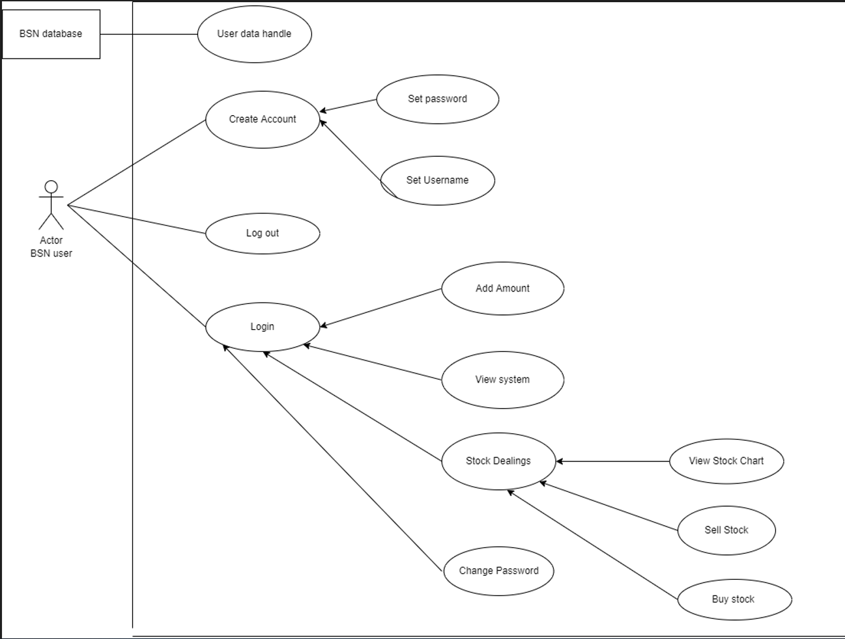
UML Diagrams
Use-case model

Slide 8
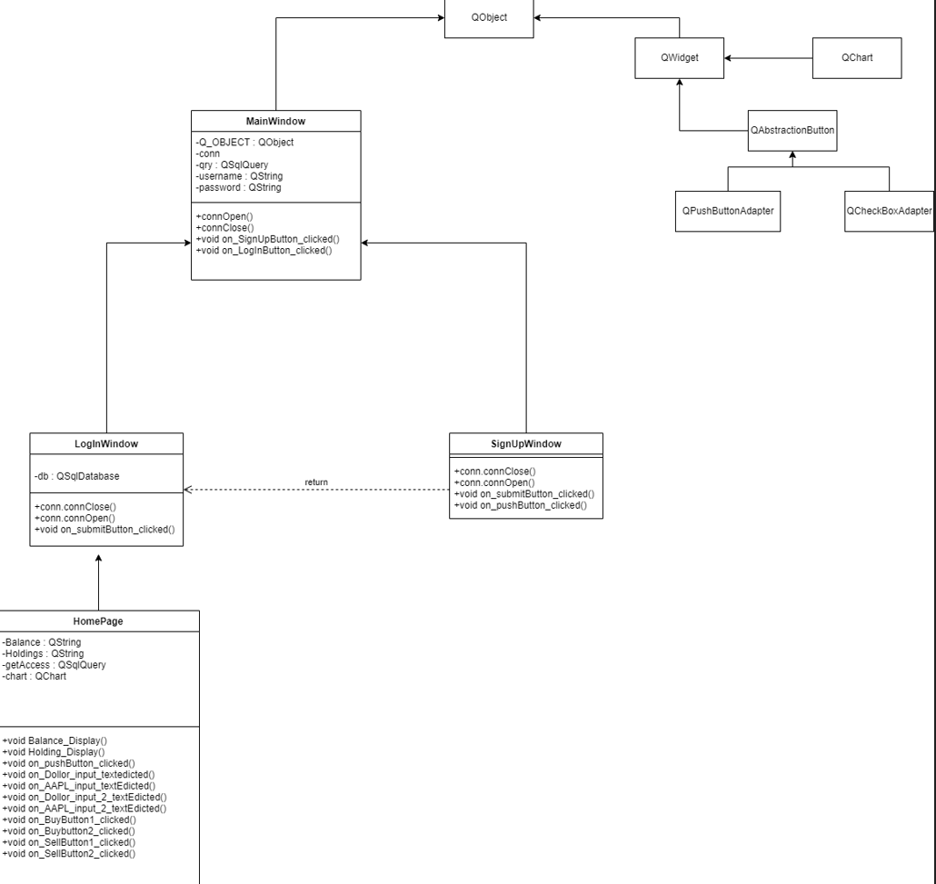
Class Diagram

Slide 9
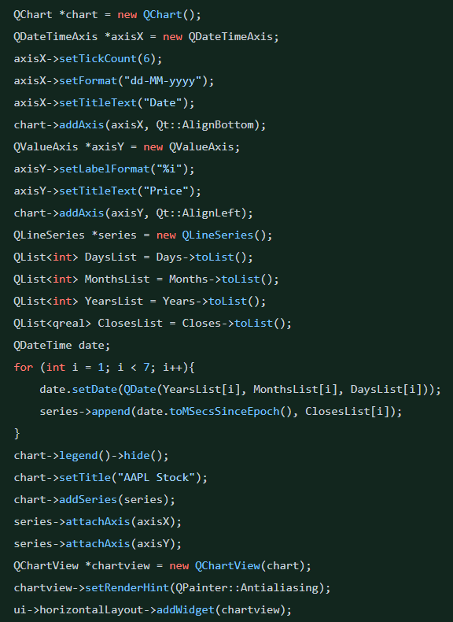
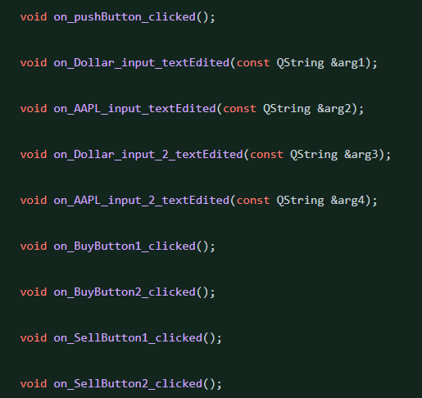
Functions used in coding BSN system
The 4 main functions used in this program:
MainWindow
SignUpWindow
LogInWindow
HomePage
Usage of Qchart
Functions in homepage

Slide 10
Functionalities supported in BSN
Add amount
View chart
Create Account
Sell stock
Login
Set username and password
Buy stock
Change Password

Slide 11
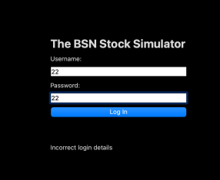
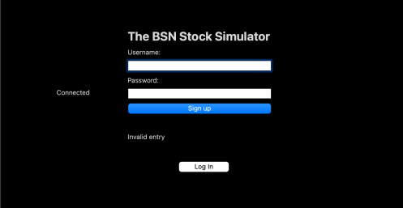
Exception and Error handling
If the user has entered unauthorised details on login page or try to create an account using invalid entry, the page pops error messages.

Slide 12
Future of BSN Trading System
On carrying the BSN project in future:
Update the customer with recent stock fluctuations like investing API (provided by APIDojo), Yahoo finance and more
Add more variety to stocks
Deal with real world money
Could not do within the limited time scale
Customise Chart
Permission to withdraw from the

Slide 13
Together we did a great job…
The entire project was divided into :
Main page – Shaun Wong
Login and signup Page – Noyal Babu
Home page –Brandon
Import of excel data info-Brandon
Creation of database – Brandon
Chart creation - Brandon
Aesthetic look of the program-Noyal Babu
Group documentation –Noyal, Brandon and Shaun
PPT – Noyal Babu

