Slide 1






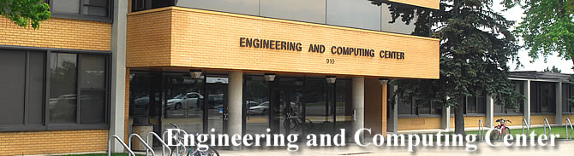
.
Avatar - Open Source Project
Cloud Computing Club
Dr. Adriano Cavalcanti
PhD MABE, MS EE, BSc CSc
Computational Nanotechnology & Biomed Robotics
Office location: ECC246
Email: adriano.cavalcanti@stcloudstate.edu
Office hours:
Check on Syllabus; & by appointment

Slide 2









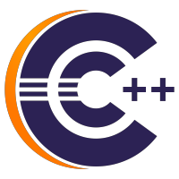

Script Automation
implementation
Using the scripting program of your choice write a program with the features
Extension: your application should rename the file extension from all files in the dataset from txt to csv. (1 point)
Automation: perform the file extension change automatically for all files in all subdirectories automatically. (1 point)
Documentation: describe in word or ppt file the steps taken in your implementation; (1 point)
Submit source code, documentation, short recorded presentation & demo program running.
Team of 3 implementation

Slide 3
Script Automation
Use the Rust Bash, or Bash, or any scripting language to write a program with following features:
Input: make your program properly process the data sample provided, as follow: e.g. /data/ >> takeoff / [>> all_subfolders ] etc. The program should automatically identify the total of files on each subdirectory for that specific category; There are N categories: takeoff land right left forward backward etc etc; your application should rename the set of all files to sequential numbers, if n files, attribute a number for each file by random attribution, counting from 1 all the way to n, considering the total number of file into that specific category in all subfolders in that category.
Unify: You need to unify all files together in their parent directory category. Make sure that no file is overwritten and that the names are organized accordingly; After unifying all files into their parent directory by their category, you can delete and clean up any temporary directory or subdirectory with the original files from the directories where you just copied the content from for that category.
Date: Change the time stamp for date and time of when the file was created to a random date and time, back in time up to the last 10 days.
Automation: have the program displaying the names and creation timestamp of files before they are changed and after they changed; Include both options to set the program to run automatically either once a week, or every 30 seconds -- show it automatically running 3 times.
Submission: describe in word or ppt file the steps taken in your implementation ; upload on D2L, source code/scripting/setups documentation and a not zipped short video demo 5 to 10 minutes, and ppt presentation; as a comment in the source code, include your name/author in the head of the program.

