Slide 1
Mapbox

Slide 2
Web Mapping Libraries
Google Maps JavaScript API
ArcGIS Maps SDK for JavaScript
Leaflet
OpenLayers
Mapbox gl js
CesiumJS
…

Slide 3
What is Mapbox?
Mapbox is a platform that provides mapping services, allowing developers to create and customize maps for web and mobile applications. It offers a variety of APIs and SDKs for integrating maps, search, navigation, and location data into applications. Mapbox also provides tools like Mapbox Studio for designing custom map styles.

Slide 4
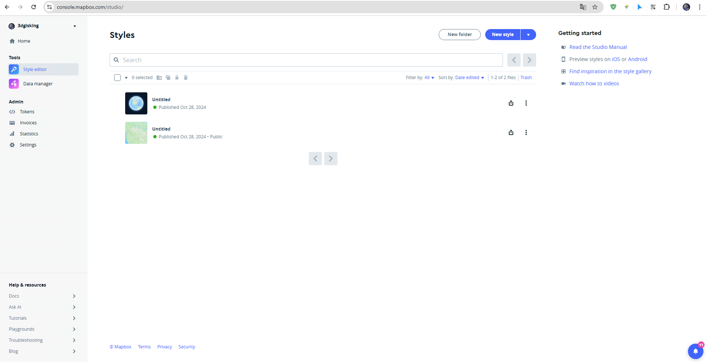

Slide 5
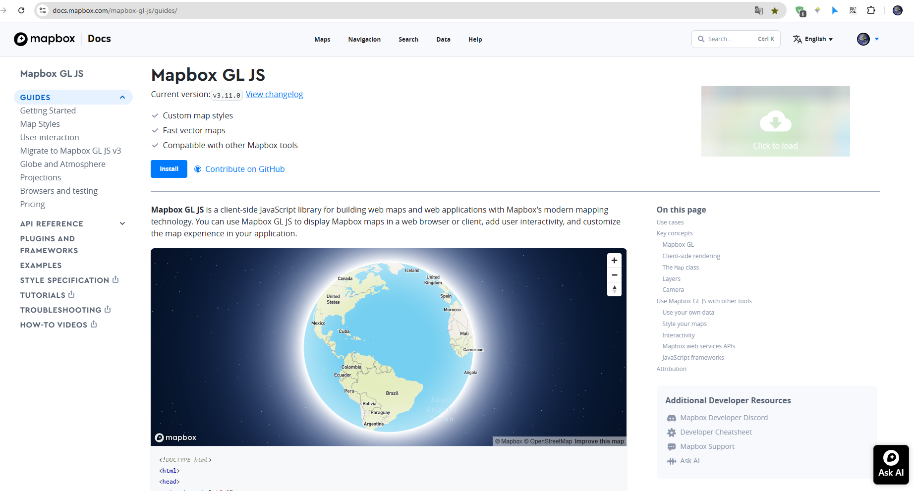

Slide 6
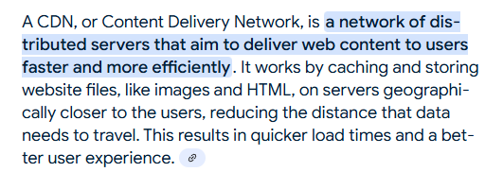
Getting Started
Prerequisites
Before you get started with Mapbox GL JS, you need to have a Mapbox access token and add Mapbox GL JS to your project using either the CDN or the mapbox-gl npm package.
To use Mapbox GL JS in your project, you need to import it using the Mapbox GL JS CDN or install the mapbox-gl npm package.

Slide 7
<!DOCTYPE html>
<html>
<head>
<meta charset="utf-8">
<title>Mapbox GL JS map</title>
<meta name="viewport" content="initial-scale=1,maximum-scale=1,user-scalable=no">
<link href="https://api.mapbox.com/mapbox-gl-js/v3.11.0/mapbox-gl.css" rel="stylesheet">
<script src="https://api.mapbox.com/mapbox-gl-js/v3.11.0/mapbox-gl.js"></script>
<style>
body { margin: 0; padding: 0; }
#map { position: absolute; top: 0; bottom: 0; width: 100%; }
</style>
</head>
<body>
<div id="map"></div>
<script>
mapboxgl.accessToken = 'pk.eyJ1IjoiM2RnaXNraW5nIiwiYSI6ImNtMnNvYmF5bDF3OGcya3E4Mm41MjJhYWUifQ.eyjl7EtxA-HVY3fUTDXqZw';
const map = new mapboxgl.Map({
container: 'map', // container ID
center: [-74.5, 40], // starting position [lng, lat]. Note that lat must be set between -90 and 90
zoom: 9 // starting zoom
});
</script>
</body>
</html>

Slide 8
import mapboxgl from 'mapbox-gl'; // or "const mapboxgl = require('mapbox-gl');"
import 'mapbox-gl/dist/mapbox-gl.css';
mapboxgl.accessToken = 'pk.eyJ1IjoiM2RnaXNraW5nIiwiYSI6ImNtMnNvYmF5bDF3OGcya3E4Mm41MjJhYWUifQ.eyjl7EtxA-HVY3fUTDXqZw';
const map = new mapboxgl.Map({
container: 'map', // container ID
style: 'mapbox://styles/mapbox/streets-v12', // style URL
center: [-74.5, 40], // starting position [lng, lat]
zoom: 9, // starting zoom
});

Slide 9
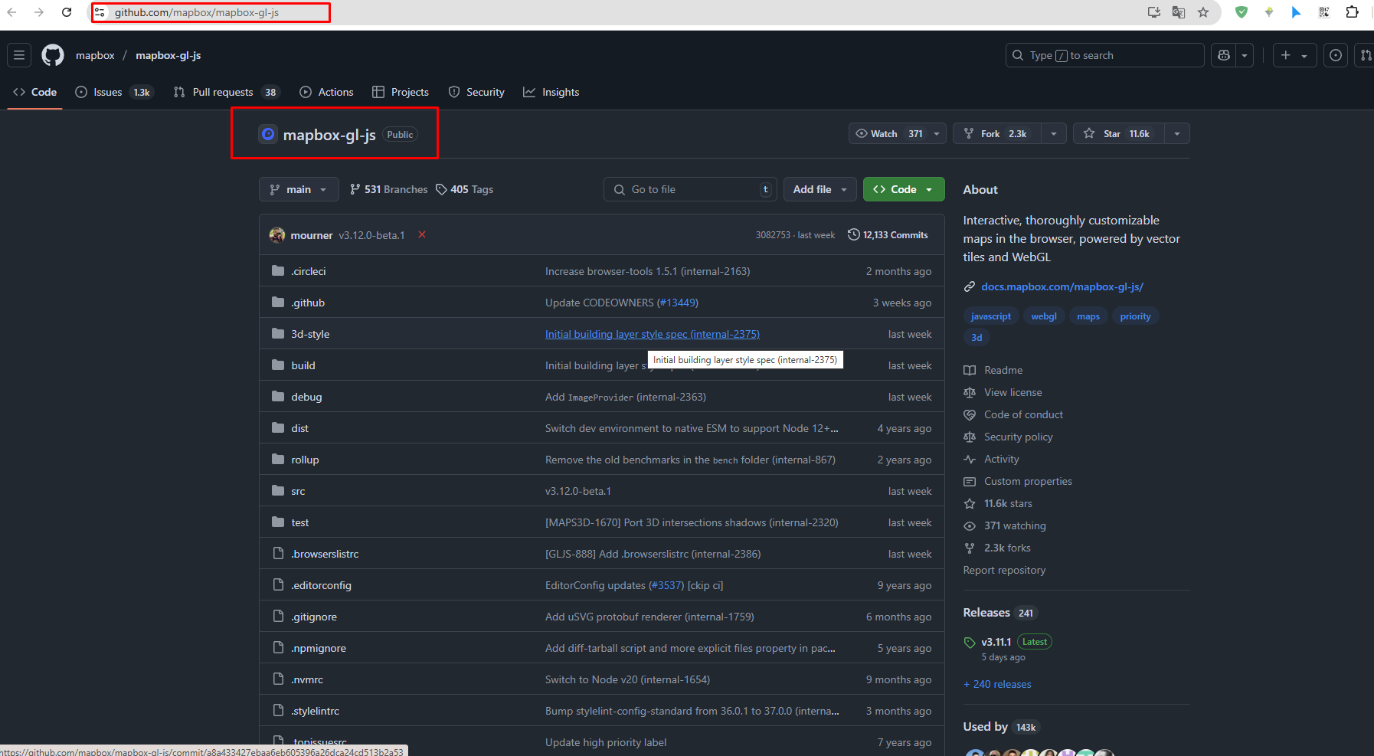

Slide 10
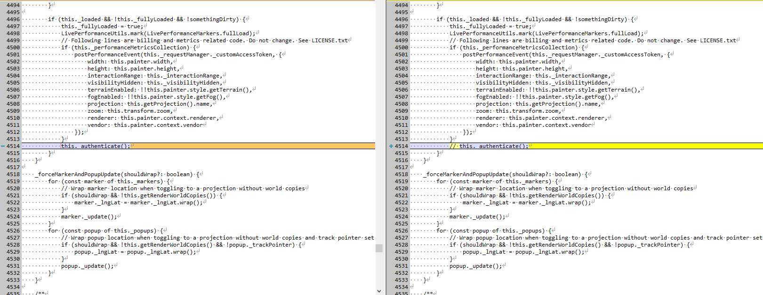

Slide 11
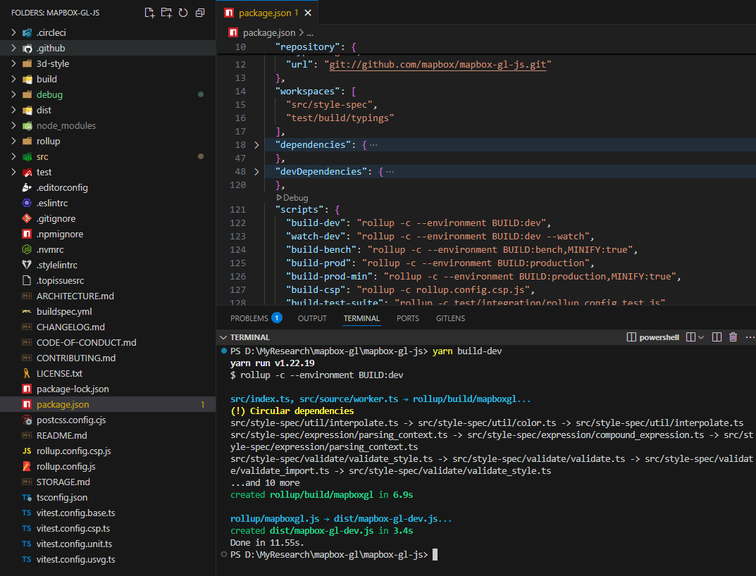

Slide 12
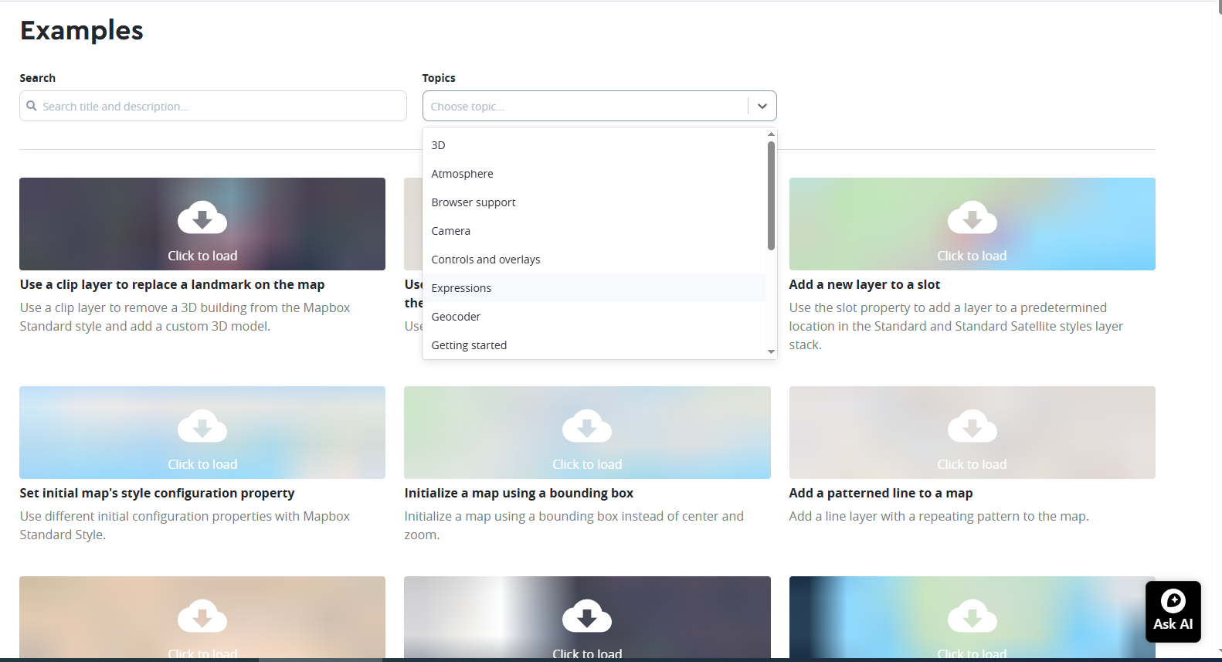
https://docs.mapbox.com/mapbox-gl-js/example/

Slide 13
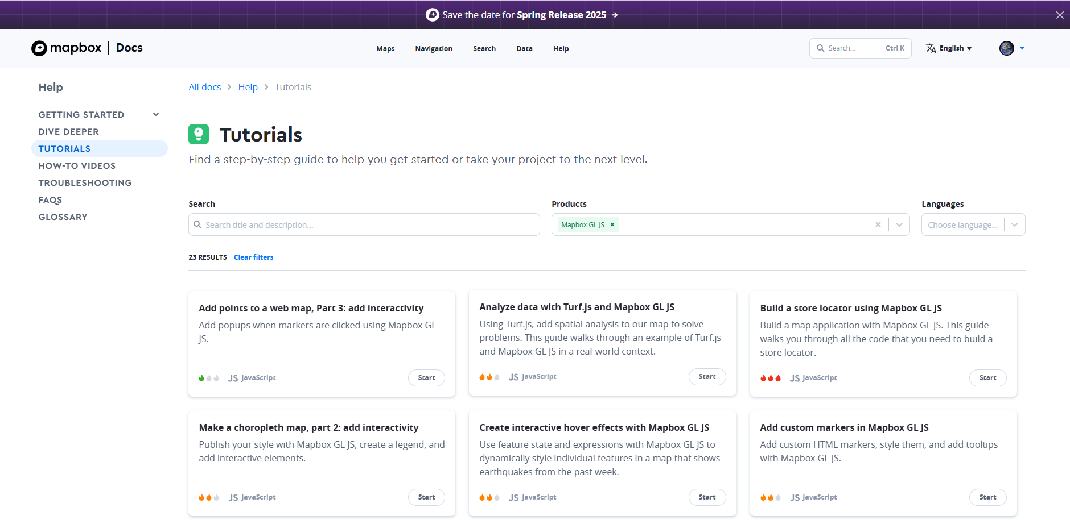
https://docs.mapbox.com/help/tutorials/?product=Mapbox+GL+JS

Slide 14
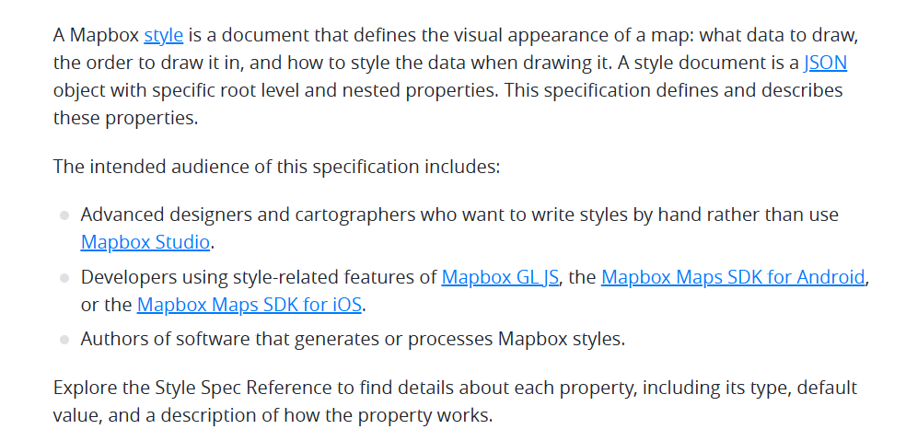
Mapbox Style Specification

Slide 15
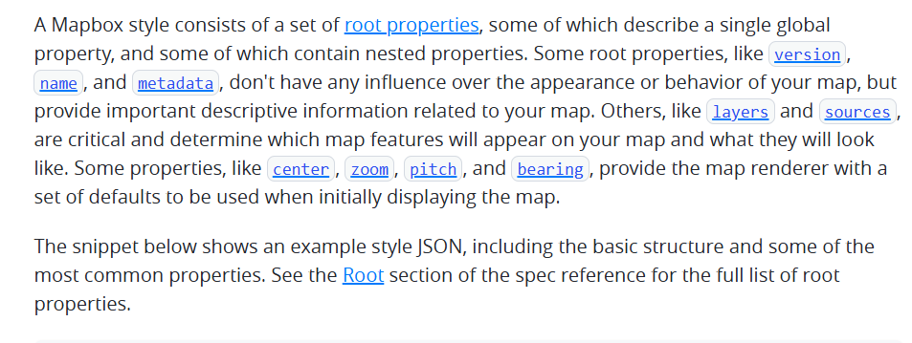
Style document structure

Slide 16
Sample style document
{
"name": "some-style",
"version": 8,
// default camera position
"center": [ -74, 40.73 ],
"zoom": 11.3,
"bearing": 20.8,
"pitch": 17.5,
// sprites and fonts
"sprite": "mapbox://sprites/mapbox/light-v11",
"glyphs": "mapbox://fonts/mapbox/{fontstack}/{range}.pbf",
// spatial data to include, used one-to-many with layers
"sources": {
"some-vector-source": {
"type": "vector",
"url": "mapbox://mapbox.mapbox-streets-v8"
},
"some-raster-source": {
"type": "raster",
"url": "mapbox://mapbox.satellite",
"tileSize": 256
},
"some-geojson-source": {
"type": "geojson",
"data": "https://path-to-geojson-data"
},
},
// layers define rendering the map, in order; used many-to-one with sources
"layers": [
{
"id": "some-layer",
"type": "fill",
"source": "some-vector-source",
"source-layer": "some-source-layer",
"layout": {
"visibility": "visible"
},
"paint": {
"fill-color": "#888888",
"fill-opacity": 0.5
}
},
{
"id": "another-layer",
"type": "circle",
"source": "some-geojson-source",
"paint": {
"circle-radius": 10,
"circle-color": "#FF0000"
}
},
{
"id": "some-raster-layer",
"type": "raster",
"source": "some-raster-source",
"minzoom": 0,
"maxzoom": 22,
"paint": {
"raster-opacity": 0.5
}
}
]
}

Slide 17
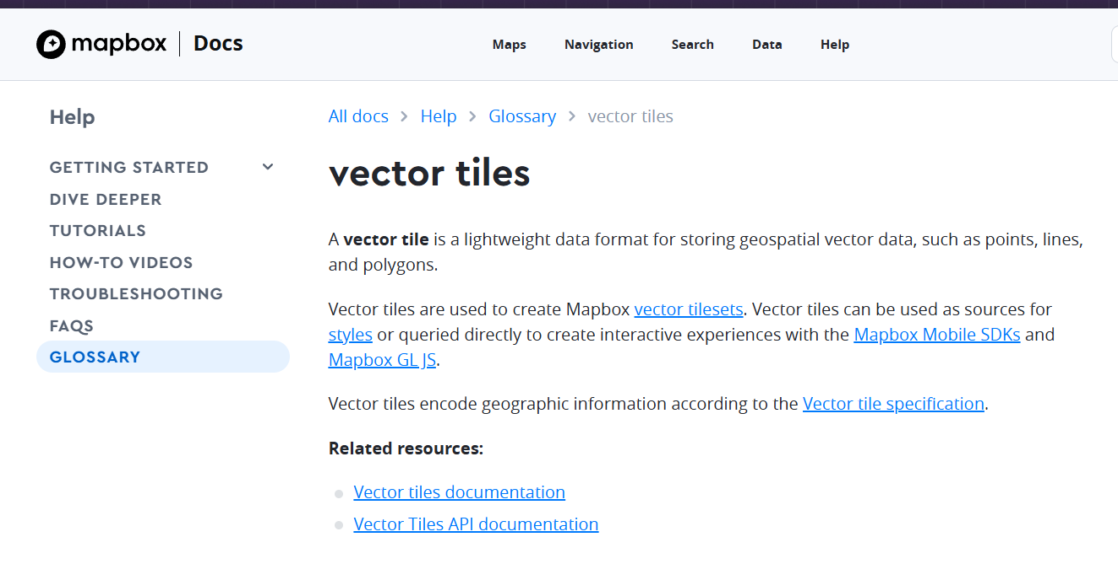
Vector Tile

Slide 18
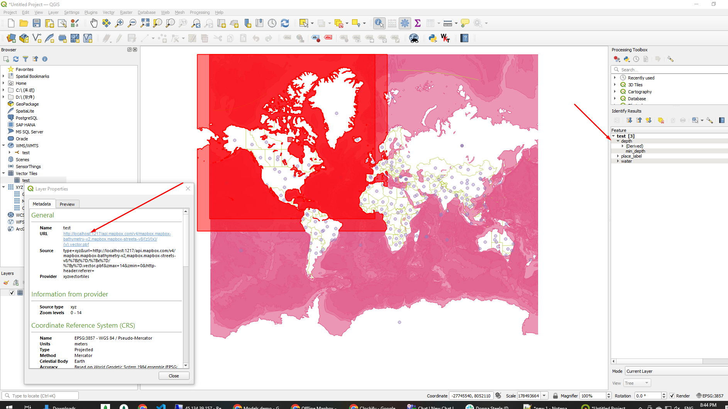

Slide 19
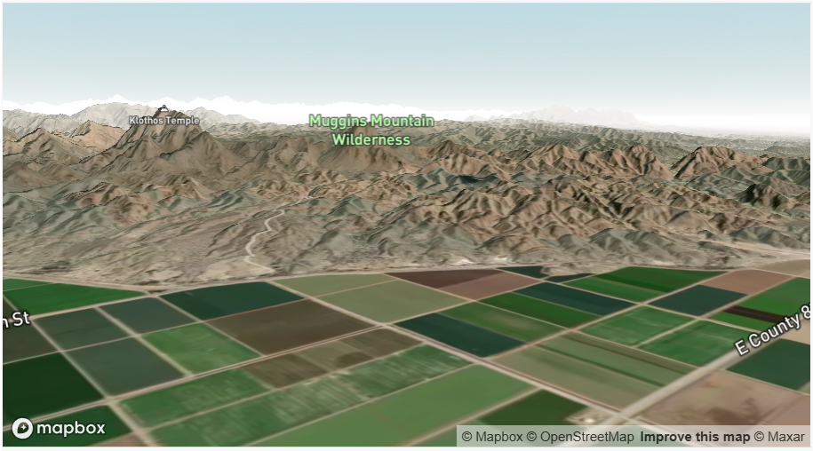
Add 3D terrain to a map

Slide 20
<!DOCTYPE html>
<html>
<head>
<meta charset="utf-8">
<title>Add 3D terrain to a map</title>
<meta name="viewport" content="initial-scale=1,maximum-scale=1,user-scalable=no">
<link href="https://api.mapbox.com/mapbox-gl-js/v3.11.0/mapbox-gl.css" rel="stylesheet">
<script src="https://api.mapbox.com/mapbox-gl-js/v3.11.0/mapbox-gl.js"></script>
<style>
body { margin: 0; padding: 0; }
#map { position: absolute; top: 0; bottom: 0; width: 100%; }
</style>
</head>
<body>
<div id="map"></div>
<script>
mapboxgl.accessToken = 'pk.eyJ1IjoiM2RnaXNraW5nIiwiYSI6ImNtMnNvYmF5bDF3OGcya3E4Mm41MjJhYWUifQ.eyjl7EtxA-HVY3fUTDXqZw';
const map = new mapboxgl.Map({
container: 'map',
zoom: 14,
center: [-114.26608, 32.7213],
pitch: 80,
bearing: 41,
// Choose from Mapbox's core styles, or make your own style with Mapbox Studio
style: 'mapbox://styles/mapbox/satellite-streets-v12'
});
map.on('style.load', () => {
map.addSource('mapbox-dem', {
'type': 'raster-dem',
'url': 'mapbox://mapbox.mapbox-terrain-dem-v1',
'tileSize': 512,
'maxzoom': 14
});
// add the DEM source as a terrain layer with exaggerated height
map.setTerrain({ 'source': 'mapbox-dem', 'exaggeration': 1.5 });
});
</script>
</body>
</html>

Slide 21
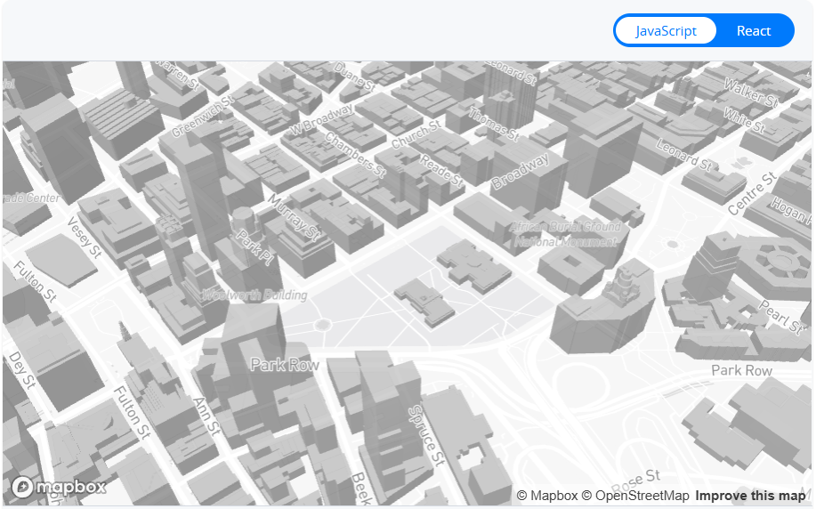
Display buildings in 3D

Slide 22
<!DOCTYPE html>
<html>
<head>
<meta charset="utf-8">
<title>Display buildings in 3D</title>
<meta name="viewport" content="initial-scale=1,maximum-scale=1,user-scalable=no">
<link href="https://api.mapbox.com/mapbox-gl-js/v3.11.0/mapbox-gl.css" rel="stylesheet">
<script src="https://api.mapbox.com/mapbox-gl-js/v3.11.0/mapbox-gl.js"></script>
<style>
body { margin: 0; padding: 0; }
#map { position: absolute; top: 0; bottom: 0; width: 100%; }
</style>
</head>
<body>
<div id="map"></div>
<script>
mapboxgl.accessToken = 'pk.eyJ1IjoiM2RnaXNraW5nIiwiYSI6ImNtMnNvYmF5bDF3OGcya3E4Mm41MjJhYWUifQ.eyjl7EtxA-HVY3fUTDXqZw';
const map = new mapboxgl.Map({
// Choose from Mapbox's core styles, or make your own style with Mapbox Studio
style: 'mapbox://styles/mapbox/light-v11',
center: [-74.0066, 40.7135],
zoom: 15.5,
pitch: 45,
bearing: -17.6,
container: 'map',
antialias: true
});
map.on('style.load', () => {
// Insert the layer beneath any symbol layer.
const layers = map.getStyle().layers;
const labelLayerId = layers.find(
(layer) => layer.type === 'symbol' && layer.layout['text-field']
).id;
// The 'building' layer in the Mapbox Streets
// vector tileset contains building height data
// from OpenStreetMap.
map.addLayer(
{
'id': 'add-3d-buildings',
'source': 'composite',
'source-layer': 'building',
'filter': ['==', 'extrude', 'true'],
'type': 'fill-extrusion',
'minzoom': 15,
'paint': {
'fill-extrusion-color': '#aaa',
// Use an 'interpolate' expression to
// add a smooth transition effect to
// the buildings as the user zooms in.
'fill-extrusion-height': [
'interpolate',
['linear'],
['zoom'],
15,
0,
15.05,
['get', 'height']
],
'fill-extrusion-base': [
'interpolate',
['linear'],
['zoom'],
15,
0,
15.05,
['get', 'min_height']
],
'fill-extrusion-opacity': 0.6
}
},
labelLayerId
);
});
</script>
</body>
</html>

