Slide 1
(Geo)Pose and Standards
Standards enable communication of Pose

Slide 2
TLDR

Slide 3
Standards-01
Standards enable communication.
Both concepts and expressions of Pose content can be standardized.
Standardization of concepts extends beyond a single domain,
Standardization of data elements – data types and classes – enables interoperation
Primitive data types
Semanticized data types
Classes
Example: glTF Geolocation, Orientation, and Bounds proposal.

Slide 4
Standards-01

Slide 5
Example: Khronos glTF 2.0
An OGC GeoPose 1.0 Basic GeoPose can geolocate and orient elements of the glTF scenegraph. The most basic element is the Scene and glTF has an extension mechanism that enables definition of a standard way to do this.

Slide 6

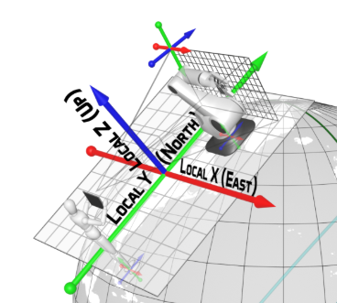
Example: Khronos glTF Geolocation, Orientation, and Bounds proposal

Slide 7
Standards-01

Slide 8
Standards-01

Slide 9
Standards-01

Slide 10
Standards-01

Slide 11
Standards-01

Slide 12
Standards-01

Slide 13
Standards-01

Slide 14
Standards-01

Slide 15
Standards-01

Slide 16
Standards-01

Slide 17
Standards-01

Slide 18
Standards-01

Slide 19
References: Overview

