Slide 1
360DS
3 Day Startup Online

Slide 2
OVERVIEW

Slide 3
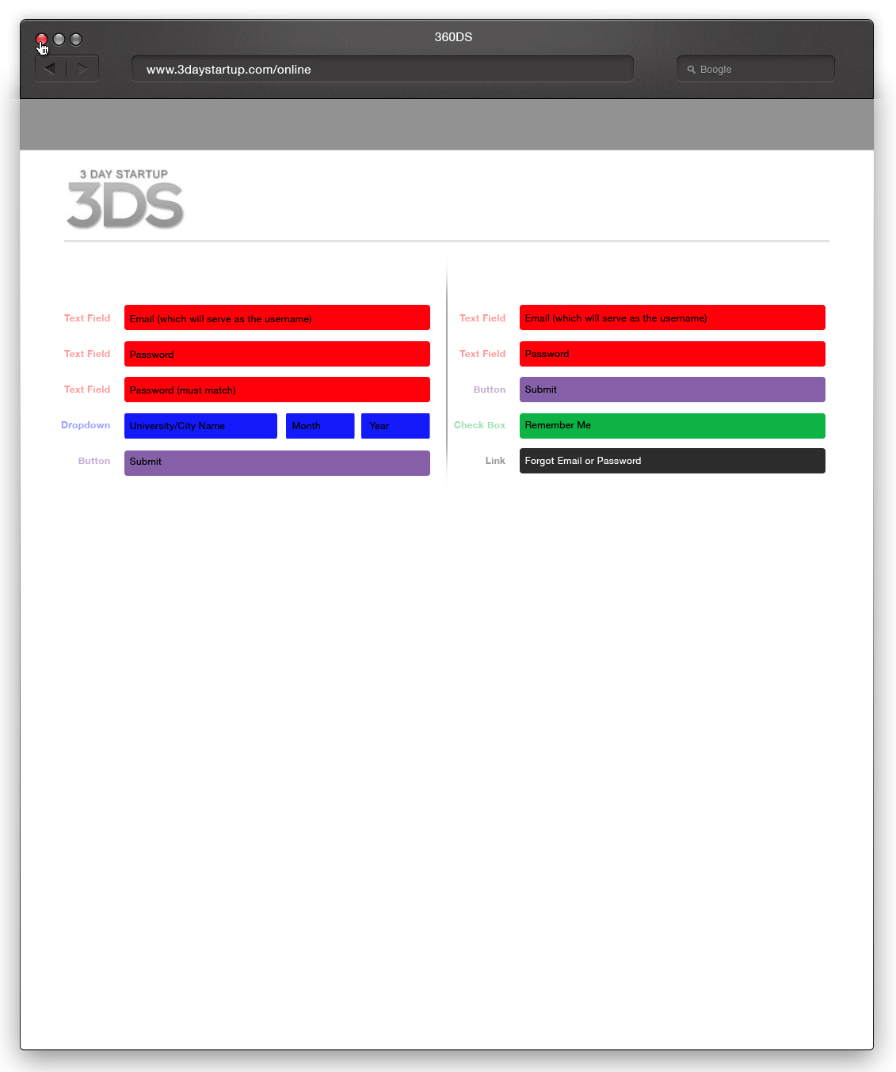
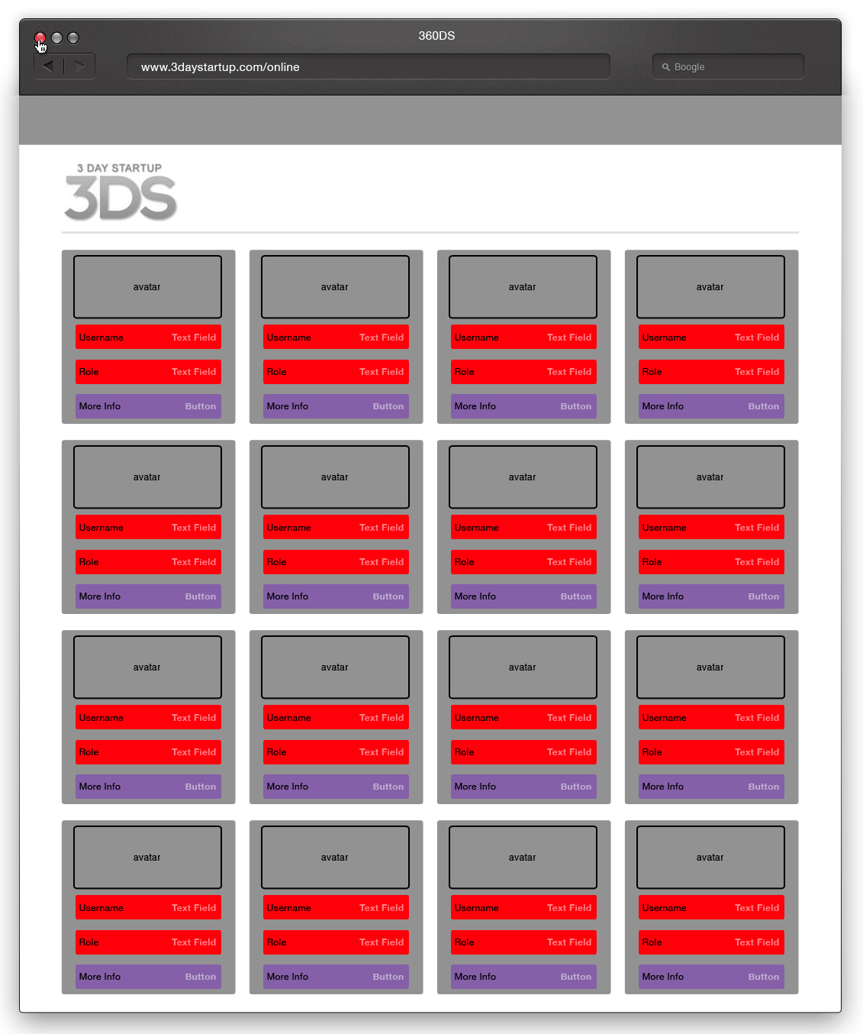
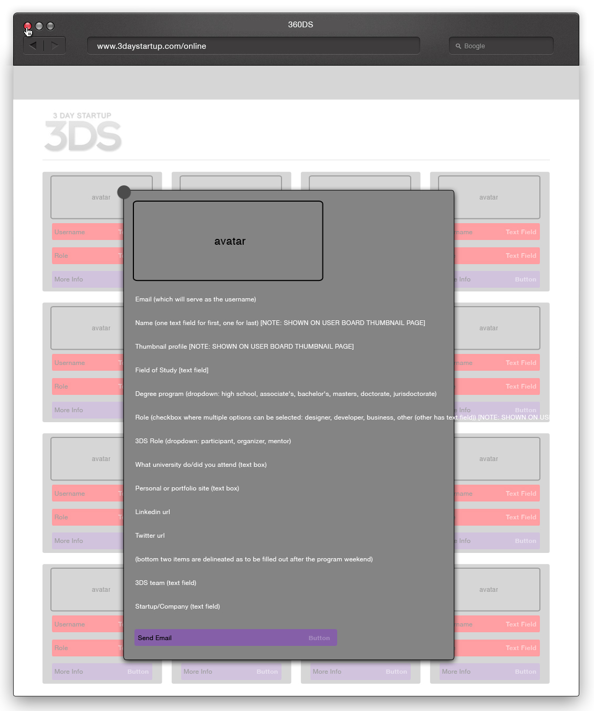
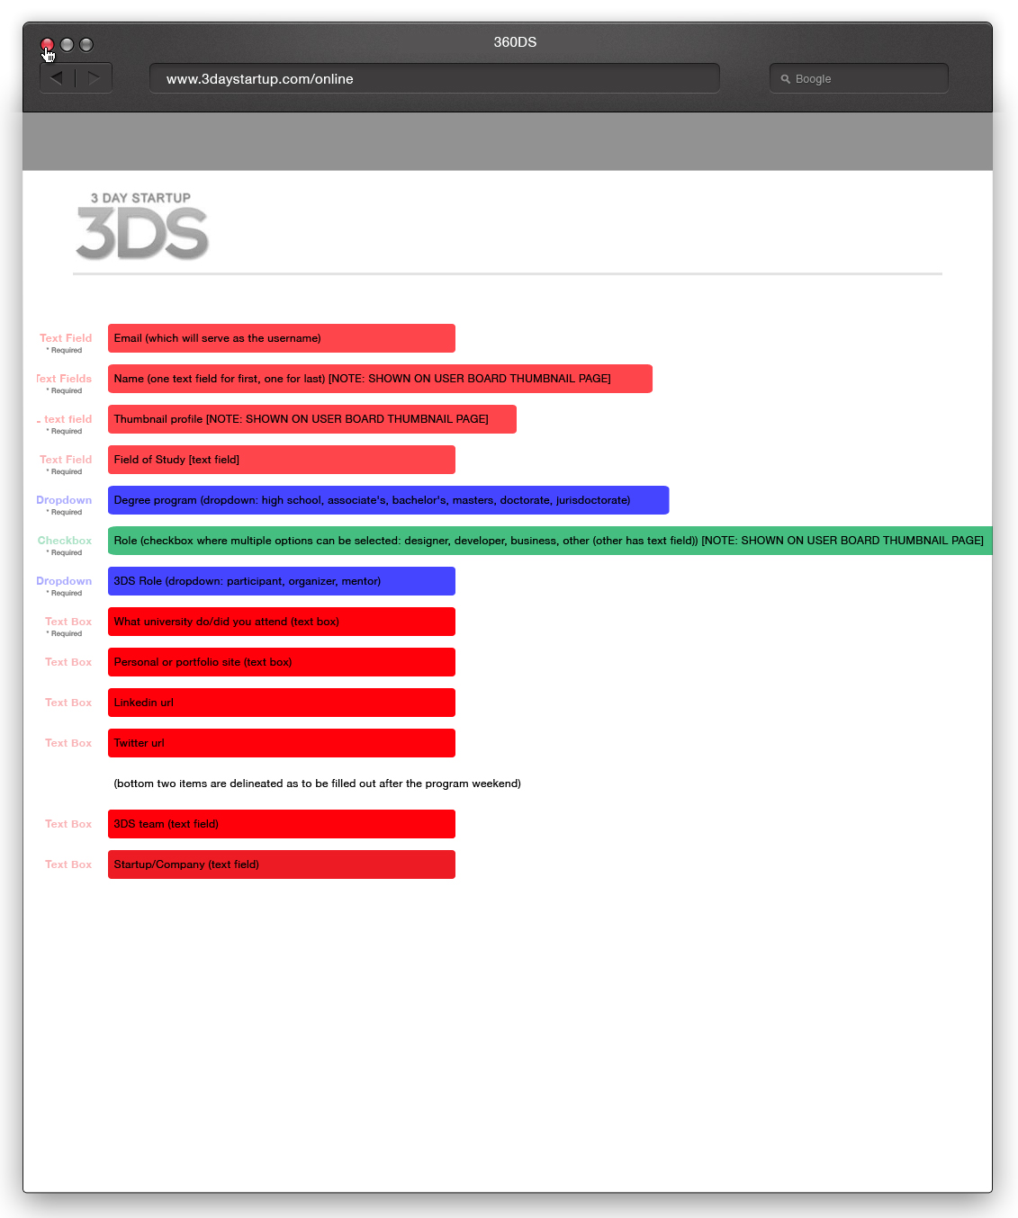
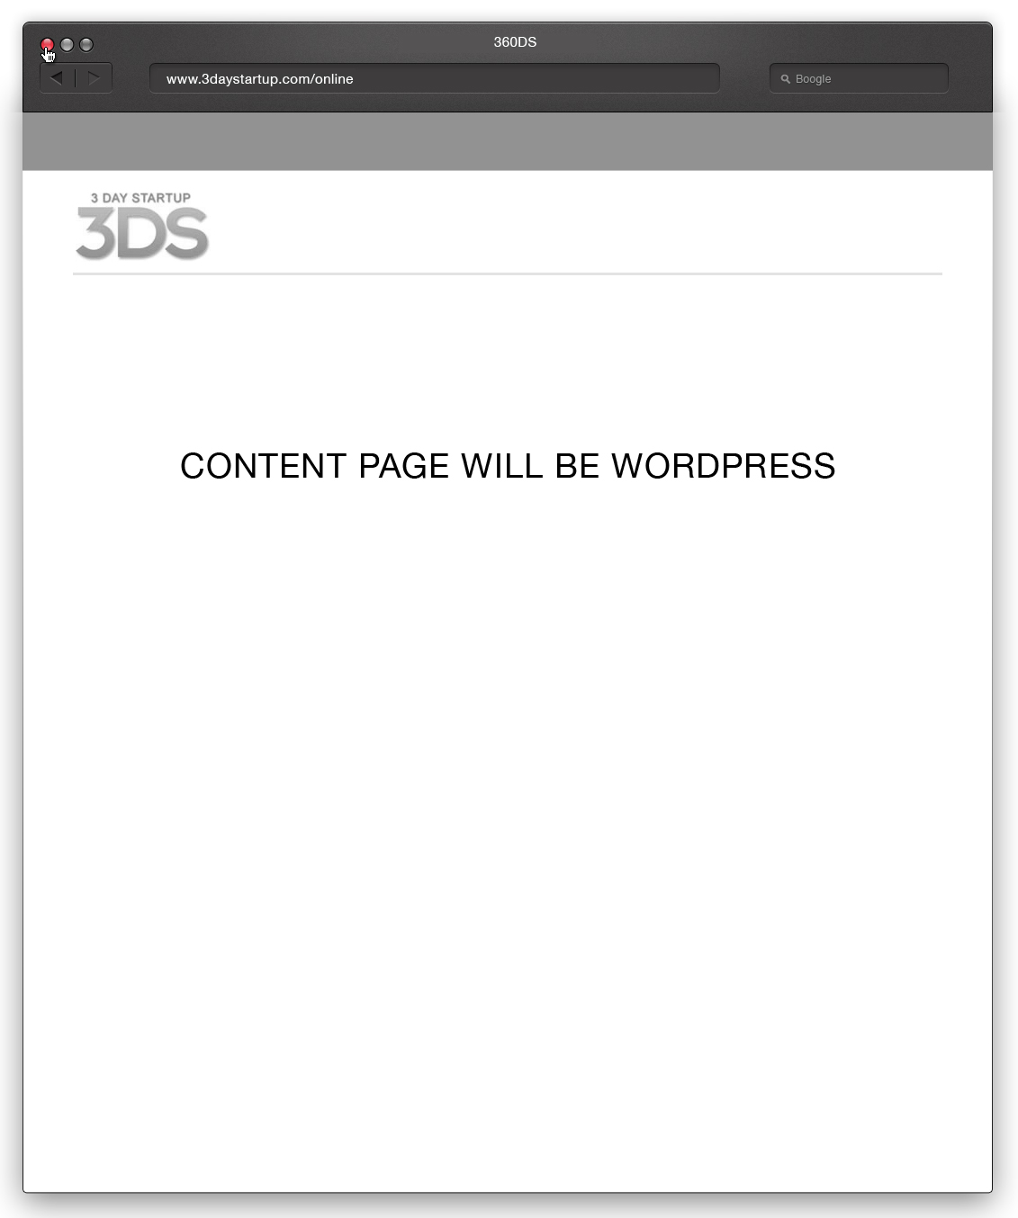
PAGES OVERVIEW
Register & Login Page
User Board
Pages needed for v1:
Registration page
Login page
User board (note: this is the home page)
User zoom pop up
Edit profile page
Content page (the typical wordpress page where Maddie and I will do everything.
Generic Content Pages
Profile Pop Up
Edit Profile
You will select these pages from Top Navigation, not shown here.

Slide 4
FLOW OVERVIEW
User Board
Profile Pop Up
Register & Login Page
t
REGISTER
LOG IN
t
t
Generic Content Pages
Edit Profile
You will select these pages from Top Navigation, not shown here.

Slide 5
Registration & Login Page

Slide 6
CONTENT OVERVIEW: Register & Login Page
REGISTER
LOG IN

Slide 7
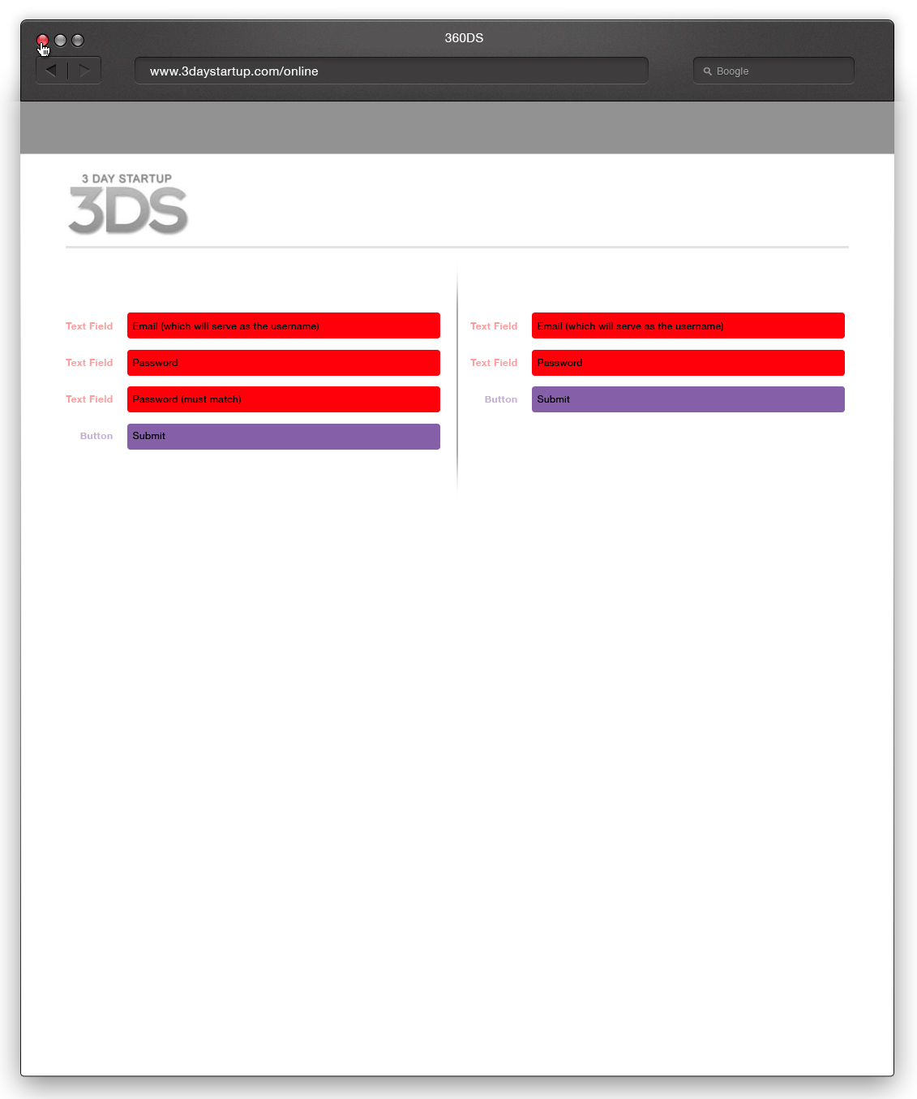
FLOW OVERVIEW: Register & Login Page
User Board
REGISTER
LOG IN
t
t
Edit Profile

Slide 8
User Board

Slide 9
CONTENT OVERVIEW: User Board

Slide 10
FLOW OVERVIEW: User Board
Profile Pop Up
t

Slide 11
Profile Pop Up

Slide 12
CONTENT OVERVIEW: Profile Pop Up

Slide 13
Edit Profile

Slide 14
CONTENT OVERVIEW: Edit Profile
Save

Slide 15
PLAIN TEXT / CONTENT OVERVIEW: Edit Profile
*Email (which will serve as the username)
*Name (one text field for first, one for last) [NOTE: SHOWN ON USER BOARD THUMBNAIL PAGE]
*Thumbnail profile [NOTE: SHOWN ON USER BOARD THUMBNAIL PAGE]
*Field of Study [text field]
*Degree program (dropdown: high school, associate's, bachelor's, masters, doctorate, jurisdoctorate)
*Role (checkbox where multiple options can be selected: designer, developer, business, other (other has text field)) [NOTE: SHOWN
ON USER BOARD THUMBNAIL PAGE]
*3DS Program (dropdown: list of programs in this format-- "3DS [university/city name] [month] [year]"
*3DS Role (dropdown: participant, organizer, mentor)
*What university do/did you attend (text box)
Personal or portfolio site (text box)
Linkedin url
Twitter url
(bottom two items are delineated as to be filled out after the program weekend)
3DS team (text field)
Startup/Company (text field)
-SAVE BUTTON
**asterisk next to required fields

Slide 16
Generic Content Pages > Tools, Perks & Info Pages

Slide 17
Generic Content Pages > Tools, Perks & Info Pages

Slide 18
Top Bar Navigation

Slide 19
Navigation
*NAVIGATION WILL BE SET IN WORDPRESS

Slide 20
THE END

