Slide 2
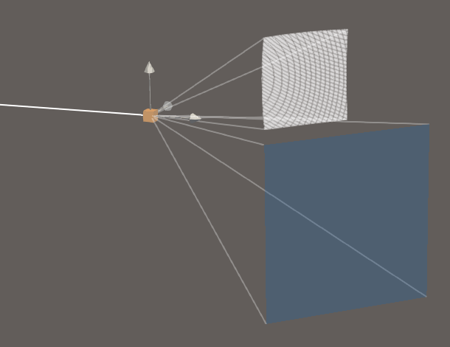

Slide 3
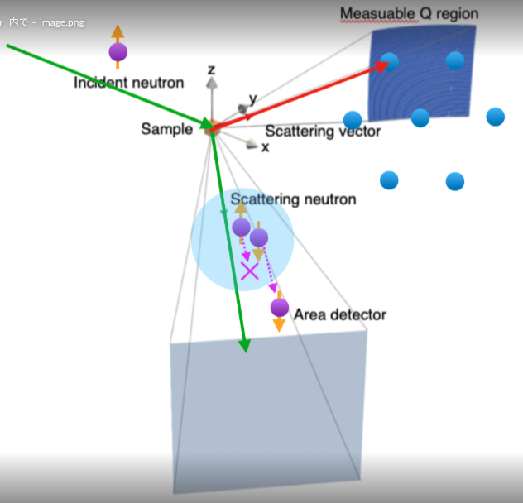

Slide 4
Measuable Q region
Incident neutron
z
y
Sample
Scattering vector
x
Scattering neutron
Area detector

Slide 5





z
$k_{i}$(in-plane)
$Q_{2}$(out-of-plane)
y
$Q_{1}$(in-plane)
Nuclear reflection
Magnetic reflections
$k_{f1}$(in-plane)
Spin analyzer acceptance
$k_{f2}$(out-of-plane)
x

Slide 6
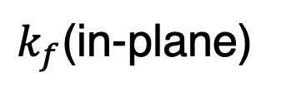
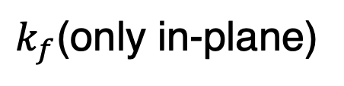
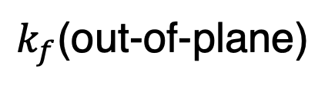
(a)
(b)
Sample
Neutron spin
Cu₂MnAl
³He-NSF
↑↓
↑
↑↓
$k_{f}$(only in-plane)
$k_{f}$(in-plane)
↑
$k_{f}$(out-of-plane)
to point detector
2D detector

Slide 7
(a)
(b)
Sample
Neutron spin
Cu₂MnAl
³He-NSF
↑↓
↑
↑↓
$k_{f}$(only in-plane)
$k_{f}$(in-plane)
↑
$k_{f}$(out-of-plane)
to point detector
2D detector

Slide 8

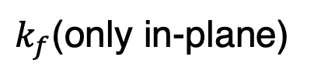


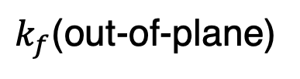
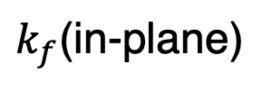
(a)
Cu₂MnAl (Polarizer)
Spin flipper off : ↑ on : ↓
Incident neutrons
Cu₂MnAl (Analyzer)
↑↓
↑
Sample
↑↓
Neutron spin
$$k_{i}$$
↑
$$Q$$
$k_{f}$(only in-plane)
point detector
(b)
³He-NSF (³He polarity can be flipped)
↑
↑↓
↑
↑↓
$k_{f}$(in-plane)
$$Q$$
$k_{f}$(out-of-plane)
2D detector

Slide 9
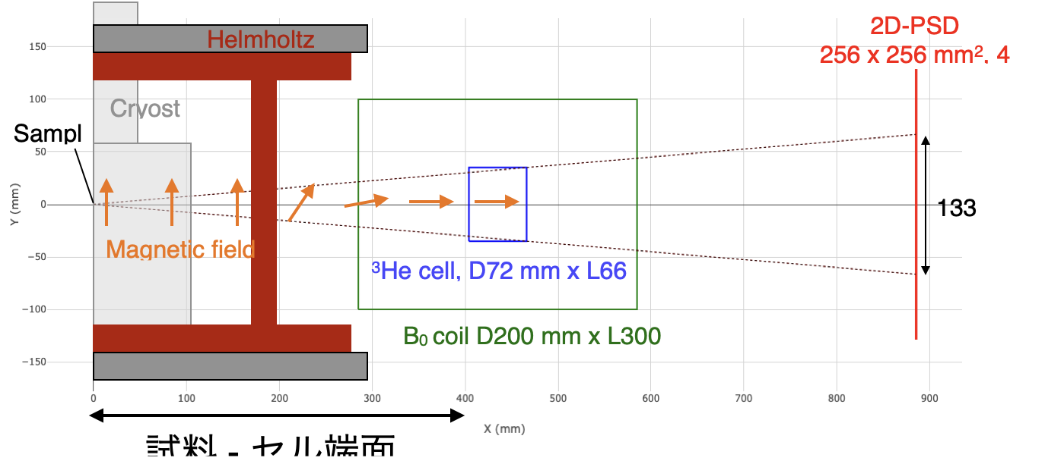

Slide 10
ω rotation
Helmholtz coil
Cryostat
Neutron Area detector
³He NSF coil
Neutron guide tube
Polarization analysis region
Magnetic field direction
RF coil
³He cell
Neutron beam path
Sample
Pickup coil

Slide 11
ω rotation
Helmholtz coil
Cryostat
Neutron Area detector
³He NSF coil
Neutron guide tube
Polarization analysis region
Magnetic field direction
RF coil
³He cell
Neutron beam path
Sample
Pickup coil

Slide 12
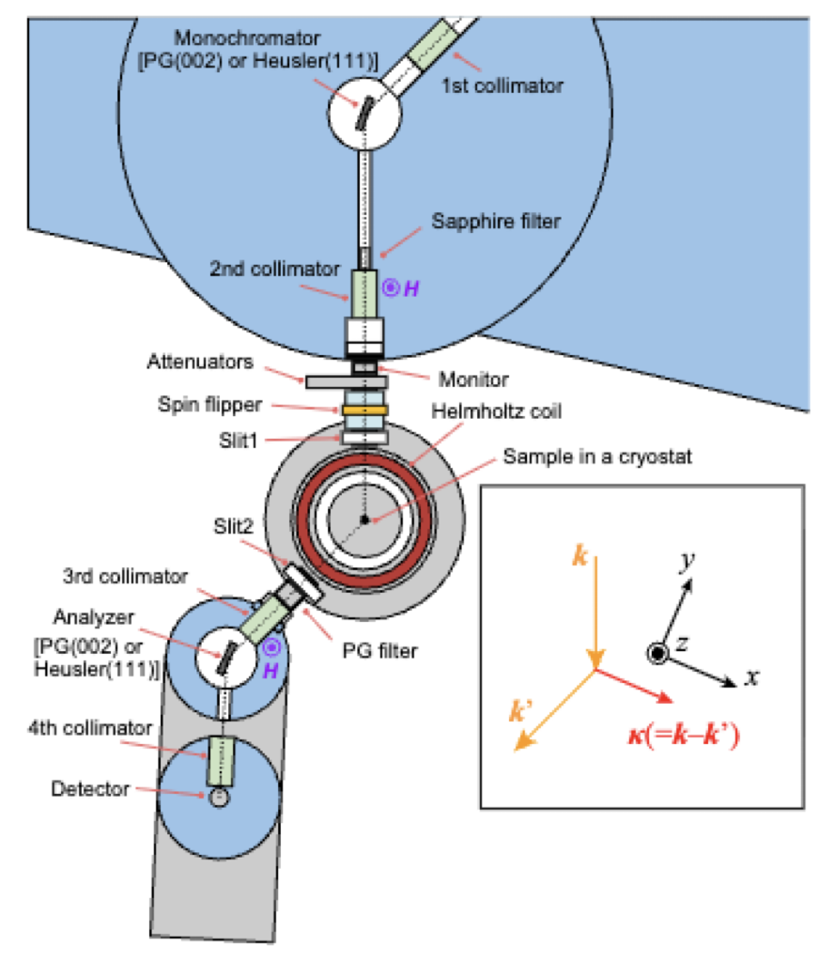
Beam stopper
Beam stopper

Slide 13
Incident neutron beam (polarized by Cu₂MnAl crystal)
Top view
Sample
Top view
Beam stopper
Neutron Area detector
³He NSF coil
RF coil
Polarization analysis region
Sample
³He cell
Incident neutron (polarized by Cu₂MnAl)
Neutron guide tube
Side view
ω rotation
Helmholtz coil
Cryostat
Magnetic field direction
Pickup coil

Slide 14
Incident neutron beam (polarized by Cu₂MnAl crystal)
Top view
Sample
Top view
Beam stopper
Neutron Area detector
³He NSF coil
RF coil
Polarization analysis region
Sample
32°
³He cell
Incident neutron (polarized by Cu₂MnAl)
Neutron guide tube
Side view
ω rotation
Helmholtz coil
Cryostat
Magnetic field direction
Pickup coil

Slide 15
Neutron Area detector
³He NSF coil
Neutron guide tube
Polarization analysis region
RF coil
³He cell

Slide 16
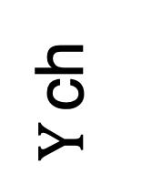
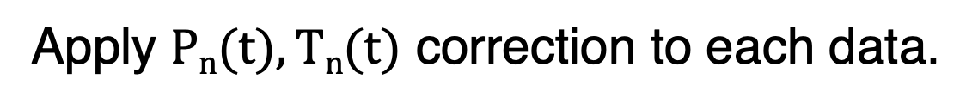
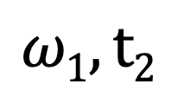
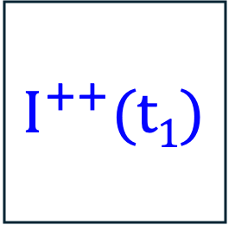
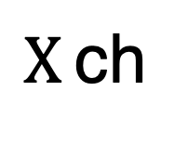
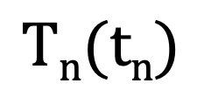
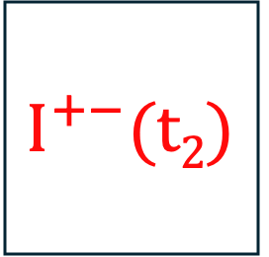

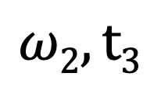
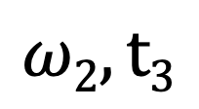
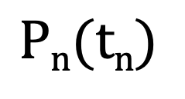
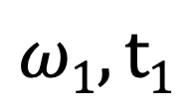
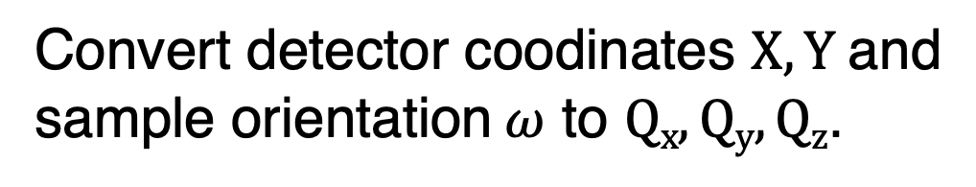
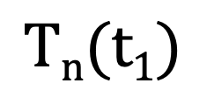
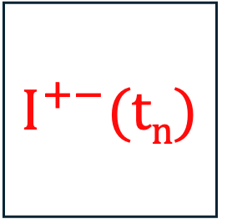
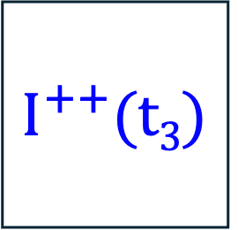
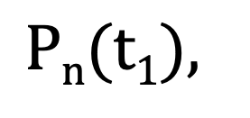
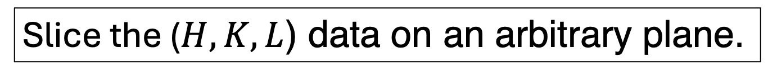
Data set
$$ω1, t1$$
$$ω1, t2$$
$$ω2, t3$$
$$ω2, t3$$
$$I^{++}(t1)$$
$$I^{+−}(t2)$$
$$I^{++}(t3)$$
$$I^{+−}(tn)$$
$Y$ ch
...
$X$ ch
$$Pn(t1),$$
$$Pn(tn)$$
$$Tn(t1)$$
$$Tn(tn)$$
Apply $Pn(t), Tn(t)$ correction to each data.
Convert detector coodinates $X, Y$and sample orientation $ω$ to $Qx, Qy, Qz$.
Transform $Qx, Qy, Qz$ to $H, K, L$ using the UB matrix.
Slice the ($H,K,L$) data on an arbitrary plane.

Slide 17
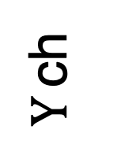
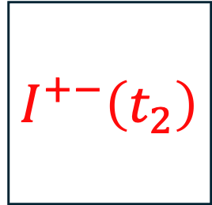
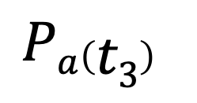
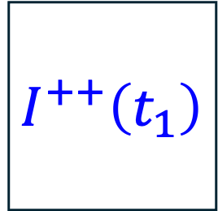
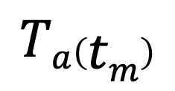
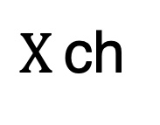
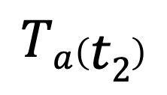


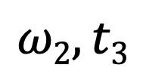
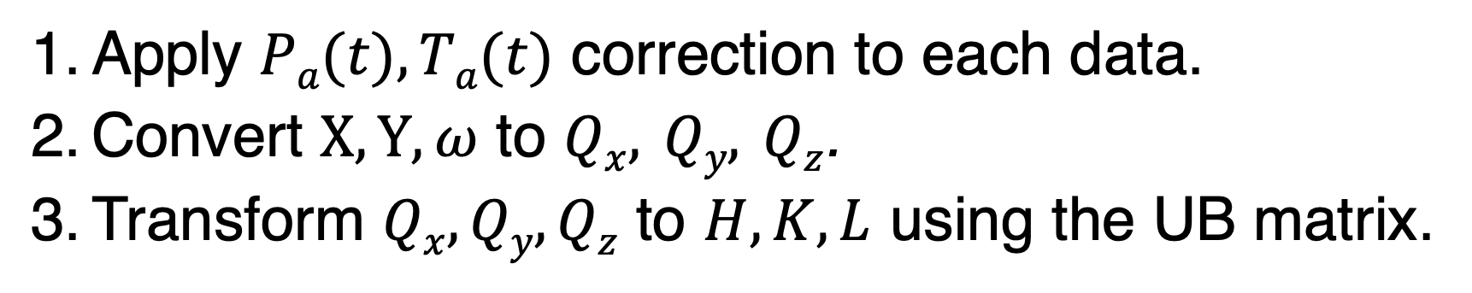
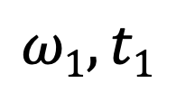
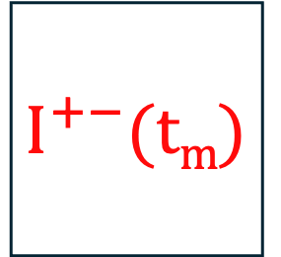

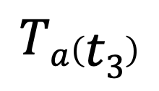
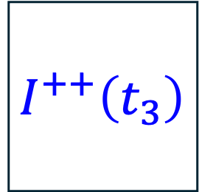
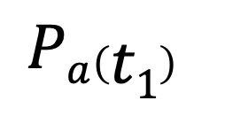
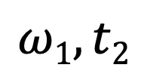

Data Set
$$ω1, t1$$
$$ω1, t2$$
$$ω2, t3$$
$$ωn, tm$$
$$I^{++}\left(t_{1}\right)$$
$$I^{+−}\left(t_{2}\right)$$
$$I^{++}\left(t_{3}\right)$$
$$I^{+−}(tm)$$
$Y$ ch
...
$X$ ch
$$Pa\left(t1\right)$$
$$Pa\left(t2\right)$$
$$Pa\left(t3\right)$$
...
$$Pa\left(tm\right)$$
$$Ta\left(t1\right)$$
$$Ta\left(t2\right)$$
$$Ta\left(t3\right)$$
$$Ta\left(tm\right)$$
Data Analysis
Apply $Pa(t), Ta(t)$ correction to each data.
Convert $X, Y, ω$ to $Qx, Qy, Qz$.
Transform $Qx, Qy, Qz$ to $H, K, L$ using the UB matrix.
Slice the ($H,K,L$) data on an arbitrary plane.

Slide 18
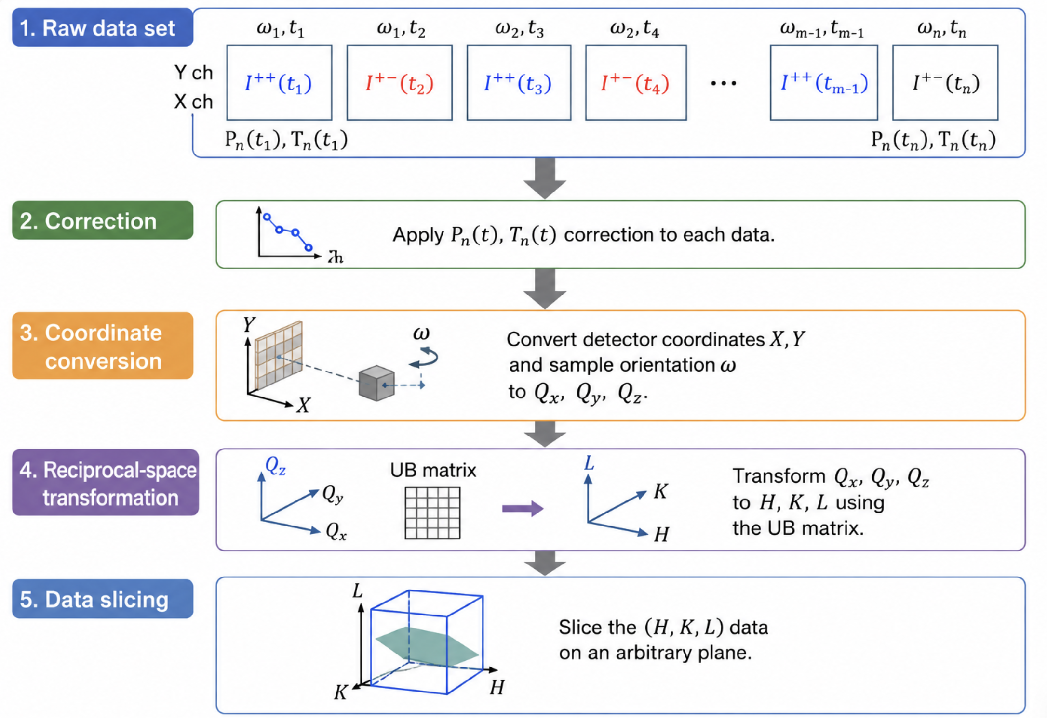

Slide 19
Neutron polarization
³He polarization
Neutron transmission

Slide 20
Neutron polarization
Neutron polarization
³He polarization
³He polarization
Neutron transmission
Neutron transmission

Slide 21
Neutron polarization
³He polarization
Neutron transmission

Slide 23


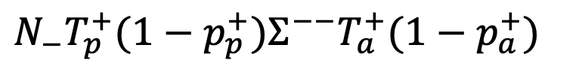
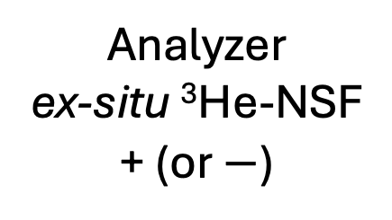


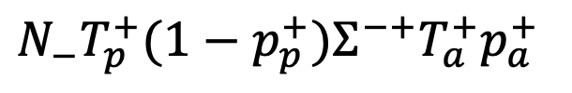
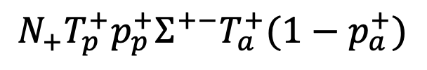







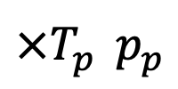


$$×Σ^{++}$$
$$×T_{a}^{+}p_{a}^{+}$$
$$N_{+}T_{p}^{+}p_{p}^{+}Σ^{++}T_{a}^{+}p_{a}^{+}$$
$$N_{+}$$
$$×T_{p}^{}p_{p}^{}$$
$$×Σ^{+−}$$
$$×T_{a}^{+}{(1−p}_{a}^{+})$$
$$N_{+}T_{p}^{+}p_{p}^{+}Σ^{+−}T_{a}^{+}(1−p_{a}^{+})$$
$$I^{++}$$
$$×Σ^{−+}$$
$$×T_{a}^{+}p_{a}^{+}$$
$$N_{−}T_{p}^{+}{(1−p}_{p}^{+})Σ^{−+}T_{a}^{+}p_{a}^{+}$$
$$N_{−}$$
$$×T_{p}^{+}{(1−p}_{p}^{+})$$
$$×Σ^{−−}$$
$$×T_{a}^{+}{(1−p}_{a}^{+})$$
$$N_{−}T_{p}^{+}{(1−p}_{p}^{+})Σ^{−−}T_{a}^{+}(1−p_{a}^{+})$$
Polarizer Cu₂MnAl +
Sample
Analyzer ex-situ ³He-NSF + (or $−$)
Detector

Slide 24
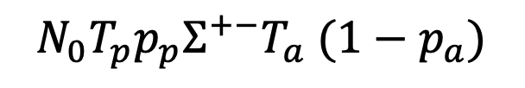











$$×Σ^{++}$$
$$×T_{a}p_{a}$$
$$N_{0}T_{p}p_{p}Σ^{++}T_{a}p_{a}$$
$$×T_{p}p_{p}$$
$$×Σ^{+−}$$
$$×T_{a}{(1−p}_{a})$$
$$N_{0}T_{p}p_{p}Σ^{+−}T_{a} (1−p_{a})$$
$$N_{0}$$
$$I^{++}$$
$$×Σ^{−+}$$
$$×T_{a}p_{a}$$
$$N_{0}T_{p}\left(1−p_{p}\right)Σ^{−+}T_{a}p_{a}$$
$$×T_{p}(1−p_{p})$$
$$×Σ^{−−}$$
$$×T_{a}{(1−p}_{a})$$
$$N_{0}T_{p}\left(1−p_{p}\right)Σ^{−−}T_{a} (1−p_{a})$$
Polarizer Cu₂MnAl +
Sample
Analyzer ex-situ ³He-NSF + (or $−$)
Detector

Slide 25













$$×Σ^{++}$$
$$×T_{a}p_{a}$$
$$×T_{p}p_{p}$$
$$×Σ^{+−}$$
$$×T_{a}{(1−p}_{a})$$
$$N_{0}$$
$$I^{++}$$
$$×Σ^{−+}$$
$$×T_{a}p_{a}$$
$$×T_{p}(1−p_{p})$$
$$×Σ^{−−}$$
$$×T_{a}{(1−p}_{a})$$
Polarizer Cu₂MnAl +
Sample
Analyzer ex-situ ³He-NSF + (or $−$)
Detector

Slide 27
1Å
3Å
(a)
(b) #Frame2-3
Sample position from spallation source
Collinear structure
Frame
#1
#2
#3
#4
#5
#6
#7
Phase transition field
(c) #Frame5-6
Magnetic field of long pulse magnet
Non-collinear structure
Kicker signal

Slide 29

Sliced plane (a)
Measured Q region
Sliced plane (b)
Reciprocal lattice points

Slide 30



Reciprocal lattice points
Two-dimensional detector
Measurable Q region
Sample
$$k_{f}$$
$$Q$$
Polarization analysis region
³He neutron spin filter (Spin analyzer)
$$k_{i}$$
Incident polarized neutron

Slide 31
(a) Unpolarized
(b) Polarized
Intensity (a.u.)
Intensity (a.u.)

Slide 32
(c) Unpolarized
(d) Polarized
(e) Line cut
(e)
(f) Line cut
(f)

Slide 33
Sliced plane (a)
Measured Q region
Sliced plane (b)
Intensity (a.u.)
Reciprocal lattice points

Slide 35


Intensity (a.u.)
Intensity (a.u.)

Slide 36
(a) Raw data
(b) Corrected data

Slide 37


(a) Non-spin flip ($I^{++}$)
(b) Spin flip ($I^{+−}$)
(c)

Slide 38
(a) Non-spin flip ($I^{++}$)
(b) Spin flip ($I^{+−}$)
(c) X-direction line profile (dased region in (a), (b))
Integrated intensity (y pixels 27-35) (a.u.)

Slide 39
(a)
(b)
(c)
Integrated intensity (y pixels 27-35) (a.u.)

Slide 40







(0,-K+2K,0) || z
Sliced Region (b),(d)
Sliced Region (c),(e)
$$H=\overline{1}$$
(-H,0,0) || -x
$$q_{3}$$
$$q_{1}$$
$$\overline{1}02$$
$$L=1.5$$
$$q_{2}$$
(0,0,L) || y

Slide 41





(0,-H+2K,0) || z
(c),(e)
(b),(d)
(-H-K/2,0,0) || -x
$$q_{3}$$
$$q_{1}$$
$$\overline{1}02$$
$$L=1.5$$
$$q_{2}$$
(0,0,L) || y

Slide 42





(c)
(f)
(a)
(f)
(-K/2,K,0) || z
(g)
(c),(e)
(b),(d)
(-H,0,0) || -x
$$q_{3}$$
(g)
$$q_{1}$$
(e)
$$\overline{1}02$$
$$L=1.5$$
$$q_{2}$$
(0,0,L) || y

Slide 43








(a)
(b)
(-K/2,K,0) || z
(c)
(b)
$$q_{1}$$
$$q_{3}$$
(-H,0,0) || -x
$$q_{1}$$
$$q_{3}$$
(c)
$$\overline{1}02$$
$$q_{3}$$
$$q_{2}$$
$$q_{1}$$
$$L=1.5$$
(0,0,L) || y
$$q_{2}$$

Slide 44






(a)
(b)
(c)
(f)
(-K/2,K,0) || z
$$q_{3}$$
$$q_{1}$$
(b), (c)
$$q_{2}$$
(d), (e)
(-H,0,0) || -x
$$q_{3}$$
$$q_{1}$$
(d)
(e)
(g)
(f)
$$\overline{1}02$$
(g)
$$q_{2}$$
(0,0,L) || y
$$q_{3}$$
$$q_{1}$$

Slide 45





(a)
(b)
(c)
(f)
(-K/2,K,0) || z
$$q_{3}$$
$$q_{1}$$
(b), (c)
$$q_{2}$$
(d), (e)
(-H,0,0) || -x
$$q_{3}$$
$$q_{1}$$
(d)
(e)
(g)
(f)
$$\overline{1}02$$
(g)
$$q_{2}$$
(0,0,L) || y
$$q_{1}$$
$$q_{3}, q_{2}$$

Slide 48

ω stage for sample
Sample + cryostat
Helmholtz coil
³He-NSF
Analyzing aperture
ω stage for ³He-NSF

Slide 49
ω stage for sample
Sample + cryostat
Helmholtz coil
³He-NSF
Analyzing aperture
ω stage for ³He-NSF

Slide 50
(a)
(b)
ω stage for sample
Sample + cryostat
Helmholtz coil
³He-NSF
Analyzing aperture
ω stage for ³He-NSF

Slide 51


Slide 52


磁場中での中性子スピンの時間発展 →ブロッホ方程式
$$\frac{dM}{dt}=γM×B$$
M : 中性子の磁気モーメント, γ : 中性子の磁気回転比,
B : 中性子が通過するパス上の磁場.
X軸 : 水平
Y軸：鉛直方向
Z軸：中性子進行方向
1 mTをZ軸方向へ印加しているパス上を初期位相σ_{x},σ_{z}=0, σ_{y}=1の中性子が通過するときの各位置でのスピン状態

