Slide 2
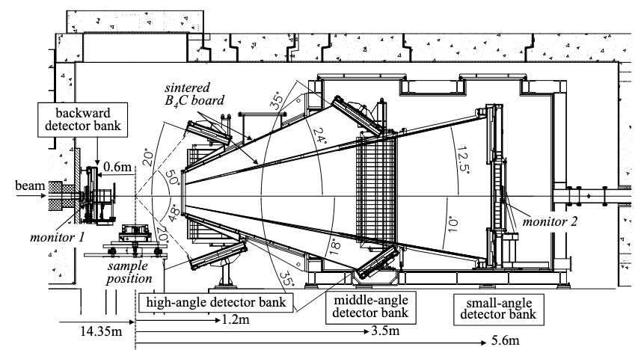
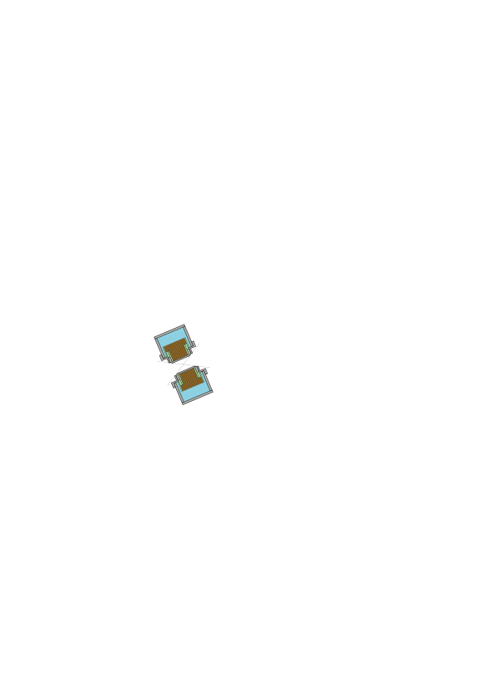

Slide 3
Detector
(High-angle)
Guide Magnet
k_{f}
Supermirror analyzer
Transmit up spin neutrons
H_{GM}
k_{i}
Incident polarized neutron beam
H_{LPM}
H_{GM}
Long pulsed Magnet
Neutron spin
Flipper off :
Flipper on :
Sample
k_{i}
k_{f}
H_{gm}

Slide 4
Detector
(High-angle)
Guide Magnet
k_{f}
Supermirror analyzer
H_{GM}
k_{i}
Incident polarized neutron beam
H_{LPM}
H_{GM}
Long pulsed Magnet
Sample

Slide 5
Detector
(High-angle)
[001] || H
[110]
k_{f}
Supermirror analyzer
H_{GM}
k_{i}
Incident polarized neutron beam
H_{LPM}
Guide Magnet
H_{GM}
Long pulsed Magnet
Guide Magnet

Slide 6
Detector
(High-angle)
[001] || H
[110]
k_{f}
Supermirror analyzer
H_{GM}
k_{i}
Incident polarized neutron beam
H_{LPM}
Guide Magnet
H_{GM}
Long pulsed Magnet
Guide Magnet

Slide 7
Detector
(High-angle)
Guide Magnet
k_{f}
Analyzer
(Supermirror)
H_{gm}
k_{i}
Incident polarized neutron beam
H_{lpm}
H_{gm}
Long pulsed Magnet
Sample
k_{i}
k_{f}
H_{gm}

Slide 8
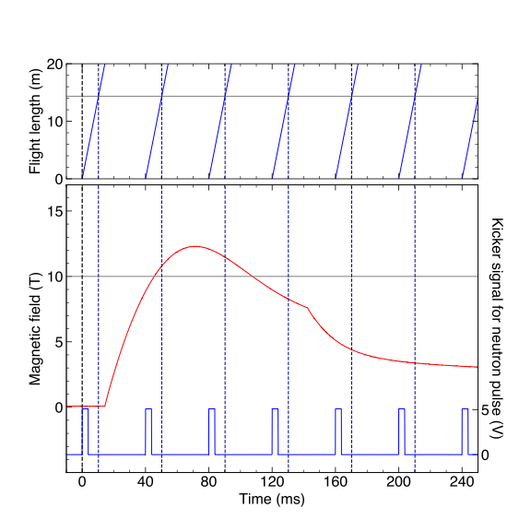
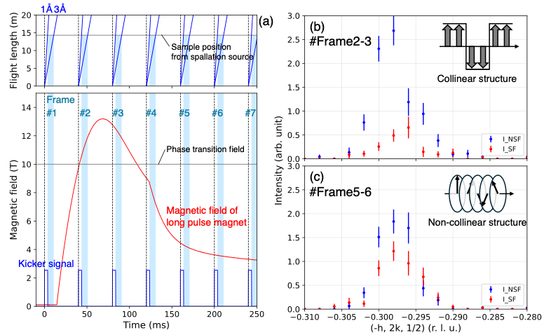
2.83 Å
Vc = 250 V
#1
#2
#3
#4
#5
#6
H_{c}

Slide 9
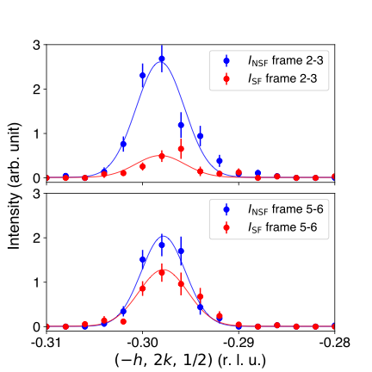
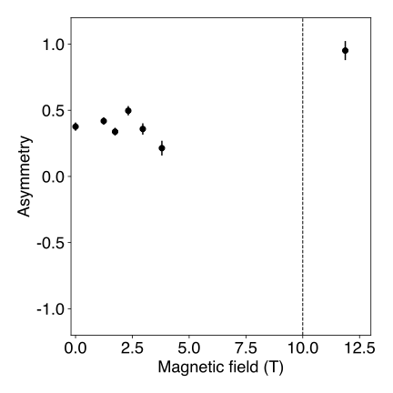
(a)
(c)
H_{c}
(b)

Slide 10
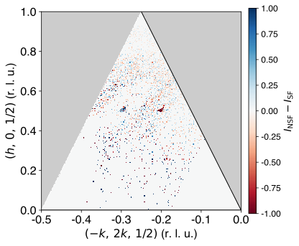
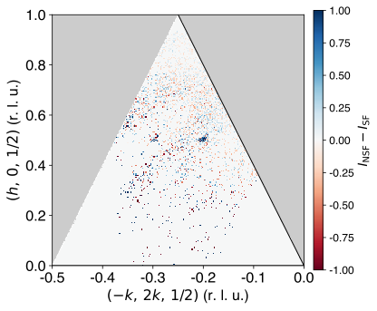
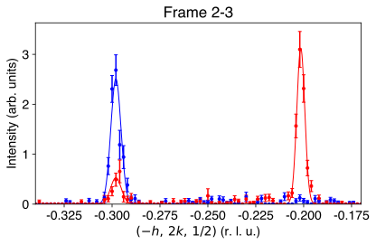
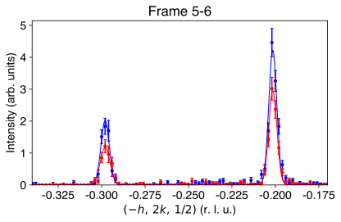
(a)
(b)
(c)
H_{c}

