Slide 1
Yet Another Game
(YAG)

Slide 2
G22 – Yet Another Group
by

Slide 3
Presented by: Daniel “3ICE” Berezvai, Alexandre Kirszenberg, Milla Mäkinen, Mengyang Chen

Slide 4
WhatsApp
2281 lines of text
Daniel: 483 messages
Alexandre: 292
Milla: 236
Mengyang: 47

Slide 5
Afternoon lovers
1987 PM vs 308 AM messages exchanged
(And most of those are 1 AM / 2 AM as well)

Slide 6
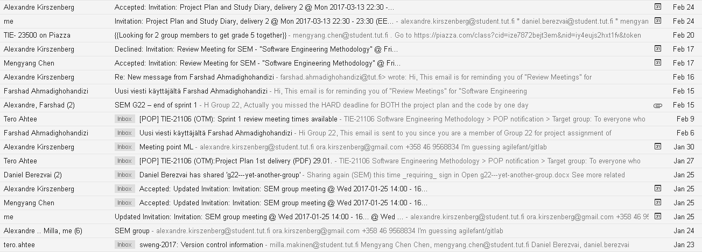
A grand total of 50 emails, mostly calendar
When searching for: “milla.makinen@student.tut.fi OR alexandre.kirszenberg@student.tut.fi OR mengyang.chen@student.tut.fi OR farshad.ahmadighohandizi@tut.fi OR tero.ahtee@tut.fi OR chenmengyang12@gmail.com”

Slide 7
Daniel Berezvai
Product Owner

Slide 8
Game modder (Warcraft 3)
And many other games.
Studied 20+ programming languages
Personal website: http://3ice.hu/

Slide 9
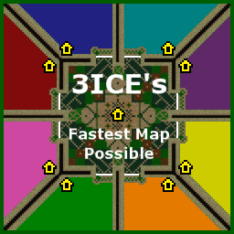
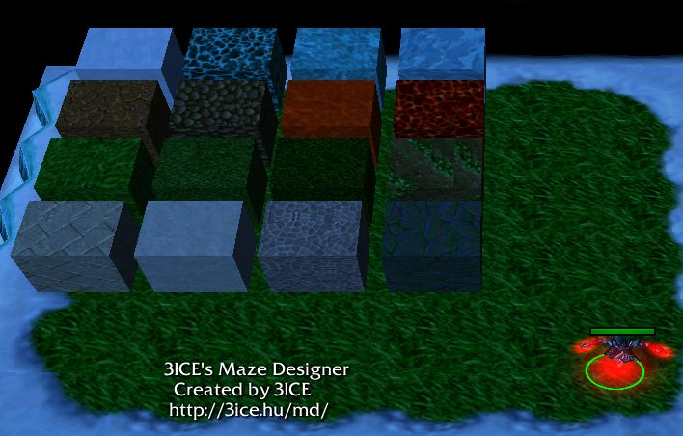
Two of my maps

Slide 10
Milla Mäkinen
Scrum Master

Slide 11
Industrial engineer, programmer at heart
And totally an artist.
https://github.com/Ymirdev
Some five years of game dev experience mainly in C++ and JavaScript.

Slide 12
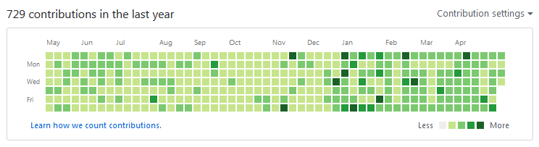
GIT GUD

Slide 13
Alexandre Kirszenberg
Developer

Slide 14
Facebook Sixth Sense
http://kirszenberg.com/facebook-sixth-sense
Programmer with previous experience as a Frontend Software Engineer. Interested in Software Development.

Slide 15
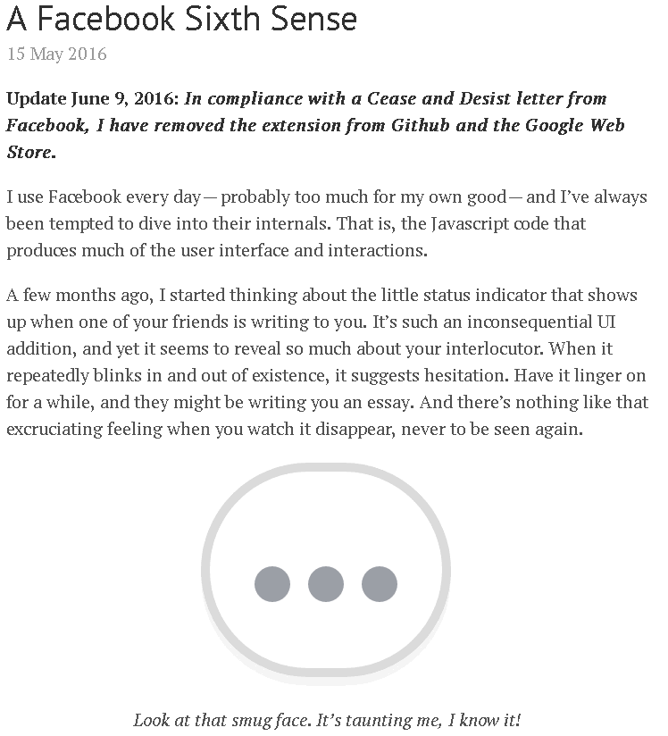
Seriously, read his blog

Slide 16
Mengyang Chen
Developer

Slide 17
(The guy who’s not here)
Coder, familiar with JavaScript and C++, interested in web programming and game programming.

Slide 18
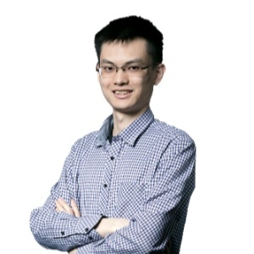

Slide 19
Mistakes
Of which there were many

Slide 20
We were featured as the “bad example”
In one of the lectures.

Slide 21
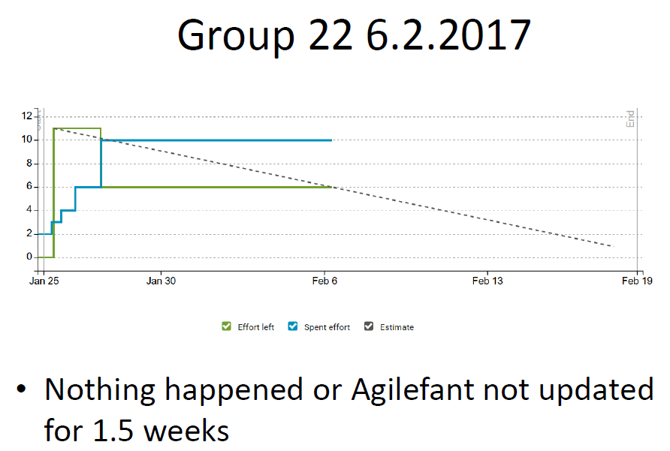

Slide 22
In our defense, we were done with four user stories
before the sprint even began!

Slide 23
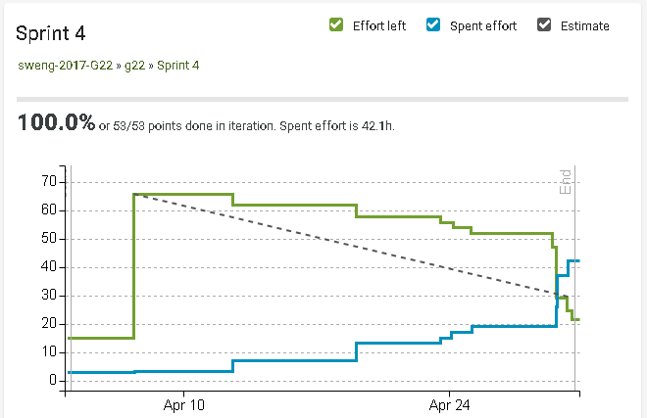
And we have improved

Slide 24
Pray to the DEMO gods

