Slide 1

Group：seven
王小艳、付维肖、郑惠芬

Slide 2
Muscle Reading
Scenario
What?
How?

Slide 3




1. sleepy reader
2. active reader
3. sleepy Muscle Reading active

Slide 4
Muscle Reading
Scenario
What?
How?

Slide 5
1. active, energy-consuming, sit-on-the-edge-of-your-seat
2. decrease difficulty and struggle by increasing energy and skill.
3. spend less time on your reading and get more out of it.

Slide 6
Muscle Reading
Scenario
What?
How?

Slide 7
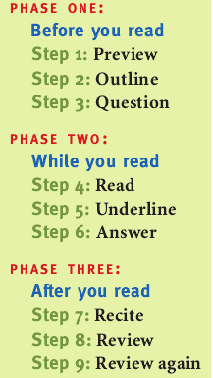

Pry Out Questions.
Root Up Answers.
Recite, Review, and Review again.

Slide 8

PHASE 1: Before you read
Step 1: preview
warm up flip through
summary statements chapter headings and subheadings
seek out familiar concepts, facts, or ideas
Step 2: Outline
understand the structure
study chapter outlines
add to your outline: heading
Step 3: Question
turn chapter headings and subheadings into questions
look for key sentences and turn these into questions

Slide 9

PHASE 2: While you read
Step 4: read
Be conscious of where you are and what you are doing.
Schedule breaks and set a reasonable goal for the entire session.
Stay focused:
visualize the material
read the material out loud
remember the goal ----answer the questions
NOTE：Sit up. Keep your spine straight. Avoid reading in bed
Step 5: Underline
Deface your books
Complete a chapter
Less than 10 percent
Step 6: Answer
Seek out the answers and write them down.
Note , ask questions in class

Slide 10


PHASE 3: After you read
Step 9: Review again
Weekly or monthly review.
Go over notes.
Read the highlighted parts .
Recite one or two of the more complicated points.
Step 7: Recite
Look at each underlined point(mirror)
Summarize
One of the best ways to learn anything is to teach it to someone else.
Step 8: Review
First complete review within 24 hours.
Look over notes , clear up anything you don’t understand.
Recite the main points again.

Slide 11

When reading is tough
Read it again.
Look for essential words.
Hold a minireview.
Read it out loud.
Talk to your instructor.
Stand up.
Use another text.
Pretend you understand, then explain it.
Stop reading.

Slide 12

Reading fast
Get your body ready.
Set a time limit.
Relax.
Move your eyes faster.
Notice and release ineffective habits.
If you’re pressed for time, skim.
Stay flexible.

Slide 13

Reading with a dictionary in your lab
Construct a word stack.
Learn—even when your dictionary is across town.
Divide words into parts.
Infer the meaning of words from their context.

Slide 14

Using your library
Ask a librarian.
Take a tour.
Search the catalog.
Inspect the collection.
Access computer resources.

Slide 15

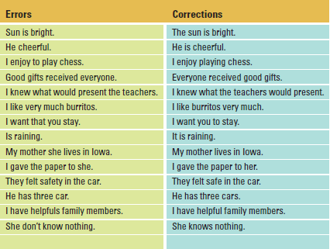
English as a second language
Build confidence
delay your mastery of English.
insecure
Choosing not to speak
isolate you from other students
native speaker of English
build relationships
+
instructors
developing English skills.
mistakes is not a sign of weakness
Analyze errors in using English

Slide 16
facial expressions and gestures
Learn by speaking and listening
radio talk shows
Imitate
read and hear English at the same time
Use computer resources
Gain skills in note taking and testing
key words
instructors will often repeat these.
main points
important examples

Slide 17
When in doubt, use expressions you understand
“fork in the road”
formal occasion
Create a community of English learners
Celebrate your gains
correct an error in English
gain
Celebrate it!

Slide 18

Put it to work
Read with a purpose.
Print online documents to read later.
Make several passes through work-related reading material.
the first sentence of each paragraph
the first and last paragraphs in each section
Read only the relevant sections of documents

Slide 19



Discuss what you read with coworkers
one-on-one
face-to-face
Create “read anytime” files.
important to read but not urgent

Slide 20


