Slide 1
The Battle of Neighborhoods
Coursera – Applied Data Science Capstone
Github: 3LexW/Coursera_Capstone

Slide 2
Disclaimer
The background of the capstone project is based on a political event in Hong Kong
The student who created this project has no incentive to influence anyone’s political stance or encourage for political action

Slide 3
Introduction

Slide 4
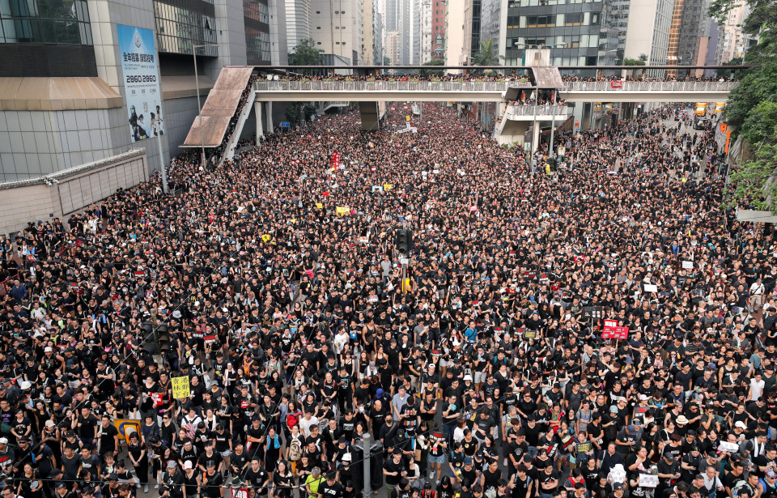
Introduction
Recent political events in Hong Kong makes Mr.X starts looking for information related to investment immigration
To avoid strong feeling of nostalgia, Mr.X want to know which city is most similar to where he lives
Montreal, Canada
London, United Kingdom
Tokyo Japan
(City reference)
Protest in Hong Kong (Source: The SUN)

Slide 5
data

Slide 6
Data Source
Wikipedia Page
List of areas in London
List of boroughs in Montreal
List of special wards of Tokyo
Geopy – for coordinate information
FourSquare API – for venues information
The center of a neighborhood will be the latitude and longitude retrieved from Geopy
radius = 100km
venues = top 50

Slide 7
methodology

Slide 8
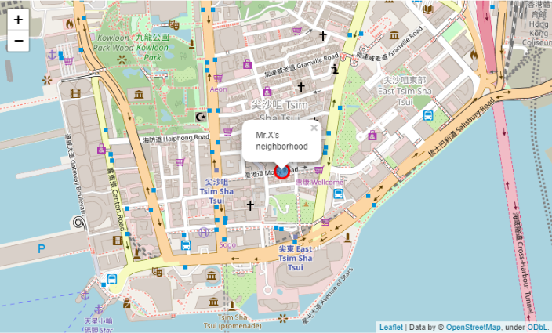
Step 1: Define Mr.X’s neighborhood

Slide 9
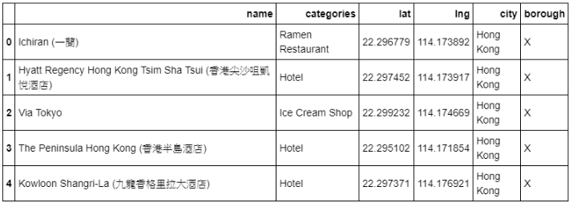
Top venues around Mr.X’s neighborhood

Slide 10
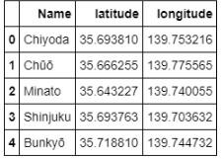
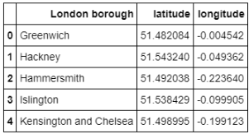
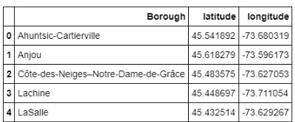
Step 2: Collect and Clean information of the three cities

Slide 11
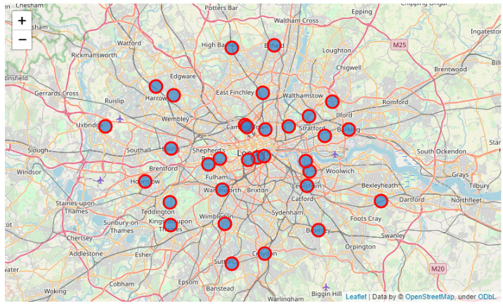
London

Slide 12
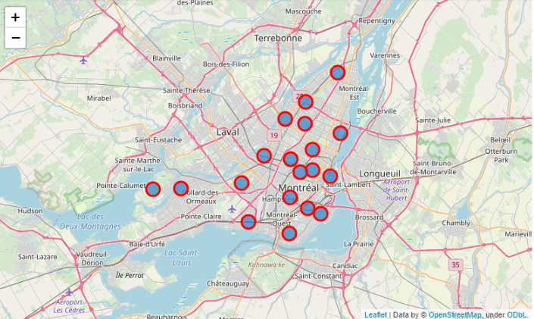
MONTREAL

Slide 13
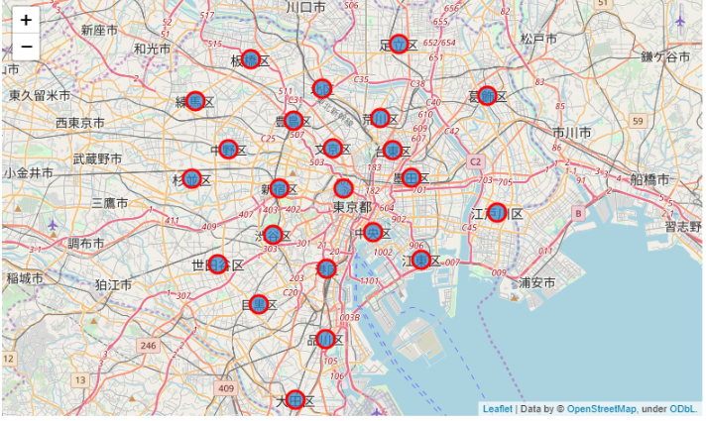
Tokyo

Slide 14
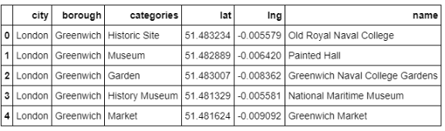
Step 3: Information of venues in three cities (Total: 2975 rows)

Slide 15
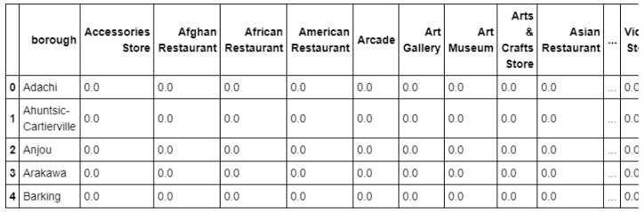
Step 4: One hot encoding table for clustering analysis

Slide 16
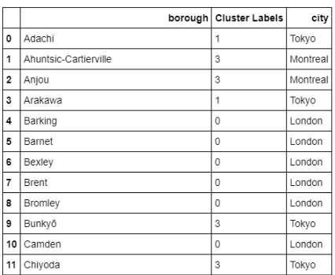
Step 5: Clustering and Generate Result

Slide 17
Results and suggestion

Slide 18
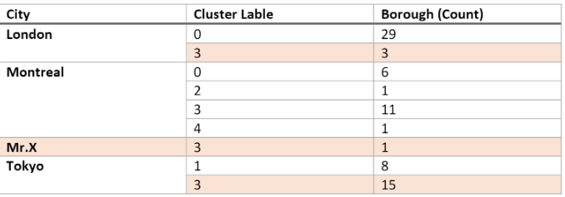
Result
Mr.X’s neighborhood is distributed to cluster 3
The proportion of boroughs belongs to cluster 3 in each city is :
London: 9.375%
Montreal: 57.8947%
Tokyo: 65.2174%
We suggest Mr.X look for information in Tokyo first, then Montreal, and finally London.

Slide 19
reflection
Possible noise that affect the results

Slide 20
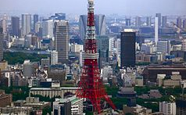
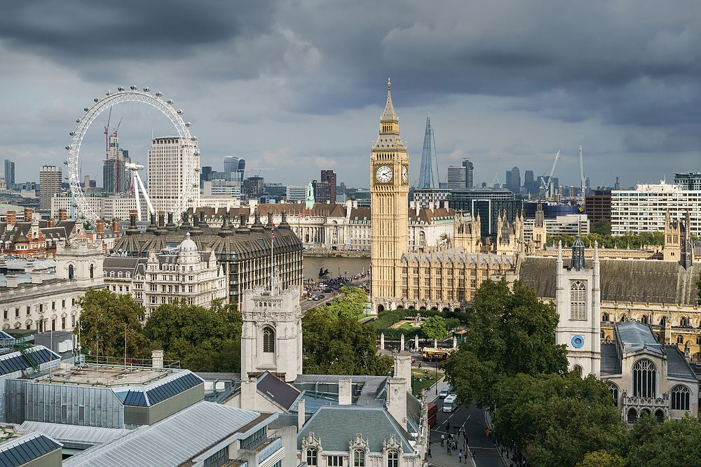
1. Difference between cities
Culture, borough size, scale of economic activity, popularity in each city can bring boroughs in the same city to the same cluster

Slide 21
2. Parameters of data collection
Radius = 1000 km
Venues = Top 50
The parameters to collect venues can lead to different results

Slide 22
3. Community contribution of data
City | Number of boroughs | Number of venues | Average venues per borough
Mr.X’s neighborhood | 1 | 50 | 50
London | 32 | 1246 | 38.9375
Montreal | 19 | 529 | 27.8421
Tokyo | 23 | 1150 | 50
After we collected all the data, we performed an analysis
The difference of city and boroughs result in the difference of average venues per borough

Slide 23
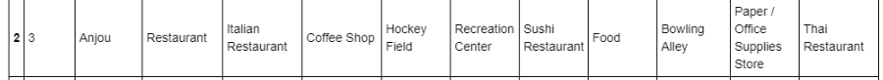
4. Labels of venue
General Category
Sub-categories of “Restaurant”
The existence of general category and sub-categories can disturb the accuracy of clustering
Generalizing the labels / category of a venue might further accurate the result

