Slide 1



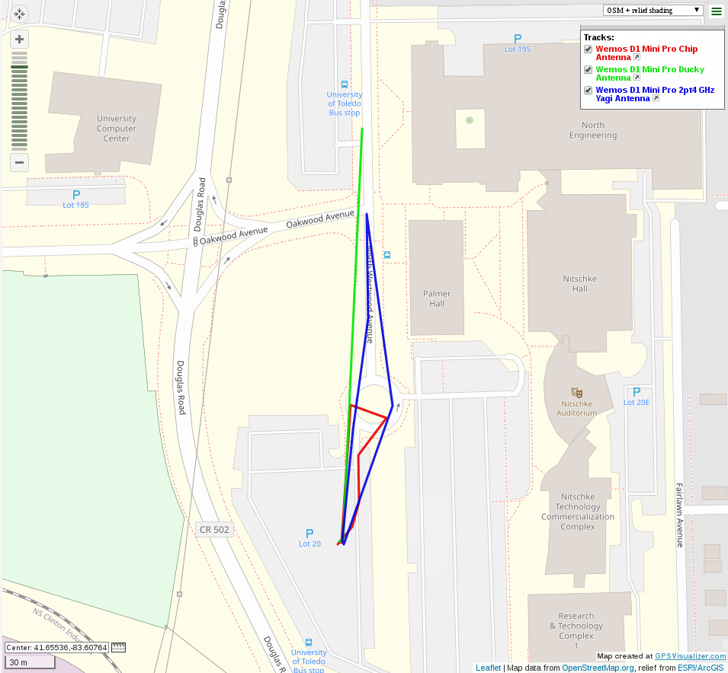
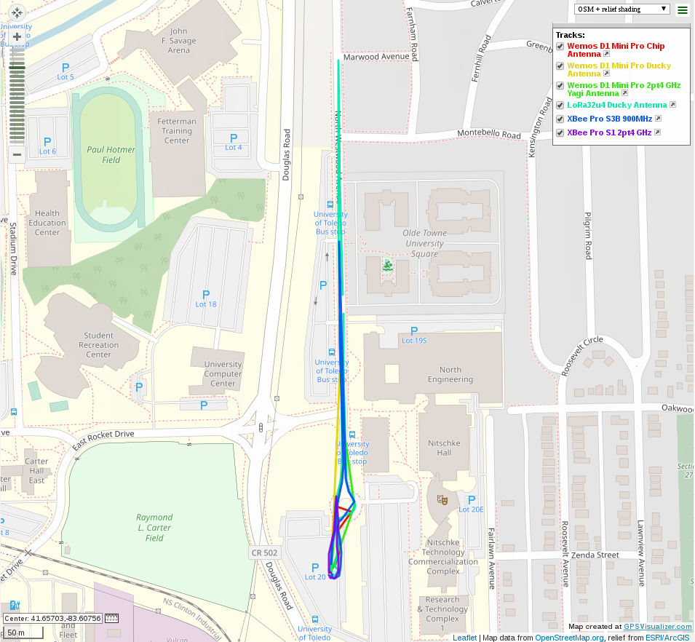
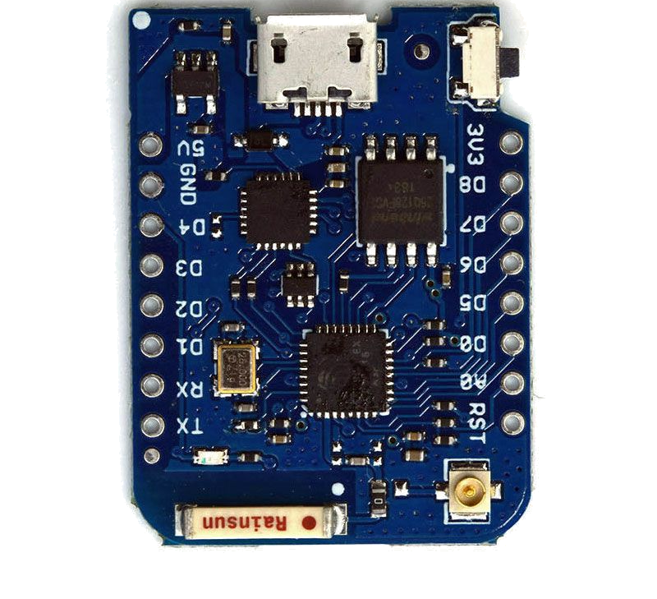
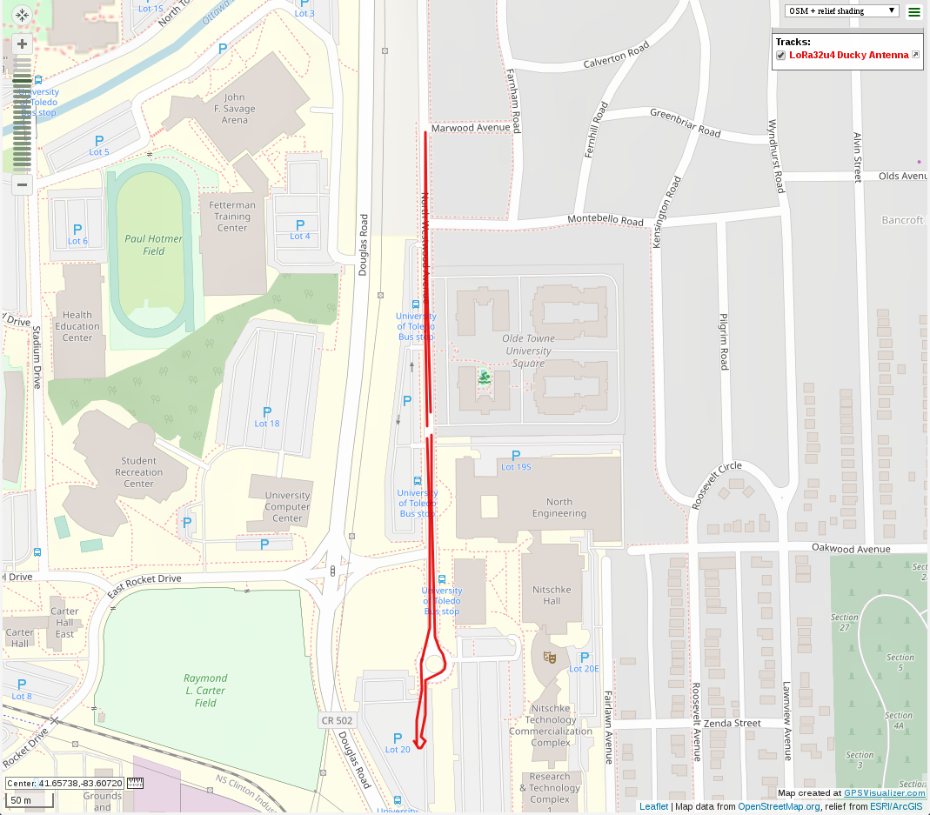
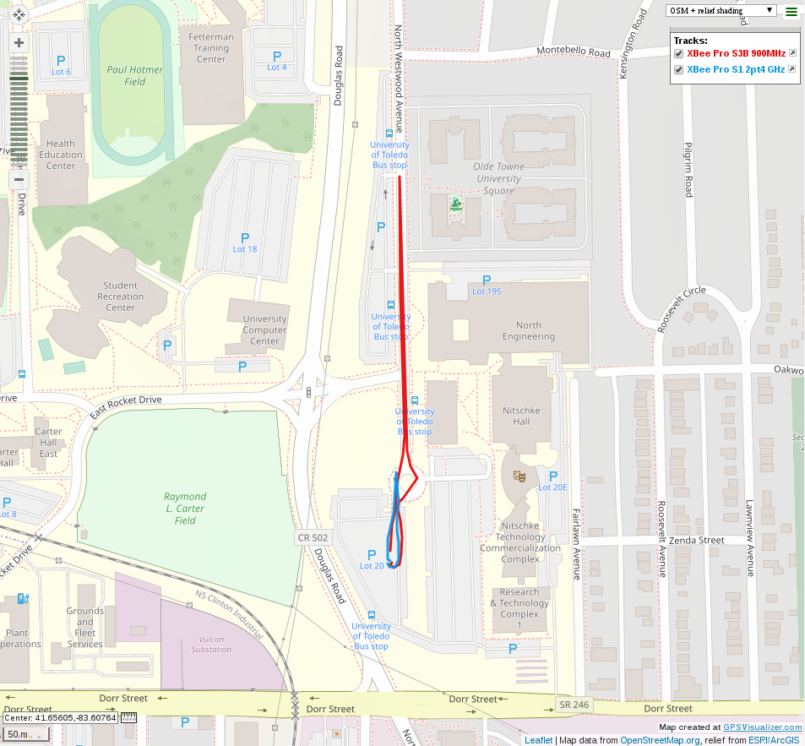
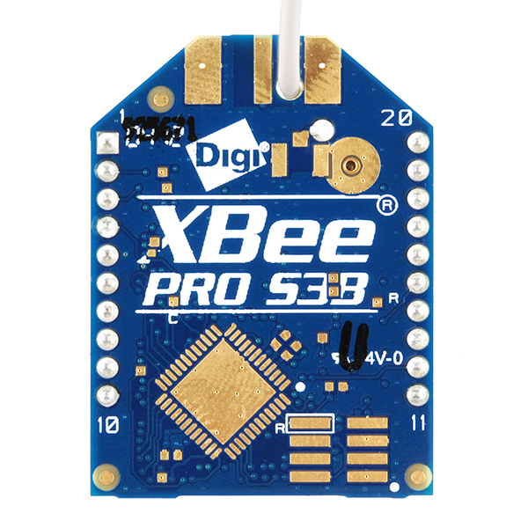
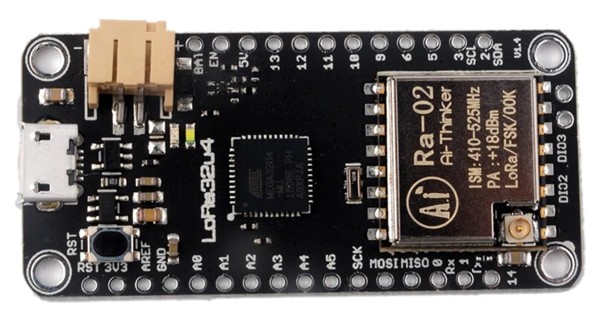
Wireless Mesh Networking for Swarm Robotics
Cameron McCaskey (cameron.mccaskey@rockets.utoledo.edu), Dr. Brian Trease (brian.trease@utoledo.edu)
The UNIVERSITY of TOLEDO, DEPARTMENT of MECHANICAL, INDUSTRIAL, & MANUFACTURING ENGINEERING
Mechanism, Mobility, &
Multifunctional Design Lab
Wemos D1 Mini Pro
Background:
Swarm robotics are robotics in which multiple robots are deployed, often with different sensor packages. In this case, the robotic swarm takes shape in the form of small boats that are deployed on Lake Erie to study harmful algae growth patterns. Swarm robotics are a complicated subject because any small increase in cost or complexity exponentially increases the cost or complexity of the entire robotic swarm. One of these key areas of interest is telemetry. Telemetry in the robotic swarm allows for the robots to be controlled from a central base station and also communicate with each other their exact location to avoid collisions.
Objective:
The objective of this research project is to use and adapt off the shelf wireless transceivers to implement the telemetry system for these swarm robotics. These off the shelf solutions allow for other labs to implement the same robotic swarm without investing in building custom electronic hardware.
The Wemos D1 Mini Pro is a board based on the ESP8266 WiFi Microcontroller by Espressif. It can use an on board chip antenna, or external antenna. The range test used the chip antenna, a ducky antenna, and a yagi antenna. For the chip and ducky antenna test, a chip antenna was used for both the receiver and transmitter. For the yagi test, a yagi antenna was used for the receiver, and a ducky antenna was used for the transmitter.
Introduction:
Range Test Results
The LoRa32u4 board offered the best range, followed by the XBee Pro S3B. This is no surprise since the transmit power and receiver sensitivity is similar for all of the modules, however the Lora32u4 board and XBee Pro S3B are 915 MHz and 900 MHz transmitters respectively. The Wemos D1 Mini Pro was the next best performing option especially with the ducky antenna. The Yagi antenna should have performed better than the ducky antenna due to the higher gain, however it is possible that the Yagi was not properly tuned to 2.4 GHz.
It is important to choose the radio module that suits the need for its intended application. In cases where ease of use is supreme, the XBee Pro S3B is best. For low cost applications the Wemos D1 Mini Pro is a good choice. For best range, the LoRa SX1276 is a good choice. The Wemos D1 Mini Pro and LoRa SX1276 both require programming which is available on Github @3MDL.
LoRa SX1276 (LoRa32u4 Board)
The Xbee is a radio transceiver module made by Digi International. They can operate in a mode known as DigiMesh which allows implementing a mesh network. The XBee Pro S3B with ¼ wave antenna is shown in red, and the XBee Pro S1 2.4GHz with ¼ wave antenna is shown in blue.
The Xbee is a radio transceiver module made by Digi International. They can operate in a mode known as DigiMesh which allows implementing a mesh network. The XBee Pro S3B with ¼ wave antenna is shown in red, and the XBee Pro S1 2.4GHz with ¼ wave antenna is shown in blue.
XBee Pro Modules
Board | Frequency (MHz) | Tx Antenna Type | Rx Antenna Type | Typical Cost (USD) | Ease of Use | Range (m)
XBee Pro S3B | 900 | ¼ Wave | ¼ Wave | $43.00 | Easy | 408
XBee Pro S1 | 2400 | ¼ Wave | ¼ Wave | $45.00 | Easy | 96
Wemos D1 Mini Pro | 2400 | Chip | Chip | $12.00 | Medium | 83
(ESP8266) | 2400 | Ducky | Ducky | $12.00 | Medium | 243
 | 2400 | Ducky | 2.4 GHz Yagi | $12.00 | Medium | 192
LoRa32u4 (SX1276) | 915 | Ducky | Ducky | $20.00 | Medium | 625
Conclusion

