Slide 1
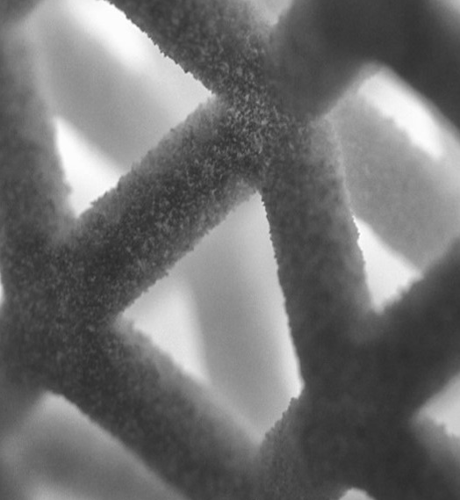
Toolpath extension proposal

Slide 2

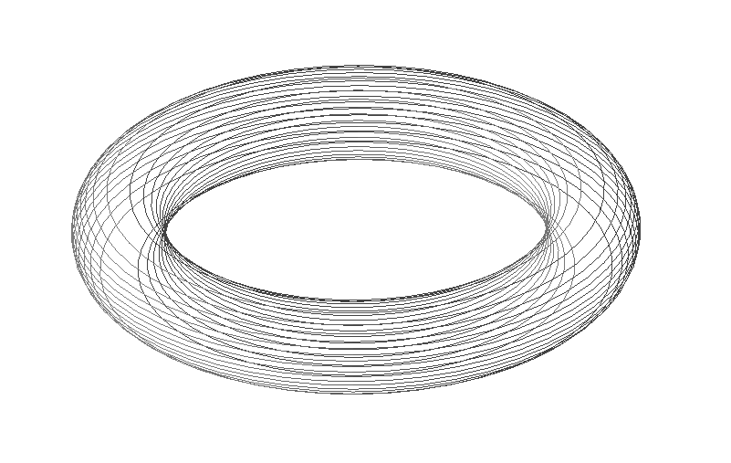
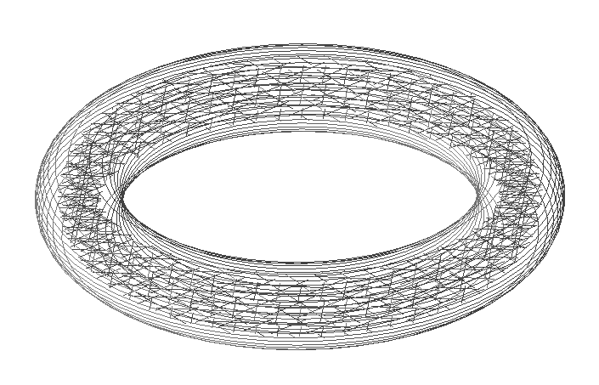
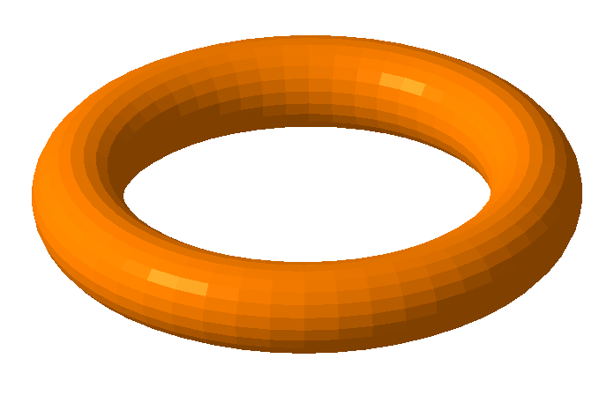

Slide 3
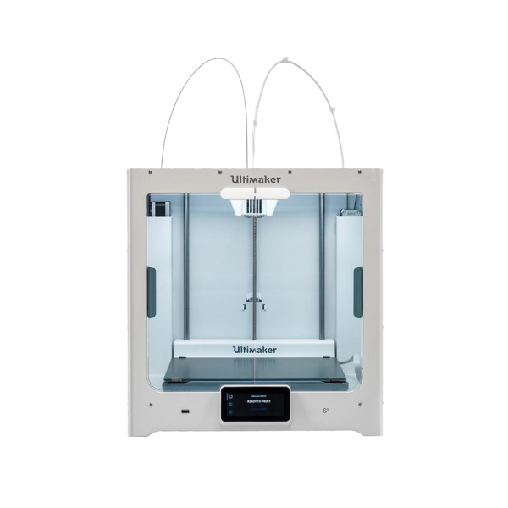
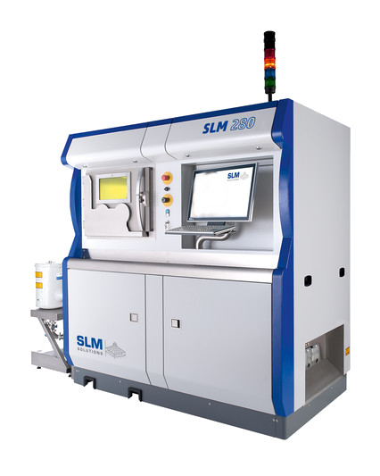
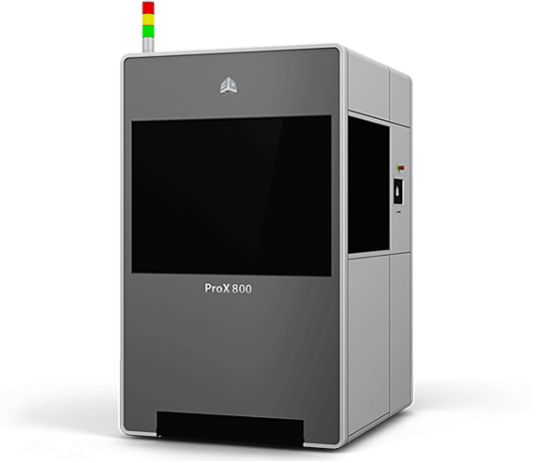
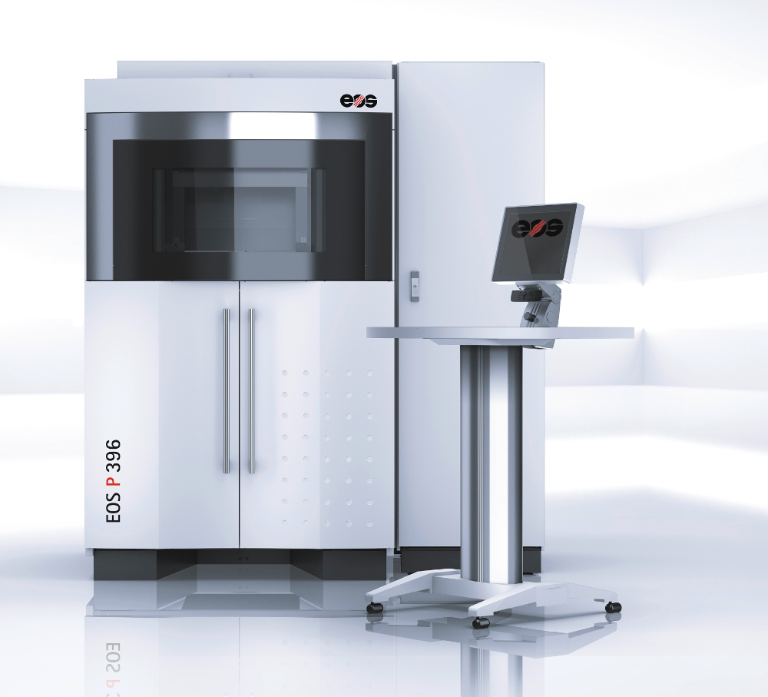
Rationale
And extension like this would cover major branches of industrial 3D Printing, namely
SLA, SLM and SLS, maybe FDM.

Slide 4
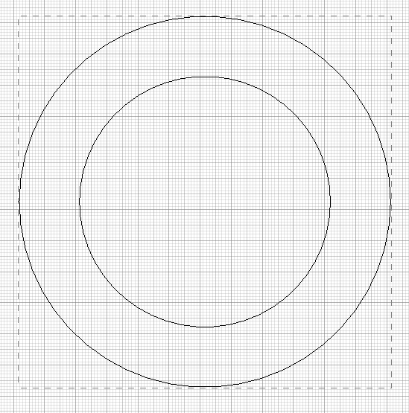
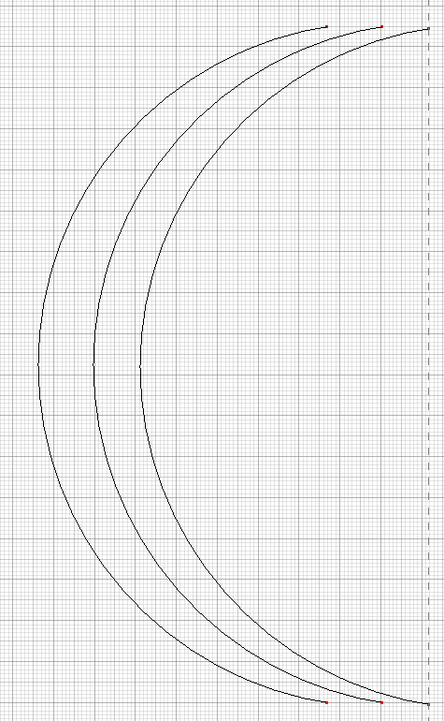
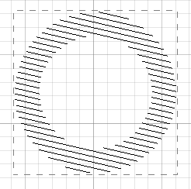
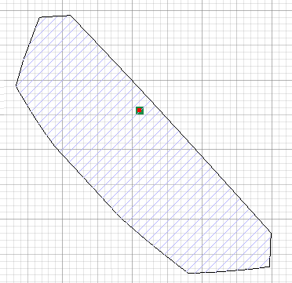

Geometry
The geometry information of a layer consists of a sequence of elements:
Closed loops
Open Polylines
Unstructured lines
(„hatches“)
Stripes
Arcs

Slide 5
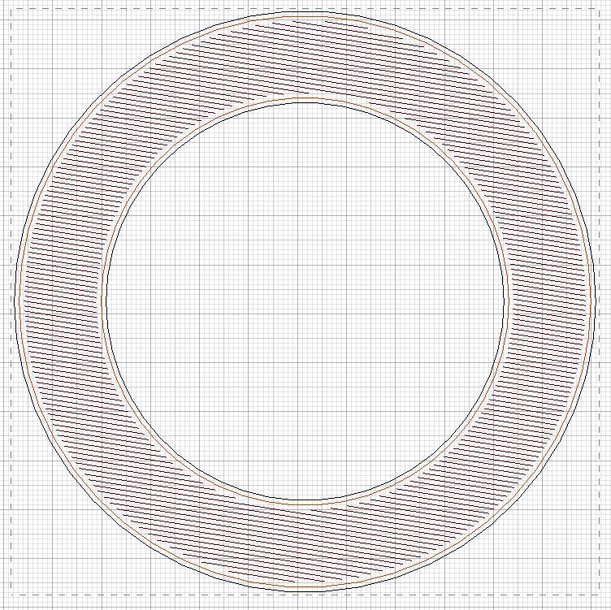
Geometry
Metadata per element:
Laserpower
Laserspeed
Laserfocus
Laserdelays
Laserindex
Proprietary extensions

Slide 6
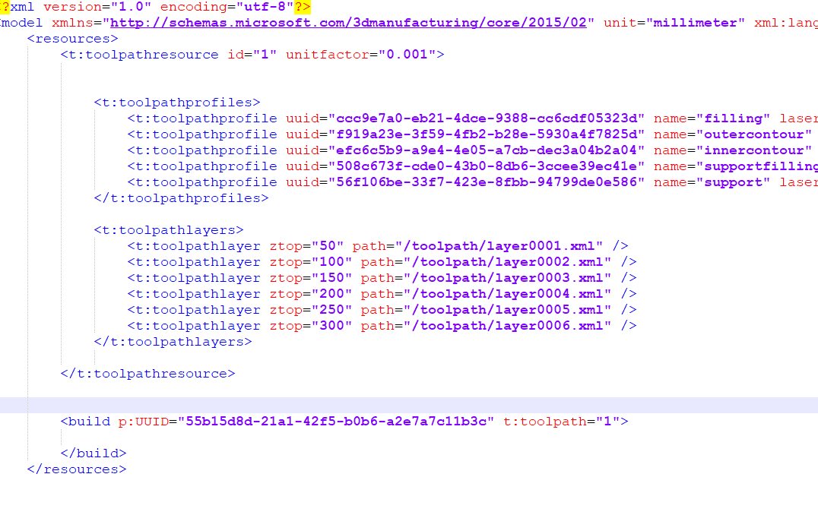
Model XML Structure

Slide 7
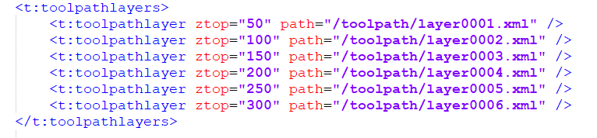
Layers XML Structure

Slide 8
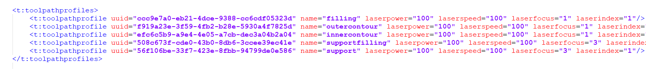
Profiles XML Structure

Slide 9
Proprietary profiles

Slide 10
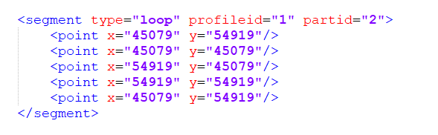
Loop Element

Slide 11
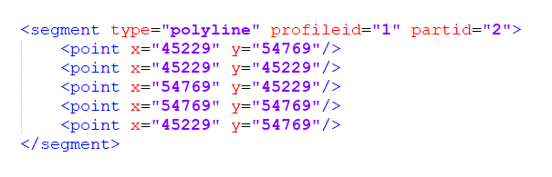
Polyline Element

Slide 12
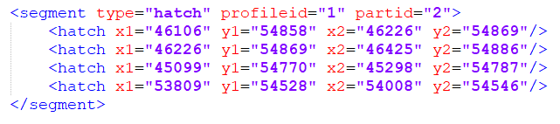
Hatches Element

Slide 13
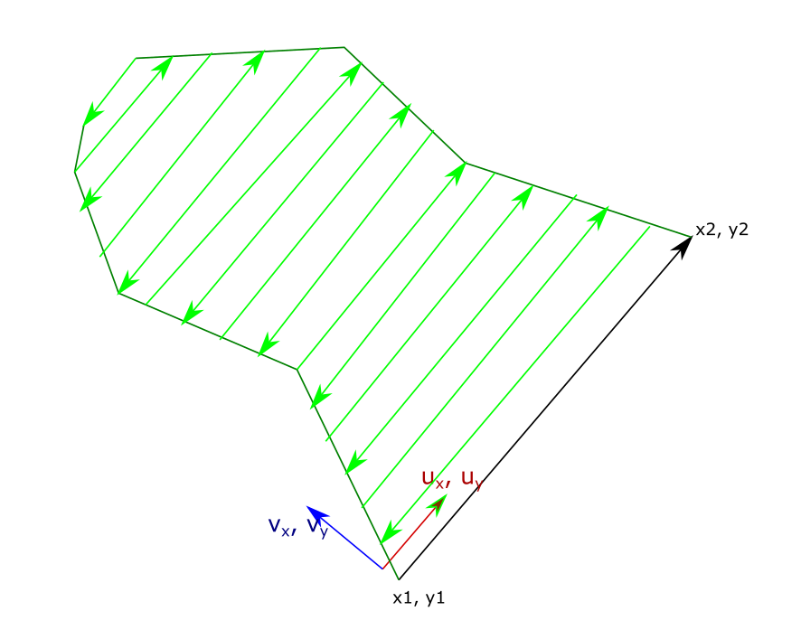
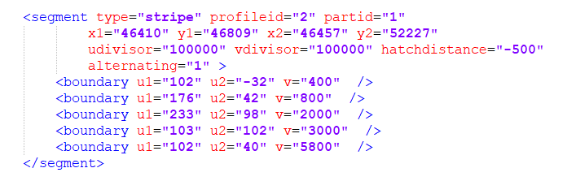
Stripe Element

Slide 14
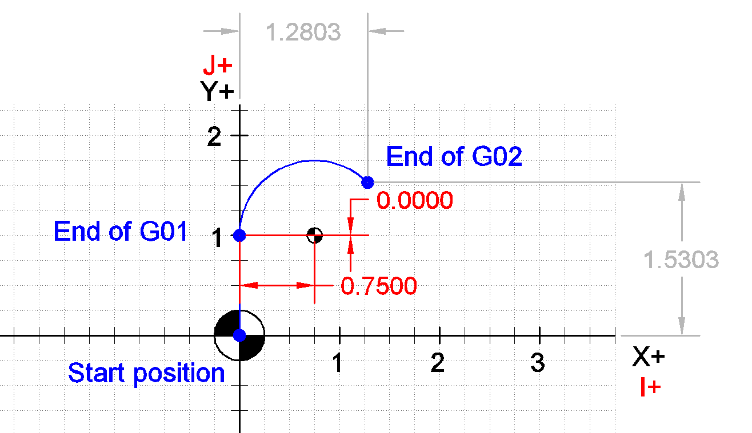
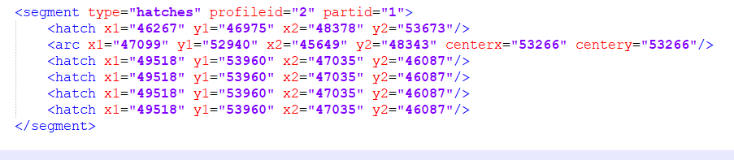
Arc Element

Slide 15
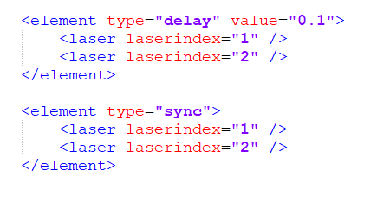
Delay and Sync Element

Slide 16

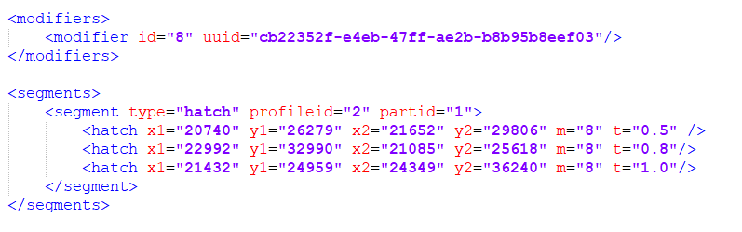
Modifiers

Slide 17

Usage of binary data streams

Slide 18
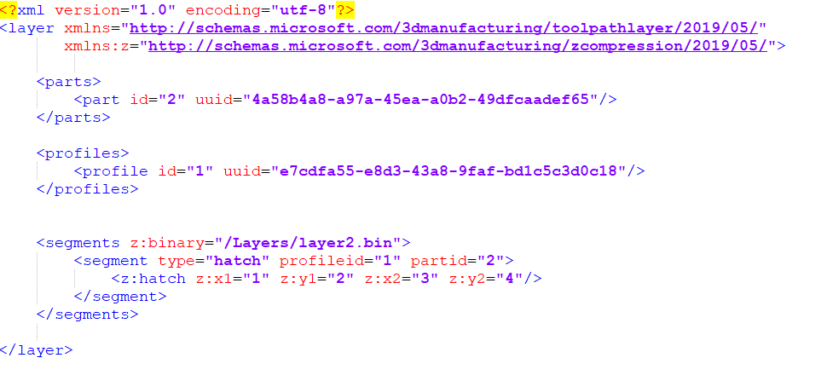

Slide 19
Tests for 3MF Toolpath Extension

Slide 20
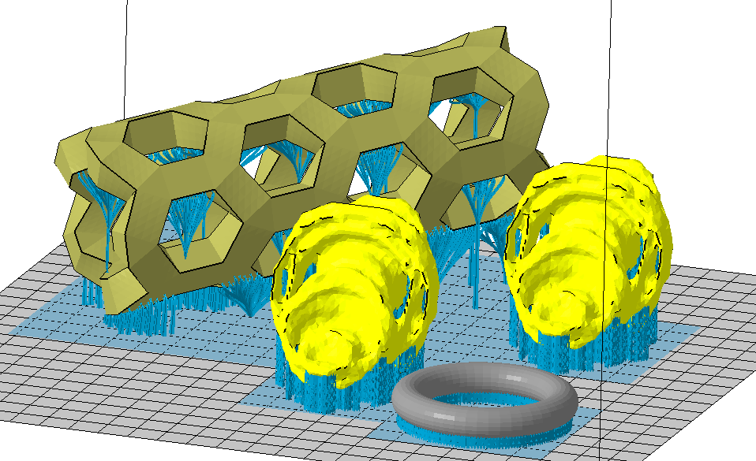
Format | Size
CLI | 146MB
SLM | 87.3MB
AI | 71.2MB
3MF | 95.8MB
3MFZ | 33.9MB
 | CLI | SLM | AI | 3MF | 3MFZ
CLI | 1.00 | 0.60 | 0.49 | 0.65 | 0.23
SLM | 1.68 | 1.00 | 0.82 | 1.09 | 0.39
AI | 2.06 | 1.23 | 1.00 | 1.34 | 0.48
3MF | 1.54 | 0.92 | 0.75 | 1.00 | 0.36
3MFZ | 4.29 | 2.56 | 2.09 | 2.79 | 1.00

Slide 21
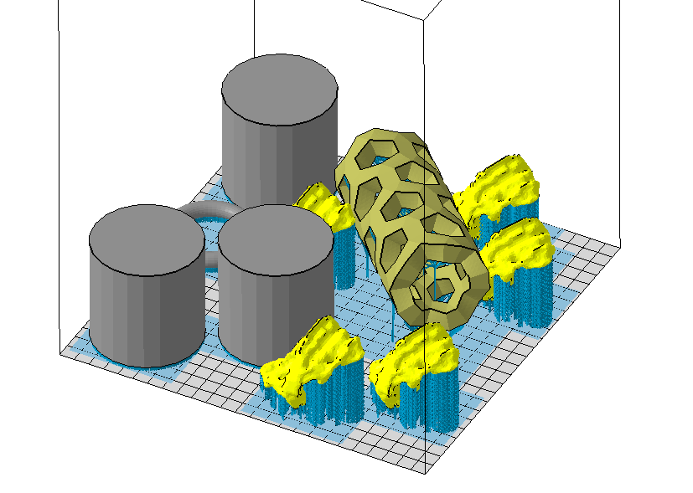
Format | Size
CLI | 432
SLM | 263MB
AI | 191.7MB
3MF | 280MB
3MFZ | 80.1MB
 | CLI | SLM | AI | 3MF | 3MFZ
CLI | 1.00 | 0.61 | 0.44 | 0.65 | 0.19
SLM | 1.64 | 1.00 | 0.73 | 1.06 | 0.30
AI | 2.26 | 1.38 | 1.00 | 1.47 | 0.42
3MF | 1.54 | 0.94 | 0.68 | 1.00 | 0.29
3MFZ | 5.40 | 3.29 | 2.39 | 3.50 | 1.00

Slide 22
Open Source Viewer

Slide 23
