Slide 1


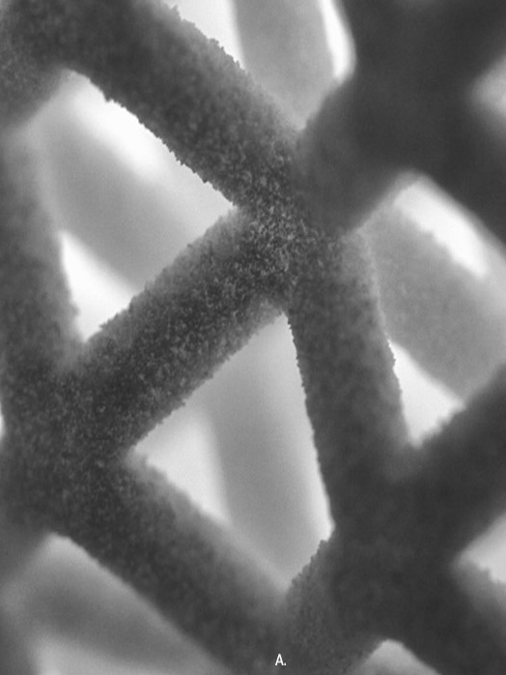
3MF Technical Working Group
Volumetric extension specification
2019/06/26
New York
copyright by the 3MF Consortium 2019

Slide 2
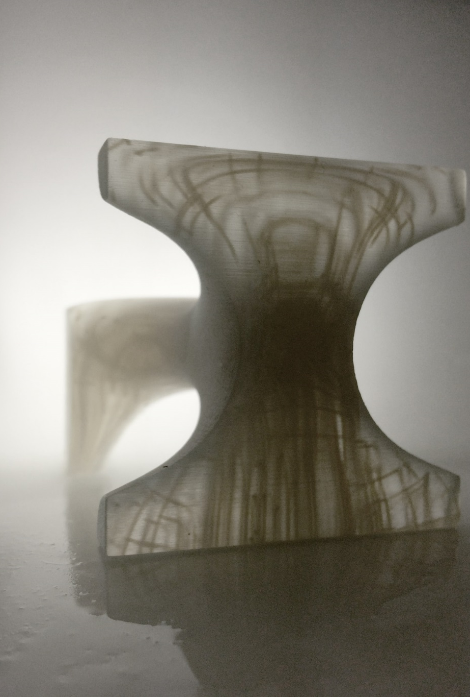
Volumetric extension - Overall concept
Enrich geometry of 3MF with volumetric elements that can represent spatially varying properties
Inefficient to handle with a mesh representation, especially in cases where the variation is continuous in space. => Use a 3D Texture-based or field-based representation. => Encode complex objects by explicitly specifying their properties at any point in space

Slide 3
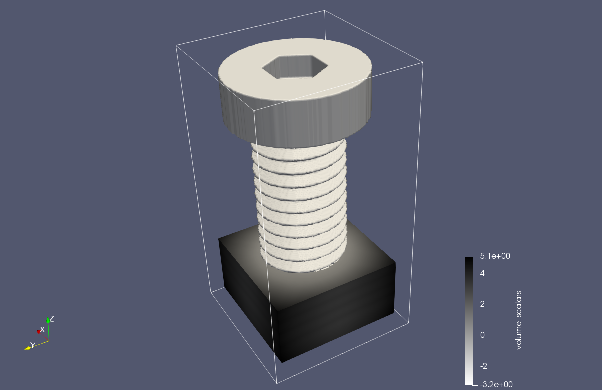
Which information should we encode
Volumetric extension
Encodes complex objects by specifying their properties at any point in space
1. Object boundary (Levelset) a single scalar value at each point in space. - If value > threshold => material - If value <= threshold, void

Slide 4
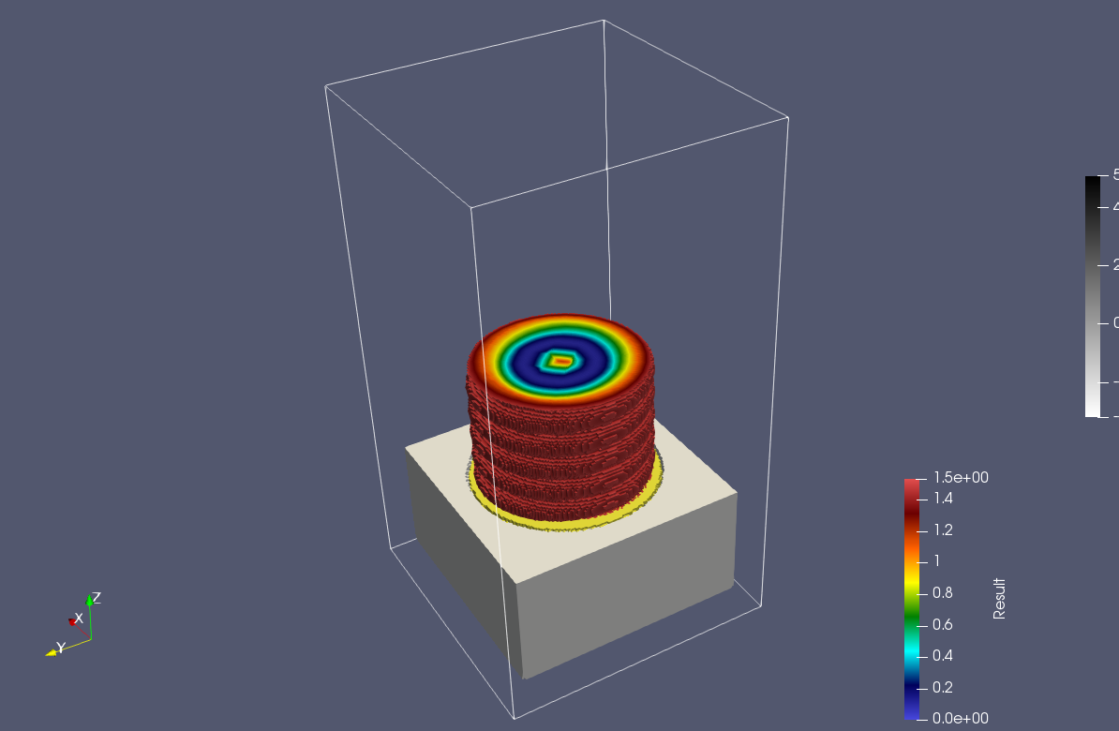
Which information should we encode
Volumetric extension
Encodes complex objects by specifying their properties at any point in space
Object boundary (Levelset)
Spatially varying Color Three scalar values (R, G, B) between 0 and 1 at each point in space
Channel R
Channel B
Channel G

Slide 5
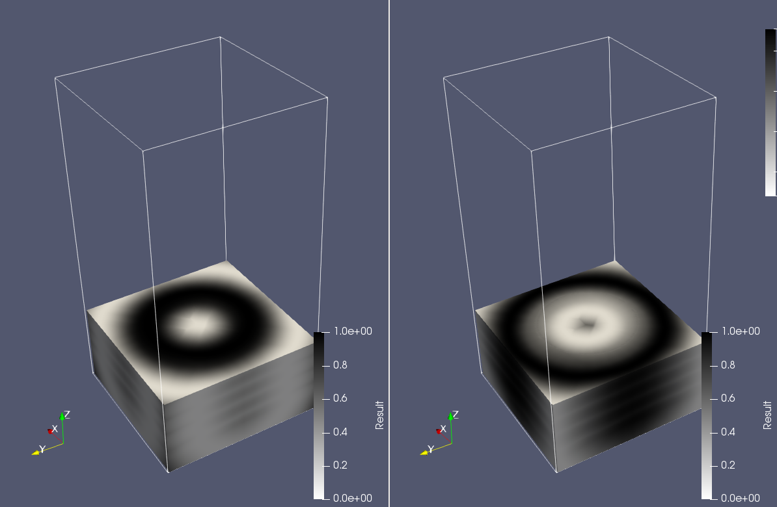
Which information should we encode
Volumetric extension
Encodes complex objects by specifying their properties at any point in space
Object boundary (Levelset)
Spatially varying Color
Material composition: - Multiple scalar channels with intensities between [0,1] - Each associated with a basematerial - Mixing according to their intensity
Intensity “Material 1”
Intensity “Material 2”

Slide 6
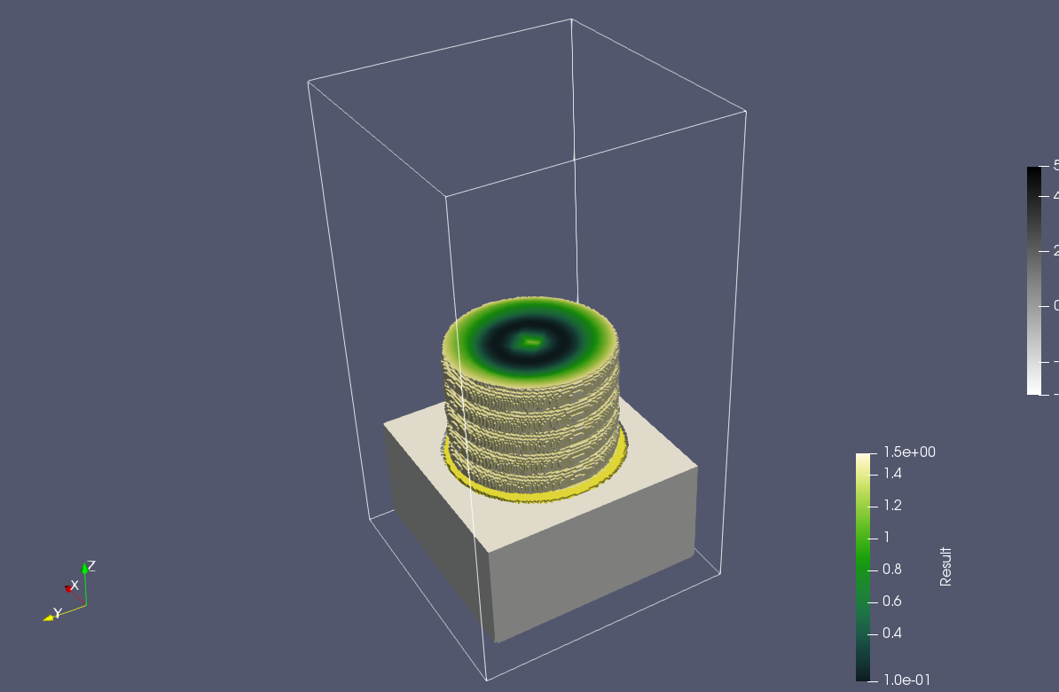
Which information should we encode
Volumetric extension
Encodes complex objects by specifying their properties at any point in space
1 -3 …
High level (arbitrary) properties: - Single channel with scalar intensity/value - Encode intensity of an abstract property: (“conductivity”, “density”, “elasticity”, …) - Consumer can decide, how they mix materials to achieve that property

Slide 7
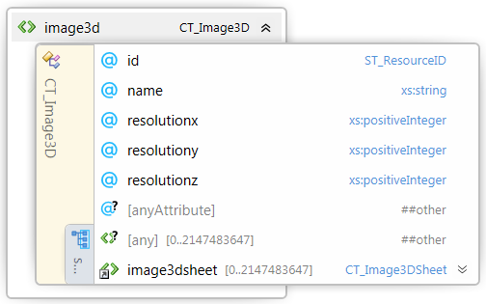
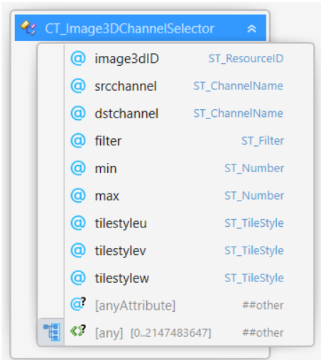
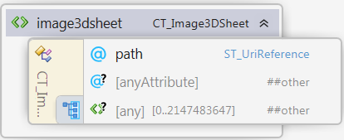
Building blocks
1. Scalar function that assigns every point in space a scalar value
Image3D: A list of PNGs with RGBA, RGB, Grey, GreyAlpha - values
Image3DChannelSelector
Picks a channel
Defines min max range
Defines interpolation
Defines repetition in space

Slide 8
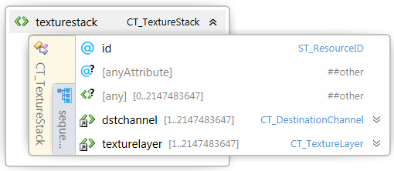
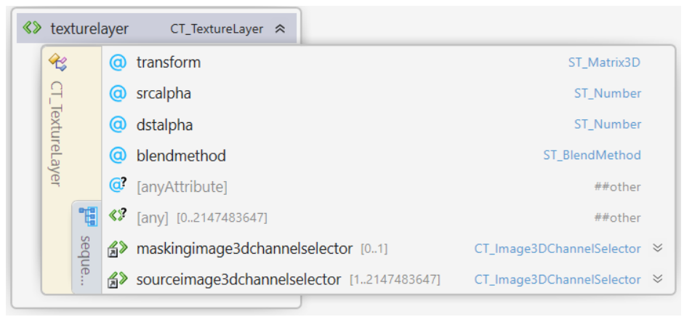
Building blocks
2. Combination rules for those functions
Boolean operations/mixing/masking: h(x,y,z) = a*f(x,y,z) + b*g(x,y,z) h(x,y,z) = f(x,y,z) * g(x,y,z) h(x,y,z) = m(x,y,z)*f(x,y,z) + (1-m(x,y,z))*g(x,y,z)
a
b
+,*, mask
m
h, g, f

Slide 9
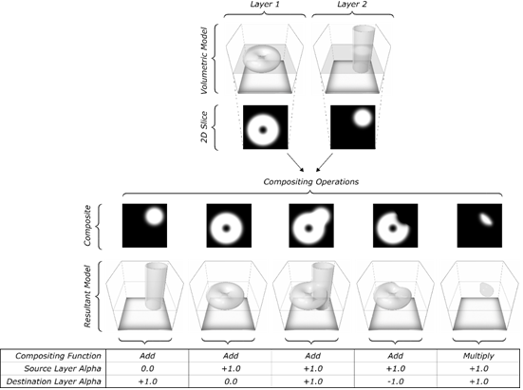
blendmthod=“mix” and “multiply”
2. Combination rules for those functions
Boolean operations/mixing/masking: h(x,y,z) = a*f(x,y,z) + b*g(x,y,z) h(x,y,z) = f(x,y,z) * g(x,y,z) h(x,y,z) = m(x,y,z)*f(x,y,z) + (1-m(x,y,z))*g(x,y,z)
a
b
+,*
h, g, f

Slide 10
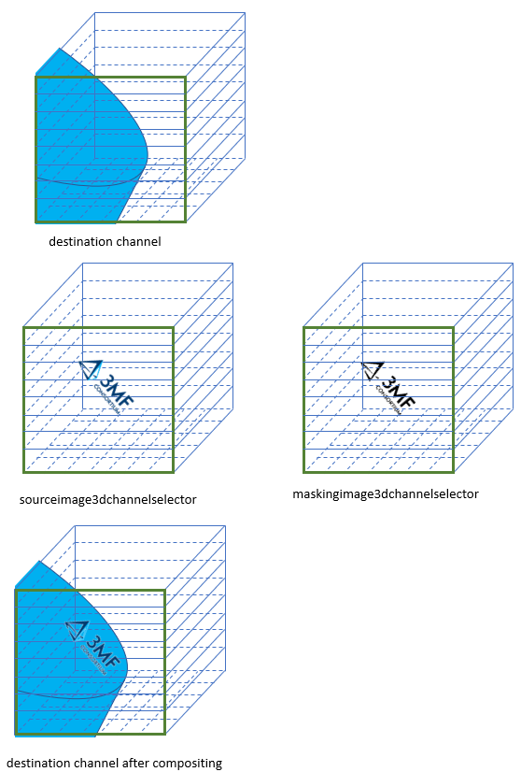
blendmthod=“mask”
2. Combination rules for those functions
Boolean operations/mixing/masking: h(x,y,z) = a*f(x,y,z) + b*g(x,y,z) h(x,y,z) = f(x,y,z) * g(x,y,z) h(x,y,z) = m(x,y,z)*f(x,y,z) + (1-m(x,y,z))*g(x,y,z)
mask
m
h, g, f

Slide 11
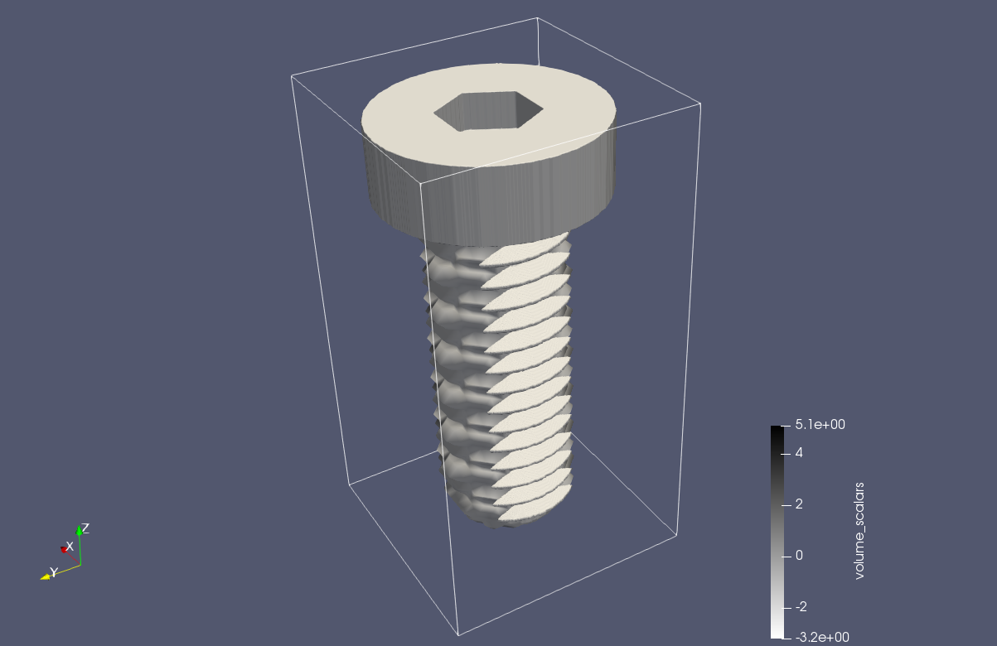
Building blocks
2. Combination rules for those functions
2. transforming them (affine linear):
g(x,y,z) = f(A(x,y,z) + b)
A, b
f

Slide 12


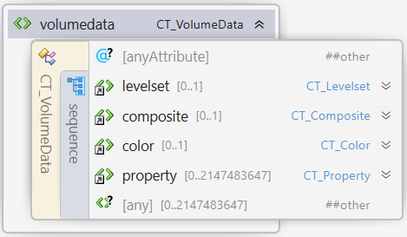


Building blocks
3. Evaluate manipulated functions in 3MF world
Object boundary (Levelset)
Spatially varying Color
Material composition
High level (arbitrary) properties
Channel “Mat 1”
Channel “Mat 2”

Slide 13
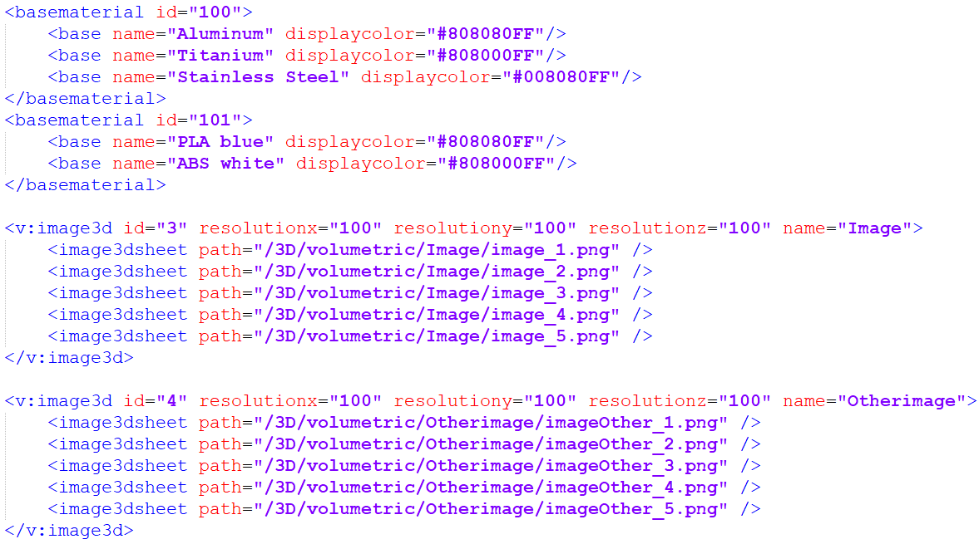
Examples
Shared resources

Slide 14
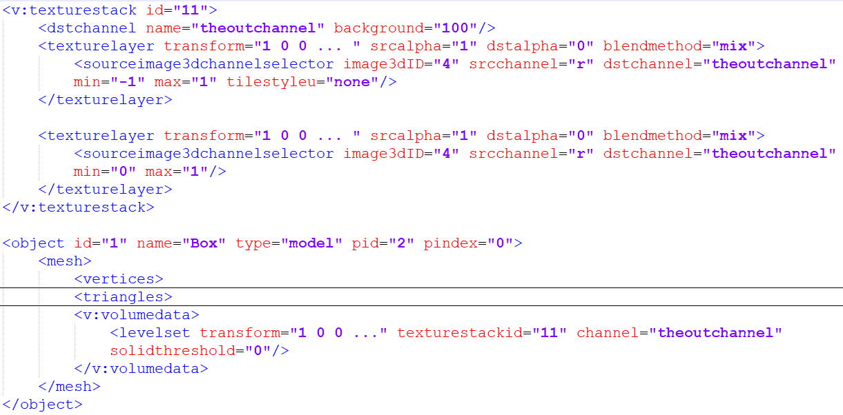
Examples
3. Evaluate manipulated functions in 3MF world
Object boundary (Levelset)

Slide 15
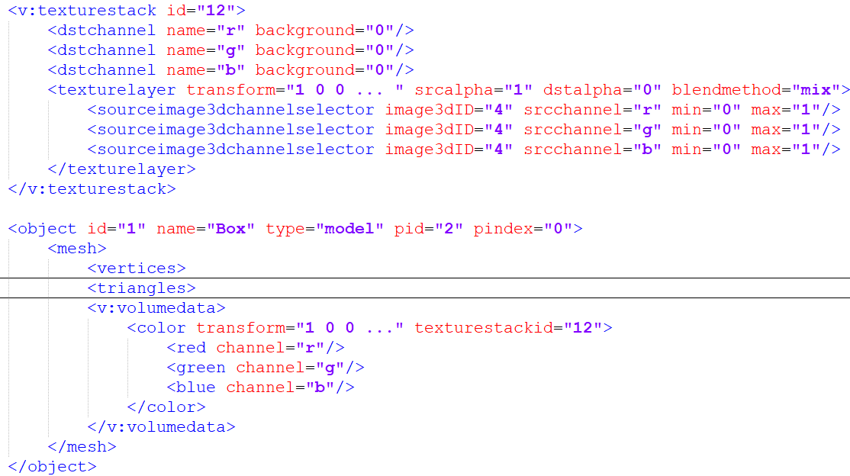
Examples
3. Evaluate manipulated functions in 3MF world
Spatially varying color

Slide 16
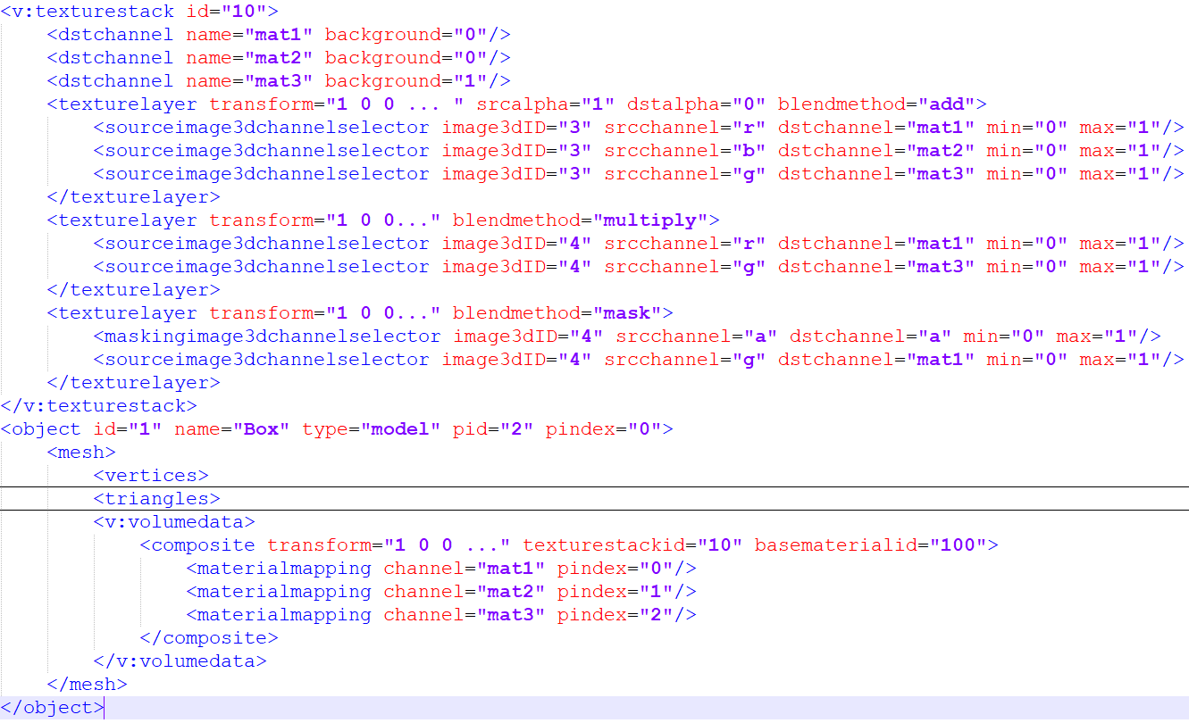
Examples
3. Evaluate manipulated functions in 3MF world
Material composition:
Channel “mat1”
Channel “mat2”

Slide 17
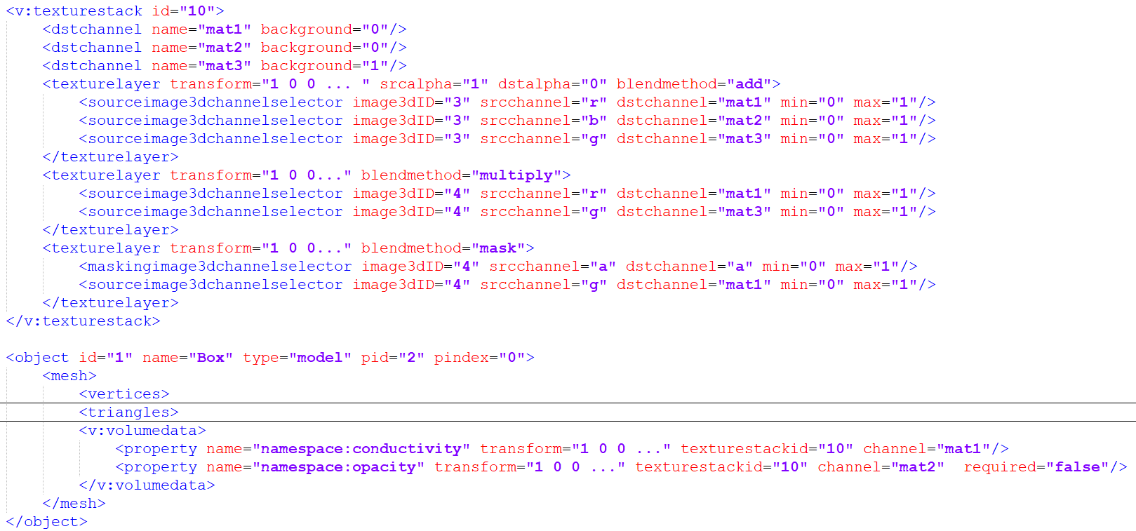
Building blocks
3. Evaluate manipulated functions in 3MF world
High level (arbitrary) properties:

Slide 18
Questions/Issues?
…

