Slide 1



3MF Technical Working Group
Volumetric specification
Original: 28th/29th November 2018
Updated: 20th December 2018
Boston, MA
401 Edgewater Place
Suite 600
Wakefield, 01880 MA
USA
copyright by the 3MF Consortium 2018

Slide 2
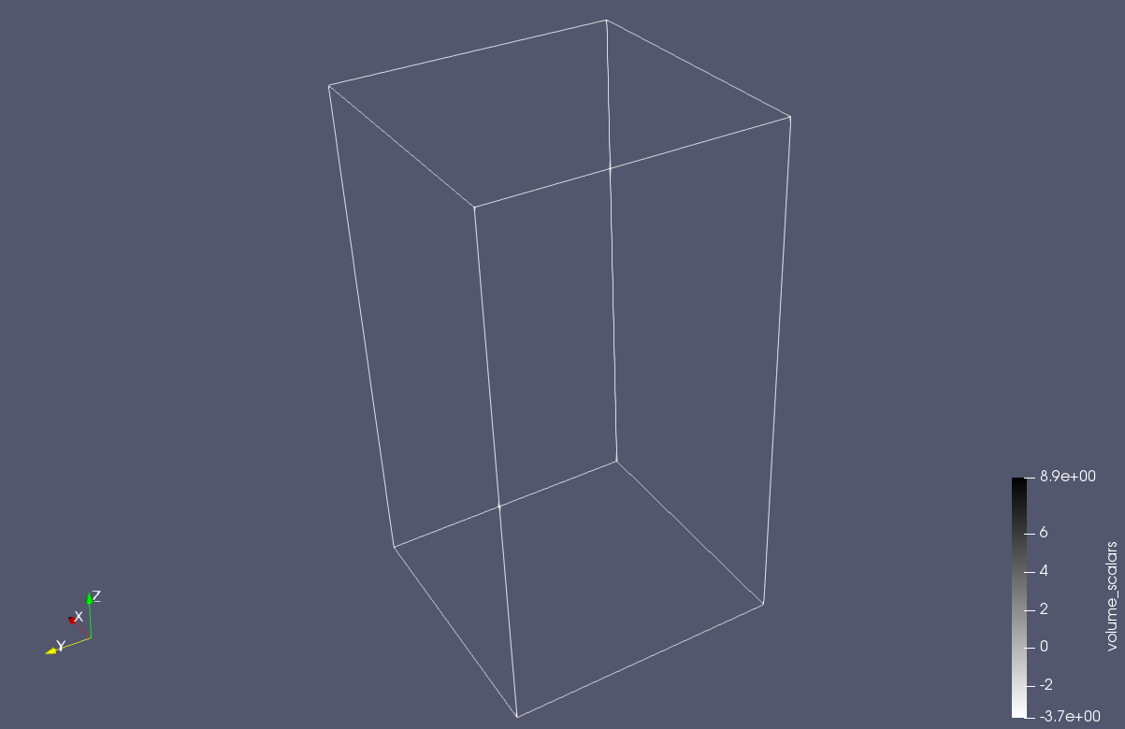
Encode geometric information in volumes
Volumetric extension
Encodes complex objects by specifying their properties at any point in space
copyright by the 3MF Consortium 2018

Slide 3
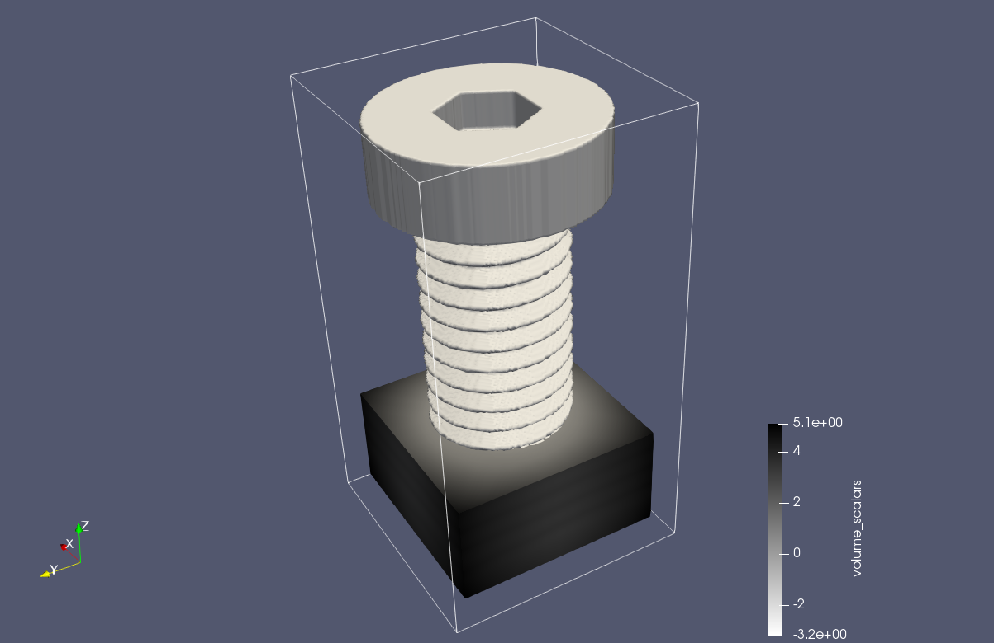
Which information should we encode
Volumetric extension
Encodes complex objects by specifying their properties at any point in space
1. Object boundary (Levelset)
copyright by the 3MF Consortium 2018

Slide 4
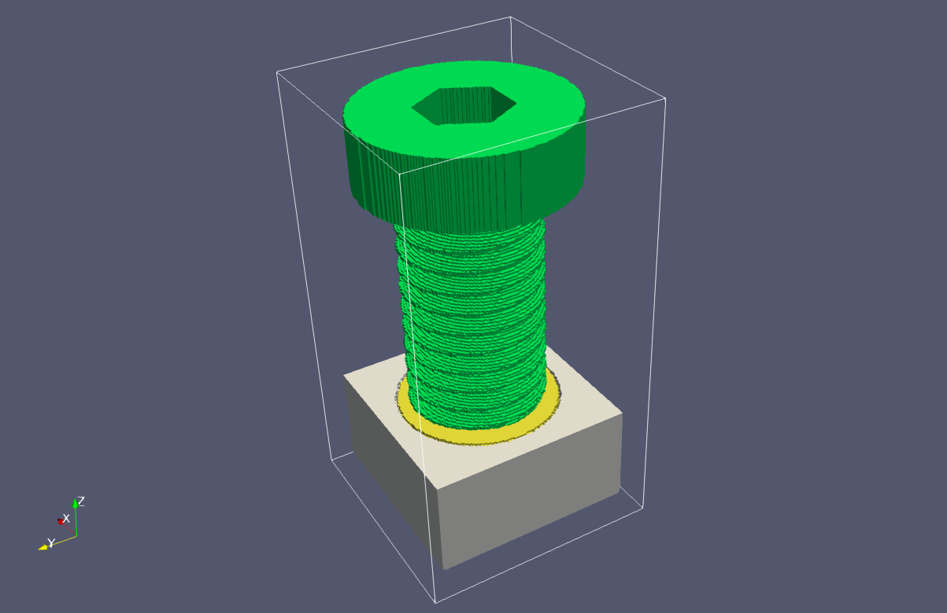
Which information should we encode
Volumetric extension
Encodes complex objects by specifying their properties at any point in space
Object boundary (Levelset)
Discrete material properties:
Discrete basematerial per location
Removed
copyright by the 3MF Consortium 2018

Slide 5
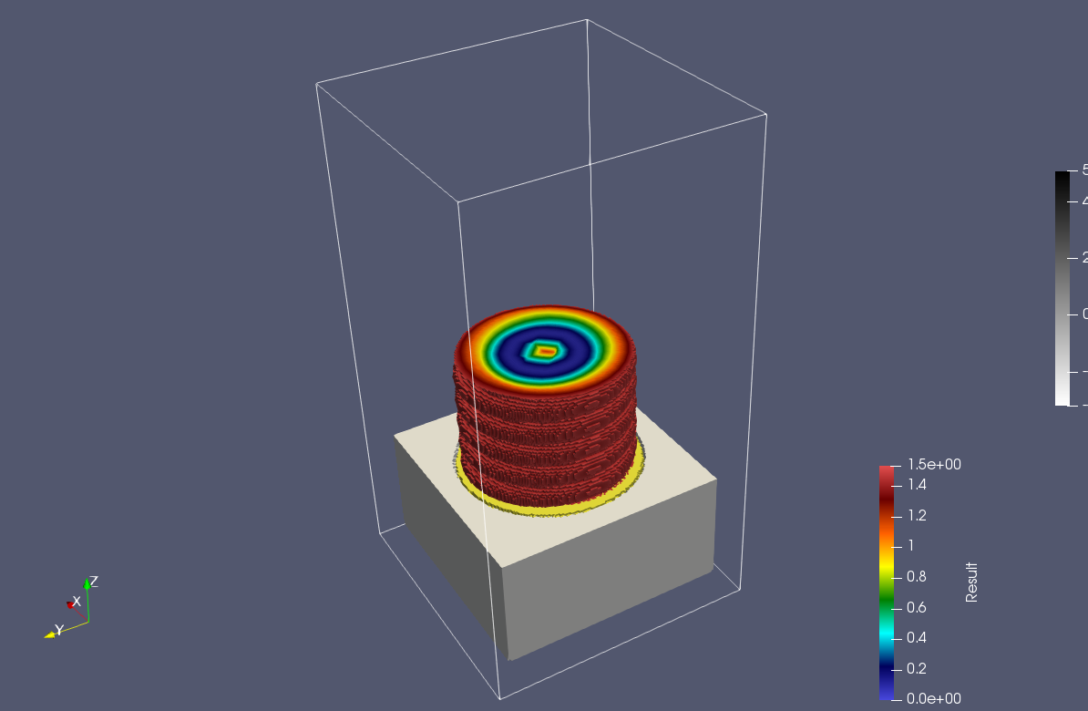
Which information should we encode
Volumetric extension
Encodes complex objects by specifying their properties at any point in space
Object boundary (Levelset)
Spatially varying Color
copyright by the 3MF Consortium 2018

Slide 6
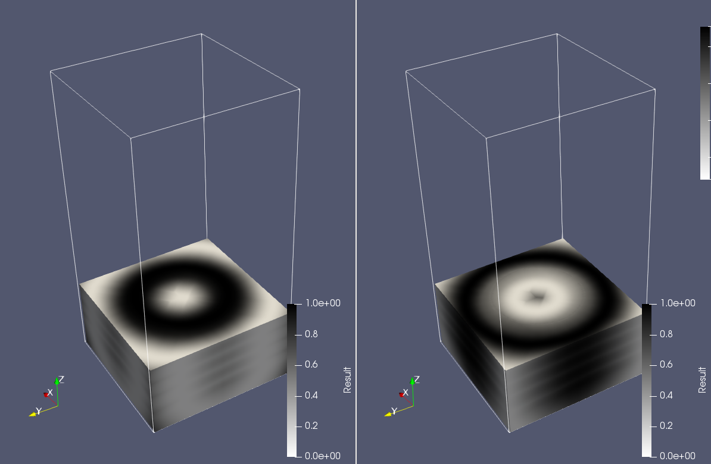
Which information should we encode
Volumetric extension
Encodes complex objects by specifying their properties at any point in space
Object boundary (Levelset)
Spatially varying Color
Material composition: - Multiple scalar channels with intensities between [0,1] - Each associated with a basematerial - Mixing according to their intensity
Channel 1
Channel 2
copyright by the 3MF Consortium 2018

Slide 7
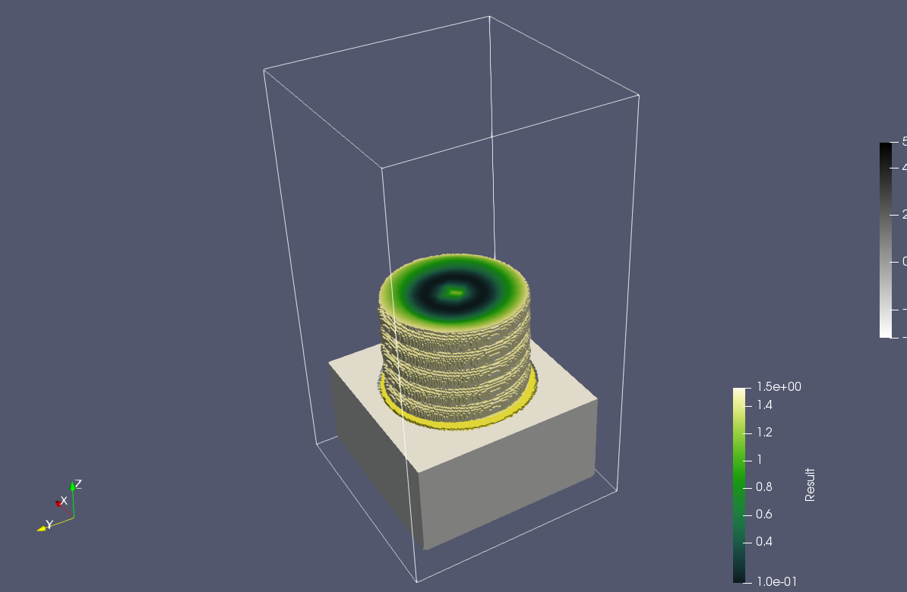
Which information should we encode
Volumetric extension
Encodes complex objects by specifying their properties at any point in space
1 -3 …
High level (arbitrary) properties: - Single channel with scalar intensity/value - Encode intensity of an abstract property: (“conductivity”, “density”, “elasticity”, …) - Consumer can decide, how they mix materials to achieve that property
copyright by the 3MF Consortium 2018

Slide 8
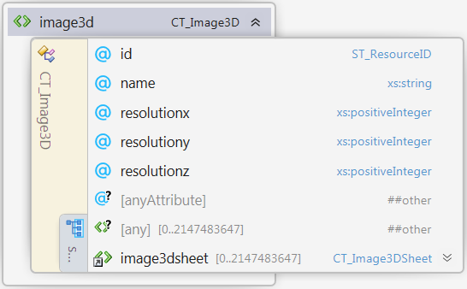
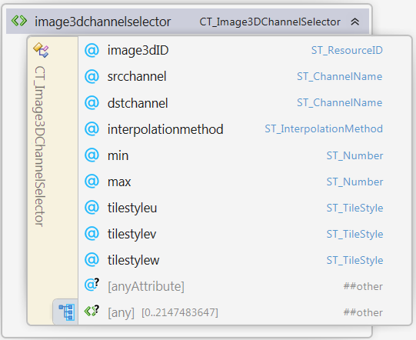
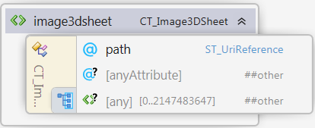
Building blocks
1. Scalar function that assigns every point in space a scalar value
Image3D: A list of PNGs with RGBA, RGB, Gray, GrayAlpha - values
Image3DChannelSelector
Picks a channel
Defines min max range
Defines interpolation
Defines repetition in space
copyright by the 3MF Consortium 2018

Slide 9
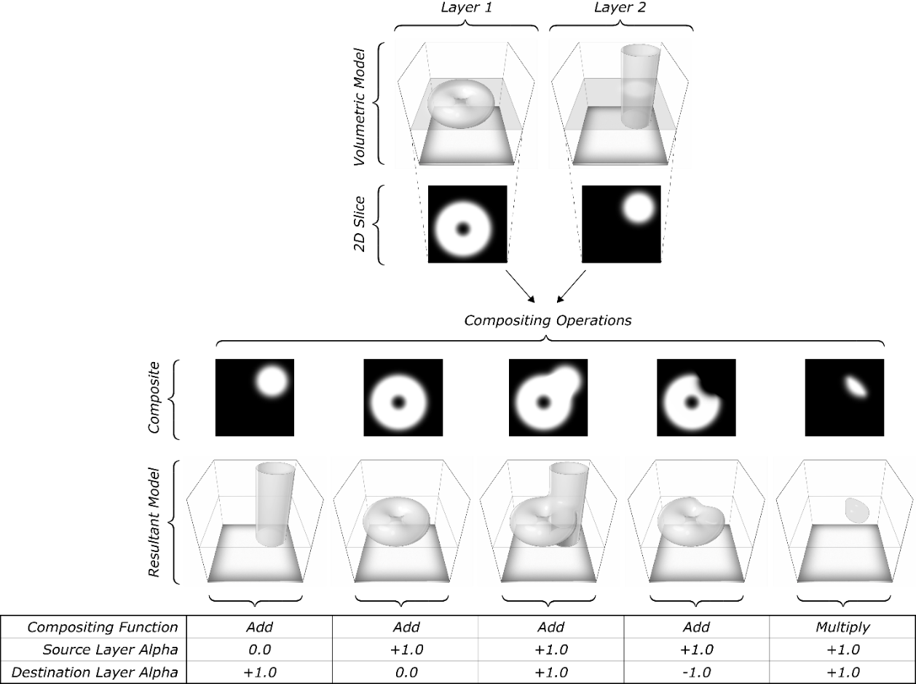
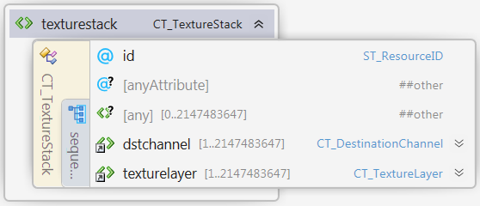
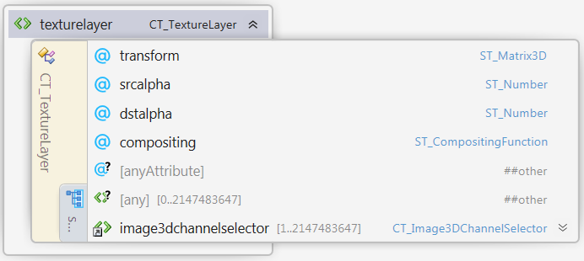
Building blocks
2. Combination rules for those functions
Boolean operations/mixing: h(x,y,z) = a*f(x,y,z) + b*g(x,y,z) h(x,y,z) = f(x,y,z) * g(x,y,z)
a
b
*, +
h, g, f
copyright by the 3MF Consortium 2018

Slide 10
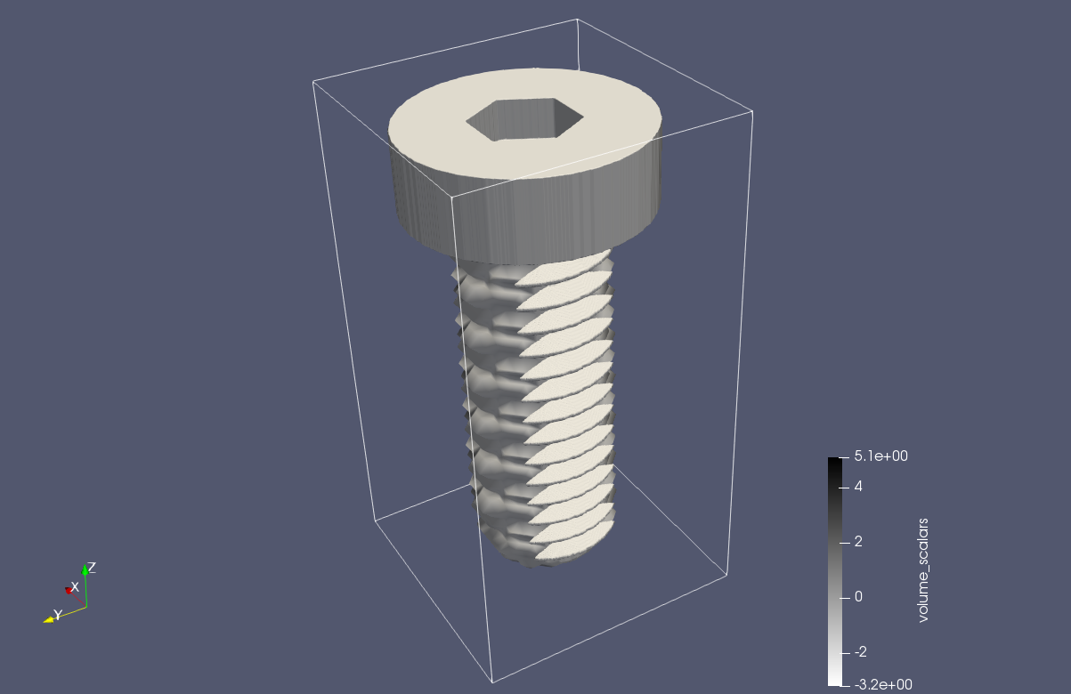
Building blocks
2. Combination rules for those functions
2. transforming them (affine linear):
g(x,y,z) = f(A(x,y,z) + b)
A, b
g, f
copyright by the 3MF Consortium 2018

Slide 11
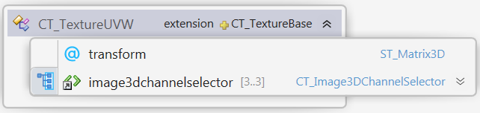
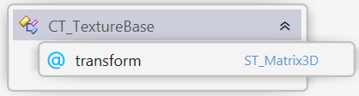
Building blocks
Removed
2. Combination rules for those functions
Reevaluating them (UVW mapping):
g(x,y,z) = f(u(x,y,z), v(x,y,z), w(x,y,z))
copyright by the 3MF Consortium 2018

Slide 12
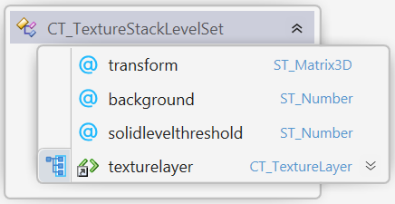
Building blocks
Reformulated
3. Evaluate manipulated functions in 3MF world
To encode Object boundaries
copyright by the 3MF Consortium 2018

Slide 13
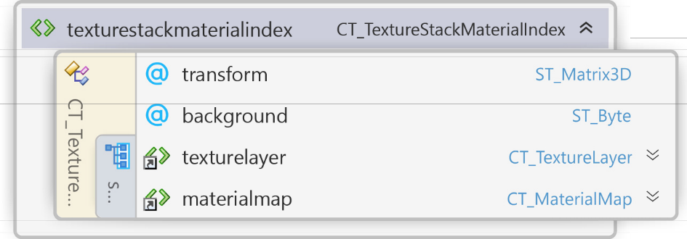
Building blocks
Reformulated
3. Evaluate manipulated functions in 3MF world
To encode materials
copyright by the 3MF Consortium 2018

Slide 14


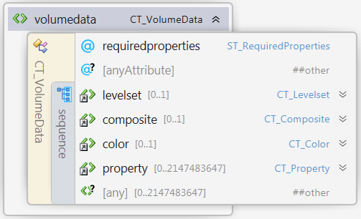


Building blocks
3. Evaluate manipulated functions in 3MF world
Object boundary (Levelset)
Spatially varying Color
Material composition
High level (arbitrary) properties
Channel 1
Channel 2
copyright by the 3MF Consortium 2018

Slide 15
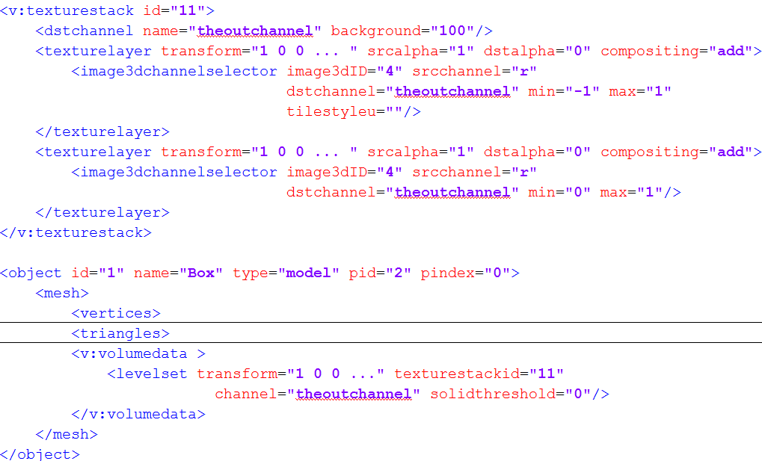
Building blocks
3. Evaluate manipulated functions in 3MF world
Object boundary (Levelset)
copyright by the 3MF Consortium 2018

Slide 16
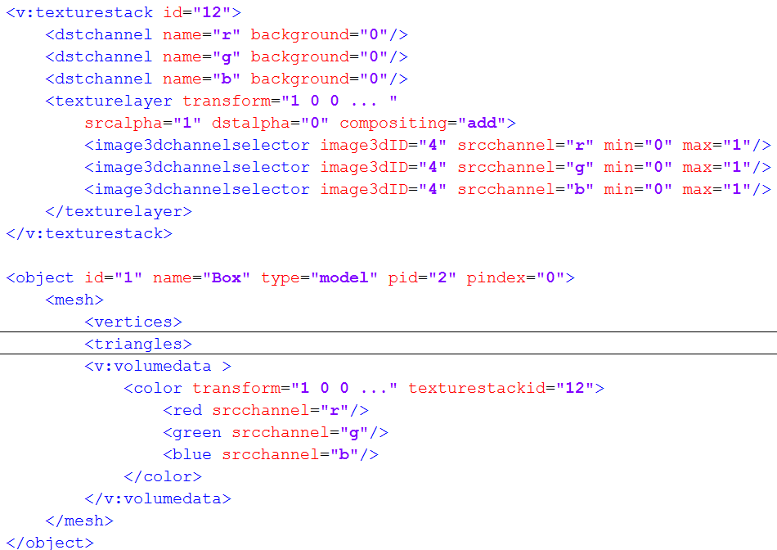
Building blocks
3. Evaluate manipulated functions in 3MF world
Spatially varying color
copyright by the 3MF Consortium 2018

Slide 17
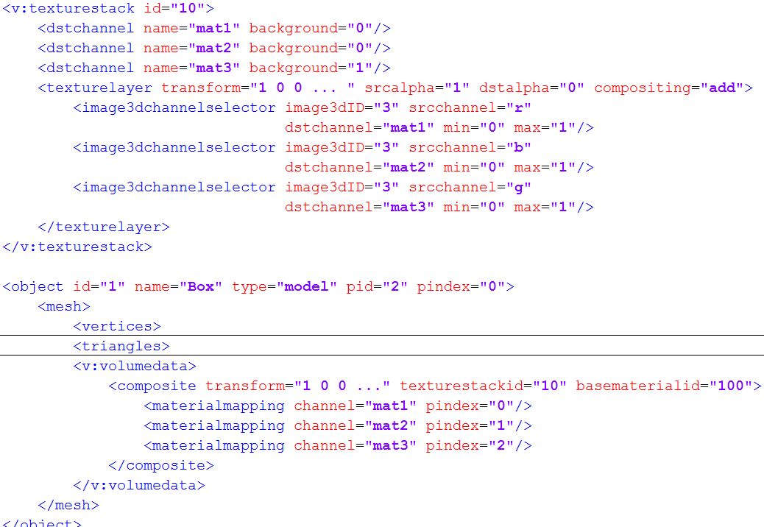
Building blocks
3. Evaluate manipulated functions in 3MF world
Material composition:
Channel 1
Channel 2
copyright by the 3MF Consortium 2018

Slide 18
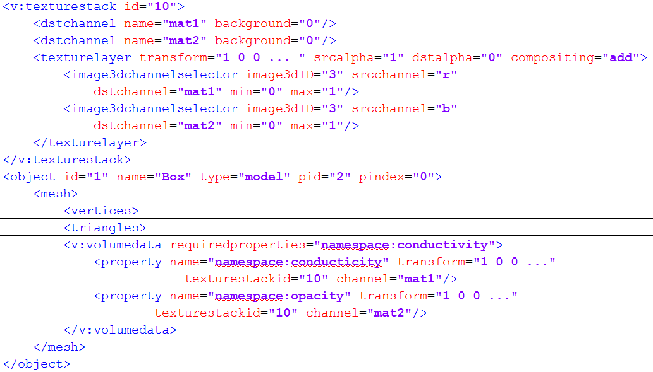
Building blocks
3. Evaluate manipulated functions in 3MF world
High level (arbitrary) properties:
copyright by the 3MF Consortium 2018

