Slide 1


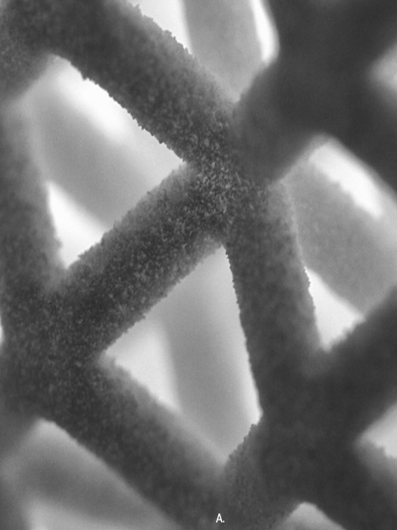
3MF Technical Working Group
Volumetric specification
28th/29th November 2018
Boston, MA
401 Edgewater Place
Suite 600
Wakefield, 01880 MA
USA
copyright by the 3MF Consortium 2018

Slide 2
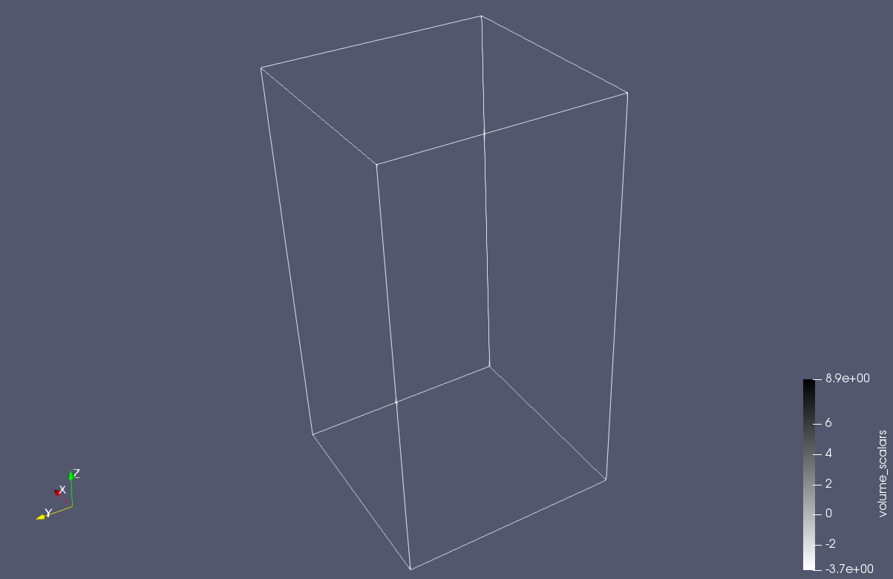
Encode geometric information in volumes
Volumetric extension
Encodes complex objects by specifying their properties at any point in space
copyright by the 3MF Consortium 2018

Slide 3
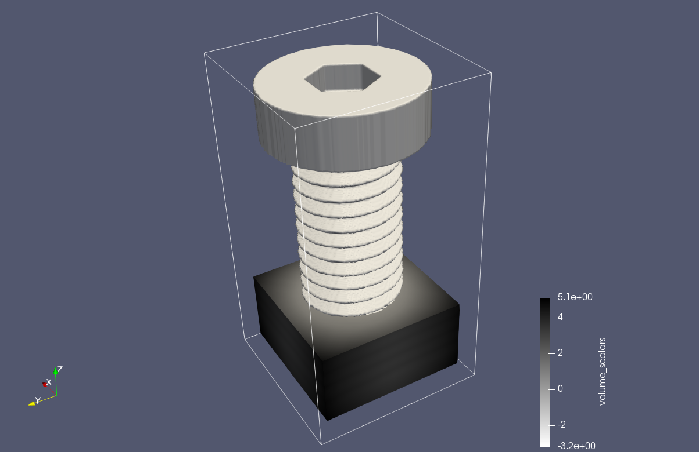
Which information should we encode
Volumetric extension
Encodes complex objects by specifying their properties at any point in space
Object boundary (Levelset)
copyright by the 3MF Consortium 2018

Slide 4
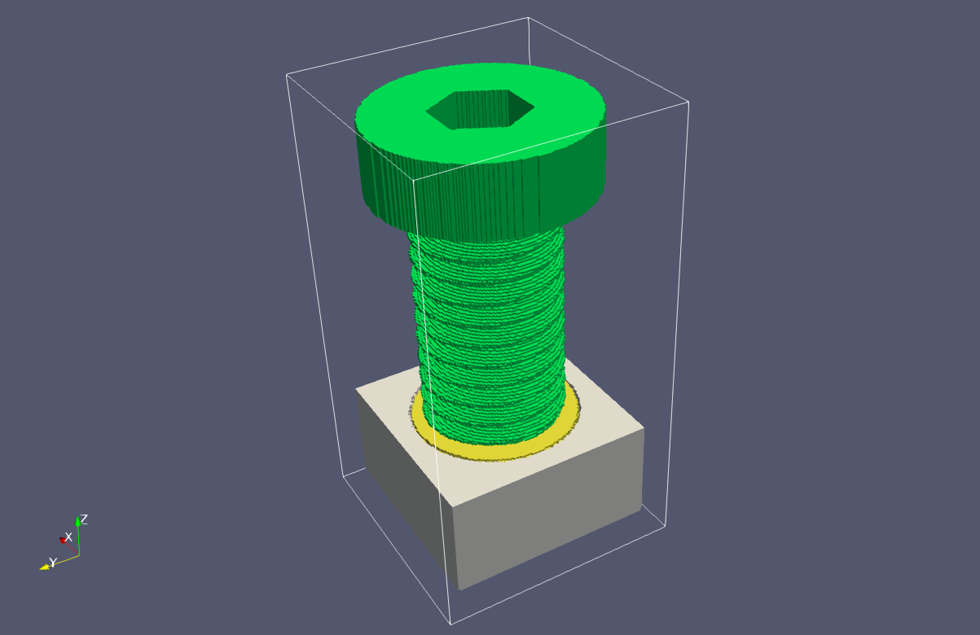
Which information should we encode
Volumetric extension
Encodes complex objects by specifying their properties at any point in space
Object boundary (Levelset)
Discrete properties:
Discrete basematerial per location
copyright by the 3MF Consortium 2018

Slide 5
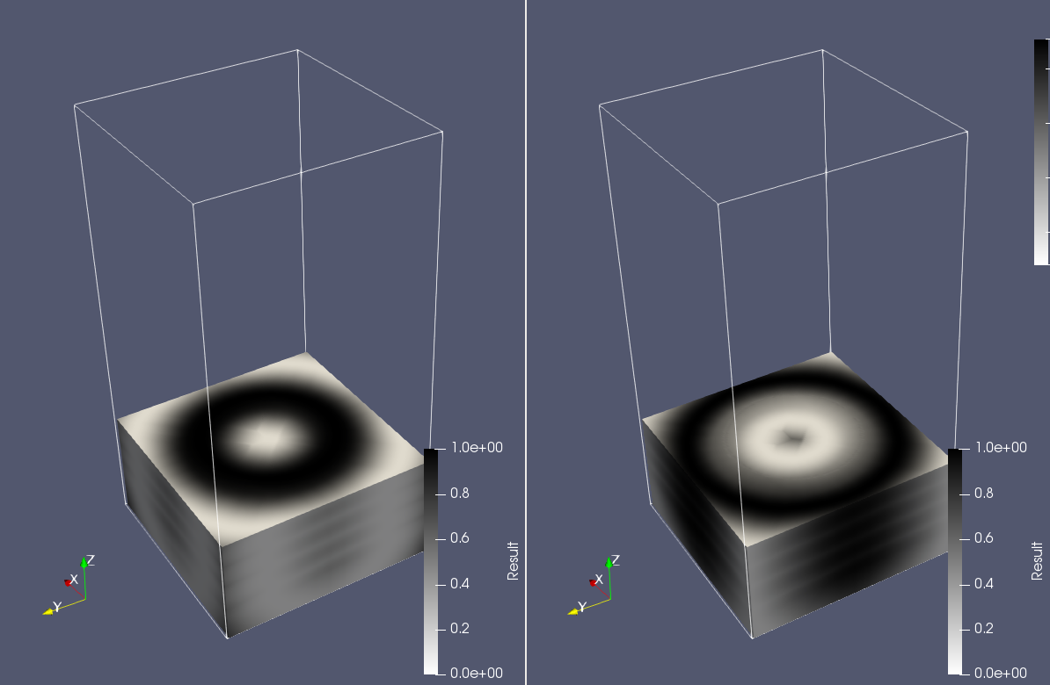
Which information should we encode
Volumetric extension
Encodes complex objects by specifying their properties at any point in space
…
High level properties: - Multiple scalar channels with intensities between [0,1] - Encode intensity of an abstract property: (“conductivity”, “density”, “elasticity”, “color rgb R”…) - Consumer can decide, how they mix materials to achieve that
OR
Composites:
Multiple scalar channels with intensities between [0,1]
Each associated with a basematerial
Mixing according to their intensity
Channel 1
Channel 2
copyright by the 3MF Consortium 2018

Slide 6
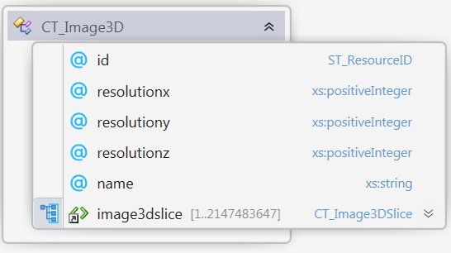
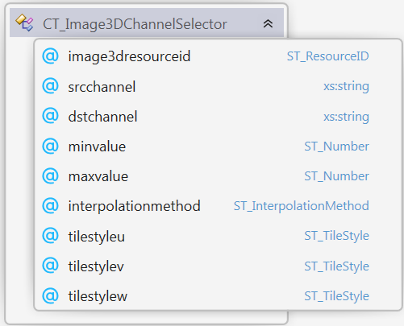
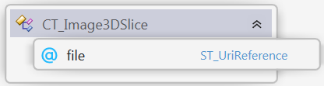
Building blocks
1. Scalar function that assigns every point in space a scalar value
Image3D: A list of PNGs with RGBA, RGB, Gray, GrayAlpha - values
Image3DChannelSelector
Picks a channel
Defines min max range
Defines interpolation
Defines repetition in space
copyright by the 3MF Consortium 2018

Slide 7
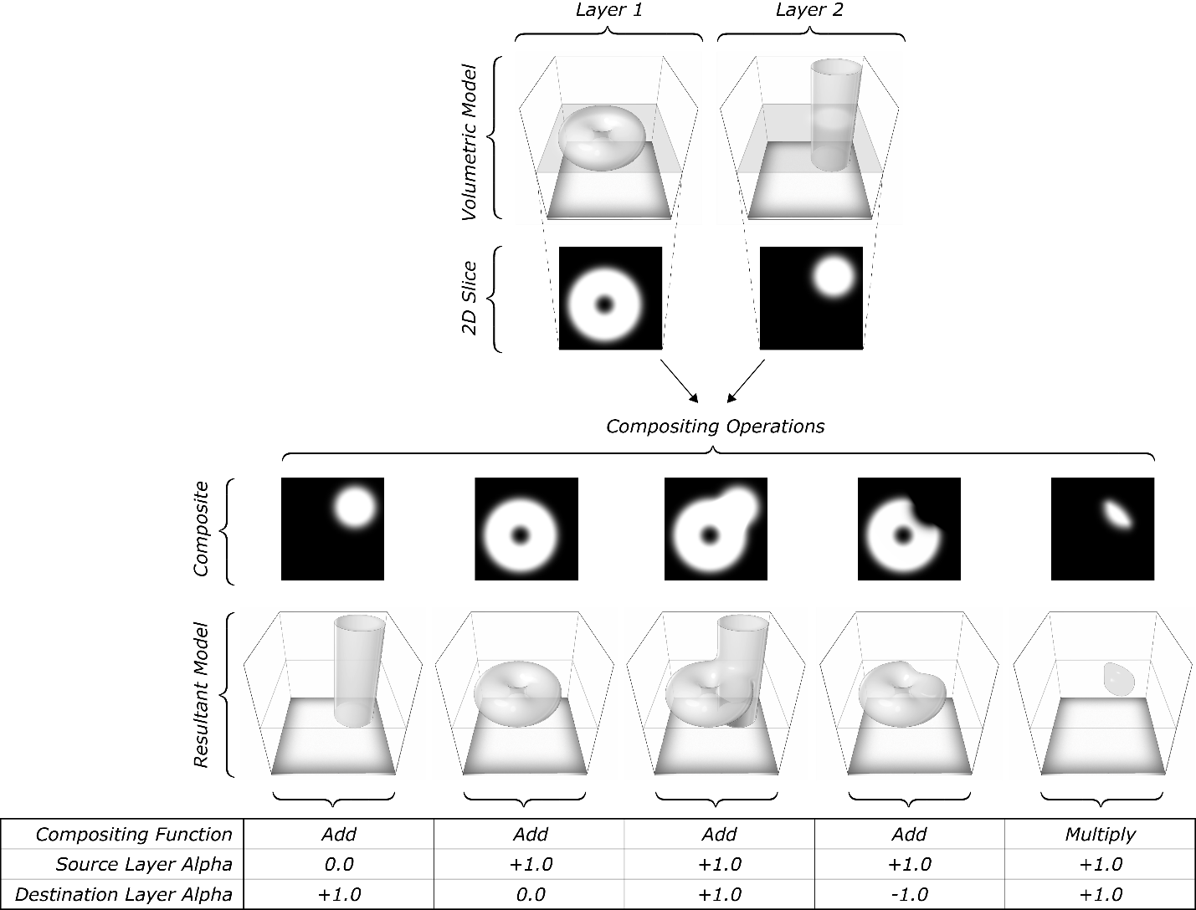
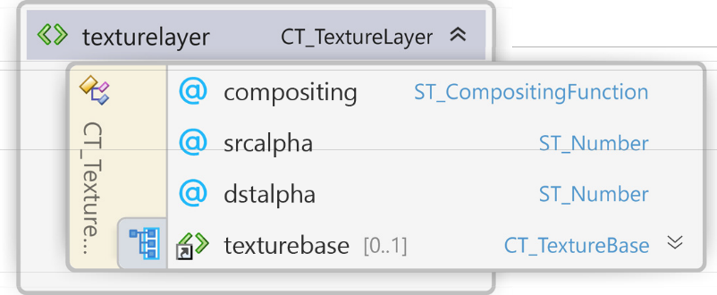
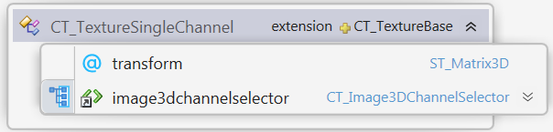
Building blocks
2. Combination rules for those functions
Boolean operations: h(x,y,z) = a*f(x,y,z) + b*g(x,y,z) h(x,y,z) = f(x,y,z) * g(x,y,z)
copyright by the 3MF Consortium 2018

Slide 8
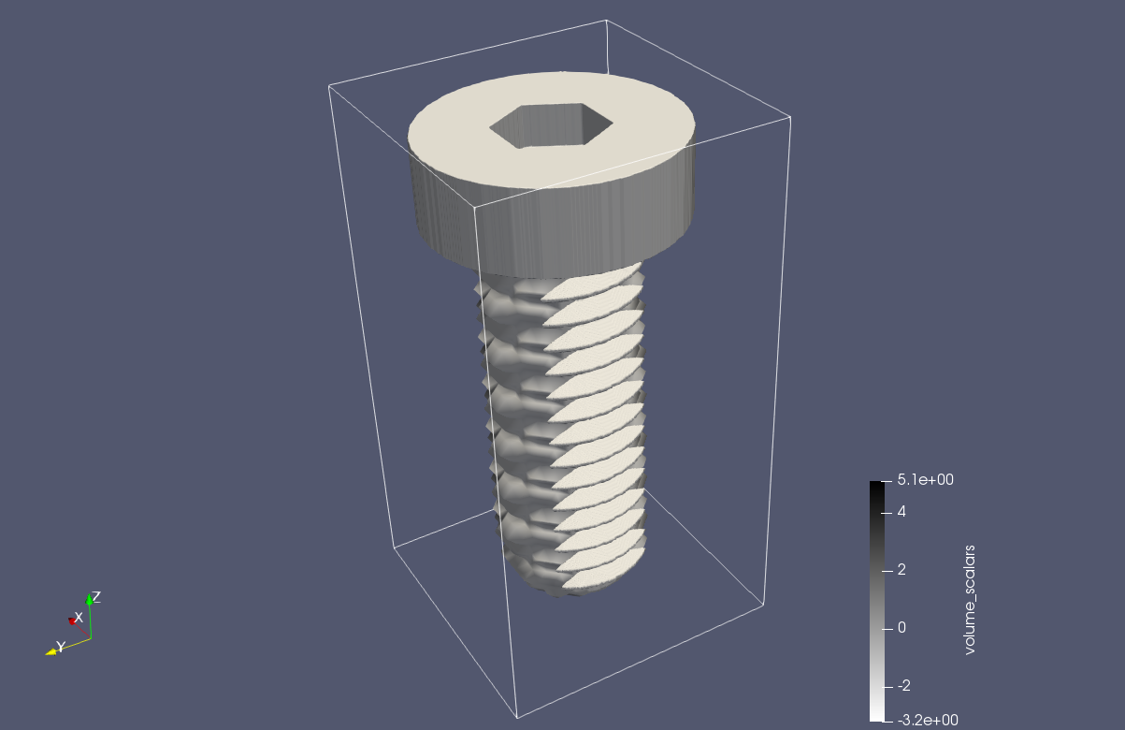
Building blocks
2. Combination rules for those functions
2. transforming them (affine linear):
g(x,y,z) = f(A(x,y,z) + b)
copyright by the 3MF Consortium 2018

Slide 9
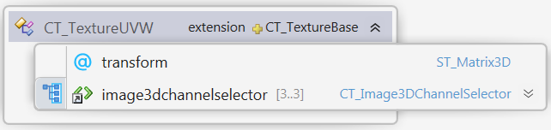
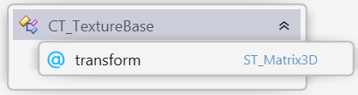
Building blocks
2. Combination rules for those functions
Reevaluating them (UVW mapping):
g(x,y,z) = f(u(x,y,z), v(x,y,z), w(x,y,z))
copyright by the 3MF Consortium 2018

Slide 10
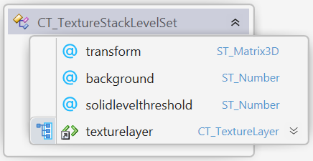
Building blocks
3. Evaluate manipulated functions in 3MF world
To encode Object boundaries
copyright by the 3MF Consortium 2018

Slide 11
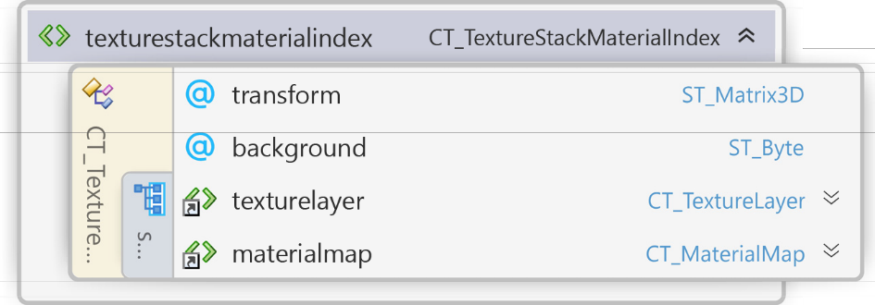
Building blocks
3. Evaluate manipulated functions in 3MF world
To encode materials
copyright by the 3MF Consortium 2018

Slide 12
Building blocks
3. Evaluate manipulated functions in 3MF world
To encode mixing: TODO
copyright by the 3MF Consortium 2018

