Slide 1
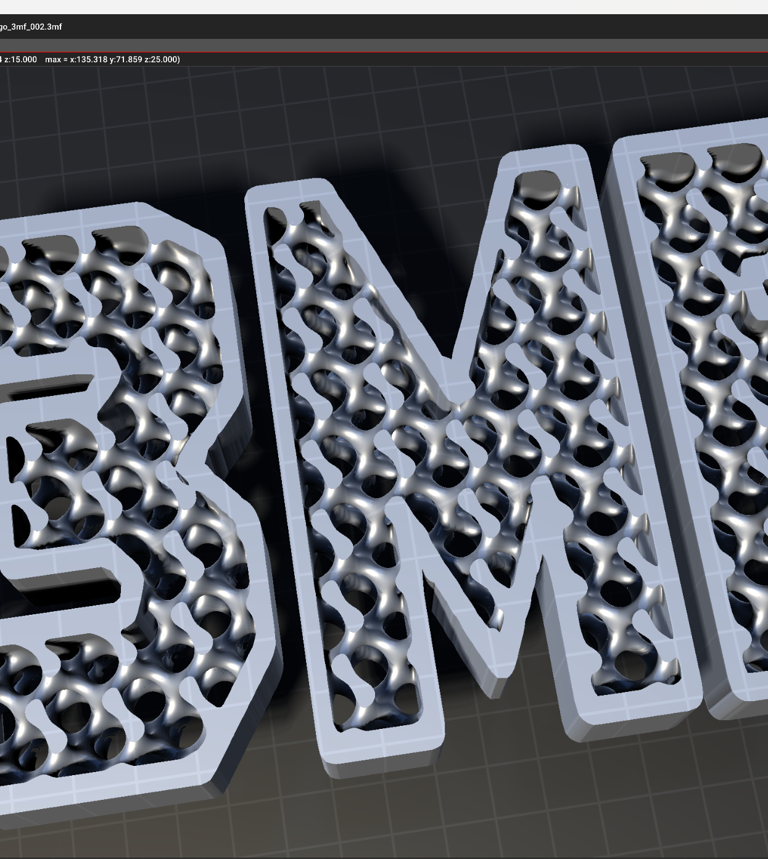

Implicit Modelling in 3MF
2024/08/15
Closing for Review

Slide 2
Outline
Brief description of volumetric spec
Separation in two specs/namespaces
New Object LevelSet
XSD schema
Moving Datatypes to implicit to decrease scope of volumetric
Using <groups> to make it easier to extend the node types in future
Implicit spec
No forward references
Implementation in lib3mf

Slide 3
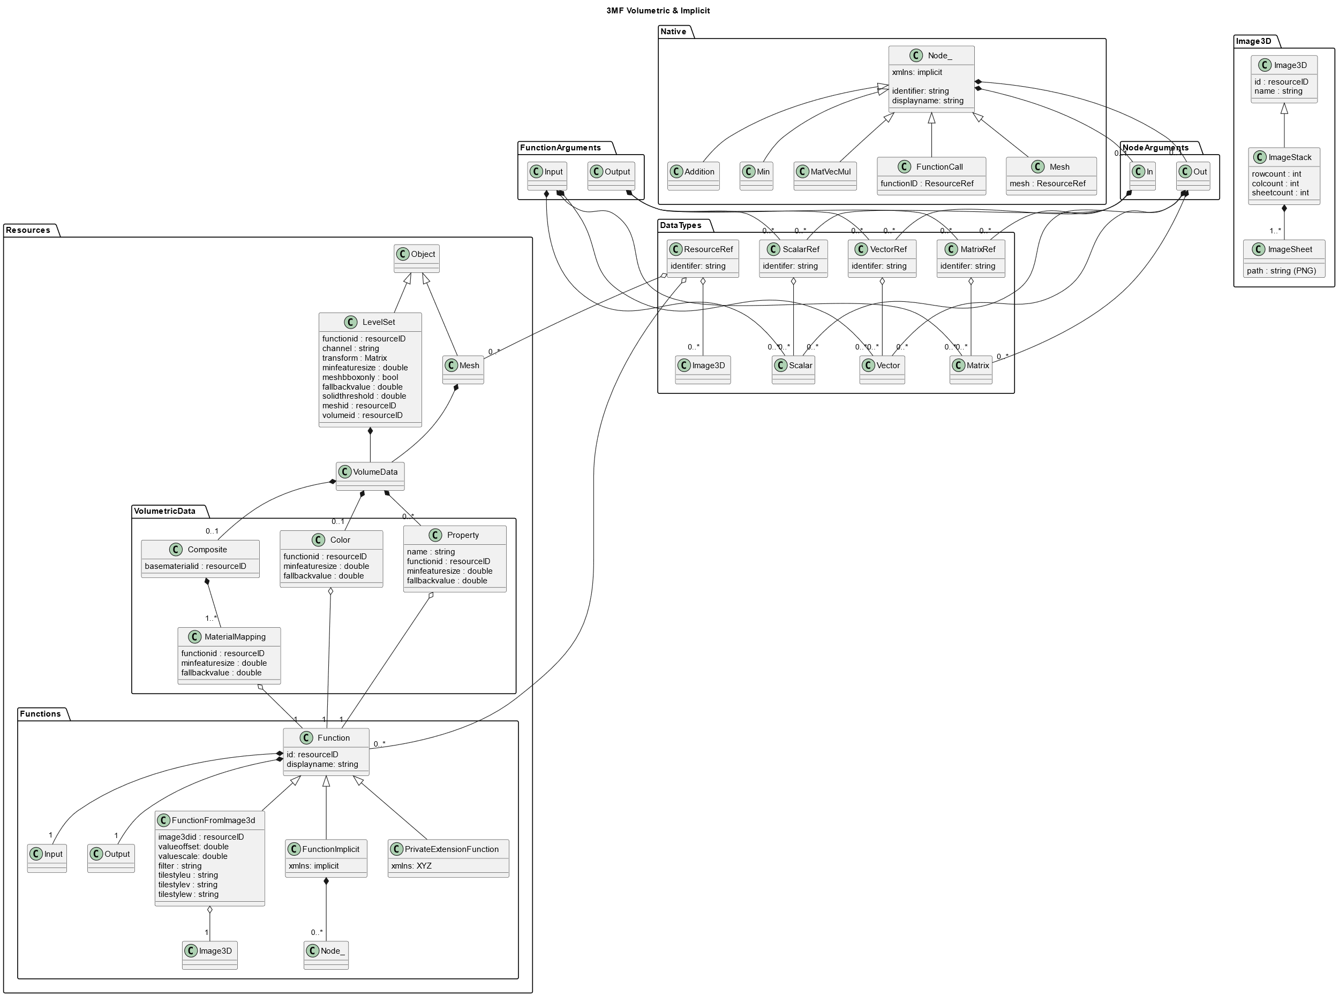
New
Now completely contained in xmls:implicit
xmls:volumetric
xmls:implicit
xmls: privateNamespace

Slide 4

<volumedata> is now a resource that can be referenced by other objects
<volumedata>
<boundary ...
is now a <levelset>-object

Slide 5
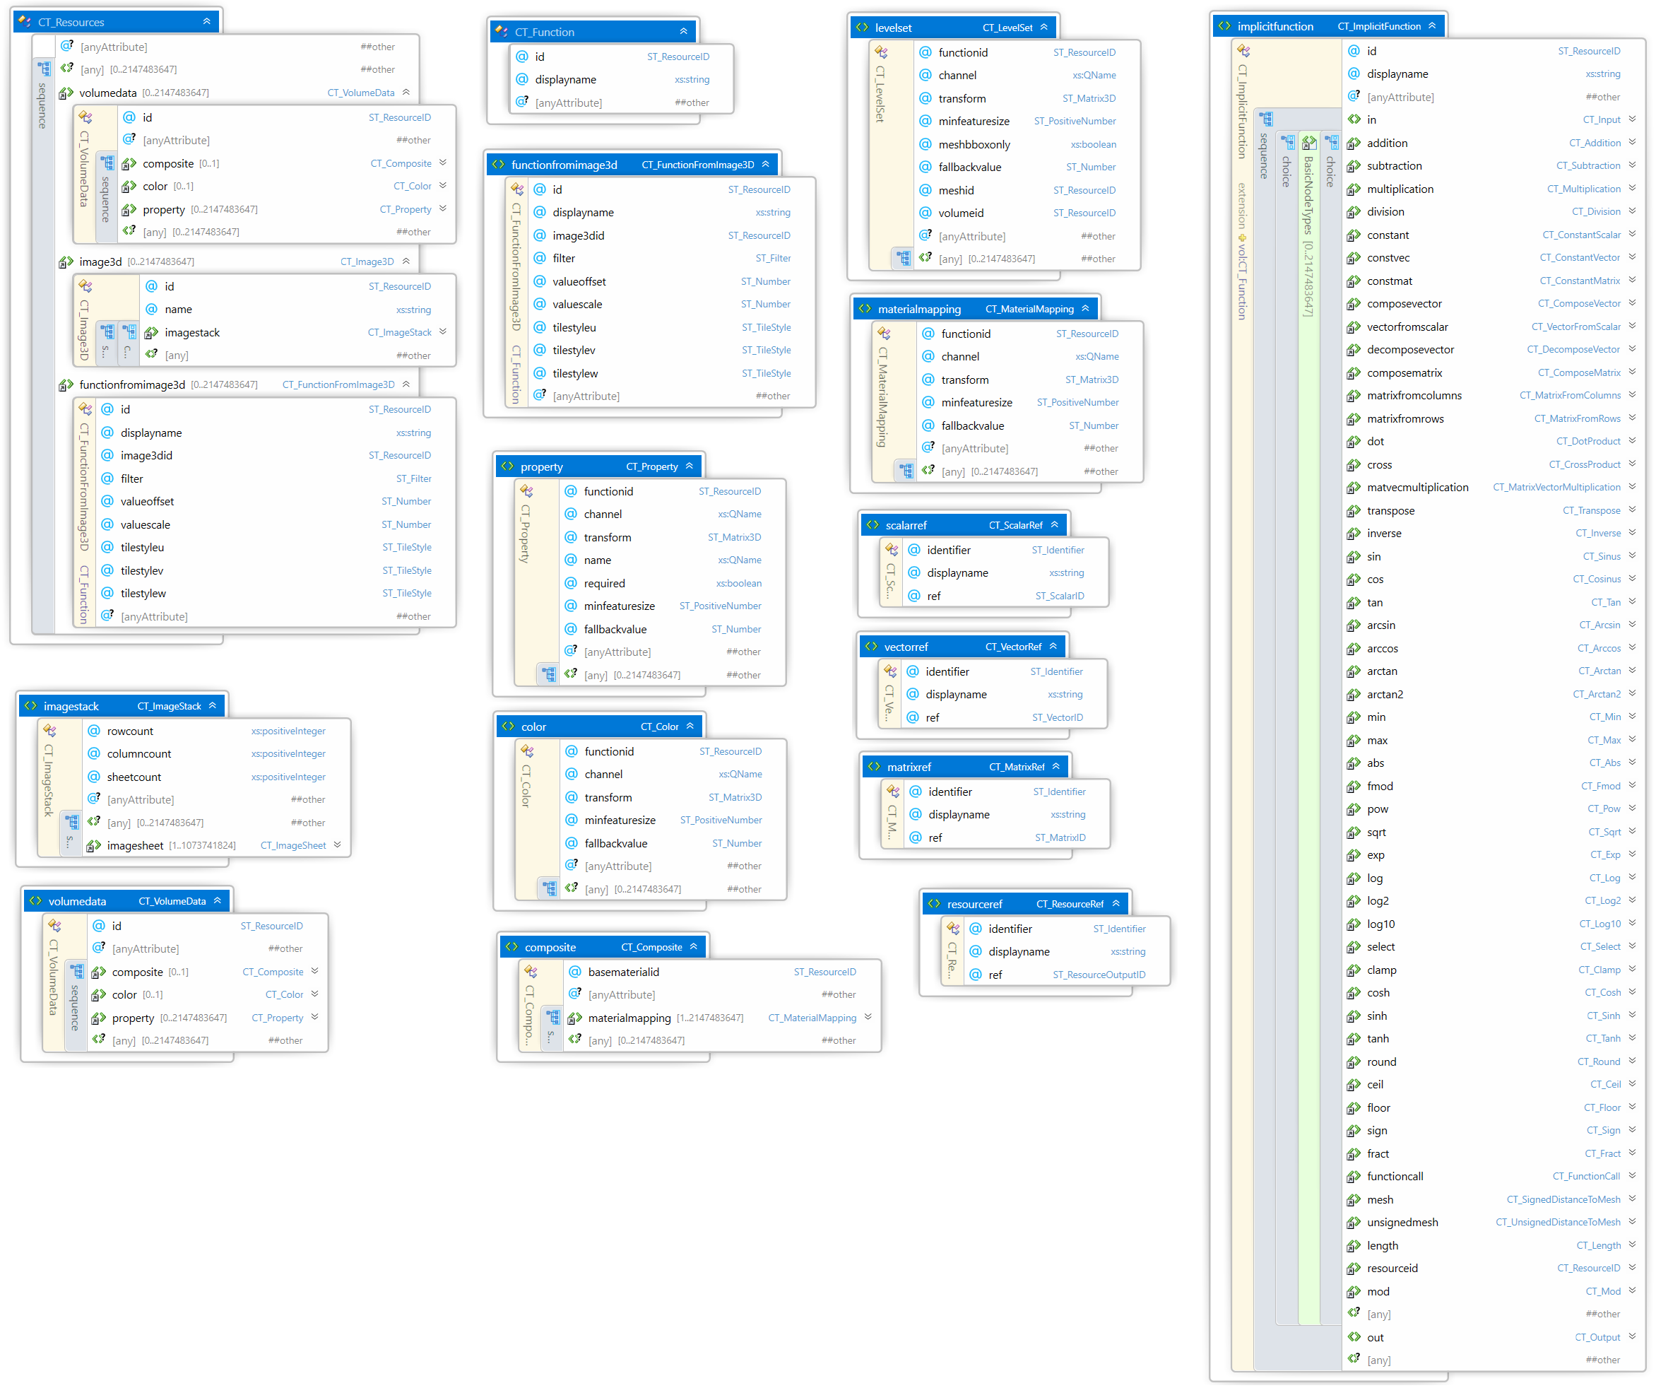

Slide 6
Implicit Spec
Not allowing forward references anymore
Enforcing that graphs are acyclic and directed
Consequence
Function definitions now have a fixed order:
<in> … </in>
Nodes in topological order
<out> … </out>

Slide 7
Implementation in lib3mf
<levelset>-object
<volumedata> as resource
Minor changes to naming and node types
Order of function elements
Order of nodes and resources is a responsibility of the producer

Slide 8
Resources for getting started
Spec: https://github.com/3MFConsortium/spec_volumetric/blob/implicit/3MF%20Volumetric%20Extension.md
Volumetric and Implicit are implemented in the implicit branch of lib3mf:
https://github.com/3MFConsortium/lib3mf/tree/implicit
Example files: https://github.com/3MFConsortium/3mf-samples/tree/implicit/examples/volumetric

Slide 9
How to get an Evaluator
Separate lib that uses lib3mf
Maybe integrated inside lib3mf
Parse Graph
(x,y,z) -> field value
Object tree
Implement functionFromImage3D (Filtering, Tilestyle)
Signed and unsigned Distance to mesh (maybe slow)
Converter from implicit to volumetric (image3d)
Simple Contour Extraction

Slide 10
Next Steps
Freeze Schema
Polish description
Implement reference cpu evaluator
Paraview-AddIn or openvdb export or vtk or binvox or anything loadable by paraview
Provide “Viewer” to QualityLogic
Simple Examples
Release at CDFAM

