Slide 1
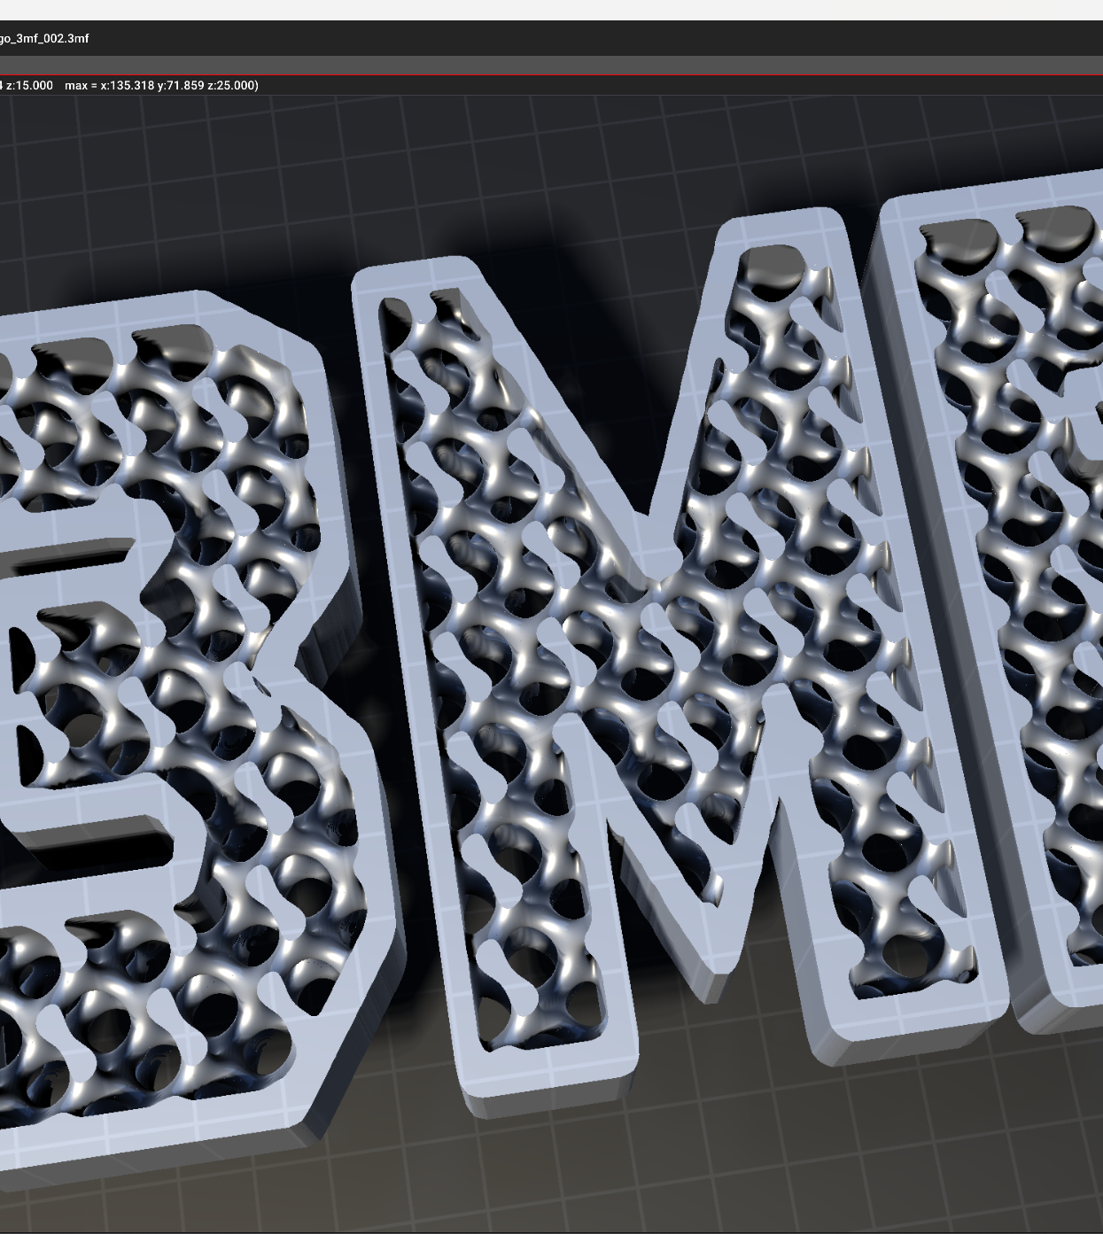

Implicit Modelling in 3MF
2024/06/12
Changes since previous f2f

Slide 2
Outline
Brief description of volumetric spec
Separation in two specs/namespaces
New Object LevelSet
XSD schema
Moving Datatypes to implicit to decrease scope of volumetric
Using <groups> to make it easier to extend the node types in future
Implicit spec
No forward references
Implementation in lib3mf

Slide 3
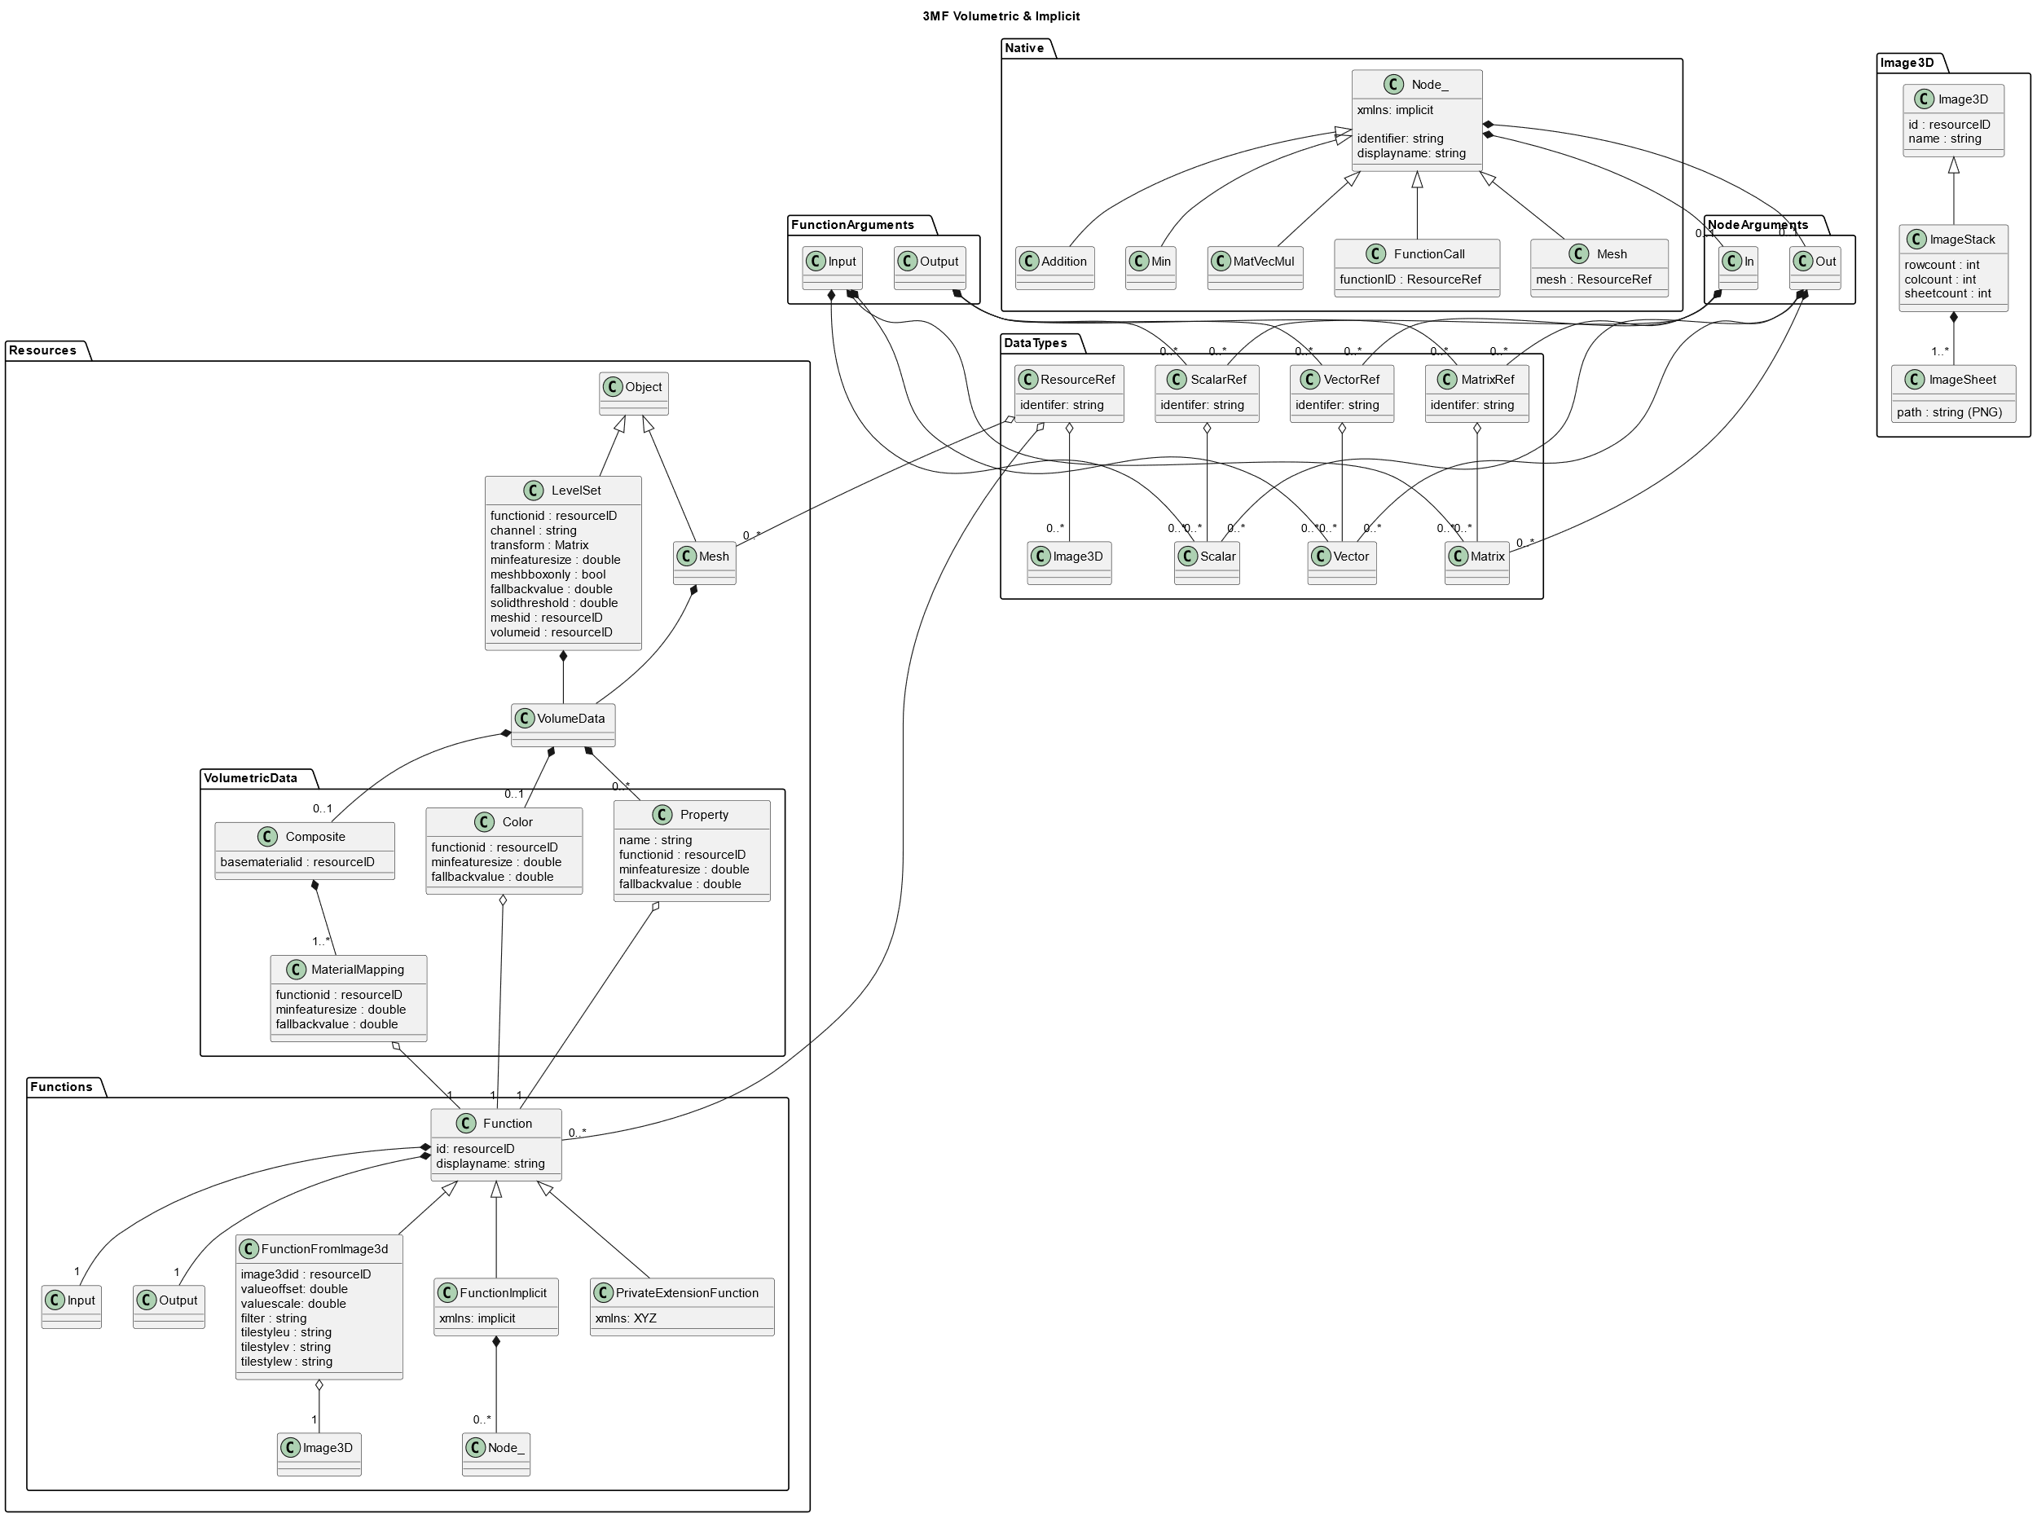
New
Now completely contained in xmls:implicit
xmls:volumetric
xmls:implicit
xmls: privateNamespace

Slide 4

<volumedata> is now a resource that can be referenced by other objects
<volumedata>
<boundary ...
is now a <levelset>-object

Slide 5
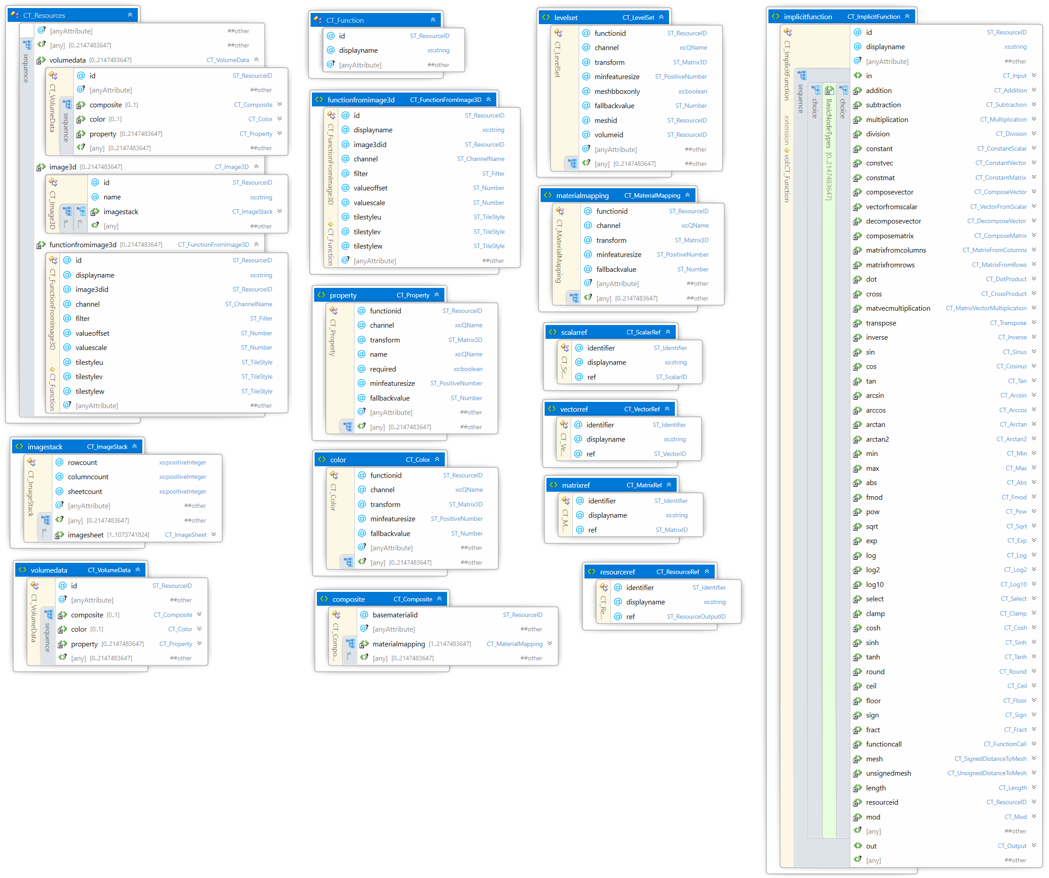

Slide 6
Implicit Spec
Not allowing forward references anymore
Enforcing that graphs are acyclic and directed
Consequence
Function definitions now have a fixed order:
<in> … </in>
Nodes in topological order
<out> … </out>

Slide 7
Implementation in lib3mf
<levelset>-object
<volumedata> as resource
Minor changes to naming and node types
Order of function elements
Order of nodes and resources is a responsibility of the producer

Slide 8
How to get an Evaluator
Separate lib that uses lib3mf
Maybe integrated inside lib3mf
Parse Graph
(x,y,z) -> field value
Object tree
Implement functionFromImage3D (Filtering, Tilestyle)
Signed and unsigned Distance to mesh (maybe slow)
Converter from implicit to volumetric (image3d)
Simple Contour Extraction

Slide 9
Next Steps
Freeze Schema
Polish description
Implement reference cpu evaluator
Paraview-AddIn or openvdb export or vtk or binvox or anything loadable by paraview
Provide “Viewer” to QualityLogic
Simple Examples
Release at CDFAM

