Slide 1
CSE 453 High Performance Database System
Dr. Abu Sayed Md. Latiful Hoque
Professor, CSE, BUET
Contact: mobile 01556346357
email: asmlatifulhoque@cse.buet.ac.bd
Notes:
‹#›

Slide 2
About Course
Course Summary:
Parallel Database Architecture, partitioning, replication, indexing and Query processing
Distributed Database Architecture, Storage and Query processing, transaction management, concurrency control and Design
Query optimization in centralized and distributed database
High performance data models: NoSQL, semi-structured and column-oriented etc.
Big data and Data Analytics: overview, Data warehousing: Storage structure and star schema, design and OLAP

Slide 3
Books
Text books:
Database System Concepts 7th Edition
By
Abraham Silberschatz, ‎ Henry F. Korth,‎ S. Sudarshan,
Reference books:
Fundamentals of Database Systems 7th Edition
By
Ramez Elmasri and Shamkant B. Navathe

Slide 4
Weightage Distribution among Assessment Tools
As per academic council guidelines
Class performance
Assignment on Data Analytics
Assignment on High Performance Data Models
Class Tests
Final Examination

Slide 5
Tentative Mode of Online Class
Lecture will be interactive using ppt slides.
After a few slides, there shall be some analytical questions to answer or some problems to solve.
Each student must write the answer in A4 size white paper with black ball point pen clearly and chronologically.
The answer of the questions or the solution of the problems will be discussed and guided so that the students can write answer/solve the question/problem.
At the end of the class, students will be given some time to upload the scanned/image of the sheets as per moodle requirements.
These uploads will be considered as class performance.
Ch.1/‹#›

Slide 6
Basic towards High Performance DBMS
What you have leant in Basic DBMS?
Data model - Relational model
Query Languages
Relational Algebra
Relational Calculus
SQL
Database Design (ERD)
Refinement of Database Design (Normalization)

Slide 7
Basic towards High Performance DBMS
What you have learnt in Basic DBMS?
Database Storage Management -> High Performance
Indexing -> High Performance
Query Processing and Optimization -> High Performance
Transaction management -> High Performance
Concurrency Control of Transactions -> High Performance
Distributed Database
-> High Performance Data Models

Slide 8
Classification of Physical Storage Media
Can differentiate storage into:
volatile storage: loses contents when power is switched off
non-volatile storage:
Contents persist even when power is switched off.
Includes secondary and tertiary storage, as well as batter-backed up main-memory.
Factors affecting choice of storage media include
Speed with which data can be accessed
Cost per unit of data
Reliability
Notes:
‹#›

Slide 9
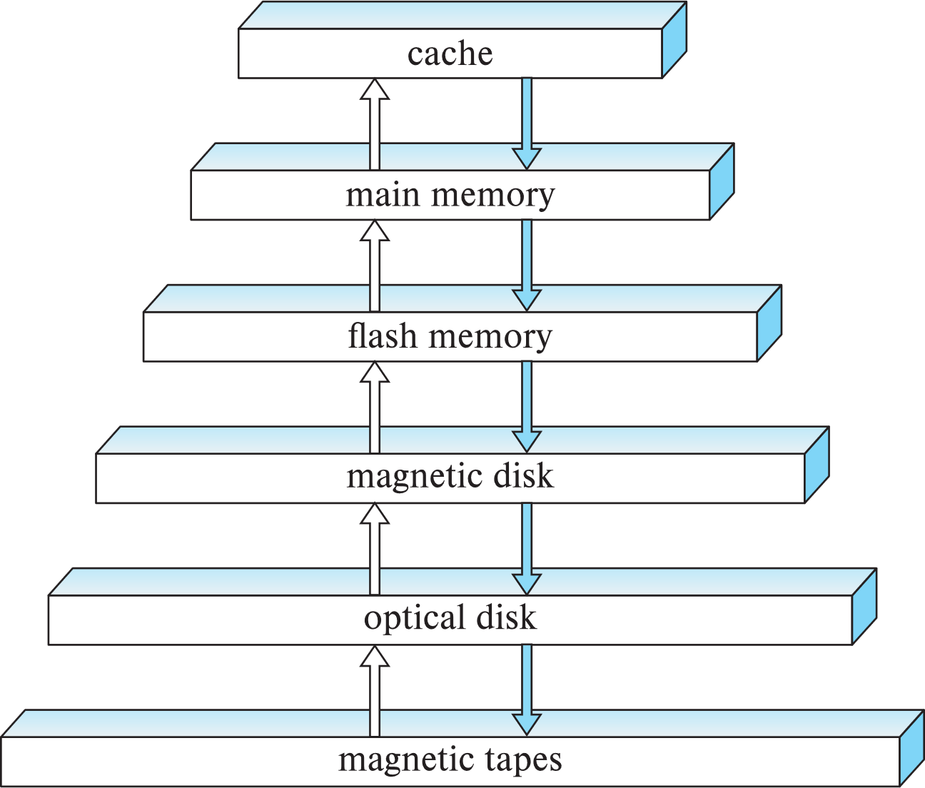
Storage Hierarchy
primary storage: Fastest media but volatile (cache, main memory).
secondary storage: next level in hierarchy, non-volatile, moderately fast access time
Also called on-line storage
E.g., flash memory, magnetic disks
tertiary storage: lowest level in hierarchy, non-volatile, slow access time
also called off-line storage and used for archival storage
e.g., magnetic tape, optical storage
Notes:
‹#›

Slide 10
DBMS System Architecture
DBMS
Main Memory
Main Memory DBMS
Disk-Based DBMS
Database
Operating System
Question 1-1: Explain the implications of storage to MMDBMS and Disk-based DBMS

Slide 11
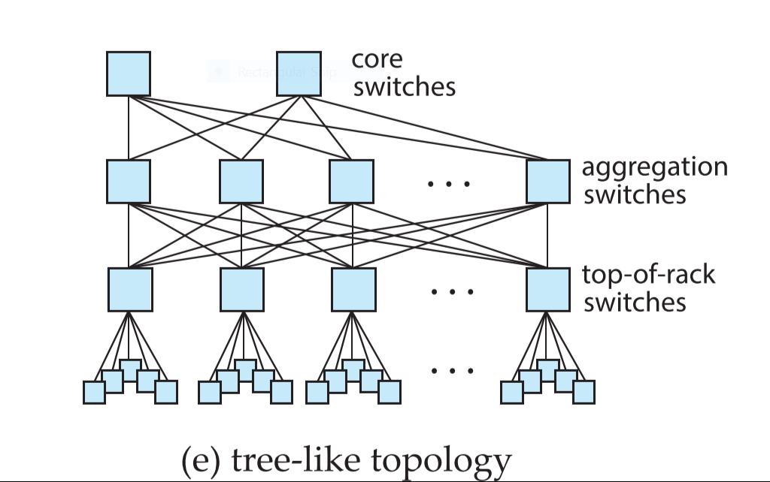
Parallel Database System Architecture (Data Center Server System)
Tree-like or Fat-Tree Topology:
widely used in data centers today
DC are typically mounted in racks
Each rack has approx. 40 nodes
Top of rack switch for approx 40 machines in rack
Each top of rack switch connected to multiple aggregation switches.
Aggregation switches connect to multiple core switches.
Notes:
‹#›

Slide 12
Parallel Systems
Parallel database systems consist of multiple processors and multiple disks connected by a fast interconnection network.
Motivation: handle workloads beyond what a single computer system can handle
High performance transaction processing
E.g. handling user requests at web-scale
Decision support on very large amounts of data
E.g. data gathered by large web sites/apps
Notes:
‹#›

Slide 13
Parallel Systems (Cont.)
A coarse-grain parallel machine consists of a small number of powerful processors
A massively parallel or fine grain parallel machine utilizes thousands of smaller processors.
Typically hosted in a data center
Two main performance measures:
throughput --- the number of tasks that can be completed in a given time interval
response time --- the amount of time it takes to complete a single task from the time it is submitted
Notes:
‹#›

Slide 14
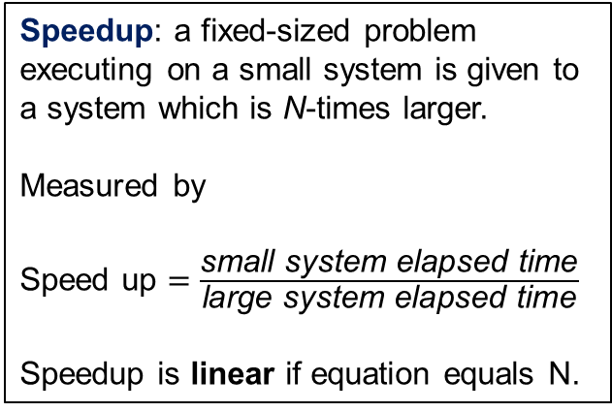
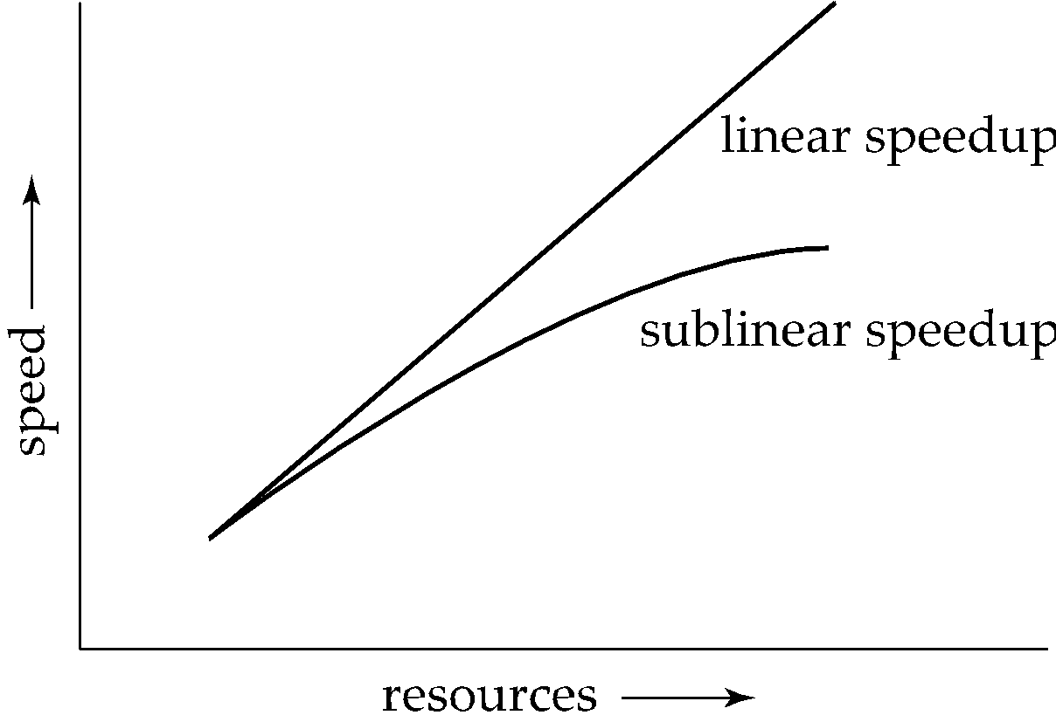
Speed-Up
3,3
2,2
Example: A server system has 1 node (small system) and elapsed to solve problem P is 10ms.
1,1
The number of node has been increased to 2. The time is 5ms. Speed up = 10 /5 = 2
The number of node has been increased to 3. The time is 3.333ms. Speed up = 10/3.33 = 3
Linear Speed up 1, 2, 3 …
Notes:
‹#›

Slide 15
Speed-Up
3,2.5
2,1.8
Example: A server system has 1 node (small system) and elapsed to solve problem P is 10ms.
1,1
The number of node has been increased to 2. The time is 5.55ms. Speed up = 10 / 5.55 = 1.8
The number of node has been increased to 3. The time is 4ms. Speed up = 10/4 = 2.5
SubLinear Speed up 1, 2, 3 …
Notes:
‹#›

Slide 16
Speed-Up
Question 2-1: A server system has 1 node (small system) and elapsed to solve problem P is 10ms.
The number of node has been increased to 2. The time to solve P is 5ms
The number of node has been increased to 3. The time to solve P is 4ms
The number of node has been increased to 4. The time to solve P is 3ms
Find the type of speedup graph for the above system and explain.
Notes:
‹#›

Slide 17
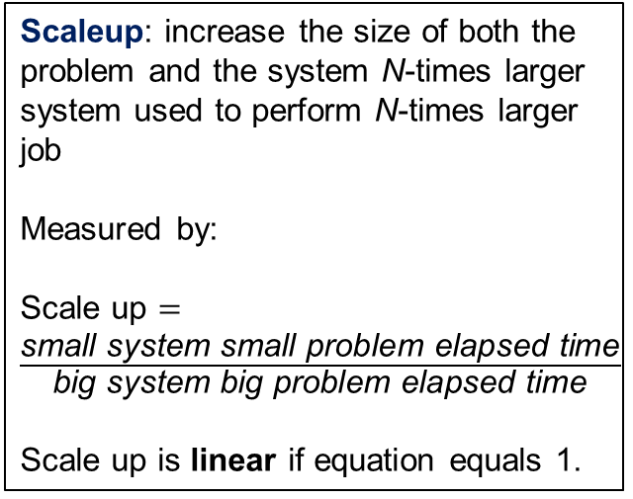
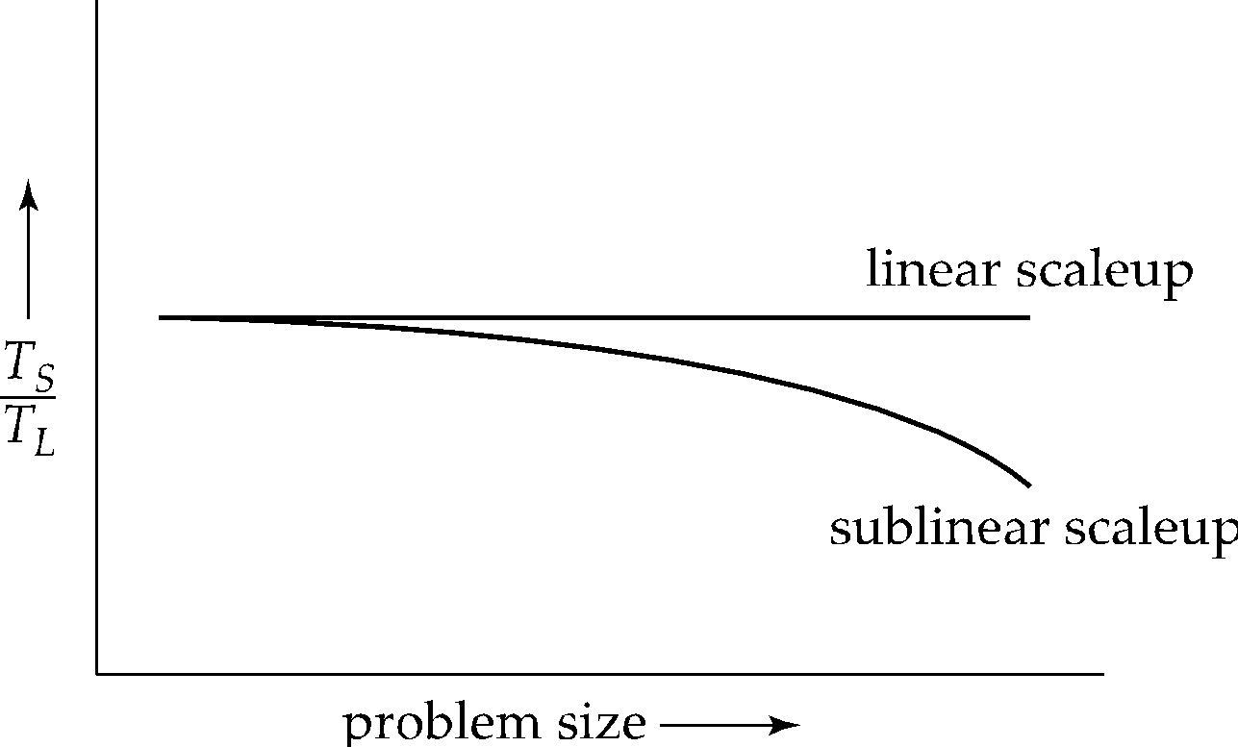
Scale-Up
P,1
2P,1
3P,1
p
2p
3p
Example: A server system has 1 node (small system) and elapsed to solve problem P is 10ms.
The number of node has been increased to 2. The size of the problem = 2p, elapsed time = 10ms, Scale up = 10/10 = 1
The number of node has been increased to 3. The size of the problem = 3p, elapsed time = 10ms, Scale up = 10/10 = 1
Linear Scale up
Notes:
‹#›

Slide 18
Scale-Up
P,1
2P,.8
3P,.7
p
2p
3p
Example: A server system has 1 node (small system) and elapsed to solve problem P is 10ms.
The number of node has been increased to 2.
The size of the problem = 2p, elapsed time = 12ms, Scale up = 10/12 = 0.8
2. The number of node has been increased to 3.
The size of the problem = 3p, elapsed time = 14 ms, Scale up = 10/14 = 0.7
SubLinear Scale up
Notes:
‹#›

Slide 19
Scale-Up
Question 2-2: A server system has 1 node (small system) and elapsed to solve problem P is 10ms.
The number of node has been increased to 4.The size of the problem = 4p, elapsed time is 40ms
The number of node has been increased to 8.The size of the problem = 8p, elapsed time is 80ms
Find type of scale up graph for the above system and explain
Notes:
‹#›

Slide 20
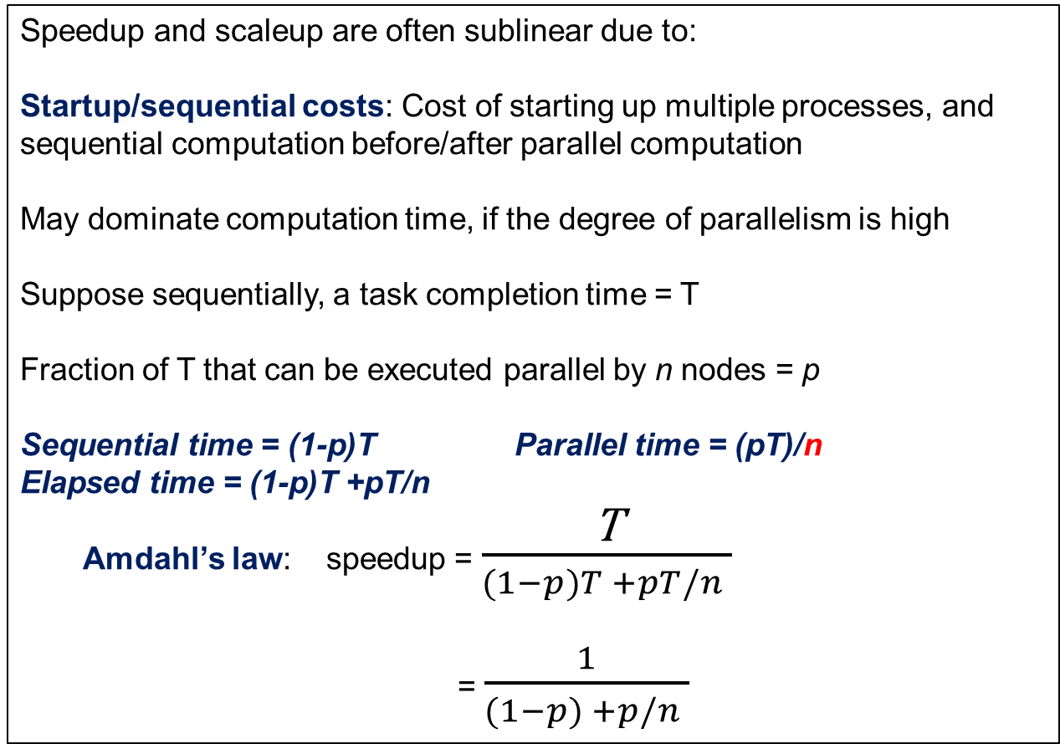
Factors Limiting Speedup and Scaleup
Notes:
‹#›

Slide 21
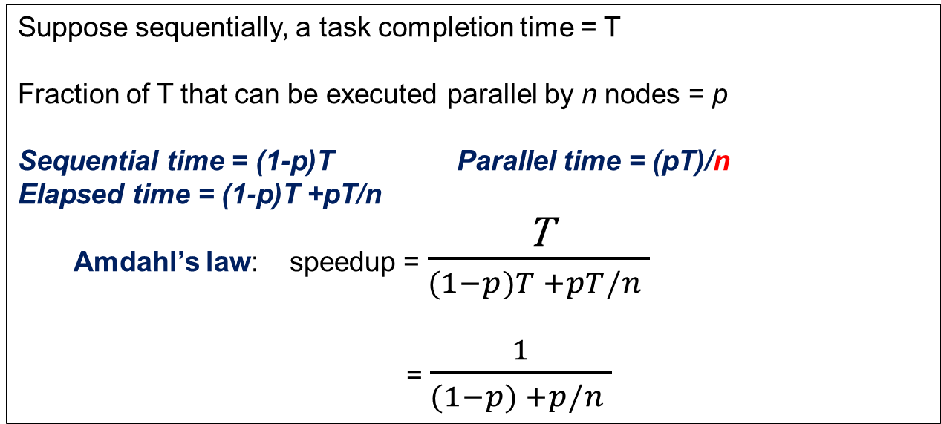
Factors Limiting Speedup and Scaleup
Question 2-3: Explain speedup as per Amdahl’s law for the following cases:
Case 1: Full fraction of T can be executed in parallel (p =1)
Case 2: No fraction of T can be executed in parallel (p =0)
Case 3: A fraction of T can be executed in parallel (0 < p <1)
Notes:
‹#›

Slide 22
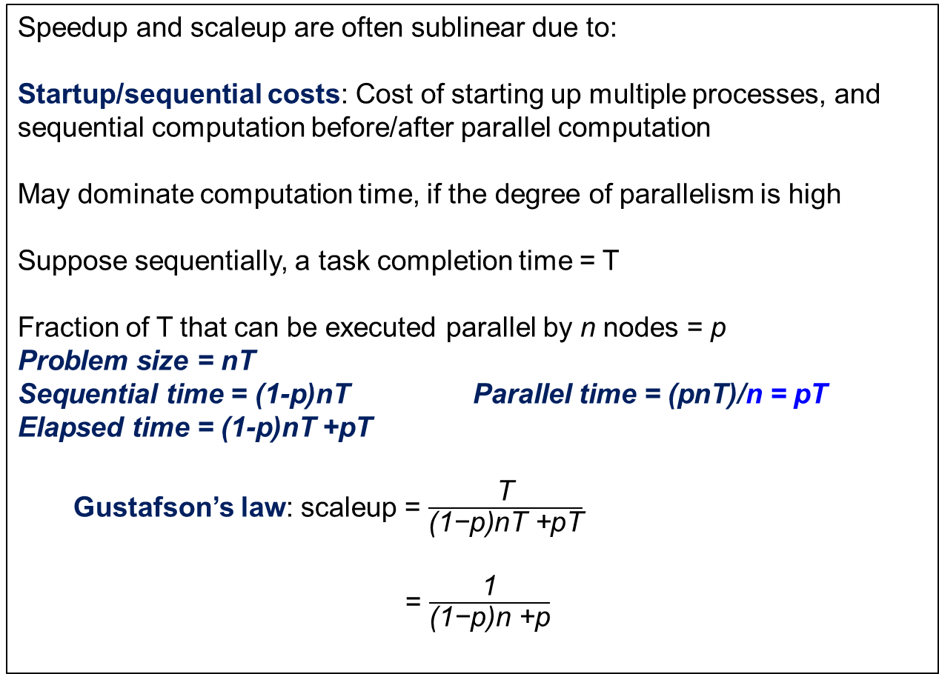
Factors Limiting Speedup and Scaleup
Notes:
‹#›

Slide 23
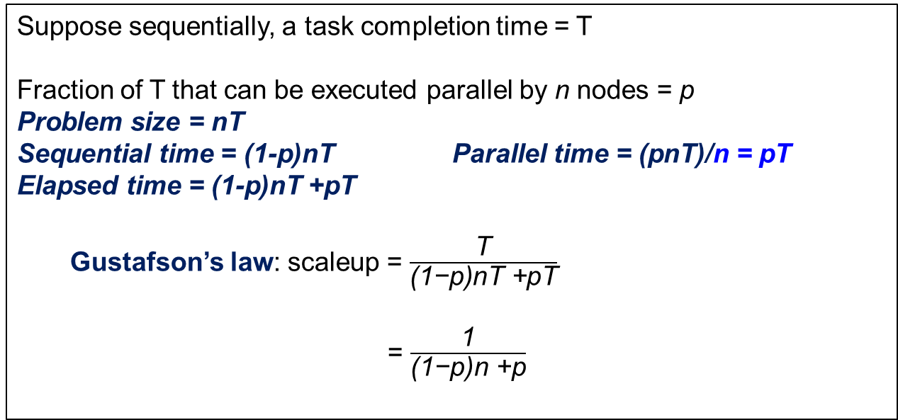
Factors Limiting Speedup and Scaleup
Question 2-2: Explain scaleup as per Gustafson’s law for the following cases:
Case 1: Full fraction of T can be executed in parallel (p =1)
Case 2: No fraction of T can be executed in parallel (p =0)
Notes:
‹#›

Slide 24
Factors Limiting Speedup and Scaleup
Speedup and scaleup are often sublinear due to:
Interference: Processes accessing shared resources (e.g.,system bus, disks, or locks) compete with each other, thus spending time waiting on other processes, rather than performing useful work.
Skew: Increasing the degree of parallelism increases the variance in service times of parallely executing tasks. Overall execution time determined by slowest of parallely executing tasks.
Notes:
‹#›

Slide 25
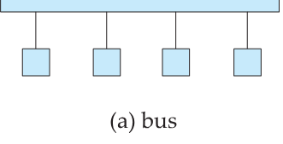
Interconnection Network Architectures
Bus. System components send data on and receive data from a single communication bus;
Does not scale well with increasing parallelism.
Notes:
‹#›

Slide 26
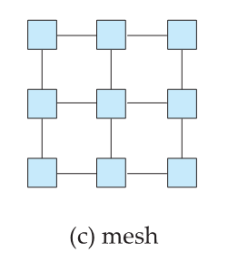
Interconnection Network Architectures
Mesh. Components are arranged as nodes in a grid, and each component is connected to all adjacent components
Communication links grow with growing number of components, and so scales better.
But may require 2(√n-1) hops to send message to a node
Notes:
‹#›

Slide 27
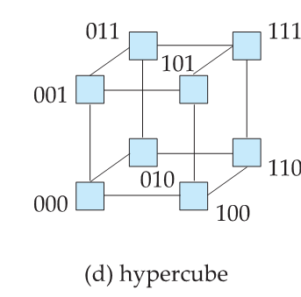
Interconnection Network Architectures
Hypercube. Components are numbered in binary; components are connected to one another if their binary representations differ in exactly one bit.
Each of n components are connected to log(n) other components and can reach each other via at most log(n) links; reduces communication delays.
Notes:
‹#›

Slide 28
Interconnection Network Architectures (Data Center Server System)
Tree-like or Fat-Tree Topology:
widely used in data centers today
DC are typically mounted in racks
Each rack has approx. 40 nodes
Top of rack switch for approx 40 machines in rack
Each top of rack switch connected to multiple aggregation switches.
Aggregation switches connect to multiple core switches.
Question 3-1: Discuss comparative advantages and Disadvantages of BUS, Mesh, Hypercube and Tree topology.
Notes:
‹#›

Slide 29
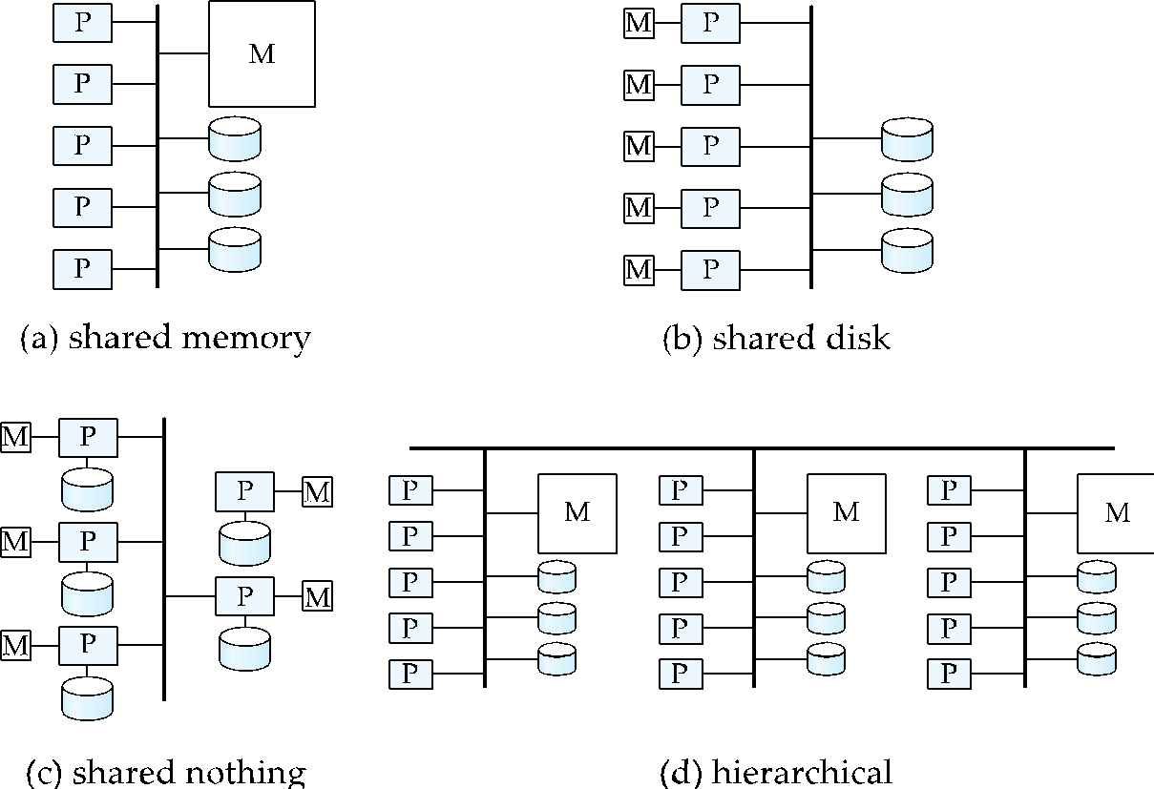
Parallel Database Architectures
Notes:
‹#›

Slide 30
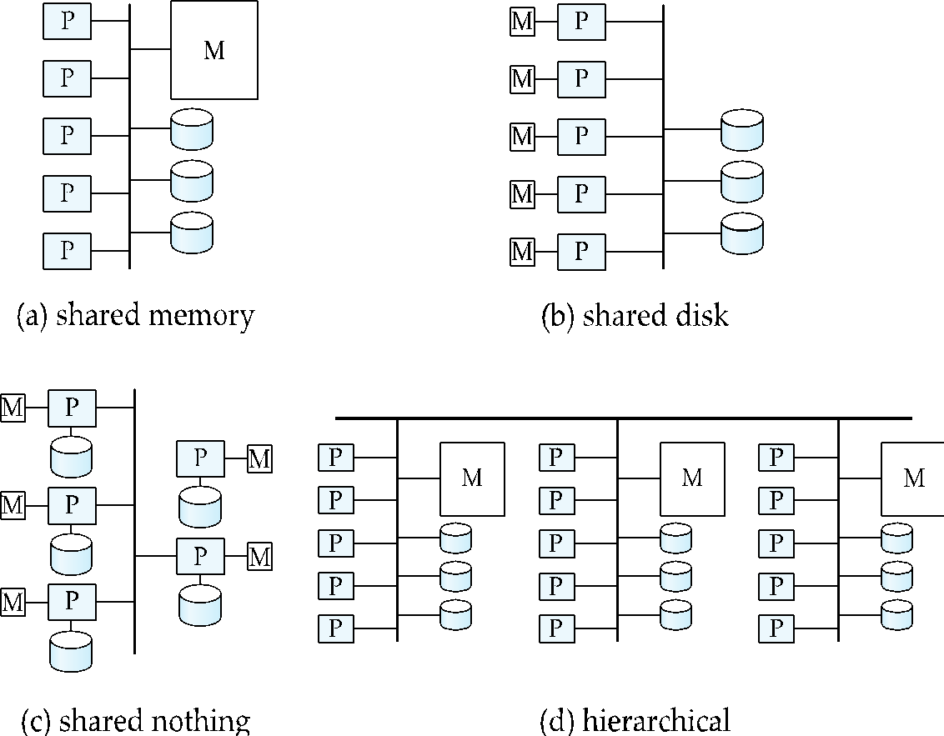
Shared Memory
Processors (or processor cores) and disks have access to a common memory
Via a bus in earlier days, through an interconnection network today
Extremely efficient communication between processors
Downside: shared-memory architecture is not scalable beyond 64 to 128 processor cores
Memory interconnection network becomes a bottleneck
Notes:
‹#›

Slide 31

Shared Disk
All processors can directly access all disks via an interconnection network, but the processors have private memories.
Architecture provides a degree of fault-tolerance — if a processor fails, the other processors can take over its tasks
the data of the failed processor is resident on disks that are accessible from all processors.
Downside: bottleneck now occurs at interconnection to the disk subsystem.
Notes:
‹#›

Slide 32
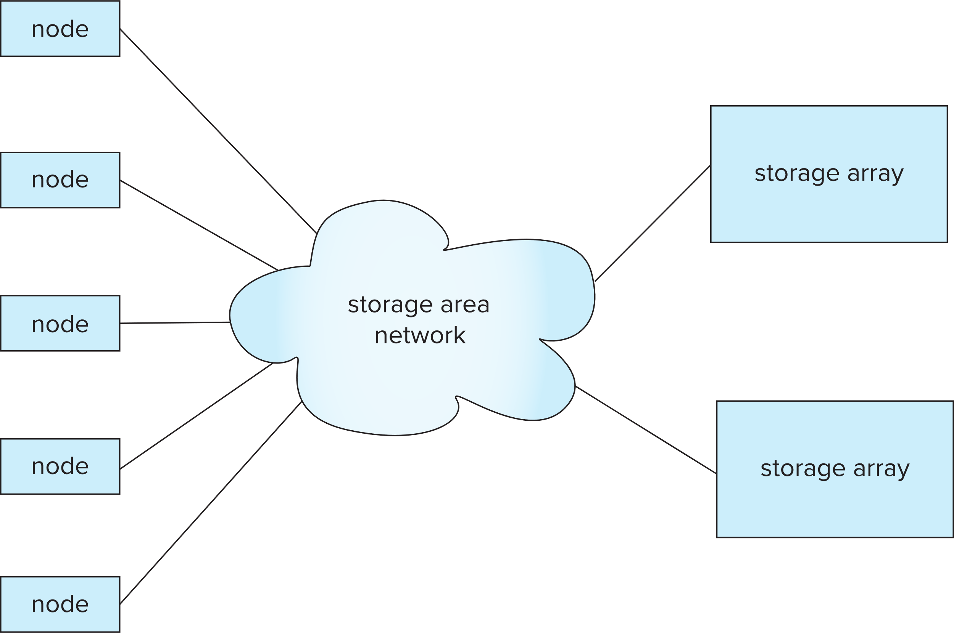
Modern Shared Disk Architectures: via Storage Area Network (SAN)

Slide 33
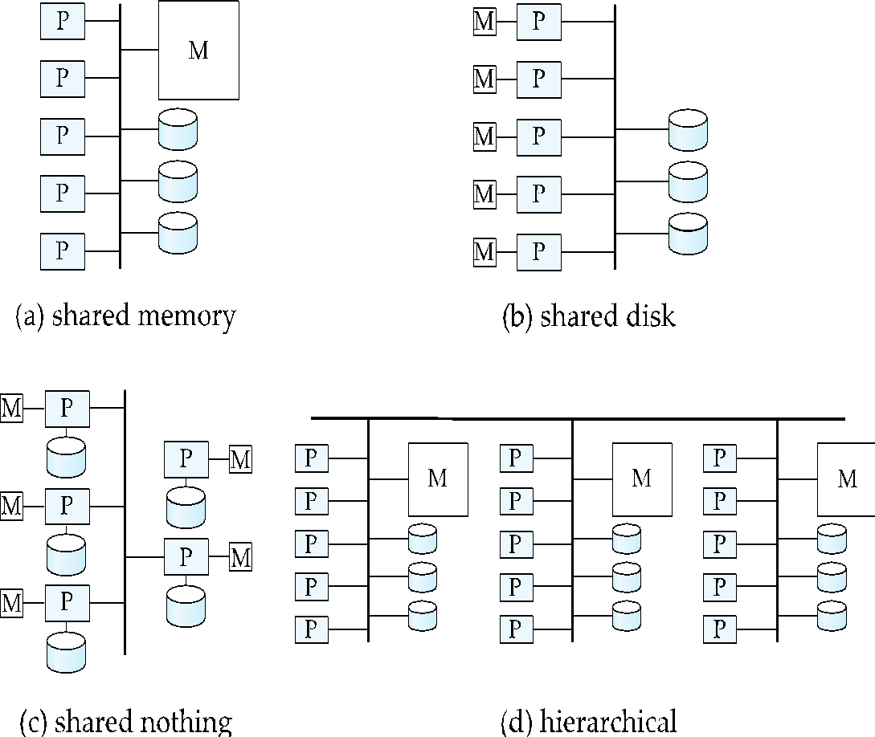
Shared Nothing
Node consists of a processor, memory, and one or more disks
All communication via interconnection network
Can be scaled up to thousands of processors without interference.
Main drawback: cost of communication and non-local disk access; sending data involves software interaction at both ends.
Notes:
‹#›

Slide 34
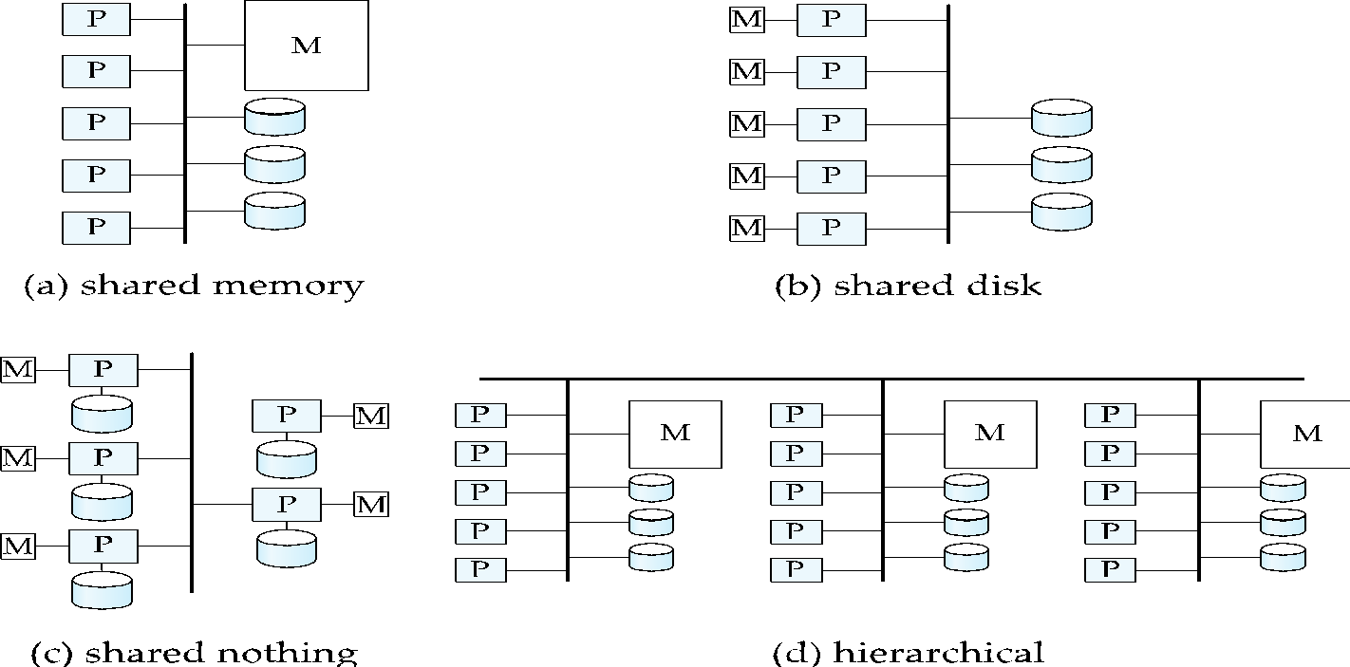
Hierarchical
Combines characteristics of shared-memory, shared-disk, and shared-nothing architectures.
Top level is a shared-nothing architecture
With each node of the system being a shared-memory system
Alternatively, top level could be a shared-disk system
With each node of the system being a shared-memory system
Question 3-2: Show the hierarchical architecture with top level be a shared-disk system and each node of the system being a shared-memory system.
Notes:
‹#›

Slide 35
Shared-Memory Vs Shared-Nothing
Shared-memory internally looks like shared-nothing!
Each processor has direct access to its own memory, and indirect (hardware level) access to rest of memory
Also called non-uniform memory architecture (NUMA)
Shared-nothing can be made to look like shared memory
Reduce the complexity of programming such systems by distributed virtual-memory abstraction
Remote Direct Memory Access (RDMA) provides very low-latency shared memory abstraction on shared-nothing systems
Often implemented on top of infiniband due it its very-low-latency
But careless programming can lead to performance issues

