Slide 1
Parallel and Distributed Storage

Slide 2
Introduction
Parallel machines have become quite common and affordable
prices of microprocessors, memory and disks have dropped sharply
Data storage needs are growing increasingly large
user data at web-scale
100’s of millions of users, petabytes of data
transaction data are collected and stored for analysis.
multimedia objects like images/videos
Parallel storage system requirements
storing large volumes of data
processing time-consuming decision-support queries
providing high throughput for transaction processing
Very high demands on scalability and availability

Slide 3
Parallel/Distributed Data Storage History
1980/1990s
Distributed database systems with tens of nodes
2000s:
Distributed file systems with 1000s of nodes
Millions of Large objects (100’s of megabytes)
Web logs, images, videos, …
Typically create/append only
Distributed data storage systems with 1000s of nodes
Billions to trillions of smaller (kilobyte to megabyte) objects
Social media posts, email, online purchases, …
Inserts, updates, deletes
Key-value stores
2010s: Distributed database systems with 1000s of nodes

Slide 4
I/O Parallelism
Reduce the time required to retrieve relations from disk by partitioning the relations on multiple disks, on multiple nodes (computers)
Our description focuses on parallelism across nodes
Same techniques can be used across disks on a node
Horizontal partitioning – tuples of a relation are divided among many nodes such that some subset of tuple resides on each node.
Contrast with vertical partitioning, e.g. r(A,B,C,D) with primary key A into r1(A,B) and r2(A,C,D)
By default, the word partitioning refers to horizontal partitioning

Slide 5
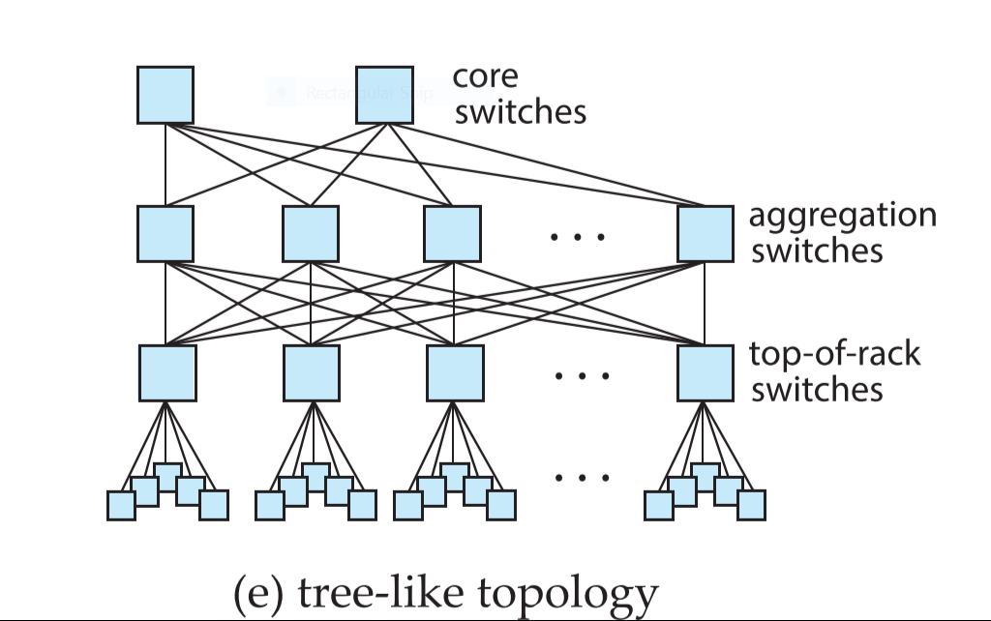
I/O Parallelism
Partitioning techniques (number of nodes = n):
Round-robin:
Send the i^{th} tuple inserted in the relation to node i mod n.
In a data center,
Nodes N0…N19 in Rack 1
Nodes N20…N39 in Rack 2
Total nodes N = 40
NID-Person relation has tuples
T0, T1, T2, T3 ………T39999
Question 4-1: Explain how tuples will be distributed into the nodes using round-robin technique.

Slide 6
Partitioning techniques (number of nodes = n):
Hash partitioning:
Choose one or more attributes as the partitioning attributes.
Choose hash function h with range 0…n - 1
Let i denote result of hash function h applied to the partitioning attribute value of a tuple. Send tuple to node i.
In a data center,
Nodes N0…N19 in Rack 1
Nodes N20…N39 in Rack 2
Total nodes N = 40
NID-Person(NID, name, DOB, street, city, district)
The tuples are:
T0, T1, T2, T3 ………T39999
Question 4-2: Explain how tuples will be distributed into the nodes using hash partitioning technique using
NID
Street, city, district.

Slide 7
Range Partitioning
Data Partitioning among Nodes
Range partitioning technique:
Choose an attribute as the partitioning attribute.
A partitioning vector [v_{o}, v₁, ..., v_{n-2}] is chosen.
Let v be the partitioning attribute value of a tuple.
Tuples such that v_{i} ≤ v < v_{i+1} go to node i+ 1.
Tuples with v < v₀ go to node 0 and tuples with v ≥ v_{n-2} go to node n-1.
E.g., with a partitioning vector [5,11]
a tuple with partitioning attribute value of 2 will go to node 0,
a tuple with value 8 will go to node 1, while
a tuple with value 20 will go to node2.
In a data center,
Nodes N0…N9 in Rack 1
Nodes N20…N19 in Rack 2
Total nodes N = 20
Student(Id, name, DOB, street, city, district)
The tuples are:
T0, T1, T2, T3 ………T399
Id ranges from 202105001 to 202105400
Question 4-3
Design a partition vector on Id for storage of student relation
Find partitions P0, P1, P19

Slide 8
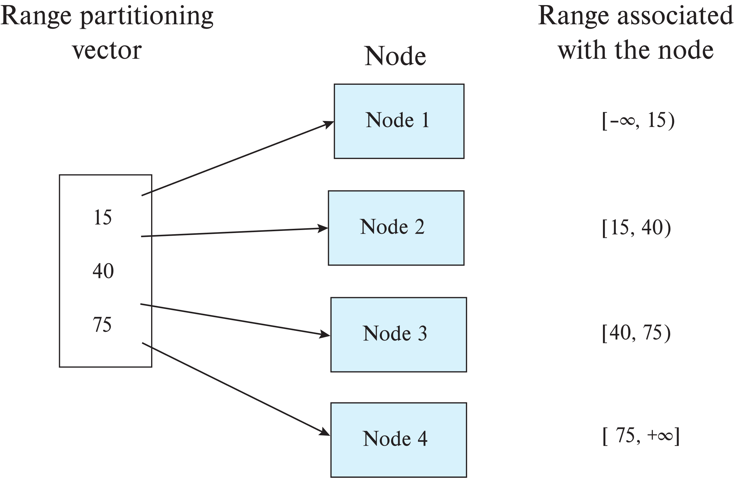
Range Partitioning
Data Partitioning among Nodes
Example: There are 4 nodes: N1, N2, N3 and N4 in a parallel database system. The schema of the relation person is as follows:
Person(NID, Name, Thana, District, Age)
Partition vector
P[f-age] = [30, 50, 75]
Perform range partitioning of person relation into 4 nodes.
Partitions:
Partition 1, age <30 in Node N1
Partition 2, 30<=age <50 in Node N2
Partition 3, 50<=age <75 in Node N3
Partition 4, age >=75 in Node N4

Slide 9
Range Partitioning
Data Partitioning among Nodes
Example: There are 4 nodes: N1, N2, N3 and N4 in a parallel database system. The schema of the relation parents is as follows:
parents(m-NID, f-NID, c-NID, f-age)
Partition vector
P[f-age] = [30, 50, 75]
Perform range partitioning of parents relation into 4 nodes.
Partitions:
Partition 1, f-age <30 in Node N1
Partition 2, 30<=f-age <50 in Node N2
Partition 3, 50<=f-age <75 in Node N3
Partition 4, f-age >=75 in Node N4

Slide 10
Data Partitioning among Nodes
Partitions:
Person relation
Partition 1, age <30 in Node N1
Partition 2, 30<=age <50 in Node N2
Partition 3, 50<=age <75 in Node N3
Partition 4, age >=75 in Node N4
Partitions:
Parents relation
Partition 1, f-age <30 in Node N1
Partition 2, 30<=f-age <50 in Node N2
Partition 3, 50<=f-age <75 in Node N3
Partition 4, f-age >=75 in Node N4
Person(NID, Name, Thana, District, Age), parents(m-NID, f-NID, c-NID, f-age)
process the query1: SELECT * FROM person r, parents s WHERE r.age = s.f-age
Question 4-4:
Explain how query 1 will be executed using 4 nodes?
Comments on speed-up and scale-up for the system.

Slide 11
Comparison of Partitioning Techniques
Evaluate how well partitioning techniques support the following types of data access:
1. Scanning the entire relation.
2. Locating a tuple associatively – point queries.
E.g., r.A = 25.
3. Locating all tuples such that the value of a given attribute
lies within a specified range – range queries.
E.g., 10 ≤ r.A < 25.
Select * from person
Select * from person where NID = 1234567890
Select * from person where NID > 1234567890
Question5-1: Explain the performance of Round robin partitioning technique for
Scanning the entire relation
Point query
Range query

Slide 12
Comparison of Partitioning Techniques (Cont.)
Round robin:
Best suited for sequential scan of entire relation on each query.
All nodes have almost an equal number of tuples; retrieval work is thus well balanced between nodes.
All queries must be processed at all nodes

Slide 13
Comparison of Partitioning Techniques
Evaluate how well partitioning techniques support the following types of data access:
1. Scanning the entire relation.
2. Locating a tuple associatively – point queries.
E.g., r.A = 25.
3. Locating all tuples such that the value of a given attribute
lies within a specified range – range queries.
E.g., 10 ≤ r.A < 25.
Select * from person
Select * from person where NID = 1234567890
Select * from person where NID > 1234567890
Question5-2: Explain the performance of hash partitioning technique for
Scanning the entire relation
Point query
Range query

Slide 14
Comparison of Partitioning Techniques (Cont.)
Hash partitioning:
Good for sequential access
Assuming hash function is good, and partitioning attributes form a key, tuples will be equally distributed between nodes
Good for point queries on partitioning attribute
Can lookup single node, leaving others available for answering other queries.
Range queries inefficient, must be processed at all nodes

Slide 15
Comparison of Partitioning Techniques
Evaluate how well partitioning techniques support the following types of data access:
1. Scanning the entire relation.
2. Locating a tuple associatively – point queries.
E.g., r.A = 25.
3. Locating all tuples such that the value of a given attribute
lies within a specified range – range queries.
E.g., 10 ≤ r.A < 25.
Select * from person
Select * from person where NID = 1234567890
Select * from person where NID > 1234567890
Question5-3: Explain the performance of range partitioning technique for
Scanning the entire relation
Point query
Range query

Slide 16
Comparison of Partitioning Techniques (Cont.)
Range partitioning:
Provides data clustering by partitioning attribute value.
Good for sequential access
Good for point queries on partitioning attribute: only one node needs to be accessed.
For range queries on partitioning attribute, one to a few nodes may need to be accessed
Remaining nodes are available for other queries.
Good if result tuples are from one to a few blocks.
But if many blocks are to be fetched, they are still fetched from one to a few nodes, and potential parallelism in disk access is wasted
Example of execution skew.

Slide 17
Handling Small Relations
Partitioning not useful for small relations which fit into a single disk block or a small number of disk blocks
Instead, assign the relation to a single node, or
Replicate relation at all nodes
For medium sized relations, choose how many nodes to partition across based on size of relation
Large relations typically partitioned across all available nodes.

Slide 18
Types of Skew
Data-distribution skew: some nodes have many tuples, while others may have fewer tuples. Could occur due to
Attribute-value skew.
Some partitioning-attribute values appear in many tuples
E.g., partitioning on age in ecommerce database
Game related DB, P[age] = [10, 20, 30, 40, 50, 60, 70]
Comments on the partition vector???
All the tuples with the same value for the partitioning attribute end up in the same partition.
Can occur with range-partitioning and hash-partitioning.

Slide 19
Types of Skew
Partition skew.
Imbalance, even without attribute –value skew
Badly chosen range-partition vector may assign too many tuples to some partitions and too few to others.
Less likely with hash-partitioning

Slide 20
Types of Skew (Cont.)
Note that execution skew can occur even without data distribution skew
E.g. relation range-partitioned on date, and most queries access tuples with recent dates
Data-distribution skew can be avoided with range-partitioning by creating balanced range-partitioning vectors
We assume for now that partitioning is static, that is partitioning vector is created once and not changed
Any change requires repartitioning
Dynamic partitioning once allows partition vector to be changed in a continuous manner
More on this later
Question 6-1: Explain the various reasons and types of skews in
Hash partitioning
Range partitioning

Slide 21
Handling Skew in Range-Partitioning
To create a balanced partitioning vector
Sort the relation on the partitioning attribute.
Construct the partition vector by scanning the relation in sorted order as follows.
After every 1/n^{th} of the relation has been read, the value of the partitioning attribute of the next tuple is added to the partition vector.
n denotes the number of partitions to be constructed.
Imbalances can result if duplicates are present in partitioning attributes.

Slide 22
Handling Skew in Range-Partitioning
To reduce cost
Partitioning vector can be created using a random sample of tuples
Alternatively histograms can be used to create the partitioning vector

Slide 23
Histograms
Histogram on attribute age of relation person
Equi-width histograms
Equi-depth histograms
break up range such that each range has (approximately) the same number of tuples
E.g. (4, 8, 14, 19)
Assume uniform distribution within each range of the histogram
Create partitioning vector for required number of partitions based on histogram

Slide 24
Histograms
Question 6-2:
What is the type of the given histogram?
Define an approximate partition vector using the histogram for a parallel system with nodes N0, N1, N2 and N3.
Draw the approximate histogram of your partition vector.

