Slide 1
Parallel and Distributed Storage

Slide 2
Virtual Node Partitioning
Key idea: pretend there are several times (10x to 20x) as many virtual nodes as real nodes
Virtual nodes are mapped to real nodes
Tuples partitioned across virtual nodes using range-partitioning vector
Hash partitioning is also possible
Example: There are 4 nodes: N1, N2, N3 and N4 in a parallel database system. The schema of the relation person is as follows:
Person(NID, Name, Thana, District, Age)
The minimum age is 1 and maximum is 110. Perform partitioning of person relation on age into 4 nodes using virtual partitioning method.
Consider 60 virtual nodes.

Slide 3
Virtual Node Partitioning
Example: There are 4 nodes: N1, N2, N3 and N4 in a parallel database system. The schema of the relation person is as follows:
Person(NID, Name, Thana, District, Age)
The minimum age is 1 and maximum is 110. Perform partitioning of person relation on age into 4 nodes using virtual partitioning method.
Consider 60 virtual nodes.
Step 1: Define partition vector for 60 virtual nodes.
Step 2: Partition person relation into virtual nodes.
Step 3: Map 60 virtual nodes to 4 real nodes using Round-robin method. Virtual node i mapped to real node (i mod 4)+1

Slide 4
Virtual Node Partitioning
Mapping table: mapping table virtual_to_real_map[] tracks which virtual node is on which real node
Allows skew to be handled by moving virtual nodes from more loaded nodes to less loaded nodes
Both data distribution skew and execution skew can be handled
Question 7-1: Explain how data distribution skew and execution skew can be handled using virtual node partitioning.

Slide 5
Dynamic Repartitioning
Virtual node approach with a fixed partitioning vector cannot handle significant changes in data distribution over time
Complete repartitioning is expensive and intrusive
Dynamic repartitioning can be done incrementally using virtual node scheme
Virtual nodes that become too big can be split
Much like B+-tree node splits
Some virtual nodes can be moved from a heavily loaded node to a less loaded node
Virtual nodes in such a scheme are often called tablets

Slide 6
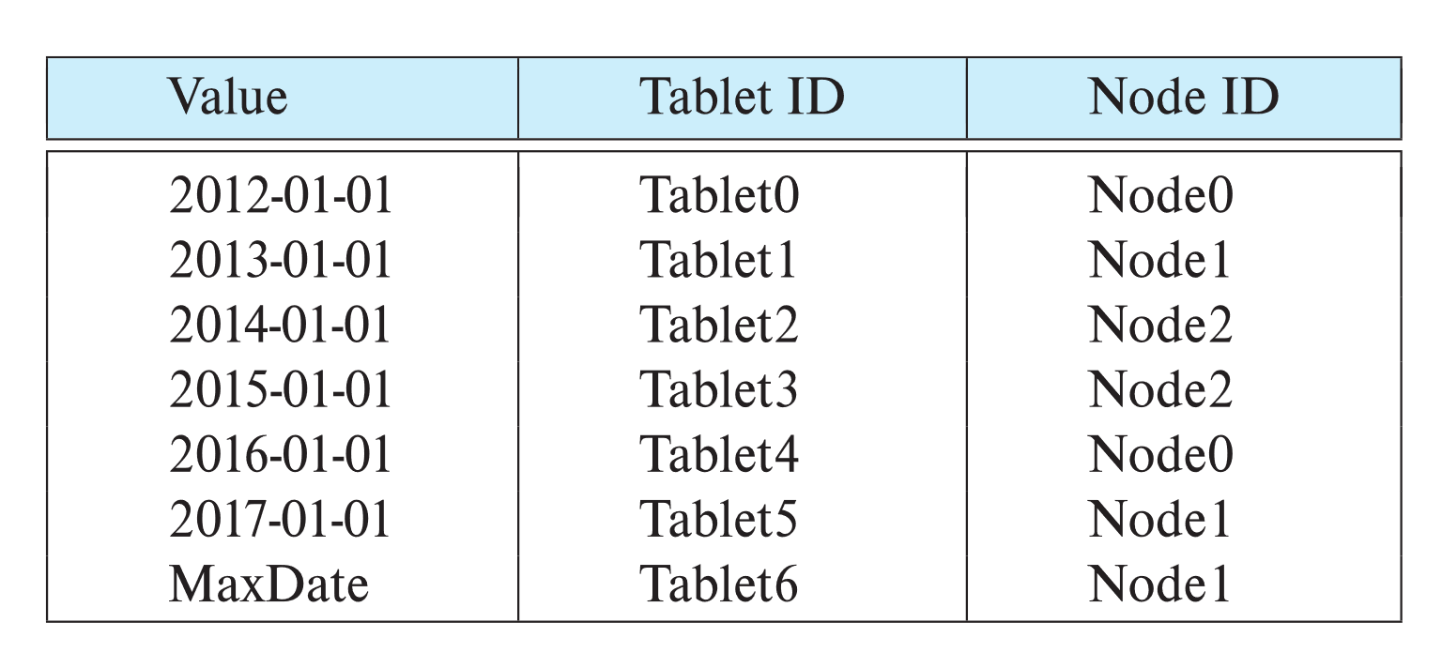
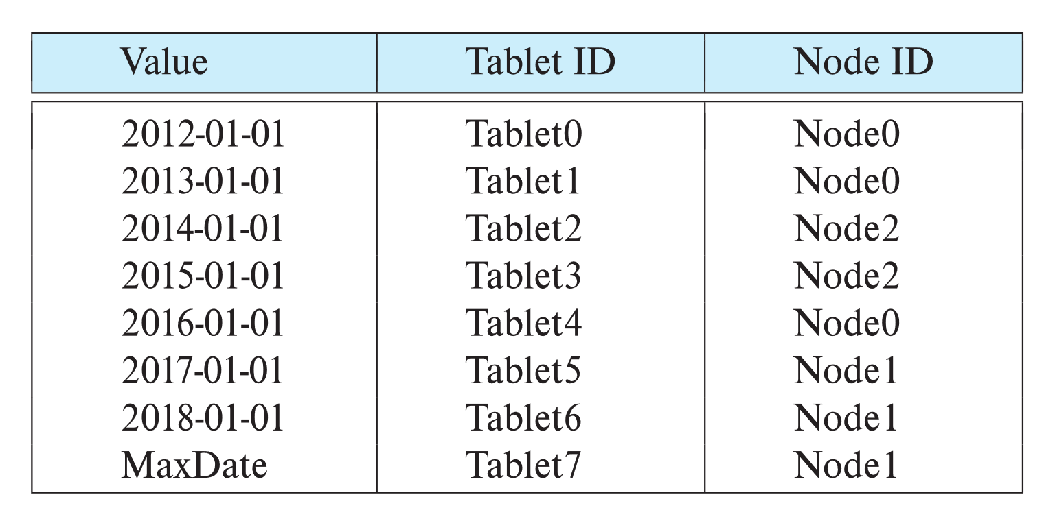
Dynamic Repartitioning
Virtual nodes in such a scheme are often called tablets
Example of initial partition table and partition table after a split of tablet 6 and move of tablet 1
Tablet move
Tablet split

Slide 7
Routing of Queries
Partition table typically stored at a master node, and at multiple routers
Queries are sent first to routers, which forward them to appropriate node
Consistent hashing is an alternative fully-distributed scheme
without any master nodes, works in a completely peer-to-peer fashion
(Self study)
Distributed hash tables are based on consistent hashing
work without master nodes or routers; each peer-node stores data and performs routing
(self study)

Slide 8
Routing of Queries
Most parallel data storage systems store the partition table at a master node. However, to support a large number of requests each second, the partition table is usually replicated, either to all client nodes that access data or to multiple routers.
Routers accept read/write requests from clients and forward the requests to the appropriate real node containing the tablet/virtual nodes based on the key values specified in the request.
Question 7-2: Explain how a query is executed in parallel storage system with dynamic partitioned storage of a relation. The query and the partitioning is on the same attribute.

Slide 9
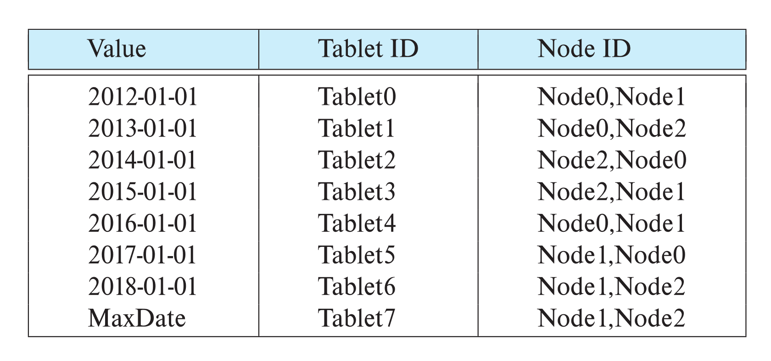
Replication
Goal: availability despite failures
Data replicated at 2, often 3 nodes
Unit of replication typically a partition (tablet)
Requests for data at failed node automatically routed to a replica
Partition table with each tablet replicated at two nodes

Slide 10
Basics: Data Replication
Location of replicas
Replication within a data center
Handles machine failures
Reduces latency if copy available locally on a machine
Replication within/across racks
Replication across data centers
Handles data center failures (power, fire, earthquake, ..), and network partitioning of an entire data center
Provides lower latency for end users if copy is available on nearby data center

Slide 11
Updates and Consistency of Replicas
Replicas must be kept consistent on update
Despite failures resulting in different replicas having different values (temporarily), reads must get the latest value.
Special concurrency control and atomic commit mechanisms to ensure consistency
Master replica (primary copy) scheme
All updates are sent to master, and then replicated to other nodes
Reads are performed at master
But what if master fails? Who takes over? How do other nodes know who is the new master?
Question 8-1: Write advantages and disadvantages of replication

Slide 12
Protocols to Update Replicas
Two-phase commit
Assumes all replicas are available
Persistent messaging
Updates are sent as messages with guaranteed delivery
Replicas are updated asynchronously (after original transaction commits)
Eventual consistency
Can lead to inconsistency on reads from replicas
Consensus protocols
Protocol followed by a set of replicas to agree on what updates to perform in what order
Can work even without a designated master

Slide 13
Distributed File Systems
The goal of first-generation distributed file systems was to allow client machines to access files stored on one or more file servers.
In contrast, later-generation distributed file systems, which we focus on, address distribution of file blocks across a very large number of nodes.
Such distributed file systems can store very large amounts of data and support very large numbers of concurrent clients.
A landmark system in this context was the Google File System (GFS), developed in the early 2000s, which saw widespread use within Google.
The open-source Hadoop File System (HDFS) is based on the GFS architecture and is now very widely used.

Slide 14
Distributed File Systems
Distributed file systems are generally designed to efficiently store large files whose sizes range from tens of megabytes to hundreds of gigabytes or more.
However, they are designed to store moderate numbers of such files, of the order of millions; they are typically not designed to stores billions of different files.
In contrast, the parallel data storage systems we have seen earlier are designed to store very large numbers (billions or more) of data items, whose size can range from small (tens of bytes) to medium (a few megabytes).

Slide 15
Distributed File Systems
As in parallel data storage systems, the data in a distributed file system are stored across a number of nodes.
Since files can be much larger than data items in a data storage system, files are broken up into multiple blocks.
The blocks of a single file can be partitioned across multiple machines.
Further, each file block is replicated across multiple (typically three) machines, so that a machine failure does not result in the file becoming inaccessible.

Slide 16
Distributed File Systems
File systems typically support two kinds of metadata:
1. A directory system, which allows a hierarchical organization of files into directories and subdirectories, and
2. A mapping from a file name to the sequence of identifiers of blocks that store the actual data in each file.

Slide 17
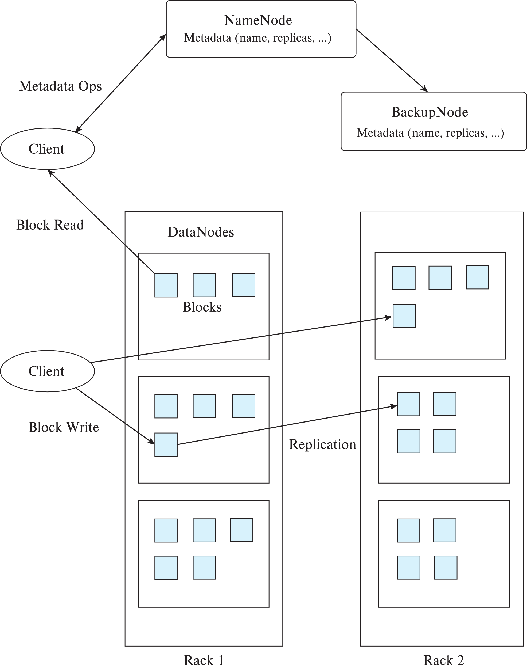
Hadoop File System (HDFS)
Client: sends filename to NameNode
NameNode
Maps a filename to list of Block IDs
Maps each Block ID to DataNodes containing a replica of the block
Returns list of BlockIDs along with locations of their replicas
DataNode:
Maps a Block ID to a physical location on disk
Sends data back to client

Slide 18
Hadoop File System (HDFS)
Question 8-2: Using 64MB block size, how can you store a file named “YourId_HDFS” of size 10GB in Hadoop file system?

Slide 19
Hadoop Distributed File System
Hadoop Distributed File System (HDFS)
Modeled after Google File System (GFS)
Single Namespace for entire cluster
Data Coherency
Write-once-read-many access model
Client can only append to existing files
Files are broken up into blocks
Typically 64 MB block size
Each block replicated on multiple (e.g., 3) DataNodes
Client
Finds location of blocks from NameNode
Accesses data directly from DataNode

Slide 20
Limitations of GFS/HDFS
Central master becomes bottleneck
Keep directory/inode information in memory to avoid IO
Memory size limits number of files
Colossus file system supports distributed master
With smaller (1MB) block size
File system directory overheads per file
Not appropriate for storing very large number of objects
File systems do not provide consistency guarantees
File systems cache blocks locally
Ideal for write-once and append only data
Can be used as underlying storage for a data storage system
E.g., BigTable uses GFS underneath

Slide 21
Sharding
Divide data amongst many cheap databases (MySQL/PostgreSQL)
Manage parallel access in the application
Partition tables map keys to nodes
Application decides where to route storage or lookup requests
Scales well for both reads and writes
Limitations
Not transparent
application needs to be partition-aware
AND application needs to deal with replication
(Not a true parallel database, since parallel queries and transactions spanning nodes are not supported)

Slide 22
Data Storage Systems vs. Databases
Distributed data storage implementations:
May have limited support for relational model (no schema, or flexible schema)
But usually do provide flexible schema and other features
Structured objects e.g. using JSON
Multiple versions of data items
Often do not support referential integrity constraints
Often provide no support or limited support for transactions
But some do!
Provide only lowest layer of database

Slide 23
Data Representation
In wide-column stores like BigTable, records may be vertically partitioned by attribute (columnar storage)
(record-identifier, attribute-name) forms a key
Multiple attributes may be stored in one file (column family)
In BigTable records are sorted by key, ensuring all attributes of a logical record in that file are contiguous
Attributes can be fetched by a prefix/range query
Record-identifiers can be structured hierarchically to exploit sorting
E.g., url: www.cs.yale.edu/people/silberschatz.html can be mapped to record identifier edu.yale.cs.www/people/silberschatz.html
Now all records for cs.yale.edu would be contiguous, as would all records for yale.edu

Slide 24
Geographically Distributed Storage
Many storage systems today support geographical distribution of storage
Motivations: Fault tolerance, latency (close to user), governmental regulations
Latency of replication across geographically distributed data centers much higher than within data center
Some key-value stores support synchronous replication
Must wait for replicas to be updated before committing an update
Others support asynchronous replication
update is committed in one data center, but sent subsequently (in a fault-tolerant way) to remote data centers
Must deal with small risk of data loss if data center fails.

Slide 25
Transactions in Key-Value Stores
Most key-value stores don’t support full-fledged transactions
But treat each update as a transaction, to ensure integrity of internal data structure
Some key-value stores allow multiple updates to one data item to be committed as a single transaction
Without support for transactions, secondary indices cannot be maintained consistently
Some key-value stores do not support secondary indices at all
Some key-value stores support asynchronous maintenance of secondary indices
Some key-value stores support ACID transactions across multiple data items along with two-phase commit across nodes
Google MegaStore and Spanner

Slide 26
Transactions in Key-Value Stores
Some key-value stores support concurrency control via locking and snapshots
Some support atomic test-and-set and increment on data items
Others do not support concurrency control
Key-value stores implement recovery protocols based on logging to ensure durability
Log must be replicated, to ensure availability in spite of failures
Distributed file systems are used to store log and data files in some key-value stores such as BigTable, HBase
But distributed file systems do not support (atomic) updates of files except for appends
LSM trees provide a nice way to index data without requiring updates of files
Some systems use persistent messaging to manage logs

Slide 27
Querying and Performance Optimizations
Many key-value stores do not provide a declarative query language
Applications must manage joins, aggregates, etc on their own
Some applications avoid computing joins at run-time by creating (what is in effect) materialized views
Application code maintains materialized views
E.g., If a user makes a post, the application may add a summary of the post to the data items representing all the friends of the user
Many key-value stores allow related data items to be stored together
Related data items form an entity-group
e.g., user data item along with all posts of that user
Makes joining the related tuples very cheap
Other functionality includes
Stored procedures executed at the nodes storing the data
Versioning of data, along with automated deletion of old versions

