Slide 1
Parallel Database Query Processing

Slide 2
Parallel Query Processing
Different queries/transactions can be run in parallel with each other.
Interquery parallelism
There are queries Q1, Q2, Q3, …..Qn
Queries are processed in parallel
Intraquery Parallelism
Individual relational operations (e.g., sort, join, aggregation) can be executed in parallel
data can be partitioned and each processor can work independently on its own partition
Queries are expressed in high level language (SQL, translated to relational algebra) makes parallelization easier.

Slide 3
Intraquery Parallelism
Intraquery parallelism: execution of a single query in parallel on multiple processors/disks; important for speeding up long-running queries.
Two complementary forms of intraquery parallelism:
Intraoperation Parallelism
parallelize the execution of each individual operation in the query
Supports high degree of parallelism
Interoperation Parallelism
execute the different operations in a query expression in parallel.
Limited degree of parallelism

Slide 4
Parallel Processing of Relational Operations
Our discussion of parallel algorithms assumes:
read-only queries
shared-nothing architecture
n nodes, N₁, ..., N_{n}
Each assumed to have disks and processors.
Initial focus on parallelization to a shared-nothing node
Parallel processing within a shared memory/shared disk node discussed later
Shared-nothing architectures can be efficiently simulated on shared-memory and shared-disk systems.
Algorithms for shared-nothing systems can thus be run on shared-memory and shared-disk systems.
However, some optimizations may be possible.

Slide 5
Intraquery Parallelism
SELECT * FROM r, s where r.B = s.B
Given:
Relations r (A, D, E, B), s(A, C, B, G)
Shared nothing architecture
Nodes: N₁, N₂, ….. N_{n} where r and s are stored by horizontal partition vector on
A = A₁, A₂, ….A_{n-1}
r is horizontal partitioned into r₁, r₂, …. r_{n}
s is horizontal partitioned into s₁, s₂, …. s_{n}
Perform r ⨝_{r.B=s.B} s using m nodes.
Repartition
Repartition
r₁
s₁
r₁′
⨝_{r.B=s.B}
s₁′
r₂
s₂
r₂′
⨝_{r.B=s.B}
s₂′
r₃
s₃
r_{m}′
⨝_{r.B=s.B}
s_{m}′
r_{n}
s_{n}

Slide 6
Intraquery Parallelism
SELECT * FROM r, s where r.B = s.B
Shared nothing architecture
Nodes: N₁, N₂, ….. N_{n} where r and s are stored by horizontal partition vector on A = A₁, A₂, ….A_{n}
r is horizontal partitioned into r₁, r₂, …. r_{n}
s is horizontal partitioned into s₁, s₂, …. s_{n}
Perform r r ⨝_{r.B=s.B} s s using m nodes.
Partition vector: B₁, B₂, ….. B_{m-1}
Steps to process the query
Step 1:
Repartition r₁, r₂, …. r_{n} into new
partitions r₁′, r₂ ′, …. r_{m}′
Repartition s₁, s₂, …. s_{n} into new
partitions s₁ ′, s₂ ′, …. s_{m} ′
Step 2:
Assign r₁′, r₂ ′, …. r_{m}′ into
nodes N₁, N₂, ….. N_{m}
Assign s₁ ′, s₂ ′, …. s_{m} ′ into
nodes N₁, N₂, ….. N_{m}
Repartition
Repartition
r₁
s₁
r₁′
⨝_{r.B=s.B}
s₁′
r₂
s₂
r₂′
⨝_{r.B=s.B}
s₂′
r₃
s₃
r_{m}′
⨝_{r.B=s.B}
s_{m}′
r_{n}
s_{n}

Slide 7
Intraquery Parallelism
SELECT * FROM r, s where r.B = s.B
Shared nothing architecture
Nodes: N₁, N₂, ….. N_{n} where r and s are stored by horizontal partition vector on A = A₁, A₂, ….A_{n}
r is horizontal partitioned into r₁, r₂, …. r_{n}
s is horizontal partitioned into s₁, s₂, …. s_{n}
Perform r r ⨝_{r.B=s.B} s s using m nodes.
Steps to process the query
Step 3:
Perform r₁′ ⨝ s₁ ′ at node N₁
Perform r₂′ ⨝ s₂ ′ at node N₂
……………….
Perform r_{m}′ ⨝ s_{m} ′ at node N_{m}
Repartition
Repartition
r₁
s₁
r₁′
⨝_{r.B=s.B}
s₁′
r₂
s₂
r₂′
⨝_{r.B=s.B}
s₂′
r₃
s₃
r_{m}′
⨝_{r.B=s.B}
s_{m}′
r_{n}
s_{n}

Slide 8
Intraquery Parallelism
Partitions
r₁ = all students id < 121000
s₁ = all takes id < 121000
r₂ = all students 121000 <= id < 131000
s₂ = all takes 121000 <= id < 131000
………
r₁₀ = all students id >= 201000
s₁₀ = all takes id >= 201000
Question 9-1
Student (id, name,cgpa, yearAdmit)
Takes(id, course-id, semester, year)
SELECT r.id, course-id, CGPA FROM student r, takes s where r.yearAdmit = s.year
Shared nothing architecture
Nodes: N₁, N₂, ….. N₁₀ where r and s are stored by horizontal partition vector on id = 121000, 131000, 141000, 151000, 161000, 171000, 181000, 191000, 201000
Total 10 partitions into 10 nodes
r is horizontal partitioned into r₁, r₂, .. r₁₀
s is horizontal partitioned into s₁, s₂, . s₁₀
The range of yearAdmit is 2015 to 2021
Find partitions of student and takes using yearAdmit
Perform r r ⨝_{yearAdmit=year} s using 6 nodes.
Repartition
Repartition
r₁
s₁
r₁′
⨝_{r.B=s.B}
s₁′
r₂
s₂
r₂′
⨝_{r.B=s.B}
s₂′
r₃
s₃
r_{m}′
⨝_{r.B=s.B}
s_{m}′
r_{n}
s_{n}

Slide 9
Intraquery Parallelism
SELECT * FROM r, s where r.A = s.A
Given:
Relations r (A, D, E, B), s(A, C, B, G)
Shared nothing architecture
Nodes: N₁, N₂, ….. N_{n} where r and s are stored by horizontal partition vector on
A = A₁, A₂, ….A_{n-1}
r is horizontal partitioned into r₁, r₂, …. r_{n}
s is horizontal partitioned into s₁, s₂, …. s_{n}
Perform r ⨝_{r.A=s.A} s using n nodes.
No Need Repartition
Repartition
Repartition
r₁
s₁
r₁′
⨝_{r.B=s.B}
s₁′
r₂
s₂
r₂′
⨝_{r.B=s.B}
s₂′
r₃
s₃
r_{m}′
⨝_{r.B=s.B}
s_{m}′
r_{n}
s_{n}
Case 2:
No. of portioning node = number of query node
Partitioning attribute and query attribute is same.

Slide 10
Intraquery Parallelism
SELECT * FROM r, s where r.A = s.A
Given:
Relations r (A, D, E, B), s(A, C, B, G)
Shared nothing architecture
Nodes: N₁, N₂, ….. N_{n} where r and s are stored by horizontal partition vector on
A = A₁, A₂, ….A_{n-1}
r is horizontal partitioned into r₁, r₂, …. r_{n}
s is horizontal partitioned into s₁, s₂, …. s_{n}
Perform r ⨝_{r.A=s.A} s using n nodes.
r₁
⨝_{r.A=s.A}
s₁
r₂
⨝_{r.A=s.A}
s₂
r₃
⨝_{r.A=s.A}
s₃
r_{n}
⨝_{r.A=s.A}
s_{n}

Slide 11
Intraquery Parallelism
Partitions
r₁ = all students id < 121000
s₁ = all takes id < 121000
r₂ = all students 121000 <= id < 131000
s₂ = all takes 121000 <= id < 131000
………
r₁₀ = all students id >= 201000
s₁₀ = all takes id >= 201000
Example
Student (id, name,cgpa, yearAdmit)
Takes(id, course-id, semester, year)
SELECT r.id, course-id FROM student r, takes s where r.id = s.id
Shared nothing architecture
Nodes: N₁, N₂, ….. N₁₀ where r and s are stored by horizontal partition vector on id = 121000, 131000, 141000, 151000, 161000, 171000, 181000, 191000, 201000
Total 10 partitions into 10 nodes
r is horizontal partitioned into r₁, r₂, . . r₁₀
s is horizontal partitioned into s₁, s₂,.. s₁₀
Find partitions of student and takes
Perform r ⨝_{r.id = s.id} s using 10 nodes.
Steps to process the query
Only one Step:
Perform r₁ ⨝ s₁ at node N₁
Perform r₂ ⨝ s₂ at node N₂
Perform r₃ ⨝ s₃ at node N₃
Perform r₄ ⨝ s₄ at node N₄
………
Perform r₁₀ ⨝ s₁₀ at node N₁₀

Slide 12
Intraquery Parallelism
Question 9-2
customer (id, name,type, country)
purchase(id, product-id, p-country, date)
SELECT r.id, product-id FROM customer r, purchase s where r.id = s.id
Shared nothing architecture
Nodes: N₁, N₂, ….. N₅ where r and s are stored by horizontal partition vector on id = 1000, 2000, 3000, 4000
Total 5 partitions into 5 nodes
r is horizontal partitioned into r₁, r₂, …. r₅
s is horizontal partitioned into s₁, s₂, …. s₅
Perform r ⨝_{r.id = s.id} s using 5 nodes.
Why is repartition not needed?

Slide 13
Sorting
We may build an index on the relation, and then use the index to read the relation in sorted order. May lead to one disk block access for each tuple.
Discussion: The case when it May lead to one disk block access for each tuple.
For relations that fit in memory, techniques like quicksort can be used.
For relations that don’t fit in memory, quicksort is not applicable. Why? external sort-merge is a good choice in this case.

Slide 14
Example: External Sorting Using Sort-Merge

Slide 15

External Sort-Merge (Run Creation)
Memory
Run Creation
Let M denote memory size (in pages).
Here M = 3
1. Create sorted runs. Let i be 1 initially. Repeatedly do the following till the end of the relation: (a) Read M blocks of relation into memory (b) Sort the in-memory blocks (c) Write sorted data to run R_{i}; increment i.
Let the final value of i be N (Here N = ?)
R1
R2
R3
Here N = 4
2. Merge the runs (next slide)…..
R4

Slide 16
External Sort-Merge (Sort-Merge)
a | 19
b | 14
Input Buffer
Output
Buffer
Merge the runs (2-way merge). Here N > M. M=3, N=4
Use 2 blocks of memory to buffer input runs, and 1 block to buffer output. Read the first block of each run into its buffer page
repeat
Select the first record (in sort order) among all buffer pages
Write the record to the output buffer. If the output buffer is full write it to disk.
Delete the record from its input buffer page. If the buffer page becomes empty then read the next block (if any) of the run into the buffer.
until all input buffer pages are empty:
a | 19
Merge pass1
R1
R2
R3
R4

Slide 17
External Sort-Merge (Sort Merge)
b | 14
d | 31
Memory
Merge the runs (2-way merge). Here N > M. M=3, N=4
Use 2 blocks of memory to buffer input runs, and 1 block to buffer output. Read the first block of each run into its buffer page
repeat
Select the first record (in sort order) among all buffer pages
Write the record to the output buffer. If the output buffer is full write it to disk.
Delete the record from its input buffer page. If the buffer page becomes empty then read the next block (if any) of the run into the buffer.
until all input buffer pages are empty:
b | 14
Merge pass1
R1
R2
R3
R4

Slide 18
External Sort-Merge (Sort Merge)
b | 14
d | 31
Memory
b | 14
Merge pass1
R1
Question 10-1: In the given example, N =4 and M = 2.
Find the size of the memory when the external sort can be done in one pass.
Find the size of the memory when the quicksort can be used.
Explain the impact of memory size in database sort performance.
R2
R3
R4

Slide 19
Parallel Sort
Suppose that we wish to sort a relation r that resides on n nodes N1, N2, … , Nn.
If the relation has been range-partitioned on the attributes on which it is to be sorted, we can sort each partition separately and concatenate the results to get the full sorted relation.
Since the tuples are partitioned on n nodes, the time required for reading the entire relation is reduced by a factor of n by the parallel access.
Question 10-2:
Given relation
Person(NID, name, street, city)
The relation has 160 million tuples and is range partitioned into 160 nodes using NID. You have to process the following queries:
Find the list of persons sorted by NID in ascending order
Find the list of persons sorted by district in alphabetic order
Explain how the above two queries will be processed.

Slide 20
Parallel Sort
If relation r has been partitioned in any other way, we can sort it in one of two ways:
We can range-partition r on the sort attributes, and then sort each partition separately.
We can use a parallel version of the external sort-merge algorithm.
Question 10-2:
Given relation
Person(NID, name, street, city)
The relation has 160 million tuples and is range partitioned into 160 nodes using NID. You have to process the following queries:
Find the list of persons sorted by NID in ascending order
Find the list of persons sorted by district in alphabetic order
Explain how the above two queries will be processed.

Slide 21
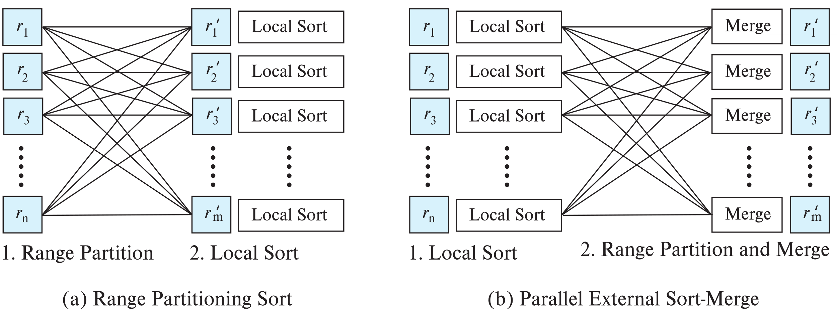
Range-Partitioning Sort
Choose nodes N₁, ..., N_{m}, where m ≤ n-1 to do sorting.
Create range-partition vector with m-1 entries, on the sorting attributes
Redistribute the relation using range partitioning
Each node N_{i} sorts its partition of the relation locally.
Example of data parallelism: each node executes same operation in parallel with other nodes, without any interaction with the others.
Final merge operation is trivial: range-partitioning ensures that, if i < j, all key values in node N_{i} are all less than all key values in N_{j}.

Slide 22
Parallel External Sort-Merge
Assume the relation has already been partitioned among nodes N₁, ..., N_{n} (in whatever manner).
Each node N_{i} locally sorts the data (using local disk as required)
The sorted runs on each node are then merged in parallel:
The sorted partitions at each node Ni are range-partitioned across the processors N₁, ..., N_{m}.
Each node Ni performs a merge on the streams as they are received, to get a single sorted run.
The sorted runs on nodes N₁, ..., N_{m} are concatenated to get the final result.

Slide 23
Parallel External Sort-Merge (Cont..)
Algorithm as described vulnerable to execution skew
all nodes send to node 1, then all nodes send data to node 2, …
Can be modified so each node sends data to all other nodes in parallel (block at a time)

Slide 24
Interoperator Parallelism
Pipelined parallelism
Consider a join of four relations
r₁ ⨝ r₂ ⨝ r₃ ⨝ r₄
Set up a pipeline that computes the three joins in parallel Each of these operations can execute in parallel, sending result tuples it computes to the next operation even as it is computing further results
Provided a pipelineable join evaluation algorithm (e.g. indexed nested loops join) is used
r₄
r₃
r₁
r₂
N2
r₃
Result
N1
Result
r₁
r₂
N3
r₄

Slide 25
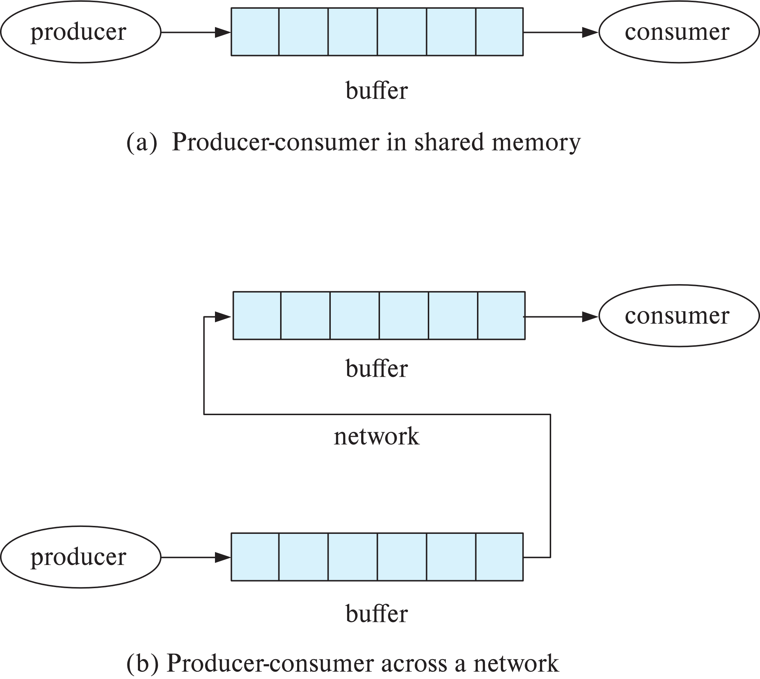
Pipelined Parallelism
Push model of computation appropriate for pipelining in parallel databases
Buffer between consumer and producer
Can batch tuples before sending to next operator
Reduce number of messages,
reduce contention on shared buffers

Slide 26
Pipelined Parallelism
N2
Producer-consumer for N1 to N2
r₃
Result
N1
N2
N1
Result
r₁
r₂
N3
r₄
N2
N1

Slide 27
Pipelined Parallelism
N2
r₃
Producer-consumer for N2 to N3
Result
N1
Result
N2
N3
r₁
r₂
N3
r₄
Question 11-1:
The relations r1, r2, r3 and r4 are partitioned into 30 nodes N1, N2, …. N30. Propose a query execution plan using itra-operation parallelism for individual joins and inter-operation pipeline parallelism.
Show the diagram.
N3
N2

Slide 28
Utility of Pipeline Parallelism
r₄
Limitations
Does not provide a high degree of parallelism since pipeline chains are not very long (Explain?)
Cannot pipeline operators which do not produce output until all inputs have been accessed (e.g. aggregate and sort) (Explain?)
Little speedup is obtained for the frequent cases of skew in which one operator's execution cost is much higher than the others (Explain?).
But pipeline parallelism is still very useful since it avoids writing intermediate results to disk
r₃
r₁
r₂
How many pipelines?
Answer = 3
Explanation 2:
Query:
Select r1.id, max(r4.salary)
From r1, r2, r3, r4
Where r1.id = r2.id and r2.id = r3.id and r3.id = r4.id
Can we process max(r4.id) in pipeline? Why?

Slide 29
Utility of Pipeline Parallelism
r₄
Limitations
Does not provide a high degree of parallelism since pipeline chains are not very long (Explain?)
Cannot pipeline operators which do not produce output until all inputs have been accessed (e.g. aggregate and sort) (Explain?)
Little speedup is obtained for the frequent cases of skew in which one operator's execution cost is much higher than the others (Explain?).
But pipeline parallelism is still very useful since it avoids writing intermediate results to disk
r₃
r₁
r₂
Explanation 3
Query:
Select r1.id, max(r4.salary)
From r1, r2, r3, r4
Where r1.id = r2.id and r2.id = r3.id and r3.id = r4.id
r1, r2 and r3 has indices and join is faster.
r4 has no index
N1 and N2 will complete the operation
N3 will be skew.

Slide 30
Independent Parallelism
Independent parallelism
Consider a join of four relations
r₁ ⨝ r₂ ⨝ r₃ ⨝ r₄
Let N₁ be assigned the computation of temp1 = r₁ ⨝ r₂
And N₂ be assigned the computation of temp2 = r₃ ⨝ r₄
And N₃ be assigned the computation of temp1 ⨝ temp₂
N₁ and N₂ can work independently in parallel
N₃ has to wait for input from N₁ and N₂
Can pipeline output of N₁ and N₂ to N₃, combining independent parallelism and pipelined parallelism
Does not provide a high degree of parallelism
useful with a lower degree of parallelism.
less useful in a highly parallel system,
N1
temp1 =
r₁ ⨝ r₂
N2
temp2 = r₃ ⨝ r₄
temp1
temp2
N3
Result =
temp1 ⨝ temp₂

Slide 31
Question 11-2:
Prepare query plan combining independent parallelism and pipeline parallelism for processing s₁ ⨝ s₂ ⨝ s₃ ⨝ s₄ ⨝ s₅ ⨝ s₆ where s₁ , s₂ , s₃ , s₄ , s₅ and s₆ are relations. The nodes N1, N2, N3, N4 and N5 are connected in a network and used to process the query.
Compare independent parallelism with pipeline parallelism.
Independent parallelism
Consider a join of four relations
r₁ ⨝ r₂ ⨝ r₃ ⨝ r₄
Let N₁ be assigned the computation of temp1 = r₁ ⨝ r₂
And N₂ be assigned the computation of temp2 = r₃ ⨝ r₄
And N₃ be assigned the computation of temp1 ⨝ temp₂
N₁ and N₂ can work independently in parallel
N₃ has to wait for input from N₁ and N₂
Can pipeline output of N₁ and N₂ to N₃, combining independent parallelism and pipelined parallelism
Does not provide a high degree of parallelism
useful with a lower degree of parallelism.
less useful in a highly parallel system,
N1
temp1 =
r₁ ⨝ r₂
N2
temp2 = r₃ ⨝ r₄
temp1
temp2
N3
Result =
temp1 ⨝ temp₂

Slide 32
Other Relational Operations
Selection σ_{θ}(r)
If θ is of the form a_{i} = v, where a_{i} is an attribute and v a value.
If r is partitioned on a_{i} the selection is performed at a single node.
If θ is of the form l <= a_{i} <= u (i.e., θ is a range selection) and the relation has been range-partitioned on a_{i}
Selection is performed at each node whose partition overlaps with the specified range of values.
In all other cases: the selection is performed in parallel at all the nodes.
Notes:
----- Meeting Notes (10/01/17 12:42) -----
also consider in or OR queries. And global index as an option

Slide 33
Other Relational Operations (Cont.)
Duplicate elimination
Perform by using either of the parallel sort techniques
eliminate duplicates as soon as they are found during sorting.
Can also partition the tuples (using either range- or hash- partitioning) and perform duplicate elimination locally at each node.
Projection
Projection without duplicate elimination can be performed as tuples are read from disk, in parallel.
If duplicate elimination is required, any of the above duplicate elimination techniques can be used.

Slide 34
Grouping/Aggregation
Step 1: Partition the relation on the grouping attributes
Step 2: Compute the aggregate values locally at each node.
Optimization: Can reduce cost of transferring tuples during partitioning by partial aggregation before partitioning
For distributive aggregate
Can be done as part of run generation
Consider the sum aggregation operation:
Perform aggregation operation at each node N_{i} on those tuples stored its local disk
results in tuples with partial sums at each node.
Result of the local aggregation is partitioned on the grouping attributes, and the aggregation performed again at each node N_{i} to get the final result.
Fewer tuples need to be sent to other nodes during partitioning.

