Slide 1
Other Relational Operations in Parallel Database System
Selection σ_{θ}(r)
If θ is of the form a_{i} = v, where a_{i} is an attribute and v a value.
If r is partitioned on a_{i} the selection is performed at a single node.
Given schema person (NID, name, street, city, district, DOB, income)
Nodes are N1, N2 ……. N64
Partitioning attribute is district and each node contains tuples of a district.
Q1: Select * from person where district = ‘Dhaka’
Q2: Select * from person where district = ‘Sherpur’
Question 12-1:
Why each of the queries Q1 and Q2 will be processed in single node?
Compare the processing time of Q1 and Q2 and suggest possible improvement.
Notes:
----- Meeting Notes (10/01/17 12:42) -----
also consider in or OR queries. And global index as an option

Slide 2
Other Relational Operations in Parallel Database System
Selection σ_{θ}(r)
If θ is of the form l <= a_{i} <= u (i.e., θ is a range selection) and the relation has been range-partitioned on a_{i}
Selection is performed at each node whose partition overlaps with the specified range of values.
Given schema person (NID, name, street, city, district, DOB, income)
Nodes are N1, N2 ……. N64
Partitioning attribute is NID and there is no skew.
Q21: Select * from person where NID > 4567891230 and NID < 8678912340
N10 - 4500000000 <NID < 5000000000
N30 - 8678912340 <NID < 8978912340
Question 12-2:Explain how Q21 will be processed.
Notes:
----- Meeting Notes (10/01/17 12:42) -----
also consider in or OR queries. And global index as an option

Slide 3
Other Relational Operations in Parallel Database System
Selection σ_{θ}(r)
In all other cases: the selection is performed in parallel at all the nodes.
Given schema person (NID, name, street, city, district, DOB, income)
Nodes are N1, N2 ……. N64
Partitioning attribute is district and each node contains tuples of a district.
Q1: Select * from person
Q2: Select * from person where DOB > ’01-jan-2000’
Question 12-3:
Why each of the queries Q1 and Q2 will be processed in all nodes in parallel?
Notes:
----- Meeting Notes (10/01/17 12:42) -----
also consider in or OR queries. And global index as an option

Slide 4
Other Relational Operations (Cont.)
Duplicate elimination
Perform by using either of the parallel sort techniques
eliminate duplicates as soon as they are found during sorting.
Can also partition the tuples (using either range- or hash- partitioning) and perform duplicate elimination locally at each node.
Select distinct (name, street, city) from person
Select distinct ( income) from person

Slide 5
Other Relational Operations (Cont.)
Projection
Projection without duplicate elimination can be performed as tuples are read from disk, in parallel.
If duplicate elimination is required, any of the above duplicate elimination techniques can be used.
r₁
s₁
r₁′
⨝_{r.B=s.B}
s₁′
r₂
s₂
r₂′
⨝_{r.B=s.B}
s₂′
r₃
s₃
r_{m}′
⨝_{r.B=s.B}
s_{m}′
r_{n}
s_{n}

Slide 6
Grouping/Aggregation
Step 1: Partition the relation on the grouping attributes
Step 2: Compute the aggregate values locally at each node.
Given schema person (NID, name, street, city, district, DOB, income)
Person relation has 160 million tuples. Nodes are N1, N2 ……. N64
Partitioning attribute is district. Repartition on income requires to transfer 80% tuples from each node.
Q31: Select income, count(NID) from person group by income
Question 12-4:
Explain how this aggregate query will be processed?
Find the repartition cost
Optimize the aggregate query and find the optimized repartition cost.

Slide 7
Optimization: Can reduce cost of transferring tuples during partitioning by partial aggregation before partitioning
For distributive aggregate
Can be done as part of run generation
Consider the count aggregation operation:
Perform aggregation operation at each node N_{i} on those tuples stored its local disk
results in tuples with partial counts at each node.
Result of the local aggregation is partitioned on the grouping attributes, and the aggregation performed again at each node N_{i} to get the final result.
Given schema person (NID, name, street, city, district, DOB, income)
Person relation has 160 million tuples. Nodes are N1, N2 ……. N64
Partitioning attribute is district. Repartition on age requires to transfer 80% tuples from each node. There are 640 distinct income in person relation
Q31: Select income, count(NID) from person group by income
Question 12-4:
Explain how this aggregate query will be processed?
Find the repartition cost
Optimize the aggregate query and find the optimized repartition cost

Slide 8
Parallel Evaluation of Query Plans
Intraoperation Parallelism
Parallel join
Parallel sort
Interoperation Parallelism
Pipeline parallilsm
Independent parallelism
Exchange operator model

Slide 9
Exchange operator model
The Volcano parallel database popularized a model of parallelization called the exchange-operator model.
The exchange operation repartitions data in a specified way; data interchange between nodes is done only by the exchange operator.
All other operations work on local data, just as they would in a centralized database system; the data may be available locally either because it is already present, or because of the execution of a preceding exchange operator.

Slide 10
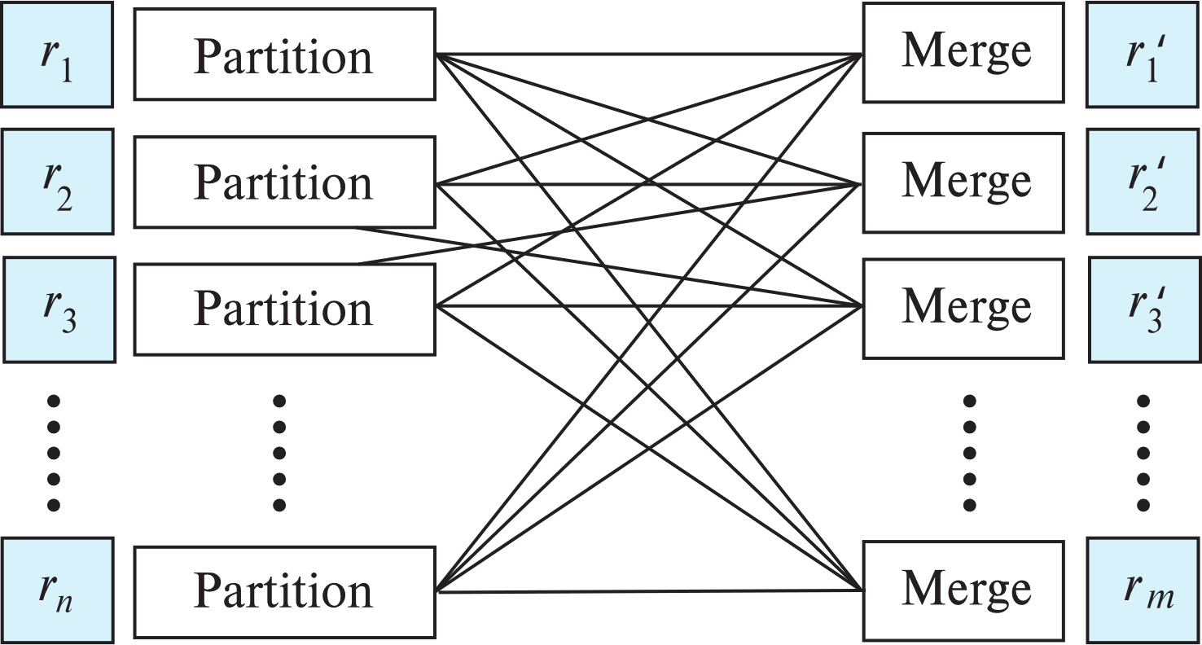
Exchange Operator
Repartitioning implemented using the exchange operator
Partition and merge steps

Slide 11
Exchange Operator Model
Movement of data encapsulated in exchange operator
Partitioning of data can be done by
Hash partitioning
Range partitioning
Replicating data to all nodes (called broadcasting)
Sending all data to a single node
Destination nodes can receive data from multiple source nodes. Incoming data can be merged by:
Random merge
Ordered merge
Other operators in a plan can be unaware of parallelism
Data parallelism: each operator works purely on local data
Not always best way, but works well in most cases

Slide 12
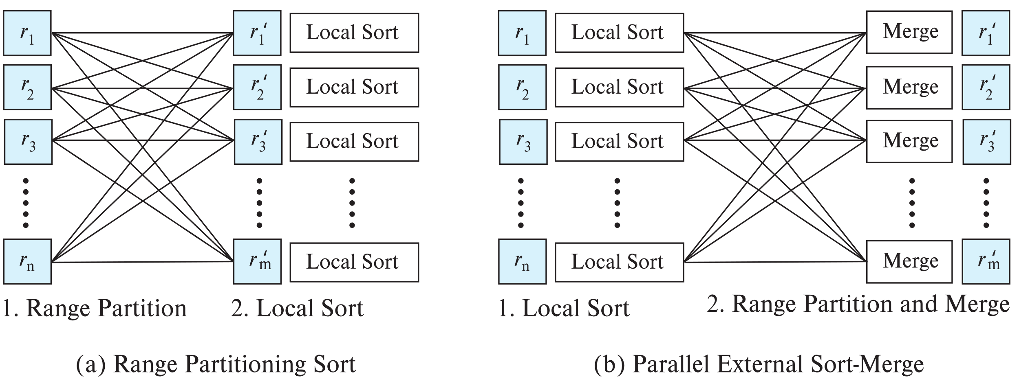
Parallel Plans Using Exchange Operator
Range partitioning sort:
Exchange operator using range partitioning, followed by
Local sort
Parallel external sort merge
Local sort followed by
Exchange operator with ordered merge
Given schema person (NID, name, street, city, district, DOB, income). Person relation has 160 million tuples. Nodes are N1, N2 ……. N64, Partitioning attribute is district.
Question 13-1:
Explain how the SQL: select * from person order by income will be executed using exchange operator (parameters: relation name, partition type, partition attribute, number of nodes) with
Range partitioning sort:
Parallel external sort merge

Slide 13
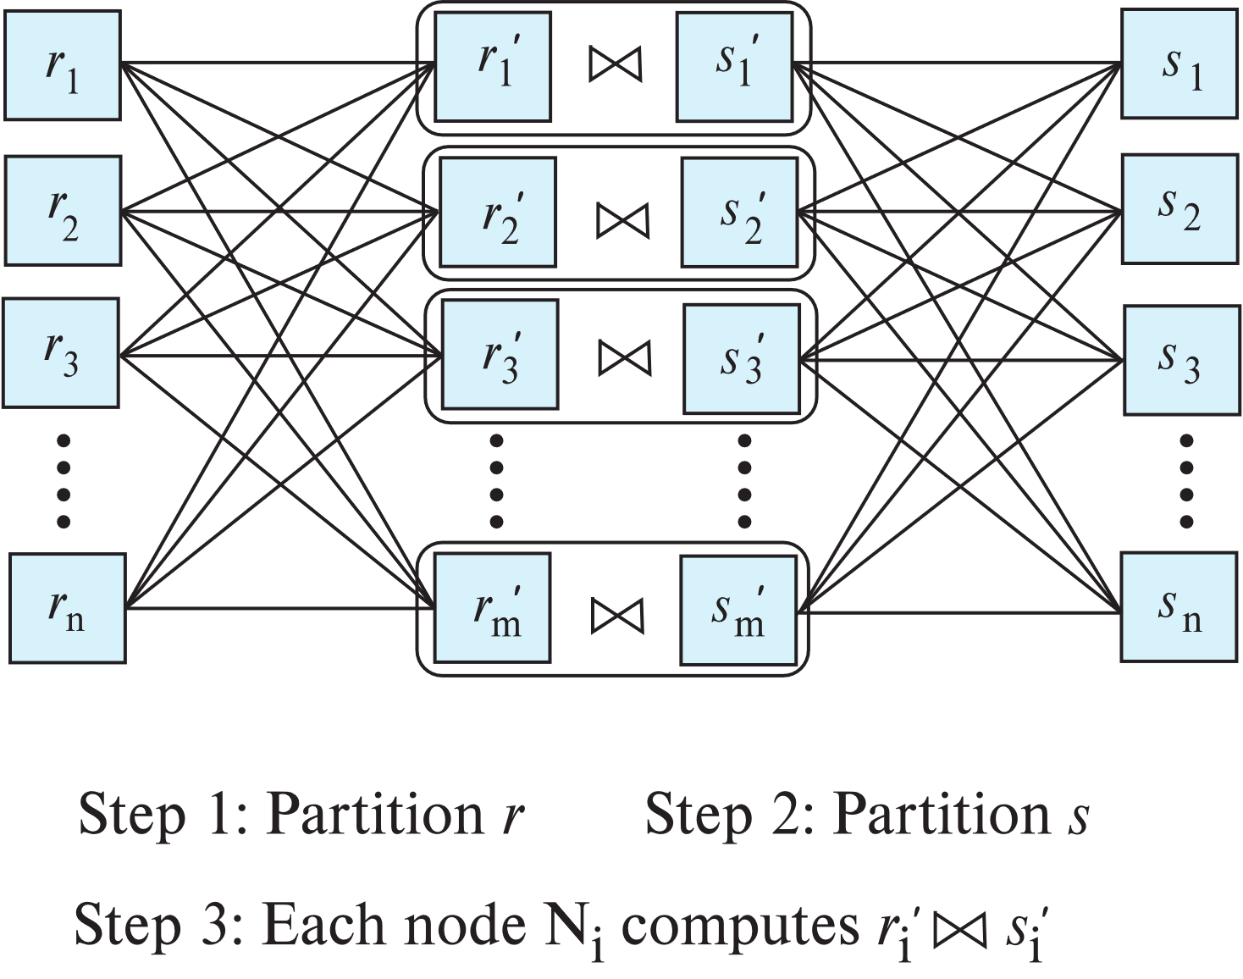
Parallel Plans Using Exchange Operator
Partitioned join
Exchange operator with hash or range partitioning, followed by
Local join
Given schema
person (NID, name, street, city, district, DOB, income)
Employee (e-Id, NID, Organization, position, district)
Person relation has 160 million tuples and employee relation has 10 million tutples. Nodes are N1, N2 ……. N64, Partitioning attribute is district.
Question 14-1:
Explain how the
SQL: select * from person p, employee e where p.NID = e.NID
will be executed using exchange operator with partitioned join

Slide 14
Parallel Plans Using Exchange Operator
Asymmetric fragment and replicate
Exchange operator using broadcast replication, followed by
Local join
Exchange operator can also implement push model, with batching
Given schema
person (NID, name, street, city, district, DOB, income)
Employee (e-Id, NID, Organization, position, district, salary)
Person relation has 160 million tuples and employee relation has 10 million tutples. Nodes are N1, N2 ……. N64, Partitioning attribute is district.
Question 14-2:
Explain how the
SQL: select * from person p, employee e where p.income > e.salary
will be executed using exchange operator with AFR join

Slide 15
Fragment-and-Replicate Join
Partitioning not possible for some join conditions
E.g., non-equijoin conditions, such as r.A > s.B.
For joins were partitioning is not applicable, parallelization can be accomplished by fragment and replicate technique
Special case – asymmetric fragment-and-replicate:
One of the relations, say r, is partitioned; any partitioning technique can be used.
The other relation, s, is replicated across all the processors.
Node Ni then locally computes the join of ri with all of s using any join technique.
Also referred to as broadcast join
Question 14-3: “Partitioning not possible for some join conditions” Explain with an example

Slide 16
Exchange Operator Model
Movement of data encapsulated in exchange operator
Partitioning of data can be done by
Hash partitioning
Xchg-HP (N, A:M), N: set of input pipelines, M: set of output pipelines, A is the set of attributes
Xchg-HP (r, A:r′, M), r: input relation, r′ is output relation, M: set of output pipelines, A is the set of attributes
Range partitioning
Xchg-RP (N, A:M)
Xchg-RP (r, A:r′, M), r: input relation, r′ is output relation, M: set of output pipelines

Slide 17
Exchange Operator Model
Movement of data encapsulated in exchange operator
Partitioning of data can be done by
Replicating data to all nodes (called broadcasting)
Xchg-Broadcast(N:M), N: set of input pipelines, M: set of output pipelines
Xchg-Broadcast(r:M), r: input relation, M: set of output pipelines
Sending all data to a single node
Xchg-Union(N:M_{i}), M_{i} is the output node
Xchg-Union(r:M_{i})

Slide 18
Exchange Operator Model
Movement of data encapsulated in exchange operator
Destination nodes can receive data from multiple source nodes. Incoming data can be merged by:
Random merge
Xcg-RM (N:M)
Ordered merge
Xch-OM (N:M)

Slide 19
Parallel Plans Using Exchange Operator
Partitioned join
Exchange operator with hash or range partitioning, followed by
Local join
Question 14-1:
Explain how the
SQL: select * from person p, employee e where p.NID = e.NID
will be executed using exchange operator with partitioned join
1.
Xchg-HP (p, NID:p′, 64)
Xchg-HP (e, NID:e′, 64)
2.
p′ ⋈ e′

Slide 20
Query Optimization for Parallel Query Execution

Slide 21
Query Optimization For Parallel Execution
Query optimization in parallel databases is significantly more complex than query optimization in sequential databases.
Different options for partitioning inputs and intermediate results
Cost models are more complicated, since we must take into account partitioning costs and issues such as skew and resource contention.

Slide 22
Parallel Query Plan Space
A parallel query plan must specify
How to parallelize each operation, including which algorithm to use, and how to partition inputs and intermediate results
How the plan is to be scheduled
How many nodes to use for each operation
What operations to pipeline within same node or different nodes
What operations to execute independently in parallel, and
What operations to execute sequentially, one after the other.
E.g., In query _{r.A} 𝛾_{sum(s.C)}(r ⋈ _{r.A=s.A r.B=s.B} s)
Partitioning r and s on (A,B) for join will require repartitioning for aggregation
But partitioning r and s on (A) for join will allow aggregation with no further repartitioning
Query optimizer has to choose best plan taking above issues into account

Slide 23
Cost of Parallel Query Execution
Resource consumption cost model
used for centralized databases
Response time cost model
attempts to better estimate the time to completion of a query
E.g., If an operation performs I/O operations in parallel with CPU execution, the response time T = max(CPU cost, I/O cost)
Resource consumption cost model uses (CPU cost + I/O cost).
E.g., if two operations o₁ and o₂ are in a pipeline, with CPU and I/O costs c₁; io₁ and c₂; io₂ respectively, then response time T = max(c₁ + c₂, io₁ + io₂).
Operators in parallel: T = max (T₁, T₁, …, T_{n})
Skew is an issue
Question 15-1: Explain the impact of skewing using the parallel cost model: T = max (T₁, T₁, …, T_{n}) for range partition join of r ⋈ s.
Notes:
Add in text: T = max (T₁, T₁, …, T_{n})

Slide 24
Cost of Parallel Query Execution (Cont.)
Response time cost model would have to take into account
Start-up costs for initiating an operation on multiple nodes
Skew in distribution of work
Response time cost model better suited for parallel databases
But not used much since it increases cost of query optimization
Notes:
Add in text: T = max (T₁, T₁, …, T_{n})

Slide 25
Choosing Query Plans
The number of parallel evaluation plans from which to choose from is much larger than the number of sequential evaluation plans
Many alternative partitioning options
Choosing a good physical organization (partitioning technique) is important to speed up queries.
Two alternatives often used for choosing parallel plans:
First choose most efficient sequential plan and then choose how best to parallelize the operations in that plan
Heuristic, since best sequential plan may not lead to best parallel plan
Parallelize every operation across all nodes
Use exchange operator to perform (re)partitioning
Use standard query optimizer with extended cost model
Notes:
Update text to reflect above organization

Slide 26
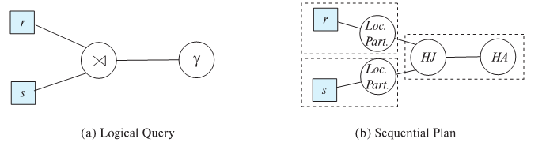
Parallel Plans
Query
Given r(A, C), s(G, B, D, E)
r.C,s.D γ sum(s.E)(r ⋈r.A=s.B s).
Dashed boxes denote pipelined segment
The sequential plan uses a hash join (denoted as “HJ” in the figure), which executes in three separate stages.
The first stage partitions the first input (r) locally on r.A;
the second stage partitions the second input (s) locally on s.B;
and the third stage computes the join of each of the corresponding partitions of r and s.
The aggregate is computed using in-memory hash-aggregation, denoted by the operator HA

Slide 27
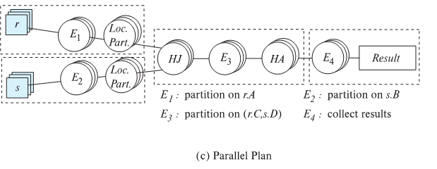
Parallel Plans
Query
Given r(A, C), s(G, B, D, E)
r.C,s.D γ sum(s.E)(r ⋈r.A=s.B s).
The parallel query evaluation plan starts with r and s already partitioned, but not on the required join attributes.
The plan, therefore, uses the exchange operation E1 to repartition r using attribute r.A; similarly, exchange operator E2 repartitions s using s.B.
Each node then uses hash join locally to compute the join of its partition of r and s.
Note that exchange of tuples across nodes is done only by the exchange operator, and all other edges denote tuple flows within each node.

