Slide 1
Data Analytics

Slide 2
Data Analytics
Overview
Data Warehousing
Online Analytical Processing
Data Mining

Slide 3
Overview
Data analytics: the processing of data to infer patterns, correlations, or models for prediction
Primarily used to make business decisions
Per individual customer
E.g., what product to suggest for purchase (Mining)
Across all customers
E.g., what products to manufacture/stock, in what quantity (DSS)
Critical for businesses today

Slide 4
Overview (Cont.)
Common steps in data analytics
Gather data from multiple sources into one location
Data warehouses also integrated data into common schema
Data often needs to be extracted from source formats, transformed to common schema, and loaded into the data warehouse
Can be done as ETL (extract-transform-load), or ELT (extract-load-transform)

Slide 5
Overview (Cont.)
Generate aggregates and reports summarizing data
Dashboards showing graphical charts/reports
Online analytical processing (OLAP) systems allow interactive querying
Statistical analysis using tools such as R/SAS/SPSS
Including extensions for parallel processing of big data
Build predictive models and use the models for decision making

Slide 6
Overview (Cont.)
Predictive models are widely used today
E.g., use customer profile features (e.g. income, age, gender, education, employment) and past history of a customer to predict likelihood of default on loan
and use prediction to make loan decision
E.g., use past history of sales (by season) to predict future sales
And use it to decide what/how much to produce/stock
And to target customers
Other examples of business decisions:
What items to stock?
What insurance premium to change?
To whom to send advertisements?
Question16-1: Write some objectives and applications of data analytics for a mobile phone company like TeleTalk, Grameen etc.

Slide 7
Overview (Cont.)
Machine learning techniques are key to finding patterns in data and making predictions
Data mining extends techniques developed by machine-learning communities to run them on very large datasets
The term business intelligence (BI) is synonym for data analytics
The term decision support focuses on reporting and aggregation

Slide 8
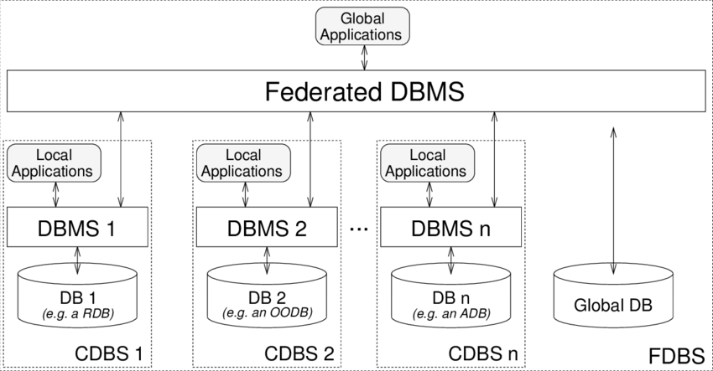
Data Integration From Multiple Sources
Many database applications require data from multiple databases
A federated database system is a software layer on top of existing database systems, which is designed to manipulate information in heterogeneous databases
Creates an illusion of logical database integration without any physical database integration

Slide 9
Data Integration From Multiple Sources
Each database has its local schema
Global schema integrates all the local schema
Schema integration
Queries can be issued against global schema, and translated to queries on local schemas

Slide 10
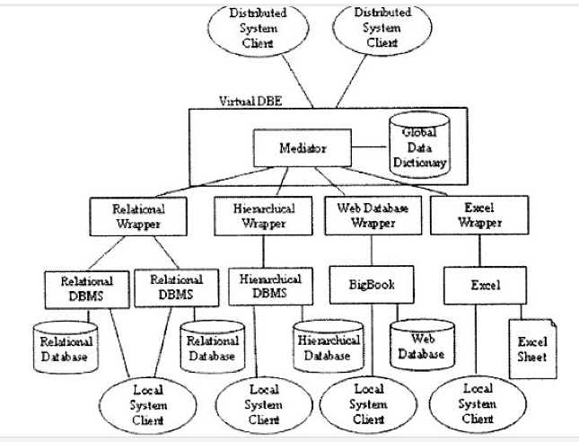
Data Integration From Multiple Sources
Wrapper for a data source is a view that translates data from local to a global schema. Wrappers must also translate updates on global schema to updates on local schema

Slide 11
Data Integration From Multiple Sources
Databases that support common schema and queries, but not updates, are referred to as mediator systems
Question 16-2:
Explain the use of federated database system / mediator system in the context of the management of higher education in Bangladesh by UGC.
Identify some entities and corresponding attributes for global schema for the above.

Slide 12
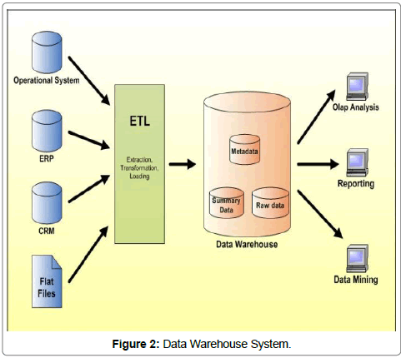
Data Warehouses Concepts
Data warehouse is an alternative to data integration
Migrates data to a common schema, avoiding run-time overhead
Cost of translating schema/data to a common warehouse schema can be significant
ETL is a process in Data Warehousing and it stands for
Extract (E),
Transform (T) and
Load (L).
It is a process in which an ETL tool extracts the data from various data source systems, transforms it in the staging area and then finally, loads it into the Data Warehouse system.

Slide 13
Data Warehouse Concepts
A data warehouse is a repository (or archive) of information gathered from multiple sources, stored under a unified schema, at a single site.
Once gathered, the data are stored for a long time, permitting access to historical data.
Thus, data warehouses provide the user a single consolidated interface to data, making decision-support queries easier to write.

Slide 14
Data Warehouse Concepts
What schema to use. Data sources that have been constructed independently are likely to have different schemas. In fact, they may even use different data models. Part of the task of a warehouse is to perform schema integration and to convert data to the integrated schema before they are stored.
Data cleansing. The task of correcting and preprocessing data is called data cleansing. Data sources often deliver data with numerous minor inconsistencies, which can be corrected.
Data transformation: Transformation of host format to warehouse format

Slide 15
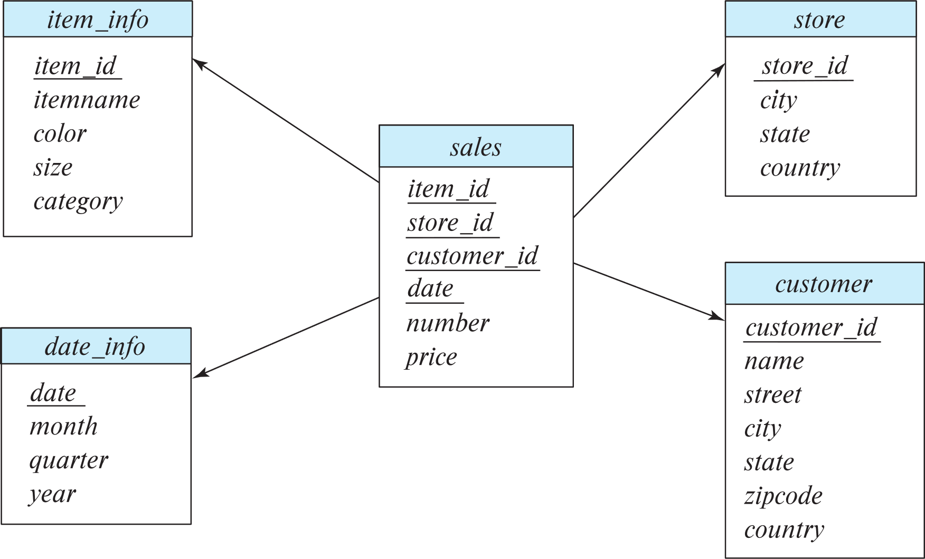
Data Warehouse Concepts
Multidimensional Data and Warehouse Schemas
Data warehouses typically have schemas that are designed for data analysis, using tools such as OLAP tools.
The relations in a data warehouse schema can usually be classified as fact tables and dimension tables.
Fact tables record information about individual events, such as sales, and are usually very large.
A table recording sales information for a retail store, with one tuple for each item that is sold, is a typical example of a fact table.

Slide 16
Data Warehouse Concepts
Multidimensional Data and Warehouse Schemas
The attributes in fact table can be classified as either dimension attributes or measure attributes,
The measure attributes store quantitative information, which can be aggregated upon; the measure attributes of a sales table would include the number of items sold and the price of the items.
In contrast, dimension attributes are dimensions upon which measure attributes, and summaries of measure attributes, are grouped and viewed.

Slide 17
Data Warehouse Concepts
Multidimensional Data and Warehouse Schemas
The dimension attributes of a sales table would include an item identifier, the date when the item is sold, which location (store) the item was sold from, the customer who bought the item, and so on.
Data that can be modeled using dimension attributes and measure attributes are called multidimensional data.
To minimize storage requirements, dimension attributes are usually short identifiers that are foreign keys into other tables called dimension tables.

Slide 18
Designing Star Schema
A fact table sales would have dimension attributes item id, store id, customer id, and date, and measure attributes number and price. The attribute store id is a foreign key into a dimension table store, which has other attributes such as store location (city, state, country). The item id attribute of the sales table would be a foreign key into a dimension table item info, which would contain information such as the name of the item, the category to which the item belongs, and other item details such as color and size. The customer id attribute would be a foreign key into a customer table containing attributes such as name and address of the customer. We can also view the date attribute as a foreign key into a date info table giving the month, quarter, and year of each date.

Slide 19
Data Warehouse Schema

Slide 20
Question 17-1:
Design a star schema for the data warehouse of call duration and bill of different types of calls of different users all mobile service phone companies.
Steps 1: Design fact table with measure attributes and dimensional attributes.
Step 2: Design the dimensional tables
Step 3: Design the star schema

Slide 21
Towards Development of Health Data Warehouse: Bangladesh Perspective
Abstract
Availability of timely and accurate data is essential for medical decision making (What?). Health care organizations face a common problem with large amount of data they have in numerous systems. Such systems are unstructured and unorganized (How?), requires computational time for data integration (Why?). Researchers, medical practitioners, health care providers and patients will not be able to utilize the knowledge stored in different repositories unless synthesize the information from disparate sources. This problem can be solved by Data warehousing.

Slide 22
Towards Development of Health Data Warehouse: Bangladesh Perspective
Data warehousing techniques share a common set of tasks, include requirements analysis, data design, architectural design, implementation and deployment. Developing Clinical data warehouse is complex and time consuming but is essential to deliver quality patient care. Data integration tasks of medical data store are much challenging when designing clinical data warehouse architecture. This research identifies prospects and complexities of Health data warehousing and Mining in Bangladesh perspective and proposes a data-warehousing model suitable for integrating data from different health care sources.

Slide 23
The Architecture of National DW
Why data cleaning required in DW? Explain with examples?
What is data transformation? Find some data to be transformed in NHDW.

Slide 24
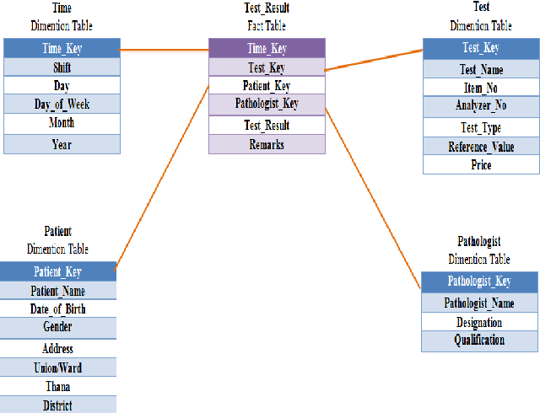
Question 18-1:
Find four useful DSS reports that can be generated from the given star schema from aggregations (average, max, min, sum, count).
Find any missing dimension.

Slide 25
Data Analysis and OLAP
Online Analytical Processing (OLAP)
Interactive analysis of data, allowing data to be summarized and viewed in different ways in an online fashion (with negligible delay)
We use the following relation to illustrate OLAP concepts
sales (item_name, color, clothes_size, quantity)
This is a simplified version of the sales fact table joined with the dimension tables, and many attributes removed (and some renamed)

Slide 26
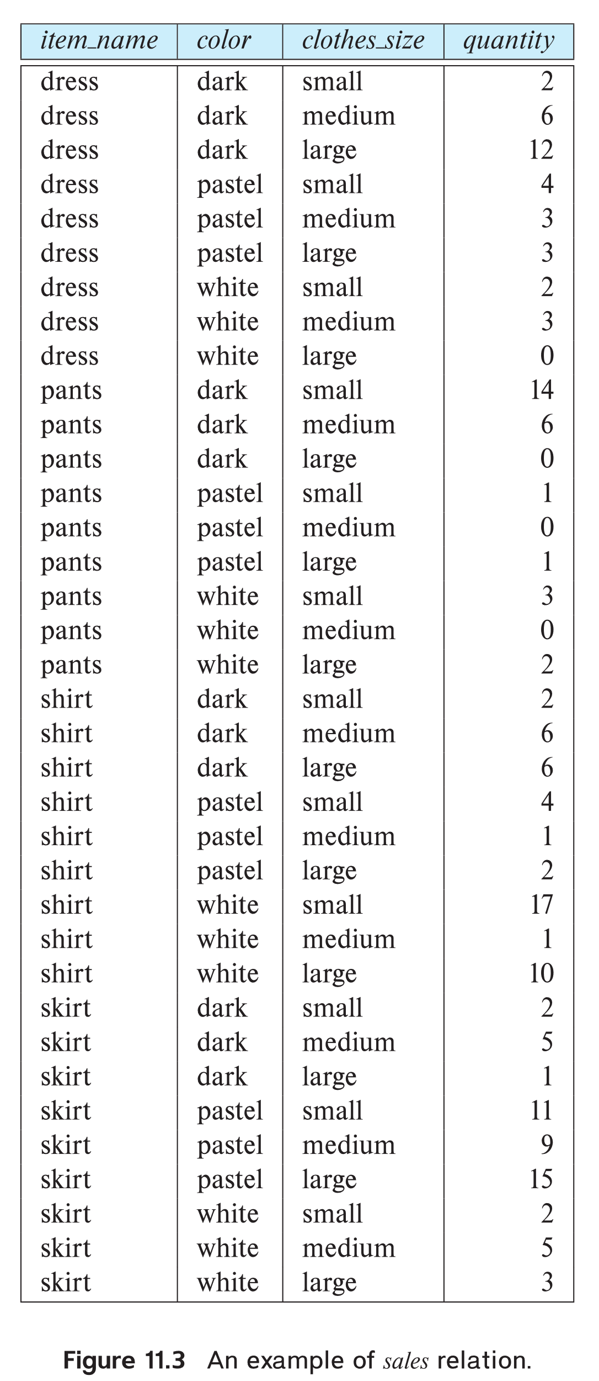
Example sales relation
How can we get the table
Sales-item (item_name, color, clothes_size, quantity)
From star schema?
Answer:
Select item_name, color, clothes_size, number as quantity
From item_info a, sales b
Where a.item_id = b.item_id
...
...
...
...
...
...
...
...

Slide 27
Cross Tabulation of sales by item_name and color
How can you find the cross-tab of sales?
Write SQL to find the cross-tab.
SQL for cloth_size:
Select sum(quantity) from sales
SQL for total of item_name:
Select item_name, sum(quantity)
From sales
Group by item_name
The table above is an example of a cross-tabulation (cross-tab), also referred to as a pivot-table.
Values for one of the dimension attributes form the row headers
Values for another dimension attribute form the column headers
Other dimension attributes are listed on top
Values in individual cells are (aggregates of) the values
of the dimension attributes that specify the cell.
SQL for total of color:
Select color, sum(quantity)
From sales
Group by item_name
SQL for other cells:
Select item_name, color, sum(quantity)
From sales
Group by item_name, color

Slide 28
Cross Tabulation of sales by item_name and color
How can you find the cross-tab of sales?
Write SQL to find the cross-tab.
SQL for cloth_size:
Select sum(quantity) from sales
SQL for total of item_name:
Select item_name, sum(quantity)
From sales
Group by item_name
Question 18-2:
Write cross tabulation structure of sales by cloth_size and item_name.
Write SQL to find the cross-tab
SQL for total of color:
Select color, sum(quantity)
From sales
Group by item_name
SQL for other cells:
Select item_name, color, sum(quantity)
From sales
Group by item_name, color

Slide 29
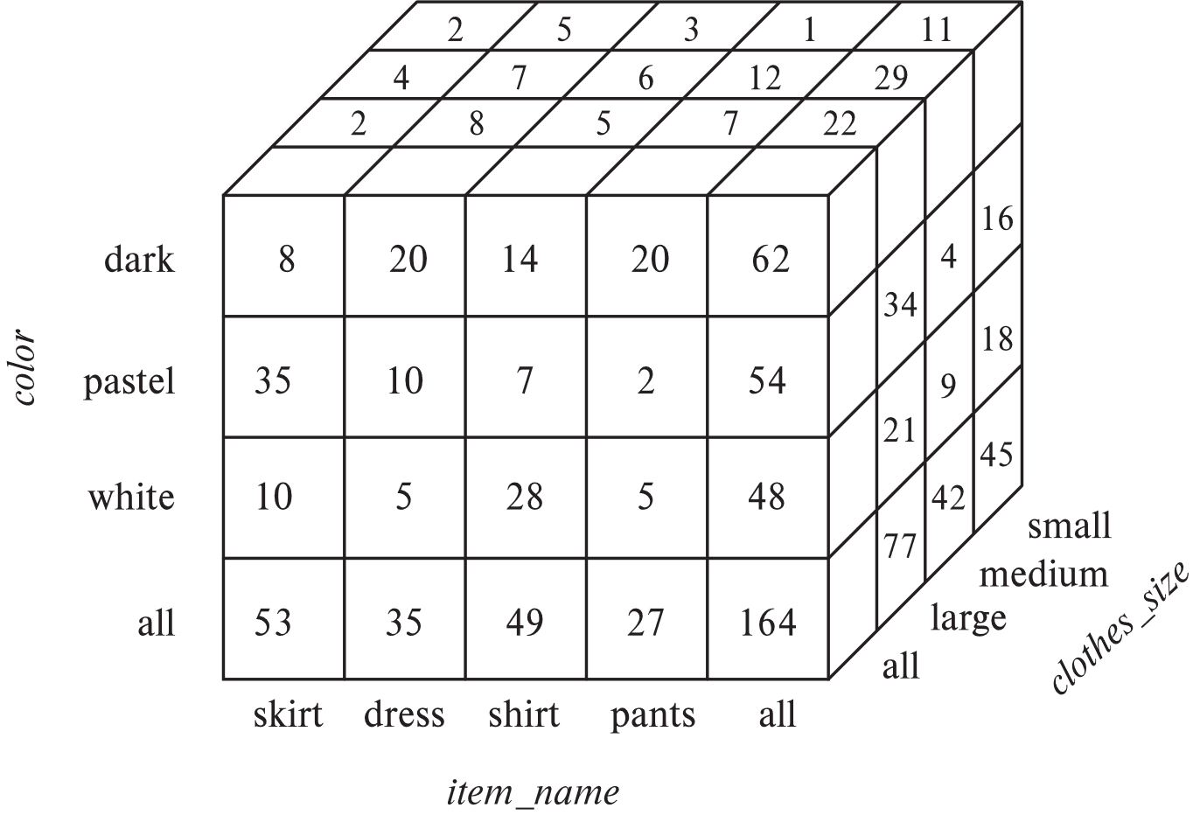
Data Cube
A data cube is a multidimensional generalization of a cross-tab
Can have n dimensions; we show 3 below
Cross-tabs can be used as views on a data cube

Slide 30
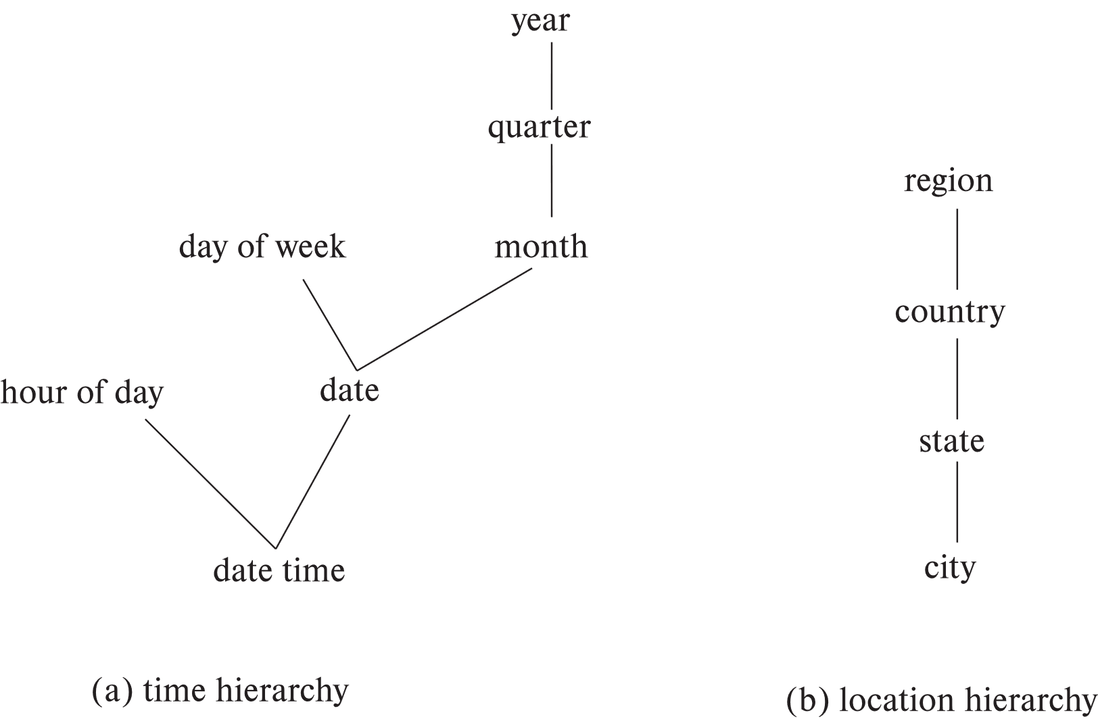
Hierarchies on Dimensions
Hierarchy on dimension attributes: lets dimensions be viewed at different levels of detail
E.g., the dimension datetime can be used to aggregate by hour of day, date, day of week, month, quarter or year

Slide 31
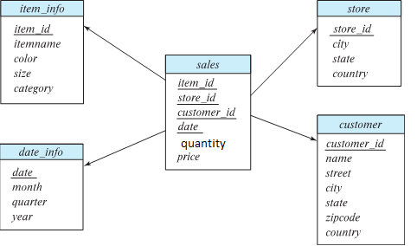
Hierarchies on Dimensions
How can you prepare DSS reports based on hierarchy?
Report on date (Year, , quarter, month, date wise report)
R1 = select year, quarter, month, date, sum(quantity) as tot_d from sales s, date_info d Where s.date = d.date Group by year, quarter, month, date
Report on date (Year, , quarter, month wise report)
R2 = select year, quarter, month sum(tot_d) as tot_m from R1 Where s.date = d.date Group by year, quarter, month, date

Slide 32
Hierarchies on Dimensions
How can you prepare DSS reports based on hierarchy?
Report on date (Year, , quarter, month, date wise report)
R1 = select year, quarter, month, date, sum(quantity) as tot_d from sales s, date_info d Where s.date = d.date Group by year, quarter, month, date
Report on month (Year, , quarter, month wise report)
R2 = select year, quarter, month sum(tot_d) as tot_m from R1 Where s.date = d.date Group by year, quarter, month, date
Report on quarter (Year, quarter wise report)
R3 = select year, quarter sum(tot_m) as tot_q from R2
Group by year, quarter
Report on year (Year wise report)
R4 = select year sum(tot_q) as tot_y from R3
Group by year
** R1, R2 R3, and R4 may be stored in the database as materialized view
Question 18-3: Write SQL for all DSS reports on location hierarchy

Slide 33
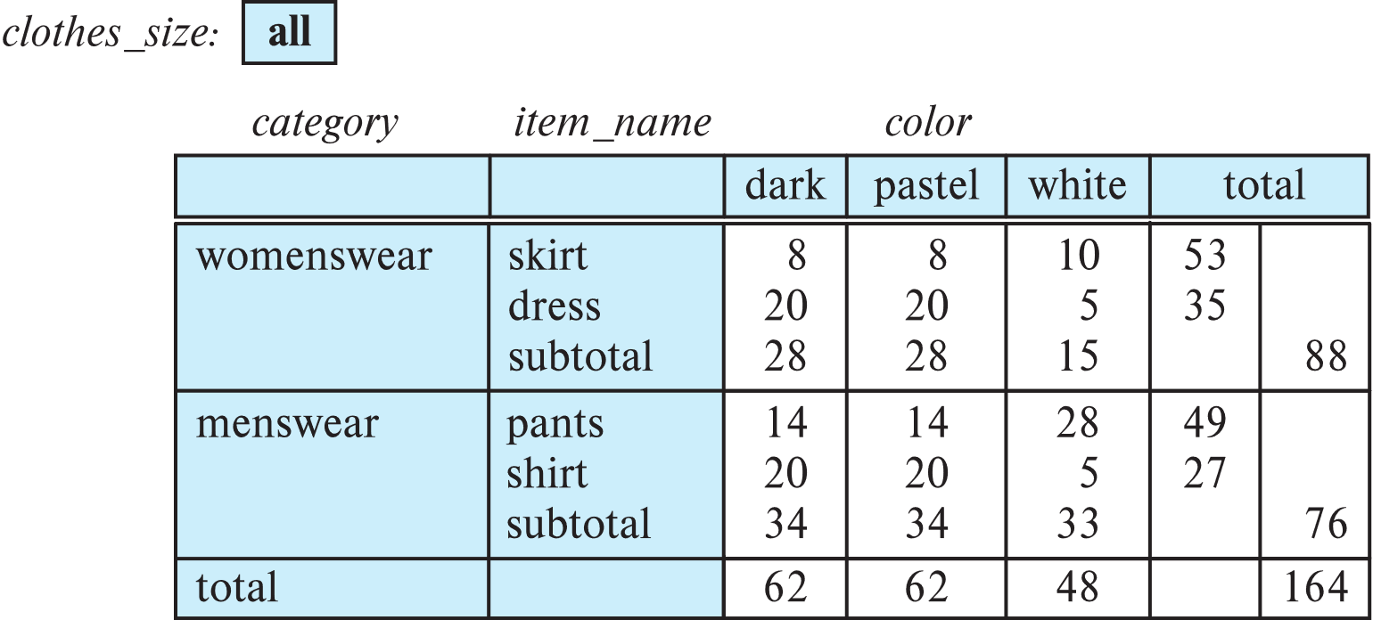
Cross Tabulation With Hierarchy
Cross-tabs can be easily extended to deal with hierarchies
Can drill down or roll up on a hierarchy
E.g. hierarchy: item_name → category

Slide 34
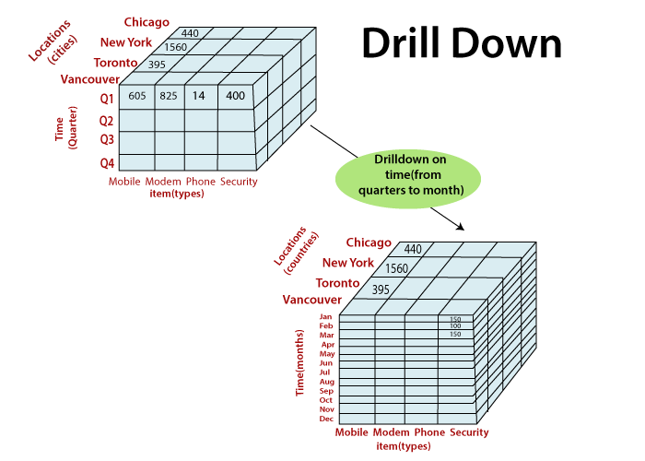
Cross Tabulation With Hierarchy
Cross-tabs can be easily extended to deal with hierarchies
Can drill down or roll up on a hierarchy
E.g. hierarchy: item_name → category
Drill down is a capability that takes the user from a more general view of the data to a more specific one at the click of a mouse. For example, a report that shows sales revenue by division can allow the user to select a division, click on it and see sales revenue by district within that division.

Slide 35
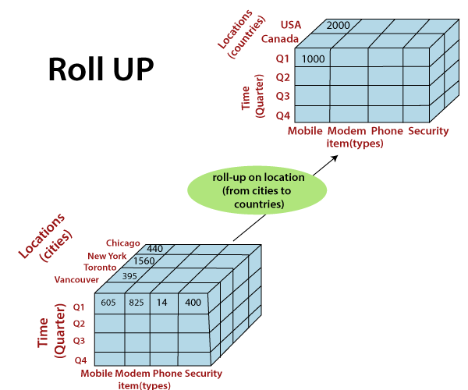
Cross Tabulation With Hierarchy
Cross-tabs can be easily extended to deal with hierarchies
Can drill down or roll up on a hierarchy
E.g. hierarchy: item_name → category
The roll-up operation aggregates the data by ascending the location hierarchy from the level of the city to the level of the country. When a roll-up is performed by dimensions reduction, one or more dimensions are removed from the cube. For example, R1 → R2 → R3 → R4.

