Slide 1
Distributed Database

Slide 2
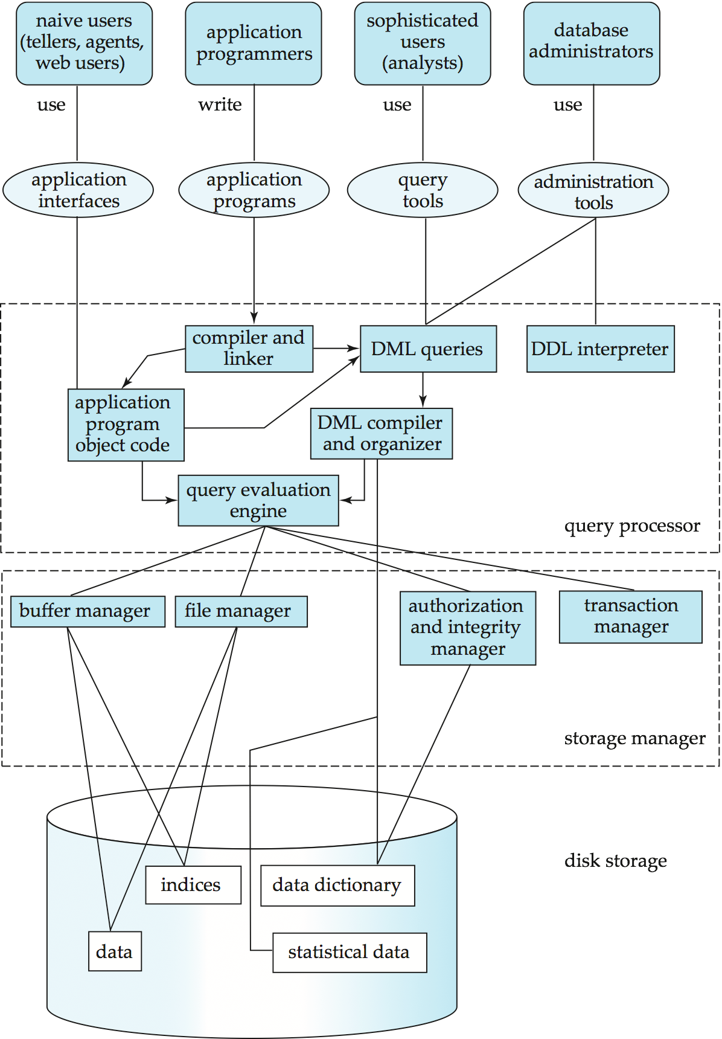
Centralized DBMS
Main Components
Data in storage
Querying Data
Query Optimization
Indexing
Transaction processing
Application Development and Design
Architecture
Advanced Model
In
Memory
Query Processor
Storage manager
In
Disk

Slide 3
Motivation
Database
Technology
Computer
Networks
integration
distribution
Distributed
Database
Systems
integration
integration ≠ centralization

Slide 4
What is a Distributed Database System?
A distributed database (DDB) is a collection of multiple, logically interrelated databases distributed over a computer network.
A distributed database management system (D–DBMS) is the software that manages the DDB and provides an access mechanism that makes this distribution transparent to the users.
Distributed database system (DDBS) = DDB + D–DBMS

Slide 5
Centralized DBMS on a Network
Site 1
Site 2
Site 5
Communication
Network
Site 4
Site 3

Slide 6
Distributed DBMS Environment
Site 1
Site 2
Site 5
Communication
Network
Site 4
Site 3

Slide 7
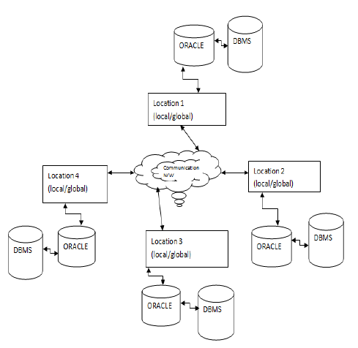
Homogeneous Distributed Database
In Homogeneous Distributed Database –
All sites shall have same DBMS

Slide 8
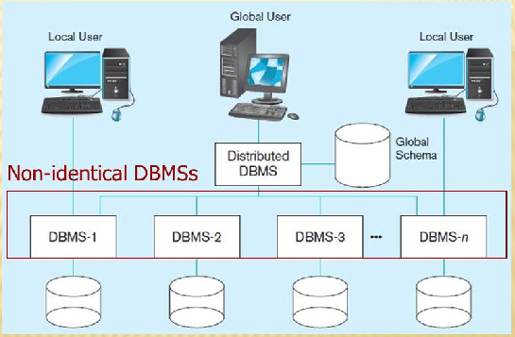
Heterogeneous Distributed Database
In Heterogeneous Distributed Database –
Different sites shall have different DBMS
Question 19-1: Compare homogeneous and heterogeneous DDBMS in terms of storage, querying and transaction.

Slide 9
Transparency
Transparency is the separation of the higher level semantics of a system from the lower level implementation issues.
Fundamental issue is to provide
data independence
in the distributed environment
Network (distribution) transparency
Replication transparency
Fragmentation transparency
horizontal fragmentation: selection
vertical fragmentation: projection
hybrid

Slide 10
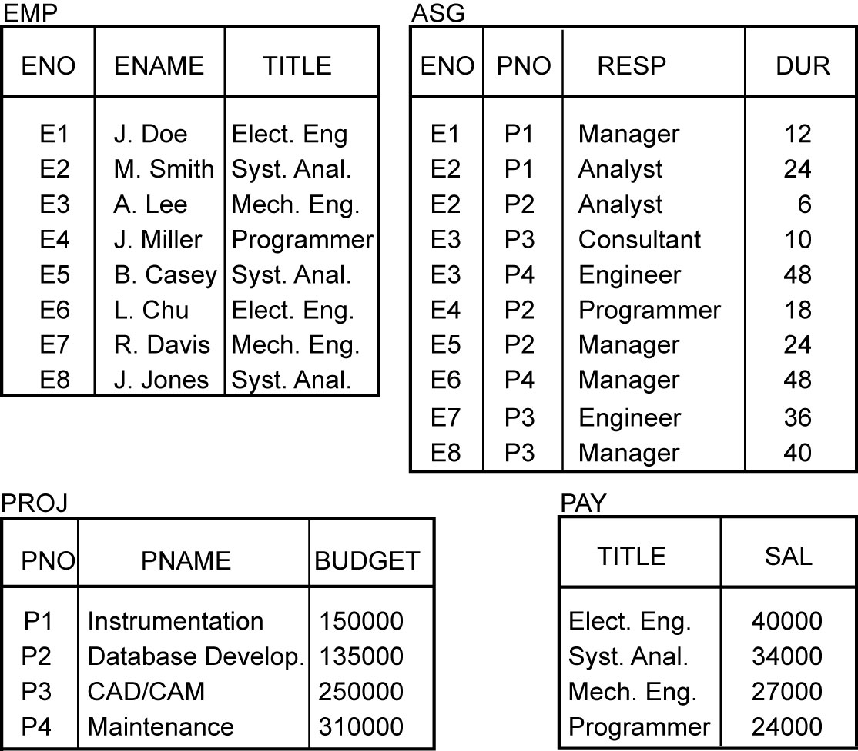
Example

Slide 11
Transparent Access
SELECT ENAME,SAL
FROM EMP,ASG,PAY
WHERE DUR > 12
AND EMP.ENO = ASG.ENO
AND PAY.TITLE = EMP.TITLE
Tokyo
Boston
Paris
Paris projects
Paris employees
Paris assignments
Boston employees
Communication
Network
Boston projects
Boston employees
Boston assignments
Montreal
New
York
Montreal projects
Paris projects
New York projects
with budget > 200000
Montreal employees
Montreal assignments
Boston projects
New York employees
New York projects
New York assignments
Notes:
Animated slide

Slide 12
Reliability Through Distributed Transactions
Replicated components and data should make distributed DBMS more reliable.
Distributed transactions provide
Concurrency transparency
Failure atomicity
Distributed transaction support requires implementation of
Distributed concurrency control protocols
Commit protocols
Data replication
Great for read-intensive workloads, problematic for updates
Replication protocols

Slide 13
Potentially Improved Performance
Proximity of data to its points of use
Requires some support for fragmentation and replication
Parallelism in execution
Inter-query parallelism
Intra-query parallelism

Slide 14
Parallelism Requirements
Have as much of the data required by each application at the site where the application executes
Full replication
How about updates?
Mutual consistency
Freshness of copies

Slide 15
Distributed DBMS Issues
Distributed Database Design
How to distribute the database
Replicated & non-replicated database distribution
A related problem in directory management
Query Processing
Convert user transactions to data manipulation instructions
Optimization problem
min{cost = data transmission + local processing}
General formulation is NP-hard

Slide 16
Distributed DBMS Issues
Concurrency Control
Synchronization of concurrent accesses
Consistency and isolation of transactions' effects
Deadlock management
Reliability
How to make the system resilient to failures
Atomicity and durability
Question 19-2: Explain the challenges in data transparency and transactional reliability in DDBMS.

Slide 17
Relationship Between Issues
Directory
Management
Query
Processing
Distribution
Design
Reliability
Concurrency
Control
Deadlock
Management

Slide 18
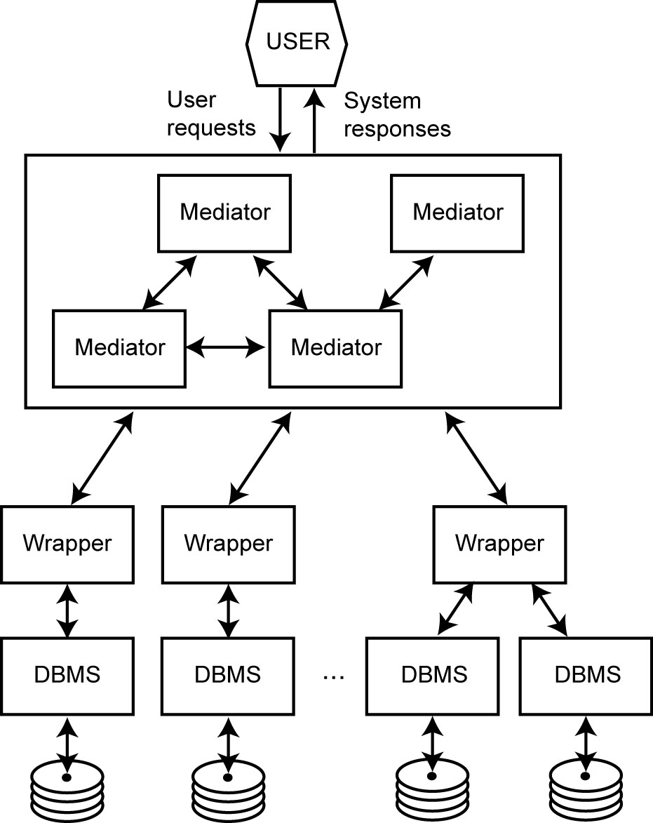
Mediator/Wrapper Architecture for Data Integration

