Slide 1
Parallel and Distributed Transaction Processing

Slide 2
Transaction Concept
A transaction is a unit of program execution that accesses and possibly updates various data items.
E.g., transaction to transfer $50 from account A to account B:
1. read(A)
2. A := A – 50
3. write(A)
4. read(B)
5. B := B + 50
6. write(B)
Two main issues to deal with:
Failures of various kinds, such as hardware failures and system crashes
Concurrent execution of multiple transactions

Slide 3
Required Properties of a Transaction
Transaction to transfer $50 from account A to account B:
1. read(A)
2. A := A – 50
3. write(A)
4. read(B)
5. B := B + 50
6. write(B)
Atomicity requirement
If the transaction fails after step 3 and before step 6, money will be “lost” leading to an inconsistent database state
Failure could be due to software or hardware
The system should ensure that updates of a partially executed transaction are not reflected in the database

Slide 4
Required Properties of a Transaction
Transaction to transfer $50 from account A to account B:
1. read(A)
2. A := A – 50
3. write(A)
4. read(B)
5. B := B + 50
6. write(B)
Durability requirement — once the user has been notified that the transaction has completed (i.e., the transfer of the $50 has taken place), the updates to the database by the transaction must persist even if there are software or hardware failures.

Slide 5
Required Properties of a Transaction (Cont.)
Transaction to transfer $50 from account A to account B:
1. read(A)
2. A := A – 50
3. write(A)
4. read(B)
5. B := B + 50
6. write(B)
Consistency requirement in above example:
The sum of A and B is unchanged by the execution of the transaction
A transaction, when starting to execute, must see a consistent database.
During transaction execution the database may be temporarily inconsistent.
When the transaction completes successfully the database must be consistent

Slide 6
Required Properties of a Transaction (Cont.)
Isolation requirement — if between steps 3 and 4, another transaction T2 is allowed to access the partially updated database, it will see an inconsistent database (the sum A + B will be less than it should be).
T1 T2
1. read(A)
2. A := A – 50
3. write(A) read(A), read(B), print(A+B)
4. read(B)
5. B := B + 50
6. write(B
Isolation can be ensured trivially by running transactions serially
That is, one after the other.

Slide 7
Required Properties of a Transaction (Cont.)
Isolation requirement — if between steps 3 and 6, another transaction T2 is allowed to access the partially updated database, it will see an inconsistent database (the sum A + B will be less than it should be).
T1 T2
1. read(A)
2. A := A – 50
3. write(A) read(A), read(B), print(A+B)
4. read(B)
5. B := B + 50
6. write(B
Isolation can be ensured trivially by running transactions serially
That is, one after the other.
However, executing multiple transactions concurrently has significant benefits.

Slide 8
ACID Properties
A transaction is a unit of program execution that accesses and possibly updates various data items. To preserve the integrity of data the database system must ensure:
Atomicity. Either all operations of the transaction are properly reflected in the database or none are.
Consistency. Execution of a transaction in isolation preserves the consistency of the database.
Isolation. Although multiple transactions may execute concurrently, each transaction must be unaware of other concurrently executing transactions. Intermediate transaction results must be hidden from other concurrently executed transactions.
That is, for every pair of transactions T_{i} and T_{j}, it appears to T_{i} that either T_{j}, finished execution before T_{i} started, or T_{j} started execution after T_{i} finished.
Durability. After a transaction completes successfully, the changes it has made to the database persist, even if there are system failures.

Slide 9
Transaction State
Active – the initial state; the transaction stays in this state while it is executing
Partially committed – after the final statement has been executed.
Failed -- after the discovery that normal execution can no longer proceed.
Aborted – after the transaction has been rolled back and the database restored to its state prior to the start of the transaction. Two options after it has been aborted:
Restart the transaction
can be done only if no internal logical error
Kill the transaction
Committed – after successful completion.

Slide 10
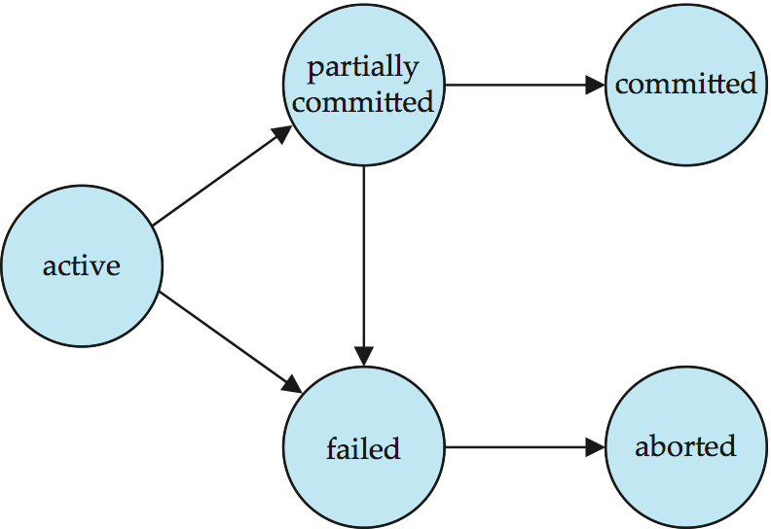
Transaction State (Cont.)

Slide 11
Distributed Transactions
Local transactions
Access/update data at only one database
Global transactions
Access/update data at more than one database
Key issue: how to ensure ACID properties for transactions in a system with global transactions spanning multiple database

Slide 12
Distributed Transactions
Transaction may access data at several sites.
Each site has a local transaction manager
Each site has a transaction coordinator
Global transactions submitted to any transaction coordinator

Slide 13
Distributed Transactions
Each transaction coordinator is responsible for:
Starting the execution of transactions that originate at the site.
Distributing sub-transactions at appropriate sites for execution.
Coordinating the termination of each transaction that originates at the site
transaction must be committed at all sites or aborted at all sites.
Site4
TC4
Site1
TM4
Site3
TC1
TC3
TM1
TM3
Question-20-1:Site 3 has initiated Transaction T to transfer Tk. 1000 from account P at site 4 to account Q at site 2. Write down the tasks of TC3.
Site2
TC2
TM2

Slide 14
Distributed Transactions
Each local transaction manager responsible for:
Maintaining a log for recovery purposes
Coordinating the execution and commit/abort of the transactions executing at that site.
Site4
TC4
Site1
TM4
Site3
Question 20-2:
Site 1 has initiated Transaction T to transfer Tk. 1000 from account A at site 3 to account B at site 2 and transaction T1 to add Tk. 5000 to account C at site 3.
Write down the tasks of TM3.
TC1
TC3
TM1
TM3
Site2
TC2
TM2

Slide 15
System Failure Modes
Failures unique to distributed systems:
Failure of a site.
Loss of massages
Handled by network transmission control protocols such as TCP-IP
Failure of a communication link
Handled by network protocols, by routing messages via alternative links
Network partition
A network is said to be partitioned when it has been split into two or more subsystems that lack any connection between them
Note: a subsystem may consist of a single node
Network partitioning and site failures are generally indistinguishable.

Slide 16
Coordinator
Transaction: Transfer Tk. 5000 from account A to account B. A in site 2 and B in site 3. Transaction has been initiated from site 1.
The transaction with lock
Site 1
Site 2
TC 1
TC 2
TM1 1
TM 2
LOG
LOG
<Start T> by TC1
Lock (A) request by TC1 granted by TM2
READ (A)
A = A- 5000
Write (A)
Lock (B) request by TC1 granted by TM3
READ (B)
B=B+5000
WRITE (B)
COMMIT (T)
UNLOCK (A)
UNLOCK (B)
Site 3
TC 3
TM 3
LOG

Slide 17
Coordinator
<Start T> by TC1
Lock (A) request by TC1 granted by TM1
READ (A)
A = A- 5000
Write (A)
Lock (B) request by TC1 granted by TM2
READ (B)
B=B+5000
WRITE (B)
COMMIT (T)
UNLOCK (A)
UNLOCK (B)
Site 1
Site 2
TC 1
TC 2
TM1 1
TM1 2
LOG
LOG
Site 3
TC 3
TM1 3
LOG
Commit protocols are used to ensure atomicity across sites
A transaction which executes at multiple sites must either be committed at all the sites, or aborted at all the sites.
Cannot have transaction committed at one site and aborted at another
Question 21-1: Why is COMMIT protocol needed to COMMIT the transaction T initiated by TC1? Explain.

Slide 18
Commit Protocols
The two-phase commit (2PC) protocol is widely used
Three-phase commit (3PC) protocol avoids some drawbacks of 2PC, but is more complex
Consensus protocols solve a more general problem, but can be used for atomic commit
The protocols we study all assume fail-stop model – failed sites simply stop working, and do not cause any other harm, such as sending incorrect messages to other sites.

Slide 19
Two Phase Commit Protocol (2PC)
Execution of the protocol is initiated by the coordinator after the last step of the transaction has been reached.
The protocol involves all the local sites at which the transaction executed
Protocol has two phases
Let T be a transaction initiated at site S1 and let the transaction coordinator at S1 be TC1

Slide 20
Phase 1: Obtaining a Decision
Coordinator
<Ready T>
Site 1
Site 2
TC 1
<Prepare T>
TC 2
Coordinator asks all participants to prepare to commit transaction T
TM1 1
TM1 2
<Prepare T>
<ready T>
TC₁ adds the records <prepare T> to the log and forces log to stable storage
sends prepare T messages to all sites at which T executed
<Prepare T>
Site 3
<Ready T>
TC 3
Upon receiving message, transaction manager at site determines if it can commit the transaction or not
TM1 3
Decision1: All sites wants to COMMIT
add the record <ready T> to the log
force all records for T to stable storage
send ready T message to TC1
<ready T>

Slide 21
Phase 2: Recording the Decision
Coordinator
<Ready T>
Site 1
Site 2
TC 1
<Prepare T>
TC 2
Transaction COMMIT by TC1
T can be committed of TC1 received a <ready T> message from all the participating sites.
Coordinator adds a decision record, <commit T> to the log and forces record onto stable storage.
Once the record stable storage it is irrevocable (even if failures occur)
Coordinator sends a message to commit to each participant informing it of the decision.
Participants take appropriate action locally.
TM1 1
TM1 2
<Prepare T>
<commit T>
<commit T>
<ready T>
<Prepare T>
Site 3
<Ready T>
<commit T>
TC 3
TM1 3
<ready T>
Question 21-2: Write down the activities of the coordinator of site 1 in phase 1 and phase 2 for the case when all the sites including coordinator wants to commit

Slide 22
Phase 2: Recording the Decision
Coordinator
<Ready T>
Site 1
Site 2
TC 1
<Prepare T>
TC 2
Transaction ABORT by TC1
Even after receiving <ready T> messages by TC1 from all the participating sites, TC1 has the authority to abort the transaction T.
Coordinator adds a decision record, <abort T> to the log and forces record onto stable storage.
Once the record stable storage it is irrevocable.
Coordinator sends a message to abort to each participant informing it of the decision.
Participants take appropriate action locally.
TM1 1
TM1 2
<Prepare T>
<abort T>
<abort T>
<ready T>
<Prepare T>
Site 3
<Ready T>
<abort T>
TC 3
TM1 3
<ready T>

Slide 23
Phase 1: Obtaining a Decision
Coordinator
<Ready T>
Site 1
Site 2
TC 1
<Prepare T>
TC 2
Coordinator asks all participants to prepare to commit transaction T
TM1 1
TM1 2
<Prepare T>
<ready T>
TC₁ adds the records <prepare T> to the log and forces log to stable storage
sends prepare T messages to all sites at which T executed
<Prepare T>
Site 3
<abort T>
TC 3
Upon receiving message, transaction manager at site determines if it can commit the transaction or not
TM1 3
Decision2: One site don’t want to COMMIT (Site3)
add a record <no T> to the log and
send abort T message to TC1
<no T>

Slide 24
Phase 2: Recording the Decision
Coordinator
<Ready T>
Site 1
Site 2
TC 1
<Prepare T>
TC 2
Transaction must be aborted by TC1
T must be aborted by TC1 if it received a <abort T> message from any of the participating sites.
Coordinator adds a decision record, <abortT> to the log and forces record onto stable storage.
Once the record stable storage it is irrevocable (even if failures occur)
Coordinator sends a message to abort to each participant informing it of the decision.
Participants take appropriate action locally.
TM1 1
TM1 2
<Prepare T>
<abort T>
<abort T>
<ready T>
<Prepare T>
Site 3
<abort T>
<abort T>
TC 3
TM1 3
<No T>
Question 21-3: Write down the activities of the site 3 in phase 1 and coordinator in phase 2 in the case when site 3 do not want to commit.

Slide 25
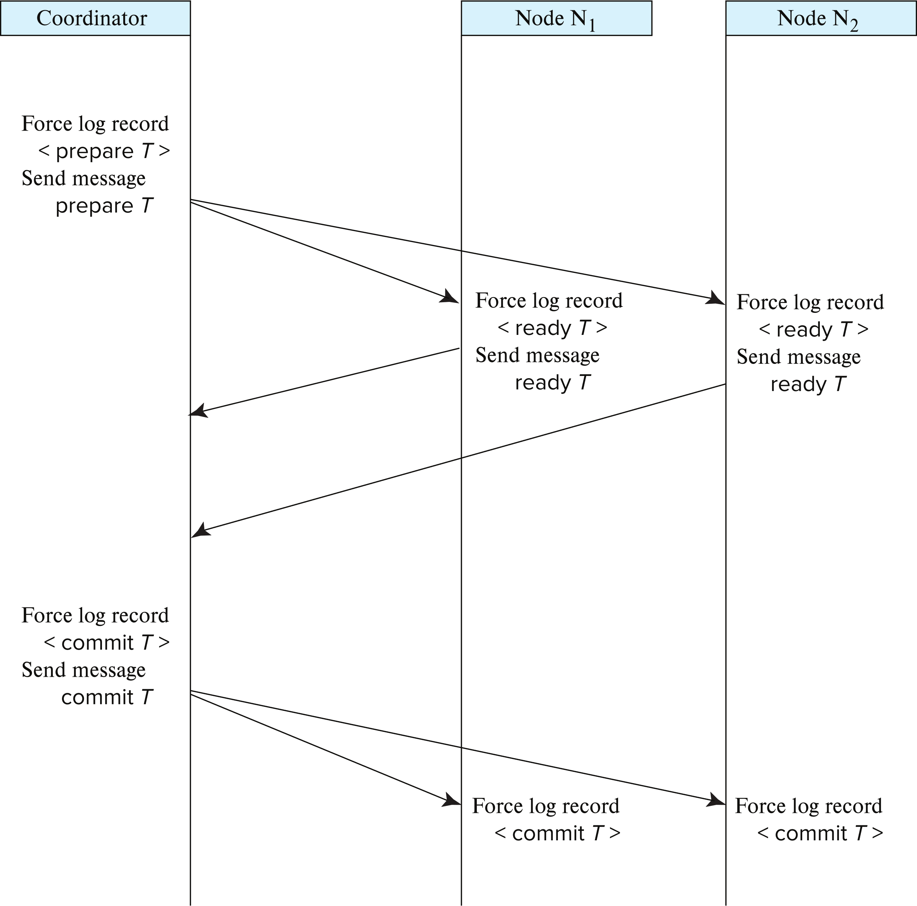
Two-Phase Commit Protocol

Slide 26
Handling of Failures - Site Failure
Site 2 was failed
When site S2 recovers, it examines its log to determine the fate of
transactions active at the time of the failure.
Site4
TC4
Case 1: Log contain <commit T> record:
site 2 executes redo (T)
Question 4-1: Why redo (T)?
Site1
TM4
Site3
TC1
TC3
TM1
TM3
Case 2: Log contains <abort T> record:
site 2 executes undo (T)
Question 4-2: Why undo (T)?
Site2
TC2
Case 3: Log contains <ready T> record:
site must consult TC1 to determine the fate of T.
If T committed, redo (T)
If T aborted, undo (T)
TM2

Slide 27
Handling of Failures - Site Failure
Case 1: Log contain <commit T> record:
site 2 executes redo (T)
Question 4-1: Why redo (T)?
Site 2 was failed
When site S2 recovers, it examines its log to determine the fate of
transactions active at the time of the failure.
Site 2 log records
<Start T>
<T, A, 20000, 15000>
<Ready T>
<T COMMIT>
<Start T> by TC1
Lock (A) request by TC1 granted by TM2
READ (A)
A = A- 5000
Write (A)
Lock (B) request by TC1 granted by TM3
READ (B)
B=B+5000
WRITE (B)
COMMIT (T)
UNLOCK (A)
UNLOCK (B)
Failed
Site 2 log
<Start T>
<T, A, 20000, 15000>
<Ready T>
<T COMMIT>
Site 2 recovery
Set A = 15000

Slide 28
Handling of Failures - Site Failure
Site 2 was failed
When site S2 recovers, it examines its log to determine the fate of
transactions active at the time of the failure.
Case 2: Log contains <abort T> record:
site 2 executes undo (T)
Question 4-2: Why undo (T)?
Site 2 log records
<Start T>
<T, A, 20000, 15000>
<Ready T>
<T Abort>
<Start T> by TC1
Lock (A) request by TC1 granted by TM2
READ (A)
A = A- 5000
Write (A)
Lock (B) request by TC1 granted by TM3
READ (B)
B=B+5000
WRITE (B)
COMMIT (T)
UNLOCK (A)
UNLOCK (B)
Failed
Site 2 log
<Start T>
<T, A, 20000, 15000>
<Ready T>
<T Abort>
Site 2 recovery
Set A = 20000

Slide 29
Handling of Failures - Site Failure
Case 3: Log contains <ready T> record:
site must consult TC1 to determine the fate of T.
If T committed, redo (T)
Site 2 was failed
When site S2 recovers, it examines its log to determine the fate of
transactions active at the time of the failure.
Site 2 log records
<Start T>
<T, A, 20000, 15000>
<Ready T>
<Start T> by TC1
Lock (A) request by TC1 granted by TM2
READ (A)
A = A- 5000
Write (A)
Lock (B) request by TC1 granted by TM3
READ (B)
B=B+5000
WRITE (B)
COMMIT (T)
UNLOCK (A)
UNLOCK (B)
Failed
Site 2 log
<Start T>
<T, A, 20000, 15000>
<Ready T>
<T COMMIT>
Site 2 recovery
Set A = 20000

Slide 30
Handling of Failures - Site Failure
Case 3: Log contains <ready T> record:
site must consult TC1 to determine the fate of T.
If T aborted, undo (T)
Site 2 was failed
When site S2 recovers, it examines its log to determine the fate of
transactions active at the time of the failure.
Site 2 log records
<Start T>
<T, A, 20000, 15000>
<Ready T>
<Start T> by TC1
Lock (A) request by TC1 granted by TM2
READ (A)
A = A- 5000
Write (A)
Lock (B) request by TC1 granted by TM3
READ (B)
B=B+5000
WRITE (B)
COMMIT (T)
UNLOCK (A)
UNLOCK (B)
Failed
Site 2 log
<Start T>
<T, A, 20000, 15000>
<Ready T>
<T Abort>
Site 2 recovery
Set A = 20000

Slide 31
Handling of Failures - Site Failure
Site4
Site 2 was failed
Case 4: The log contains no control records concerning T implies that S2 failed before responding to the prepare T message from TC1.
Since the failure of S2 precludes the sending of such a response TC1 must abort T
S2 must execute undo (T)
TC4
Site1
TM4
Site3
TC1
TC3
TM1
TM3
Site2
TC2
TM2
Discuss when the transaction will be undo(T) and when it will be redo(T)

Slide 32
Handling of Failures - Coordinator Failure
If coordinator fails while the commit protocol for T is executing then participating sites must decide on T’s fate
Site4
Case 1: If an active site contains a <commit T> record in its log, then T must be committed.
TC4
Site1
TM4
Site3
TC1
TC3
Case 2: If an active site contains an <abort T> record in its log, then T must be aborted.
TM1
TM3
Case 3: If some active participating site does not contain a <ready T> record in its log, then the failed coordinator C_{i} cannot have decided to commit T. Can therefore abort T.
Site2
TC2
TM2

Slide 33
Handling of Failures - Coordinator Failure
If coordinator fails while the commit protocol for T is executing then participating sites must decide on T’s fate
Site4
Case 4: If none of the above cases holds, then all active sites must have a <ready T> record in their logs, but no additional control records (such as <abort T> or <commit T>). In this case active sites must wait for C_{i} to recover, to find decision.
TC4
Site1
TM4
Site3
TC1
TC3
TM1
TM3
Blocking problem: active sites may have to wait for failed coordinator to recover.
Site2
TC2
Question-22-1:Site 3 has initiated Transaction T3 to transfer Tk. 1000 from account P at site 4 to account Q at site 2.
Explain the atomicity of T3 for different types of site and coordinator failures.
TM2

Slide 34
Recovery and Concurrency Control
In-doubt transactions: When a failed site is recovered, the transactions those have a <ready T>, but neither a <commit T>, nor an <abort T> log record.
The recovering site must determine the commit / abort status of In-doubt transactions by contacting other sites;
this can slow the recovery (How?)
Because after recovery, all active transactions must have redo or undo based on Commit / abort status
Or can block the recovery (How?)
In case of coordinator failure, site cannot decide commit/abort and indefinite wait for coordinator

Slide 35
Delay in Recovery (Example)
Case 3: Log contains <ready T> record:
site must consult TC1 to determine the fate of T.
If T committed, redo (T)
Site 2 was failed
When site S2 recovers, it examines its log to determine the fate of
transactions active at the time of the failure.
Site 2 log records
<Start T>
<T, A, 20000, 15000>
<Ready T>
<Start T> by TC1
Lock (A) request by TC1 granted by TM2
READ (A)
A = A- 5000
Write (A)
Lock (B) request by TC1 granted by TM3
READ (B)
B=B+5000
WRITE (B)
COMMIT (T)
UNLOCK (A)
UNLOCK (B)
Failed
Delay
Site 2 log
<Start T>
<T, A, 20000, 15000>
<Ready T>
<T COMMIT>
Site 2 recovery
Set A = 20000

Slide 36
Delay in Recovery (Example)
Case 3: Log contains <ready T> record:
site must consult TC1 to determine the fate of T.
If T aborted, undo (T)
Site 2 was failed
When site S2 recovers, it examines its log to determine the fate of
transactions active at the time of the failure.
Site 2 log records
<Start T>
<T, A, 20000, 15000>
<Ready T>
<Start T> by TC1
Lock (A) request by TC1 granted by TM2
READ (A)
A = A- 5000
Write (A)
Lock (B) request by TC1 granted by TM3
READ (B)
B=B+5000
WRITE (B)
COMMIT (T)
UNLOCK (A)
UNLOCK (B)
Failed
Delay
Site 2 log
<Start T>
<T, A, 20000, 15000>
<Ready T>
<T Abort>
Site 2 recovery
Set A = 20000

Slide 37
Recovery and Concurrency Control
For faster recovery, Recovery algorithms can note lock information in the log.
Instead of <ready T>, write out <ready T, L> L = list of locks held by T when the log is written (read locks can be omitted).
Question: A Transaction T5 has Read lock (A), Write Lock (D) and Write Lock ( E) at site 3. T5 has Write Lock ( G) at site 2. T5 is initiated by site 1. The data item A, D and E are in site 3. Site 3 wants to commit T5. What log record will be written by site 3? How will it be used for recovery?
<ready T5, {D,E}>
For every in-doubt transaction T, all the locks noted in the <ready T, L> log record are reacquired.
After lock reacquisition, transaction processing can resume; the commit or rollback of in-doubt transactions is performed concurrently with the execution of new transactions.

Slide 38
Avoiding Blocking Using Consensus
Blocking problem of 2PC is a serious concern
How it arises?
T1 is initiated by site 1 (coordinator)
T1 has data from site 2, 3 and 4. Site 2, 3 and 4 are ready to commit and has written <ready T1> to their log.
Site 2, 3 and 4 are blocked for T1 and wait until site 1 is restored.
Idea: involve multiple nodes in decision process, so failure of a few nodes does not cause blocking as long as majority don’t fail
Site4
TC4
Site1
TM4
Site3
TC1
TC3
Just after that, site 1 failed.
TM1
TM3
Site2
TC2
TM2

Slide 39
Avoiding Blocking Using Consensus
Solution of Blocking Problem
Distributed consensus protocol
A set of n nodes need to agree on a decision
Inputs to make the decision are provided to all the nodes, and then each node votes on the decision
The decision should be made in such a way that all nodes will “learn” the same value for the transaction even if some nodes fail during the execution of the protocol.
Site4
TC4
Site1
TM4
Site3
TC1
TC3
TM1
TM3
Site2
TC2
TM2

Slide 40
Using Consensus to Avoid Blocking
Solution of Blocking Problem
Distributed consensus protocol
After getting response from 2PC participants, coordinator can initiate distributed consensus protocol by sending its decision to a set of participants who then use consensus protocol to commit the decision
If coordinator fails before informing all consensus participants
Choose a new coordinator, which follows 2PC protocol for failed coordinator
If a commit/abort decision was made as long as a majority of consensus participants are accessible, decision can be found without blocking
Site4
TC4
Site1
TM4
Site3
TC1
TC3
TM1
TM3
Site2
TC2
TM2

Slide 41
Using Consensus to Avoid Blocking
Solution of Blocking Problem
Distributed consensus protocol
Case 1: Coordinator (Site 1) failed before sending commit proposal to site 2, 3 and 4.
Steps:
A new coordinator will be selected (e.g., site 3).
Site 3 will initiate 2PC on behalf of site 1
Commit/abort will be performed as per consensus protocol.
No blocking of site 2, 3 and 4 for T1.
Site4
TC4
Site1
TM4
Site3
TC1
TC3
TM1
TM3
Site2
TC2
TM2

Slide 42
Using Consensus to Avoid Blocking
Solution of Blocking Problem
Distributed consensus protocol
Case 2: Coordinator (Site 1) failed after sending commit proposal to site 2, 3 and 4.
Commit/abort will be performed as per consensus protocol.
No blocking of site 2, 3 and 4 for T1.
Site4
TC4
Site1
TM4
Site3
TC1
TC3
TM1
TM3
Site2
TC2
TM2

Slide 43
Distributed Transactions via Persistent Messaging
Notion of a single transaction spanning multiple sites is inappropriate for many applications
E.g., transaction crossing an organizational boundary
Latency of waiting for commit from remote site
Question: There is an account A under organization 1 and an account B under organization 2. Transfer Tk. 5000 from account A to account B using persistent messaging protocol.
Persistent messaging systems are systems that provide transactional properties to messages
Persistent messages are guaranteed to be delivered exactly once
Debit Tk. 5000 from account A and send a message to organization 2
Organization 2 receives message and credits Tk. 5000 to account B

Slide 44
Distributed DBMS Environment
Organization 1
Site 1
Site 2
Site 5
Communication
Network
Organization 2
Site 4
Site 3

Slide 45
Persistent Messaging
Atomicity issue
Once transaction sending a message is committed, message must guaranteed to be delivered
Guarantee as long as destination site is up and reachable, code to handle undeliverable messages must also be available
e.g., credit money back to source account.
If sending transaction aborts, message must not be sent

Slide 46
Error Conditions with Persistent Messaging
Code to handle messages has to take care of variety of failure situations (even assuming guaranteed message delivery)
E.g., if destination account does not exist, failure message must be sent back to source site
When failure message is received from destination site, or destination site itself does not exist, money must be deposited back in source account
Problem if source account has been closed
get humans to take care of problem

Slide 47
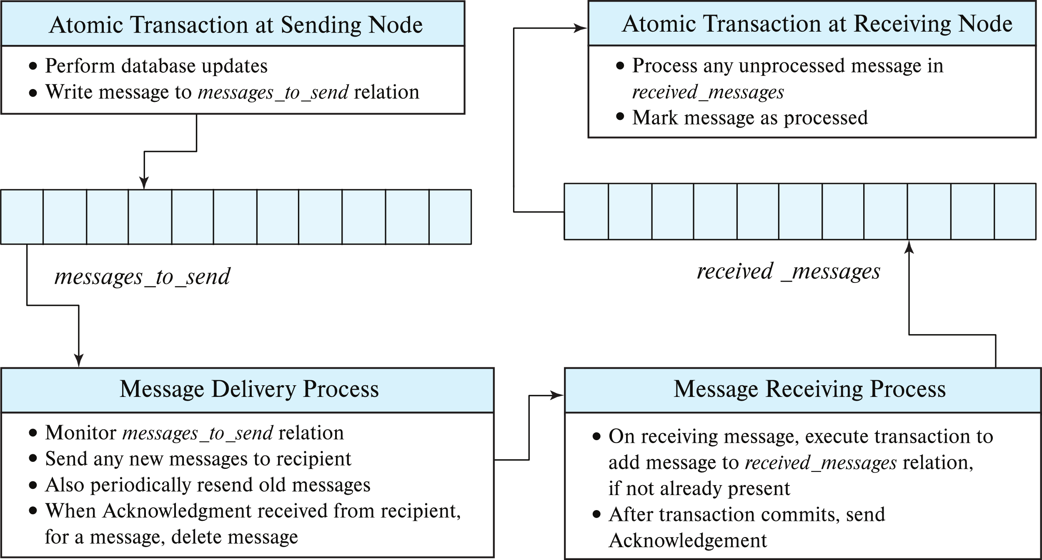
Persistent Messaging Implementation
Question 23-1: There is an account A under organization 1 and an account B under organization 2.
Show all the steps to transfer Tk. 5000 from account A to account B using persistent messaging protocol.
Discuss all types of failures and atomicity issues.

Slide 48
Persistent Messaging (Cont.)
Receiving site may get duplicate messages after a very long delay
To avoid keeping processed messages indefinitely
Messages are given a timestamp
Received messages older than some cutoff are ignored
Stored messages older than the cutoff can be deleted at receiving site

Slide 49
Persistent Messaging (Cont.)
Workflows provide a general model of transactional processing involving multiple sites and possibly human processing of certain steps
E.g., when a bank receives a loan application, it may need to
Contact external credit-checking agencies
Get approvals of one or more managers
and then respond to the loan application
Persistent messaging forms the underlying infrastructure for workflows in a distributed environment

