Slide 1
Concurrency Control in Centralized Databases

Slide 2
Atomocity Using Lock-Based Protocols
A lock is a mechanism to control concurrent access to a data item
Data items can be locked in two modes :
exclusive (X) mode. Data item can be both read as well as written. X-lock is requested using lock-X instruction.
shared (S) mode. Data item can only be read. S-lock is requested using lock-S instruction.
Lock requests are made to the concurrency-control manager by the transaction manager. Transaction can proceed only after request is granted.
Lock-compatibility matrix

Slide 3
Atomocity Using Lock-Based Protocols
Lock-compatibility matrix
T1 | T2 | T3 | Lock status
LOCK-S(A) |  |  | GRANT(A,T1)
READ(A)
 | LOCK-S(A) |  | GRANT(A,T2)
 | READ(A)
 |  | LOCK-X(A) | WAIT(A,T3)
 |  | WRITE(A)

Slide 4
Atomocity Using Lock-Based Protocols
Lock-compatibility matrix
T4 | T5 | T6 | Lock status
LOCK-X(A)
WRITE(A)
 | LOCK-S(A)
 | READ(A)
 |  | LOCK-X(A)
 |  | WRITE(A)
GRANT(A,T4)
WAIT(A,T5)
WAIT(A,T6)

Slide 5
Atomocity Using Lock-Based Protocols
Lock-compatibility matrix
T7 | T8 | T9 | Lock status
LOCK-X(A)
WRITE(A)
 | LOCK-X(B)
 | WRITE(B)
 |  | LOCK-X(C)
 |  | WRITE(C)
GRANT(A,T7)
GRANT(B,T8)
GRANT(C,T9)

Slide 6
Atomocity Using Lock-Based Protocols
Lock-compatibility matrix
Question 24-1 Put appropriate lock and show lock status
T1 | T2 | T3 | T4 | LOCK STATUS
READ(P)
 | WRITE(Q)
 |  | READ(P)
 |  |  | WRITE(P)

Slide 7
Lock-Based Protocols
Example of a transaction performing locking:
T₂: lock-S(A);
read (A);
unlock(A);
lock-S(B);
read (B);
unlock(B);
display(A+B)
Locking as above is not sufficient to guarantee serializability — if A and B get updated in-between the read of A and B, the displayed sum would be wrong.
A locking protocol is a set of rules followed by all transactions while requesting and releasing locks. Locking protocols restrict the set of possible schedules.

Slide 8
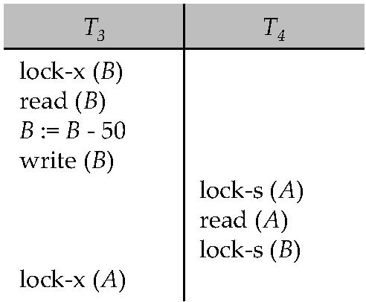
Pitfalls of Lock-Based Protocols
Consider the partial schedule
Neither T₃ nor T₄ can make progress — executing lock-S(B) causes T₄ to wait for T₃ to release its lock on B, while executing lock-X(A) causes T₃ to wait for T₄ to release its lock on A.
Such a situation is called a deadlock.
To handle a deadlock one of T₃ or T₄ must be rolled back and its locks released.

Slide 9
The Two-Phase Locking Protocol
This is a protocol which ensures conflict-serializable schedules.
Phase 1: Growing Phase
transaction may obtain locks
transaction may not release locks
Phase 2: Shrinking Phase
transaction may release locks
transaction may not obtain locks
The protocol assures serializability. It can be proved that the transactions can be serialized in the order of their lock points (i.e. the point where a transaction acquired its final lock).
Rigorous two-phase locking is even stricter: here all locks are held till commit/abort. In this protocol transactions can be serialized in the order in which they commit.

Slide 10
Schedules
Schedule – a sequences of instructions that specify the chronological order in which instructions of concurrent transactions are executed
A schedule for a set of transactions must consist of all instructions of those transactions
Must preserve the order in which the instructions appear in each individual transaction.
A transaction that successfully completes its execution will have a commit instructions as the last statement
By default transaction assumed to execute commit instruction as its last step
A transaction that fails to successfully complete its execution will have an abort instruction as the last statement

Slide 11
Serializability
Basic Assumption – Each transaction preserves database consistency.
Thus, serial execution of a set of transactions preserves database consistency. (T1, T2, T3, ….., Tn)
A (possibly concurrent) schedule is serializable if it is equivalent to a serial schedule. Different forms of schedule equivalence give rise to the notions of:
1. Conflict serializability
2. View serializability

Slide 12
SERIALIZABILITY
Schedule 1 (Serial Schedule)
Schedule 2 (Equivalent concurrent Schedule)
T1 | T2
READ(A)
READ(B)
R=A+B
DISPLAY(R)
 | READ(A)
 | READ(C )
 | A = A-1000
 | C=C+1000
 | WRITE(A)
 | WRITE(C)
T1 | T2
READ(A)
 | READ(A)
 | READ(C )
 | A = A-1000
 | C=C+1000
READ(B)
R=A+B
DISPLAY(R)
 | WRITE(A)
 | WRITE(C)

Slide 13
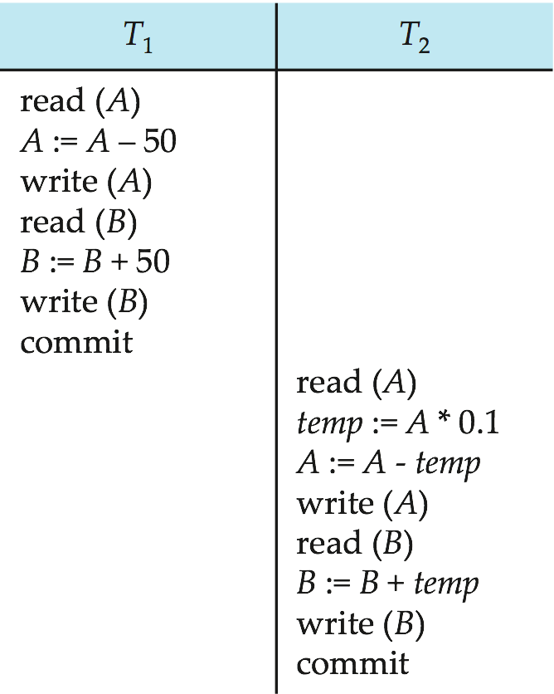
Schedule 1
Let T₁ transfer $50 from A to B, and T₂ transfer 10% of the balance from A to B.
An example of a serial schedule in which T₁ is followed by T₂ :
A =100, B=100, .In schedules 1, the sum “A + B” is preserved.

Slide 14
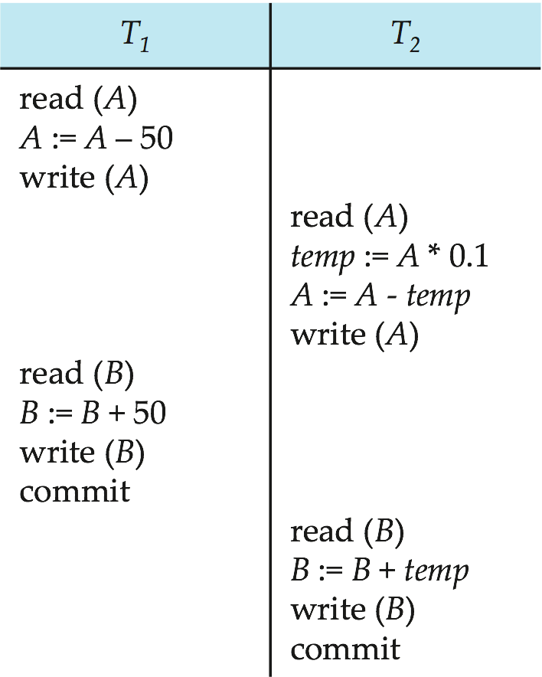
Schedule 2
Let T₁ and T₂ be the transactions defined previously. The following schedule is not a serial schedule, but it is equivalent to Schedule 1.
Question 24-2:
Given A = 100 and B= 100. Prove that the above concurrent schedule preserve database consistency.
Explain conflict serializability

Slide 15
Concurrency Control in Distributed Databases

Slide 16
Concurrency Control
Site5
Concurrency control mechanism maintains the ACID property of transaction by lock based protocol.
Modify concurrency control schemes for use in distributed environment.
We assume that each site participates in the execution of a commit protocol to ensure global transaction atomicity.
We assume all replicas of any item are updated
TC5
Site1
TM5
Site4
TC1
TC4
TM1
TM4
Site2
Site3
TC2
TC3
TM2
TM3
A
B

Slide 17
Automatic Acquisition of Locks
A transaction T_{i} issues the standard read/write instruction, without explicit locking calls.
The operation read(D) is processed as:
if T_{i} has a lock on D
then
read(D)
else begin
if necessary wait until no other
transaction has a lock-X on D
grant T_{i} a lock-S on D;
read(D)
end

Slide 18
Automatic Acquisition of Locks (Cont.)
write(D) is processed as:
if T_{i} has a lock-X on D
then
write(D)
else begin
if necessary wait until no other transaction has any lock on D,
if T_{i} has a lock-S on D
then
upgrade lock on D to lock-X
else
grant T_{i} a lock-X on D
write(D)
end;
All locks are released after commit or abort

Slide 19
Single-Lock-Manager Approach
In the single lock-manager approach, lock manager runs on a single chosen site, say Site1. All lock requests sent to central lock manager
How to perform READ (A)?
The transaction can read the data item from any one of the sites at which a replica of the data item resides.
Question 25-1 Let us consider the transaction T41 at site 4. The transaction display of balance of account A. There is single lock manager at site 1.
Write the transaction with lock.
Write the steps to obtain the lock by T41.
A
AB
Site5
TC5
Site1
TM5
Site4
TC1
TC4
SLM
LOCK_S(A)
TM1
LOCK_S(A)
TM4
LOCK_S(A)
LOCK_S(A)
Site2
Site3
TC2
TC3
TM2
TM3
A
B

Slide 20
Single-Lock-Manager Approach
In the single lock-manager approach, lock manager runs on a single chosen site, say Site1. All lock requests sent to central lock manager
How to perform write (B)?
The transaction has to write the data item to all of the sites at which a replica of the data item resides.
Question 25-2 Let us consider the transaction T21 at site 2. The transaction add Tk. 1000 to account B. There is single lock manager at site 1.
Write the transaction with lock.
Write the steps to obtain the lock by T21.
A
AB
Site5
TC5
Site1
TM5
Site4
TC1
TC4
SLM
TM1
LOCK_X(B)
TM4
LOCK_X(B)
LOCK_X(B)
Site2
Site3
TC2
TC3
TM2
TM3
A
B
Writes must be performed on all replicas of a data item

Slide 21
Single-Lock-Manager Approach
Advantages of scheme:
Simple implementation
Simple deadlock handling
Disadvantages of scheme are:
Bottleneck: lock manager site becomes a bottleneck
Vulnerability: system is vulnerable to lock manager site failure.

Slide 22
Distributed Lock Manager
In the distributed lock-manager approach, functionality of locking is implemented by lock managers at each site
Lock managers control access to local data items
Locking is performed separately on each site accessed by transaction
Every replica must be locked and updated
But special protocols may be used for replicas (more on this later)
A
AB
Site5
TC5
LM
Site1
TM5
Site4
TC1
TC4
LM
LM
TM1
TM4
Site2
Site3
TC2
TC3
LM
LM
TM2
TM3
A
B

Slide 23
Distributed Lock Manager
Advantage: work is distributed and can be made robust to failures
Disadvantage:
Possibility of a global deadlock without local deadlock at any single site
Lock managers must cooperate for deadlock detection
A
AB
Site5
TC5
LM
Site1
TM5
Site4
TC1
TC4
LM
LM
TM1
TM4
Site2
Site3
TC2
TC3
LM
LM
TM2
TM3
Compare single lock manager and distributed lock manager approach.
A
B

Slide 24
Replication
High availability is a key goal in a distributed database
Robustness: the ability to continue function despite failures
Replication is key to robustness
Replication decisions can be made at level of data items, or at the level of partitions

Slide 25
Concurrency Control With Replicas
Focus here on concurrency control with locking
Failures addressed later
Ideas described here can be extended to other protocols
Primary copy
one replica is chosen as primary copy for each data item (e.g., A in site 2)
Node containing primary replica is called primary node (site 2 for A)
concurrency control decisions made at the primary copy only (by site 2)
A
AB
Site5
TC5
Site1
TM5
Site4
TC1
TC4
TM1
TM4
Site2
Site3
TC2
TC3
TM2
TM3
Example: How LOCK-X(A) of T10 at site 3 will be obtained using primary protocol? Site 2 is primary copy for A.
site 3 sends LOCK-X(A) request to sites 2.
If T10 gets lock on A, then A is locked and T10 proceeds
A
B

Slide 26
Concurrency Control With Replicas
Focus here on concurrency control with locking
Failures addressed later
Ideas described here can be extended to other protocols
Primary copy
one replica is chosen as primary copy for each data item (e.g., A in site 2)
Node containing primary replica is called primary node (site 2 for A)
concurrency control decisions made at the primary copy only (by site 2)
A
AB
Site5
TC5
Site1
TM5
Site4
TC1
TC4
TM1
TM4
Site2
Site3
TC2
TC3
TM2
TM3
Question: How LOCK-X(B) of T2 at site 2 will be obtained using primary copy protocol? Site 4 is primary copy for B.
A
B

Slide 27
Concurrency Control With Replicas
Benefit: Low overhead of locking (How?)
Drawback: primary copy failure (site 2 for A) results in loss of lock information and non-availability of data item (A), even if other replicas (site 1, site 4) are available
Extensions to allow backup server to take over possible, but vulnerable to problems on network partition
A
AB
Site5
TC5
Site1
TM5
Site4
TC1
TC4
TM1
TM4
Site2
Site3
TC2
TC3
TM2
TM3
A
B

Slide 28
Concurrency Control With Replicas (Cont.)
Majority protocol:
Transaction requests locks at majority/all replicas
Lock is successfully acquired on the data item only if lock obtained at a majority of replicas
A
AB
Site5
TC5
Site1
TM5
Site4
TC1
TC4
TM1
TM4
Example: How LOCK-X(A)/ LOCK-S(A) of T10 at site 3 will be obtained using majority protocol?
site 3 sends LOCK-X(A)/ LOCK-S(A) request to sites 1, 2 or 2,4 or 1,4 or 1,2,4.
If T1 gets lock on 2 sites, then A is locked and T1 proceeds
Site2
Site3
TC2
TC3
TM2
TM3
A
B

Slide 29
Concurrency Control With Replicas (Cont.)
Number of messages in Majority Protocol
Benefit:
Resilient to node failures
Processing can continue as long as at least a majority of replicas are accessible
Overheads
Higher cost due to multiple messages
Possibility of deadlock even when locking single item
Example: A data item Q is replicated to 10 sites. Transaction T1 has LOCK-S(A).
What is the minimum number of messages required to obtain this lock using majority protocol?
Messages for lock request
= 10/2 + 1 = 6
Messages for lock grant
= 10/2 + 1 = 6
Messages for unlock
= 10/2 + 1 = 6
Total = 6+6+6 = 18

Slide 30
Concurrency Control With Replicas (Cont.)
Number of messages in Majority Protocol
Benefit:
Resilient to node failures and node failures
Processing can continue as long as at least a majority of replicas are accessible
Overheads
Higher cost due to multiple messages
Possibility of deadlock even when locking single item
Question 26-1: A data item P is replicated to 12 sites. Transaction T2 has LOCK-X(P).
Find the minimum number of messages required to
obtain this lock using majority protocol?
unlock

Slide 31
Concurrency Control With Replicas (Cont.)
Number of messages in Majority Protocol
Benefit:
Resilient to node failures and node failures
Processing can continue as long as at least a majority of replicas are accessible
Overheads
Higher cost due to multiple messages
Possibility of deadlock even when locking single item
How can you avoid such deadlocks?
A data item Q is replicated to n sites. Transaction T1 has LOCK-S(A).
What is the minimum number of messages required to obtain this lock?
Messages for lock request
= n/2 + 1
Messages for lock grant
= n/2 + 1
Messages for unlock
= n/2 + 1
Total = 3(n/2 + 1)

Slide 32
Concurrency Control With Replicas (Cont.)
Number of messages in Primary Copy Protocol
Messages for lock request
= 1
Messages for lock grant
=1
Messages for unlock
= 1
Total = 1+1+1 = 3
Example: A data item Q is replicated to 10 sites. Transaction T1 has LOCK-S(A).
What is the number of messages required to obtain this lock using primary copy protocol?

Slide 33
Concurrency Control With Replicas (Cont.)
Biased protocol
Shared lock can be obtained on any replica
Reduces overhead on reads
Exclusive lock must be obtained on all replicas
Blocking if any replica is unavailable
Example: A data item Q is replicated to 10 sites. Transaction T1 has LOCK-S(A).
What is the minimum number of messages required to obtain this lock?
Messages for lock request
= 1
Messages for lock grant
=1
Messages for unlock
= 1
Total = 1+1+1 = 3
Example: A data item Q is replicated to 10 sites. Transaction T1 has LOCK-X(A).
What is the minimum number of messages required to obtain this lock?
No. of messages = 3*10 = 30

Slide 34
Concurrency Control With Replicas (Cont.)
Biased protocol
Shared lock can be obtained on any replica
Reduces overhead on reads
Exclusive lock must be obtained on all replicas
Blocking if any replica is unavailable
Question26-2: Data item A and B are replicated to 15 sites. Transaction T11 has LOCK-X(A) and LOCK-S(B).
What are the minimum number of sites required to obtain these locks using biased protocol?
Find the number of messages to obtain lock and release lock in each case.
Compare biased protocol with majority protocol in terms of performance.

Slide 35
Quorum Consensus Protocol
Quorum consensus protocol for locking
Each site is assigned a weight; let S be the total of all site weights
Choose two values read quorum Q_{R} and write quorum Q_{W}
Such that Q_{r} + Q_{w} > S and 2 * Q_{w} > S
Each read must lock enough replicas that the sum of the site weights is ≥ Q_{r}
Each write must lock enough replicas that the sum of the site weights is ≥ Q_{w}
Can choose Q_{r} and Q_{w} to tune relative overheads on reads and writes
Suitable choices result in majority and biased protocols.
What are they?
Example: The data item P is replicated in 9 sites and the weight of each site is 1. Q_{w} is 7 and Q_{r} is 3. S=9
Find the number of replicas to be locked for
LOCK-S
LOCK-X
For Lock-S, Qr = 3,
Sum of site weight = 3
Number of sites = 3
For Lock-X, Qw = 7
Sum of site weight = 7
Number of sites = 7

Slide 36
Quorum Consensus Protocol
Example: The data item P is replicated in 9 sites S1, S2, S3, S4, S5, S6, S7, S8, S9 and the weight of the sites are1,1,1,2,2,2,3,3,3 respectively. Q_{w} is 12 and Q_{r} is 7.
Find the replicas to be locked for
LOCK-S(P)
LOCK-X(P)
Starting the sites with lowest weight with ascending order.
Starting the sites with highest weight with descending order.
Quorum consensus protocol for locking
Each site is assigned a weight; let S be the total of all site weights
Choose two values read quorum Q_{R} and write quorum Q_{W}
Such that Q_{r} + Q_{w} > S and 2 * Q_{w} > S
Each read must lock enough replicas that the sum of the site weights is ≥ Q_{r}
Each write must lock enough replicas that the sum of the site weights is ≥ Q_{w}
Can choose Q_{r} and Q_{w} to tune relative overheads on reads and writes
Suitable choices result in majority and biased protocols.
What are they?
a. Ascending order
Weights S1 + S2 + S3 + S4 + s5
= 1+1+1+2+2= 7 = Q_{r}
For LOCK-S(P), sites to have locked is
S1, S2, S3, S4, s5
Weights S1+S2+S3+S4+s5+S6+S7
= 1+1+1+2+2+2+3= 12= Q_{w}
For LOCK-X(P), sites to have locked is
S1, S2, S3, S4, s5,S6,S7

Slide 37
Quorum Consensus Protocol
Example: The data item P is replicated in 9 sites S1, S2, S3, S4, S5, S6, S7, S8, S9 and the weight of the sites are1,1,1,2,2,2,3,3,3 respectively. Q_{w} is 12 and Q_{r} is 7.
Find the replicas to be locked for
LOCK-S(P)
LOCK-X(P)
Starting the sites with lowest weight with ascending order.
Starting the sites with highest weight with descending order.
Quorum consensus protocol for locking
Each site is assigned a weight; let S be the total of all site weights
Choose two values read quorum Q_{R} and write quorum Q_{W}
Such that Q_{r} + Q_{w} > S and 2 * Q_{w} > S
Each read must lock enough replicas that the sum of the site weights is ≥ Q_{r}
Each write must lock enough replicas that the sum of the site weights is ≥ Q_{w}
Can choose Q_{r} and Q_{w} to tune relative overheads on reads and writes
Suitable choices result in majority and biased protocols.
What are they?
b. Descending order
Weights S9+S8+S7
= 3+3+3= 9 > Q_{r}
For LOCK-S(P), sites to have locked are
S9, S8, S7
Weights S9+S8+S7+S6+S5
= 3+3+3+2+2= 13 > Q_{w}
For LOCK-X(P), sites to have locked are
S9,S8,S7,S6,S5

Slide 38
Quorum Consensus Protocol
Quorum consensus protocol for locking
Each site is assigned a weight; let S be the total of all site weights
Choose two values read quorum Q_{R} and write quorum Q_{W}
Such that Q_{r} + Q_{w} > S and 2 * Q_{w} > S
Each read must lock enough replicas that the sum of the site weights is ≥ Q_{r}
Each write must lock enough replicas that the sum of the site weights is ≥ Q_{w}
Can choose Q_{r} and Q_{w} to tune relative overheads on reads and writes
Suitable choices result in majority and biased protocols.
What are they?
Question: The data item P is replicated in 8 sites S1, S2, S3, S4, S5, S6, S7, S8 and the weight of the sites are 2,2,2,3,3,3,4,4 respectively.
a. Find Q_{w} and Q_{r}.
Find the replicas to be locked for
LOCK-S(P)
LOCK-X(P)
b. Starting the sites with lowest weight with ascending order.
c. Starting the sites with highest weight with descending order.

