Slide 1
Deadlock Handling in Distributed Transactions

Slide 2
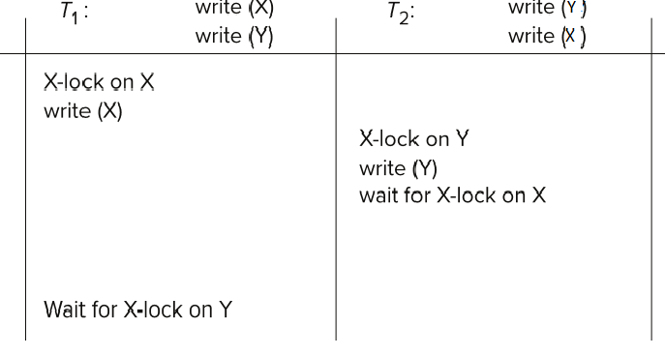
Deadlock Handling
Consider the following two transactions and history, with item X and transaction T₁ at site 1, and item Y and transaction T₂ at site 2:
Result: deadlock which cannot be detected locally at either site

Slide 3
Deadlock Detection
Wait-for Graph
Transaction T1 request a lock for data A that is locked by T2
Transaction T2 request a lock for data B that is locked by T3
Transaction T1 request a lock for data B that is locked by T3
T1
T2
T3
Question 27-1 Construct wait-for graph for the following.
Transaction T1 request a lock for data A that is locked by T4
Transaction T2 request a lock for data B that is locked by T4
Transaction T3 request a lock for data B that is locked by T4
Transaction T4 request a lock for data C that is locked by T1

Slide 4
Deadlock Detection
Two sites- S10 and S20
Wait for graph for S10
Transaction T1 request a lock for data A that is locked by T2
Wait for graph for S20
Transaction T2 request a lock for data B that is locked by T3
S10
S20
T1
T2
T2
T3
Deadlock detection
Coordinator (S30)
In the centralized deadlock-detection approach, a global wait-for graph is constructed and maintained in a single site; the deadlock-detection coordinator
T1
T2
T3

Slide 5
Deadlock Detection
Real graph: Real, but unknown, state of the system.
Constructed graph: Approximation generated by the controller during the execution of its algorithm .
T3 → T4 added to S20 but message has not reached to coordinator due to network delay
Real graph and constructed graph are not the same.
S10
S20
T4
T1
T2
T2
T3
Deadlock detection
Coordinator (S30)
T1
T4
T1
T4
T2
T3
T2
T3
Real graph
Constructed graph

Slide 6
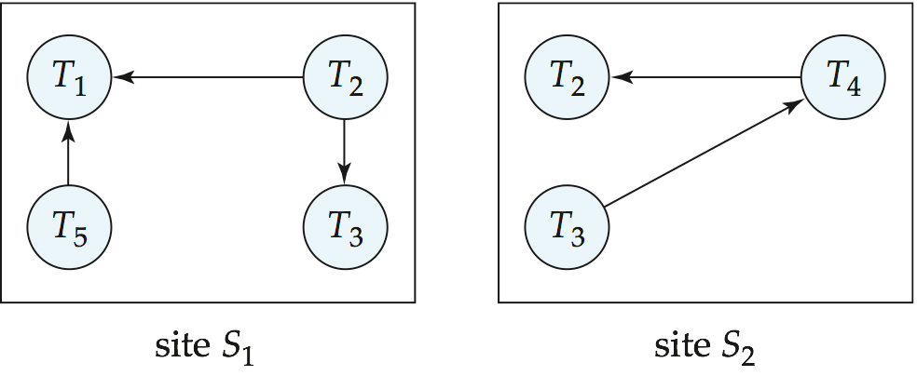
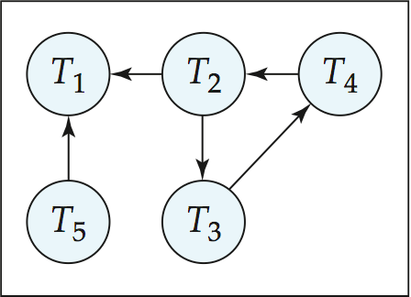
Local and Global Wait-For Graphs
The global wait-for graph can be constructed when:
a new edge is inserted in or removed from one of the local wait-for graphs.
a number of changes have occurred in a local wait-for graph.
the coordinator needs to invoke cycle-detection.
If the coordinator finds a cycle, it selects a victim and notifies all sites. The sites roll back the victim transaction.
Local
Global

Slide 7
Local and Global Wait-For Graphs
Question 27-2: Construct the global wait-for graph and find the deadlock status
Cycle 1: T2→T3 → T2
Global
T3
T2
Site 3

Slide 8
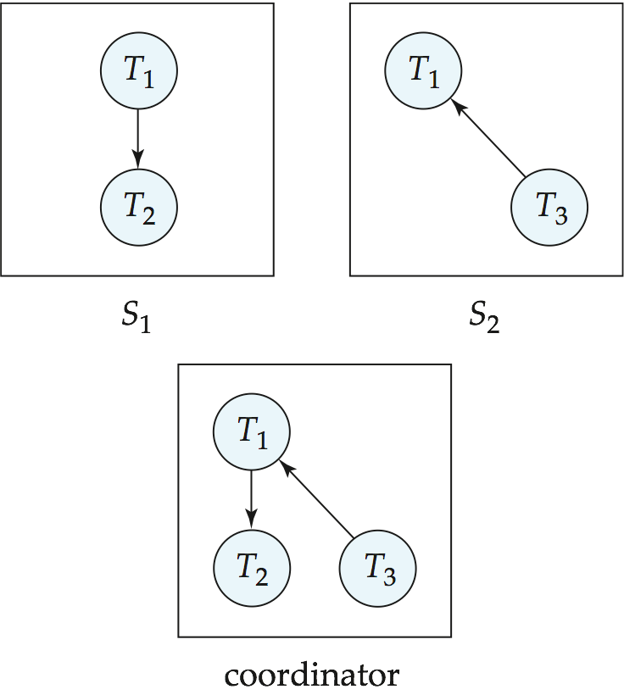
Example Wait-For Graph for False Cycles
Initial state:

Slide 9
Example Wait-For Graph for False Cycles
Suppose that starting from the state shown in figure,
1. T₂ releases resources at S₁ resulting in a message remove T₁ → T₂ message from the Transaction Manager at site S₁ to the coordinator)
T2
2. And then T₂ requests a resource held by T₃ at site S₂ resulting in a message insert T₂ → T₃ from S₂ to the coordinator
False Cycle
Suppose further that the insert message reaches before the delete message this can happen due to network delays
The coordinator would then find a false cycle
T₁ → T₂ → T₃ → T₁

Slide 10
Distributed Deadlocks
The false cycle above never existed in reality.
False cycles cannot occur if two-phase locking is used.
Unnecessary rollbacks may result
When deadlock has indeed occurred and a victim has been picked, and meanwhile one of the transactions was aborted for reasons unrelated to the deadlock.
Due to false cycles in the global wait-for graph
In the distributed deadlock-detection approach, sites exchange wait-for information and check for deadlocks
Expensive and not used in practice

Slide 11
Distributed Timestamp-Based Protocols
Timestamp based concurrency-control protocols can be used in distributed systems
Each transaction must be given a unique timestamp
Main problem: how to generate a timestamp in a distributed fashion
Each site generates a unique local timestamp using either a logical counter or the local clock.
Global unique timestamp is obtained by concatenating the unique local timestamp with the unique identifier.
Discussion:
Why site identifier in LSB and local unique timestamp in MSB?
What would happen if it would be reverse?

Slide 12
Distributed Timestamp-Based Protocols
Example on Timestamp Generation
The site identifiers of S1, S2 and S3 are 10, 20 and 30 respectively. The transactions T5 is in site 2, T6 in site 3 and T7 in site 1 respectively. Local timestamp for T5, T6 and T7 are 99, 88 and 99 respectively. Find the timestamp of T5, T6 and T7
Global timestamp for T5 = T5 local timestamp + identifier of S2
= concat (99 + 20) = 9920
Global timestamp for T6 = T6 local timestamp + identifier of S3
= concat (88 + 30) = 8830
Global timestamp for T5 = T7 local timestamp + identifier of S1
= concat (99 + 10) = 9910
Question:
The site identifiers of S3, S4 and S5 are 111, 555 and 333 respectively. The transactions T5 is in S5, T6 in S4 and T7 in S3 respectively. Local timestamp for T5, T6 and T7 are 101, 101 and 102 respectively. Find the timestamp of T5, T6 and T7.

Slide 13
Distributed Timestamp-Based Protocols
Question:
The site identifiers of S3, S4 and S5 are 111, 555 and 333 respectively. The transactions T5 is in S5, T6 in S4 and T7 in S3 respectively. Local timestamp for T5, T6 and T7 are 101, 101 and 102 respectively.
Find the timestamp of T5, T6 and T7.

Slide 14
Distributed Timestamps
Problem of Slow Local Clock
A node with a slow clock will assign smaller timestamps (HOW?)
Because of local unique timestamp
Still logically correct: serializability not affected
But: “disadvantages” transactions

Slide 15
Distributed Timestamps
To fix the problem of slow clock
Keep clocks synchronized using network time protocol
Or, define within each node N_{i} a logical clock (LC_{i}), which generates the unique local timestamp
Require that N_{i} advance its logical clock whenever a request is received from a transaction Ti with timestamp < x,y> and x is greater that the current value of LC_{i}.
In this case, site N_{i} advances its logical clock to the value x + 1
EXAMPLE
Site S1 has LC1 with value = 88
T2 has timestamp <99, S3> and T2 access data at S1
What will be the new value of LC1?

