Slide 1
Complex Data Types

Slide 2
Outline
Semi-Structured Data
Object Orientation
Textual Data
Spatial Data

Slide 3
Semi-Structured Data
Many applications require storage of complex data, whose schema changes often
The relational model’s requirement of atomic data types may be an overkill
E.g., storing set of interests as a set-valued attribute of a user profile may be simpler than normalizing it
Data exchange can benefit greatly from semi-structured data
Exchange can be between applications, or between back-end and front-end of an application
Web-services are widely used today, with complex data fetched to the front-end and displayed using a mobile app or JavaScript
JSON and XML are widely used semi-structured data models

Slide 4
Features of Semi-Structured Data Models
Flexible schema
Wide column representation: allow each tuple to have a different set of attributes, can add new attributes at any time
Some common wide-column store database examples include Apache Cassandra, Scylla, Apache HBase, Google BigTable, and Microsoft Azure Cosmos DB.
When it comes to a wide-column database, Cassandra is often mentioned first because of its pioneering work.

Slide 5
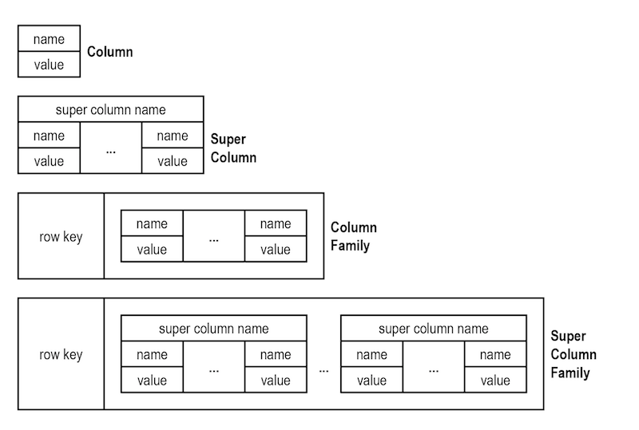
Wide column
Question 28-1:
Explain how the wide column representation support flexible schema.
Compare RDBMS with wide column

Slide 6
Features of Semi-Structured Data Models
Flexible schema
Sparse column representation: schema has a fixed but large set of attributes, by each tuple may store only a subset
Sparse columns are ordinary columns that have an optimized storage for null values.
Sparse columns reduce the space requirements for null values at the cost of more overhead to retrieve nonnull values.
Consider using sparse columns when the space saved is at least 20 percent to 40 percent.

Slide 7
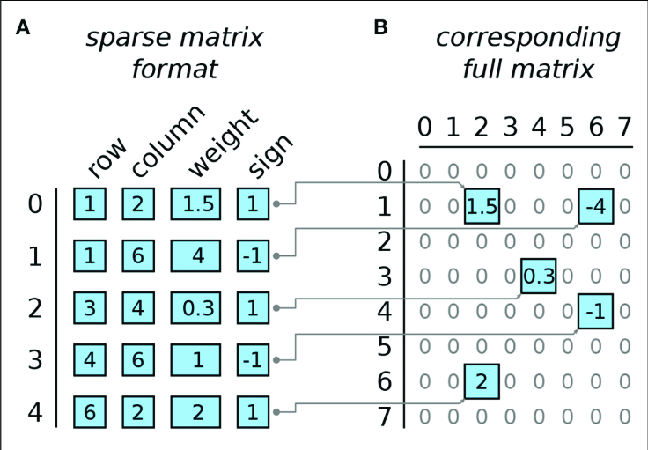
Features of Semi-Structured Data Models
Flexible schema
Sparse column representation: schema has a fixed but large set of attributes, by each tuple may store only a subset

Slide 8
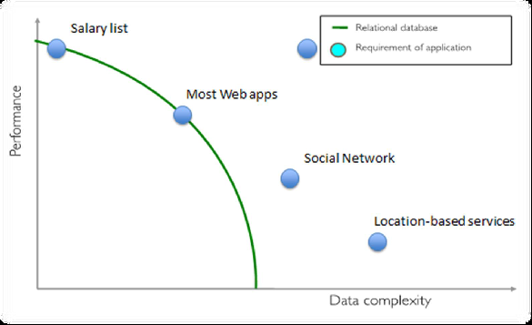
Relational DBMS VS Data Complexity

Slide 9
NoSQL why, what and when?
Relational databases were not built for distributed applications.
Because...
Joins are expensive
Hard to scale horizontally
Impedance mismatch occurs
Expensive (product cost, hardware, Maintenance)
And It’s weak in:
Speed (performance)
High availability
Partition tolerance

Slide 10
NoSQL why, what and when?

Slide 11
NoSQL why, what and when?
What is a schema-less data model?
In relational Databases:
You can’t add a record which does not fit the schema
You need to add NULLs to unused items in a row
We should consider the datatypes. i.e : you can’t add a stirng to an interger field
You can’t add multiple items in a field (You should create another table: primary-key, foreign key, joins, normalization, ... !!!)

Slide 12
NoSQL why, what and when?
In NoSQL Databases:
There is no schema to consider
There is no unused cell
There is no datatype (implicit)
Most of considerations are done in application layer
We gather all items in an aggregate (document)

Slide 13
NoSQL why, what and when?
A No SQL database provides a mechanism for storage and retrieval of data that employs less constrained consistency models than traditional relational database
No SQL systems are also referred to as "NotonlySQL“ to emphasize that they do in fact allow SQL-like query languages to be used.

Slide 14
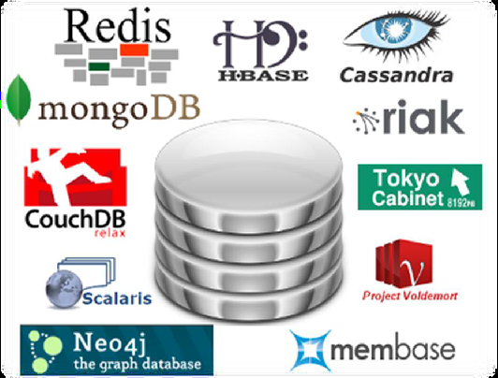
Characteristics of NoSQLdatabases
NoSQL avoids:
Overhead of ACID transactions
Complexity of SQL query
Burden of up-front schema design
DBA presence
Transactions (It should be handled at application layer)
Provides:
Easy and frequent changes to DB
Fast development
Large data volumes(eg.Google)
Schema less

Slide 15
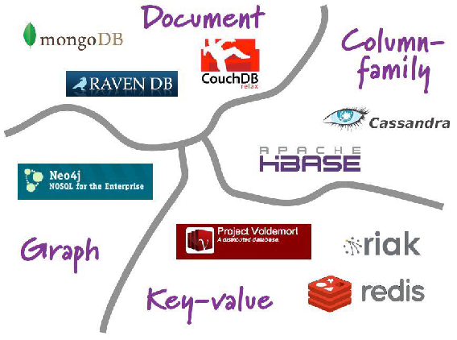
NoSQL Data Models
NoSQL databases are classified in four major datamodels:
•Key-value
•Document
•Column family
•Graph
Each DB has its own query language

Slide 16
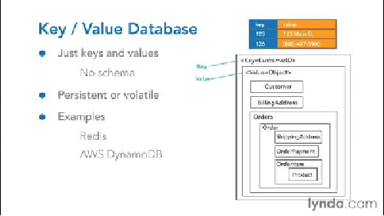
Key-value data model
➢Simplest NOSQL databases
➢The main idea is the use of a hash table
➢Access data (values) by strings called keys
➢Data has no required format data may have any format
➢Data model: (key, value) pairs
➢Basic Operations:
Insert(key,value),
Fetch(key),
Update(key),
Delete(key)

Slide 17
Column family data model
Some statistics about Facebook Search (using Cassandra)
MySQL > 50 GB Data
➢Writes Average : ~300 ms
➢Reads Average : ~350 ms
Rewritten with Cassandra > 50 GB Data
➢Writes Average : 0.12 ms
➢Reads Average : 15 ms

Slide 18

Graph data model
➢Based on Graph Theory.
➢Scale vertically, no clustering.
➢You can use graph algorithms easily
➢Transactions
➢ACID

Slide 19
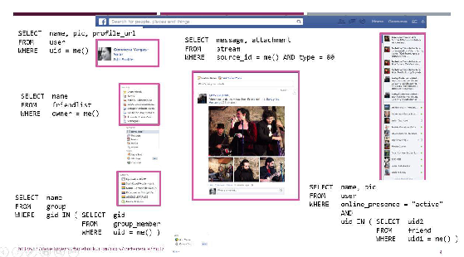
Document based data model (MongoDB)
•Pair each key with complex data structure known as data structure.
•Indexes are done via B-Trees.
•Documents can contain many different key-value pairs, or key-array pairs, or even nested documents.

Slide 20
SQL vs NOSQL

Slide 21
Features of Semi-Structured Data Models
Multivalued data types
Sets, multisets
E.g.,: set of interests {‘basketball, ‘La Liga’, ‘cooking’, ‘anime’, ‘jazz’}
Key-value map (or just map for short)
Store a set of key-value pairs
E.g., {(brand, Apple), (ID, MacBook Air), (size, 13), (color, silver)}
Operations on maps: put(key, value), get(key), delete(key)
, Arrays
Widely used for scientific and monitoring applications

Slide 22
Features of Semi-Structured Data Models
Arrays
Widely used for scientific and monitoring applications
E.g., readings taken at regular intervals can be represented as array of values instead of (time, value) pairs
[5, 8, 9, 11] instead of {(1,5), (2, 8), (3, 9), (4, 11)}
Multi-valued attribute types
Modeled using non first-normal-form (NFNF) data model
Supported by most database systems today
Array database: a database that provides specialized support for arrays
E.g., compressed storage, query language extensions etc
Oracle GeoRaster, PostGIS, SciDB, etc

Slide 23
Nested Data Types
Hierarchical data is common in many applications
JSON: JavaScript Object Notation
Widely used today
XML: Extensible Markup Language
Earlier generation notation, still used extensively

Slide 24
JSON
Textual representation widely used for data exchange
Since objects do not have to adhere to any fixed schema, they are basically the same as key-value maps, with the attribute names as keys and the attribute values as the associated values.
Data is in name/value pairs
Data is separated by commas
Curly braces hold objects
Square brackets hold arrays
In JSON, values must be one of the following data types:
a string, a number, an object (JSON object), an array, a Boolean, null

Slide 25
JSON
Example of JSON data { "ID": "22222", "name": { "firstname: "Albert", "lastname: "Einstein" }, "deptname": "Physics", "children": [ {"firstname": "Hans", "lastname": "Einstein" }, {"firstname": "Eduard", "lastname": "Einstein" } ] }
Types: integer, real, string, and
Objects: are key-value maps, i.e. sets of (attribute name, value) pairs
Arrays are also key-value maps (from offset to value)
Question 29-1: Write the relational representation of this JSON data

