Slide 1

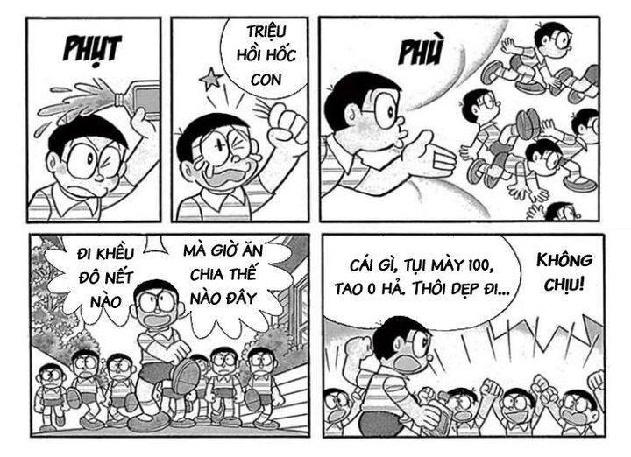



Linear
Dropout
GELU
Feature Extraction
Vision
Transformer
Dropout
Linear
Dropout
Linear
GELU
Dropout
GELU
Linear
Dropout
Linear
GELU
Input
GELU
PaddleOCR
+
VietOCR
Text OCR
Linear
Dropout
GELU
Linear
Dropout
Images
GELU
Fusion Block
Linear
Dropout
GELU
Linear
Dropout
GELU
Hốc phó và đám hốc con.
jina-embedding-v3
Linear
Dropout
GELU
Linear
Dropout
Caption
GELU
Linear
VisoBERT
Classify
Linear
Dropout
GELU
Linear
Dropout
GELU
Linear
Dropout
GELU
Linear
Dropout
GELU
Proposed Pipeline

Slide 2
Feature Extraction
Input
Vision
Transformer
PaddleOCR
+
VietOCR
Text OCR
Images
Caption
Hốc phó và đám hốc con.
jina-embedding-v3
VisoBERT

Slide 3
Dropout
Linear
Dropout
Linear
GELU
Dropout
GELU
Linear
Dropout
Linear
GELU
GELU
Linear
Dropout
GELU
Linear
Dropout
GELU
Linear
Dropout
GELU
Linear
Dropout
GELU
Linear
Dropout
GELU
Linear
Dropout
GELU
Linear
Dropout
GELU
Linear
Dropout
GELU

Slide 4
Fusion Block
Linear
Dropout
GELU
Linear
Dropout
GELU

Slide 5
Linear
Classification

