Slide 1

Walchand College of Engineering
(Government Aided Autonomous Institution)
Vishrambag, Sangli, 416415
Department of Computer Science & Engineering
Presentation on
1947
Gate.app
AY:2023-24
Team Members:
21510027 : Datta Gangji
21510087 :Jyotiraditya Patil
21510097 : Viraj Patil
Under the guidance of
Prof. Siddharaj Pujari
Date: 28/04/2024

Slide 2
Agenda
Abstract
Problem statement
Objectives
Methodology
UML diagrams
Technology stack
Implementation/Results
Outcomes/Applications
Conclusion
References

Slide 3
Abstract
The Graduate Aptitude Test in Engineering (GATE) stands as a pivotal examination for engineering graduates seeking higher education, research opportunities, and esteemed career paths in engineering and technology. However, the preparation process for GATE poses significant challenges, including the need to navigate a vast syllabus, master complex concepts, and develop effective study strategies.
This project seeks to revolutionize GATE exam preparation through an innovative web platform. It offers a vast repository of practice papers meticulously aligned with the exam's format and difficulty levels. Leveraging advanced AI algorithms, the platform provides personalized performance analysis and study recommendations tailored to each aspirant's strengths and weaknesses.
Furthermore, the platform harnesses predictive modeling techniques to anticipate question tags likely to appear in future exams. By analyzing extensive datasets of past GATE papers and trends, it empowers aspirants with valuable insights into the exam's patterns. This enables them to streamline their preparation efforts and focus on the most relevant topics, increasing their chances of success.

Slide 4
Problem statement
Design and develop a web-based portal, named GATE.app, to assist Graduate Aptitude Test in Engineering (GATE) aspirants in improving their performance through practice papers and personalized ML-driven recommendations. Additionally, implement question prediction using machine learning techniques based on analysis of previous papers.

Slide 5
Objectives
To develop a user-friendly web portal for GATE exam preparation.
To provide personalized performance analysis and recommendations.
To utilize machine learning techniques for question tag prediction based on previous papers.

Slide 6
Methodolgy
Research: Gather stakeholder input and market insights to shape GATE.app features.
Tech Tools: Choose HTML/CSS, JavaScript, and Python frameworks for user-friendly design.
Provide recommendation and analysis on the basis of visualization.
Predictive Models: Create models to anticipate exam topics, aiding focused preparation.
Testing: Conduct rigorous tests for reliability, scalability, and security.
Deployment: Establish hosting, pipelines, and CI/CD for seamless updates.
Feedback Loop: Collect user input for continuous platform refinement.

Slide 7
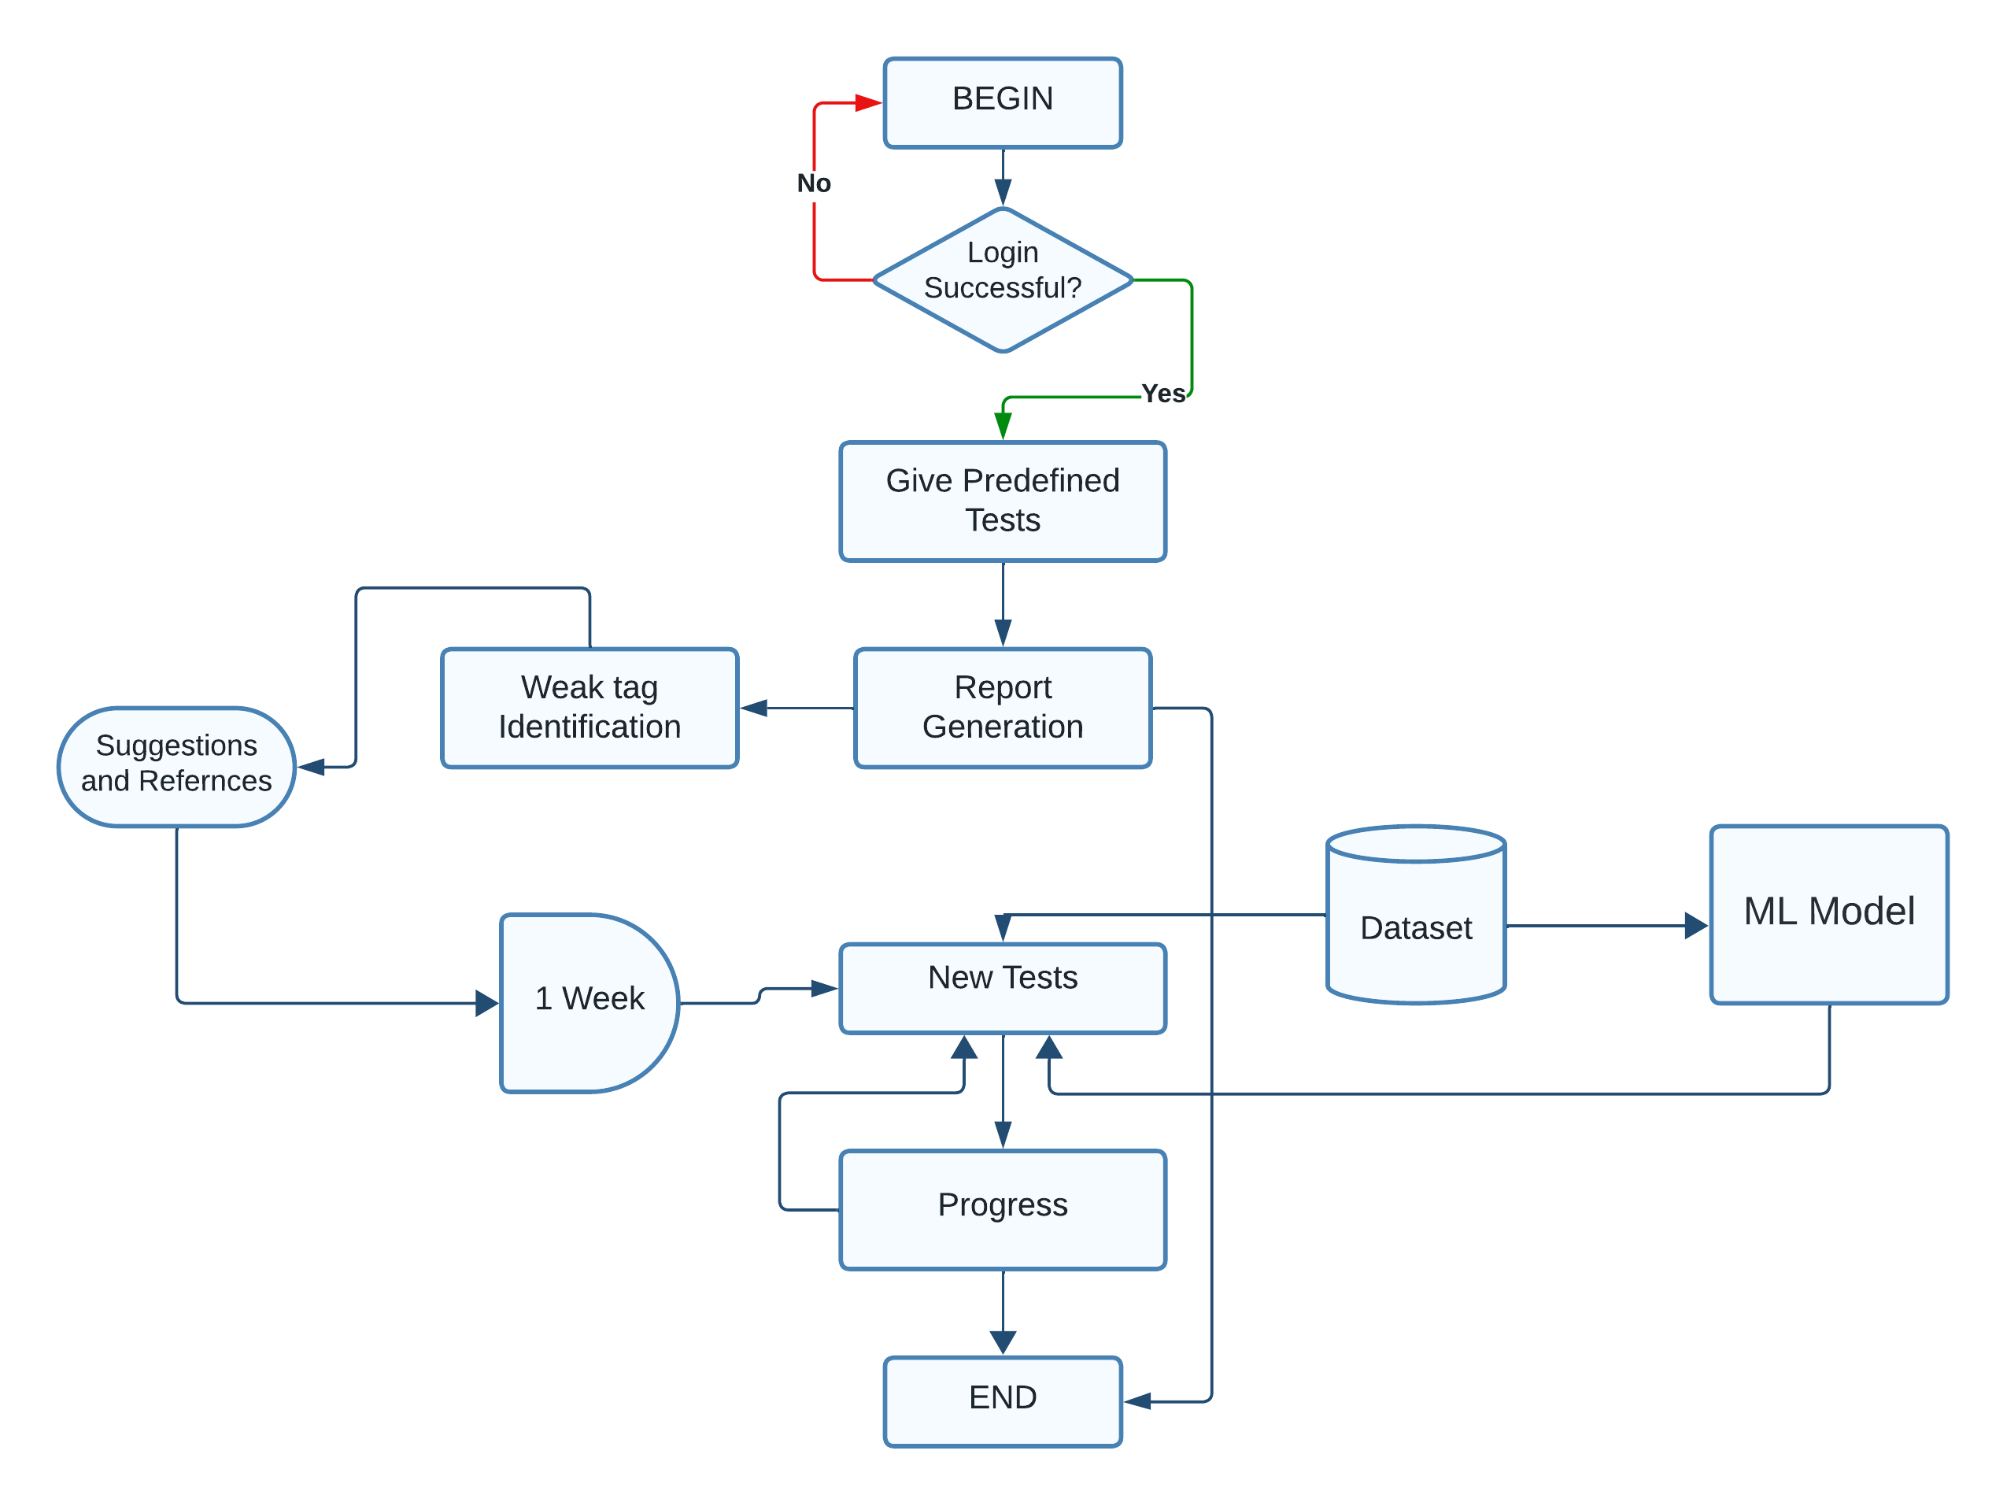
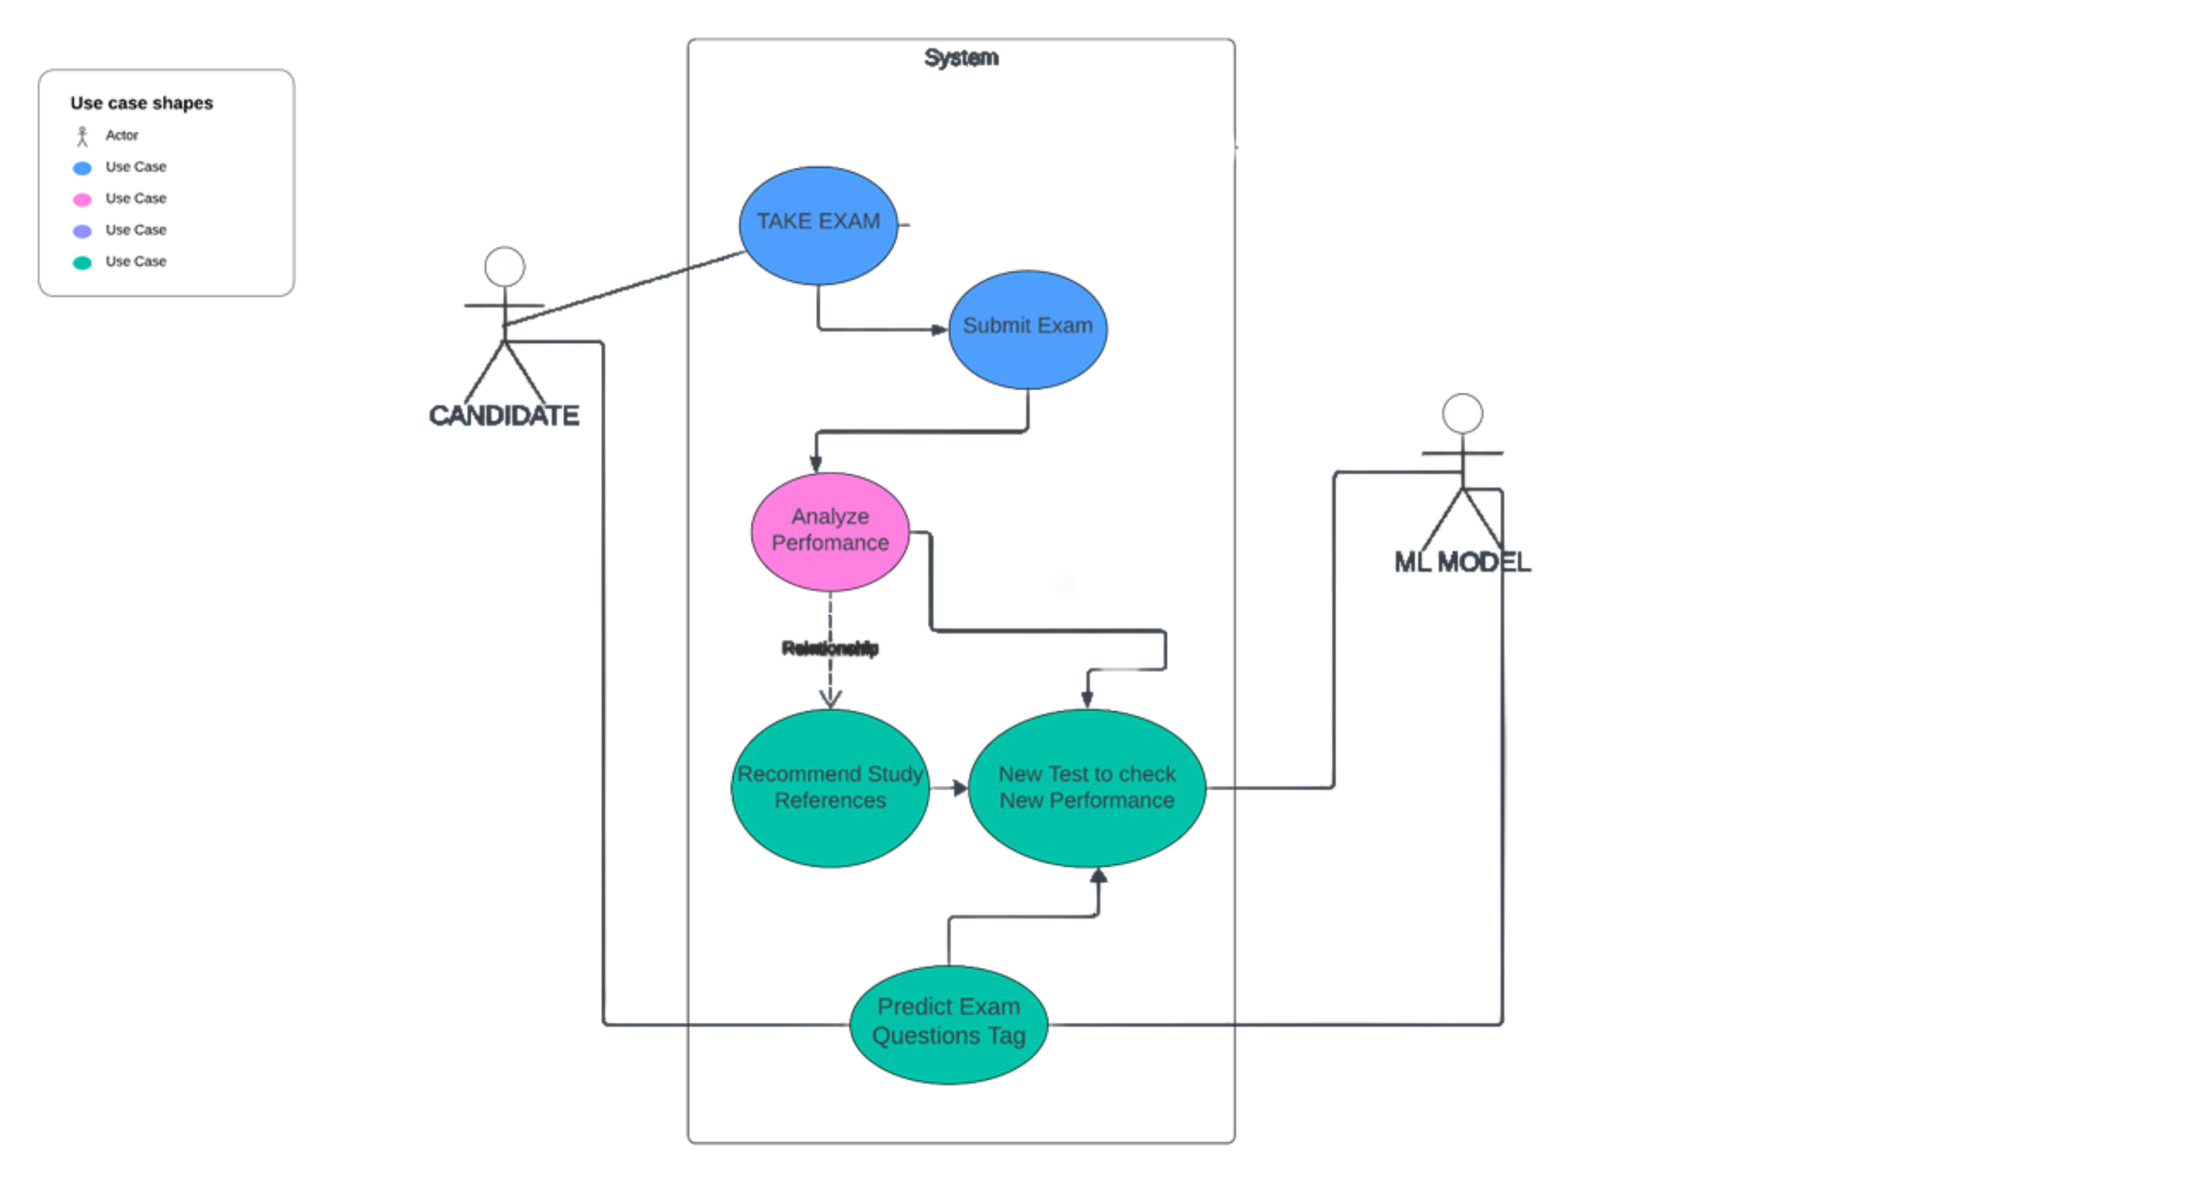
Diagram

Slide 8
Technology Stack Font: Times New roman Size:28 alignment: Left
SOFTWARE & HARDWARE SPECIFICATION
Frontend: HTML, CSS, ReactJs Backend: Nodejs, Python Database: MongoDB Machine Learning: RandomForest

Slide 9
Implementation/results
User-Friendly Web Portal Development:
Successfully developed a user-friendly web portal named GATE.app specifically tailored for GATE exam preparation.
The portal offers intuitive navigation, easy access to tests, and personalized recommendations, enhancing the overall user experience for aspirants.
Performance Analysis and Recommendations:
Implemented personalized performance analysis and recommendations, enabling aspirants to receive tailored insights into their strengths and weaknesses

Slide 10
Implementation/results
Aspirants can leverage these recommendations to optimize their study strategies and focus on areas that require improvement, leading to enhanced performance in the GATE exam.
Question Prediction using Machine Learning Techniques:
Utilized machine learning techniques to predict question tags based on analysis of previous GATE exam papers.
The predictive models developed enable aspirants to anticipate the types of questions likely to appear in future exams, aiding them in prioritizing their preparation efforts effectively.
Accuracy: 0.9167 or 91.67%

Slide 11
Conclusion
.

Slide 12
references
Smith, J., Johnson, A., & Williams, B. (2018). "Personalized Learning in Exam Preparation: A Survey-based Analysis." Journal of Educational Technology, 10(2), 135-150.
Johnson, C., & Patel, R. (2019). "Machine Learning for Question Prediction in Educational Contexts." International Conference on Artificial Intelligence in Education Proceedings, 78-92.
Gupta, S., & Singh, M. (2020). "Artificial Intelligence in Educational Platforms: A Literature Review." Journal of Educational Technology Research, 15(4), 289-305.
Liang, Q., & Chen, Z. (2021). "Trends and Patterns in GATE Exam Questions: A Statistical Analysis." Journal of Engineering Education Research, 25(3), 210-225.
Kumar, V., et al. (2022). "Impact of Practice Tests on Exam Performance: A Survey-based Study." International Journal of Educational Assessment, 18(1), 55-68.

Slide 13
Thank You

