Slide 1
Compilo
Prashant Bhandari
Pratyush Thapa
Preksha Koirala
Swapnil Tamrakar

Slide 2
Problem statement
Professor having to download and compile all files by each student for all the assignments manually.
Time consuming
Unnecessary hassle

Slide 3
Solution presented
A software to automate the downloading, testing and validating of programs submitted as a part of the assignments.

Slide 4
Intended Audience
Students
Professors
Teaching Assistants

Slide 5
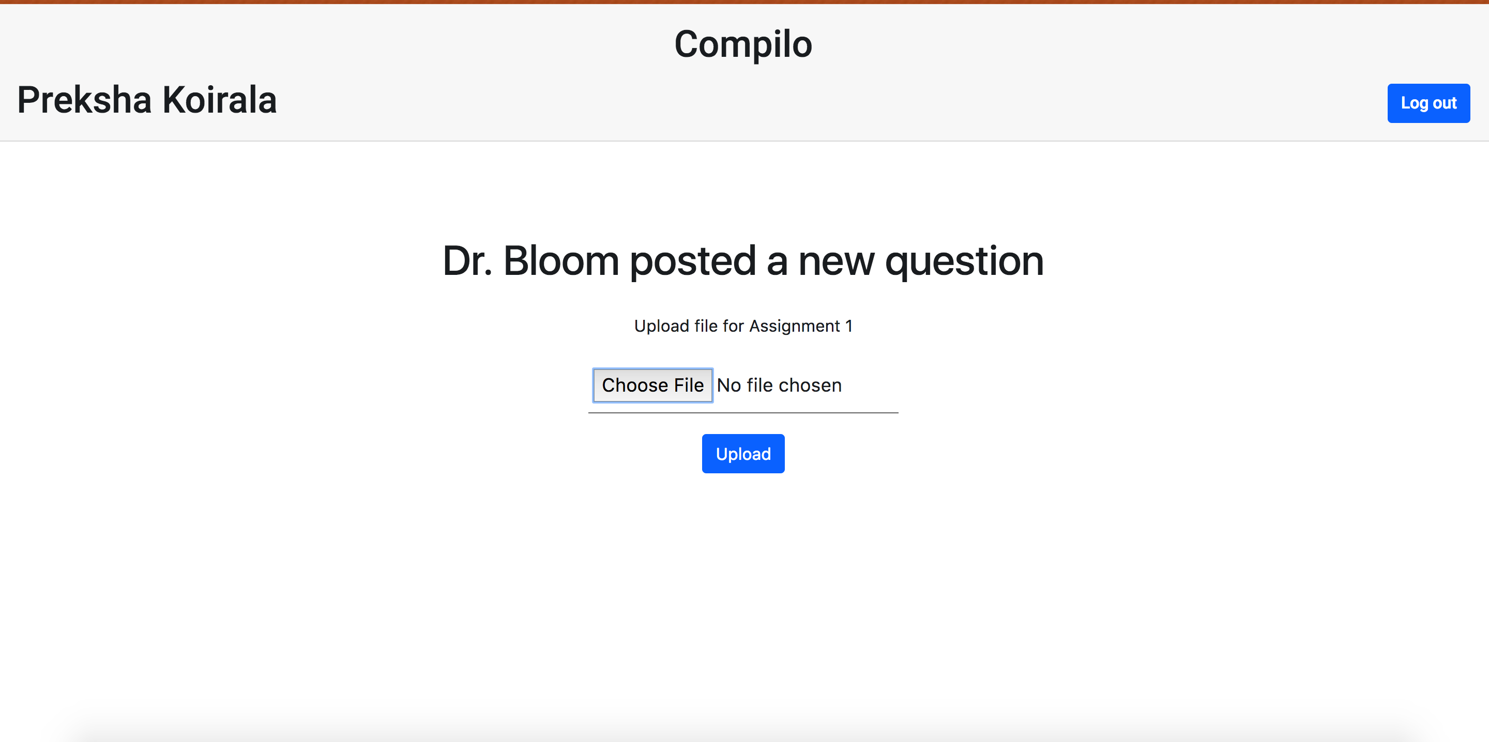
Human Interface Design

Slide 6
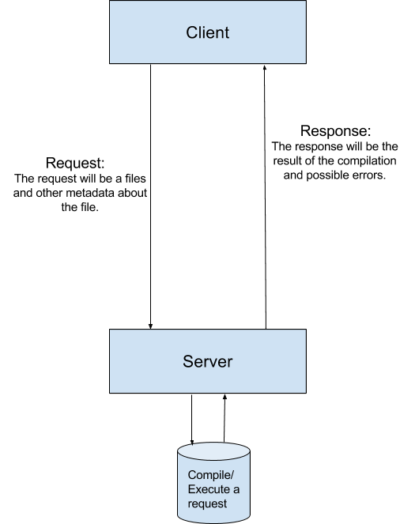
System Overview
The user will interact with the server via a web app from a web browser
All the computing will be done on a server
The data to be processed would be send to the server via a remote procedure call request
The server will send back the result generated output as a response
The response from the server will be the result of the compilation and execution of the program and additionally the compilation errors or any runtime errors if there are any.

Slide 7
Overview of System implementation
On the client side, the user will upload files (C++ and python).
On the server side, the data is stored in temporary memory
Executed according to the compilers based on the language.
The server also collects data based on the execution of the files.
The result is then sent to the client in JSON format.
Notes:
777777

Slide 8
Data Structures Used
The global data structure of this software is best characterized as a database.
Temporary data structures include results in JSON format
The program files (input data) are also stored on the server side momentarily until it finishes execution

