Slide 1


CRISIS MASTERCLASS
Cold outreach EDM campaign
Strategy, lead magnets and full email copy for your review
Prepared by 3P Digital for My PR Partner | July 2026

Slide 2
WHERE THIS FITS
One goal: enrolments before the end of July
The product is ready and the market is primed.
Crisis Masterclass is live at $340/month (ex GST) with Melissa Agnes and the Crisis Ready Institute behind it. The Schools Program is live from $440/month. Nothing else in Australia sells ongoing, certified crisis training as a subscription.
The plan: direct email to the decision makers.
Cold outreach EDM sequences to school principals and council chief executives, with industry association CEOs as the next wave. Four emails per audience, each sequence leading with free value and closing on enrolment.
What we are asking you to review in this deck.
The market case, the three lead magnets we have built, the full copy of all eight emails, and the compliance approach. Approve, amend or redline anything: your name is on the emails, so nothing sends until you sign off.
3P Digital x My PR Partner | Crisis Masterclass EDM campaign | July 2026 1

Slide 3
THE MARKET: SCHOOLS
Principals are living small crises weekly
87.6%
of principals report cyberbullying from parents and caregivers (ACU Principal Wellbeing Survey 2025)
54.4%
are seriously considering quitting; most say they learned crisis handling on the job
11,297
verified school leader email addresses in our database, 7,384 with the principal named
Why now
AI deepfake incidents are the fastest growing school crisis category: eSafety has published a dedicated schools response guide, and schools that pre-draft their response are being profiled as best practice. Recent high-profile school scandals have made every principal aware that the first 24 hours of communication decide the outcome.
Compliance pressure works for us
Child Safe Standards, critical incident requirements for school registration, and board-level reputational risk duties give principals a governance reason to buy, not just a fear reason. Term 3 has just started: mid-year budget reviews are happening right now.
3P Digital x My PR Partner | Crisis Masterclass EDM campaign | July 2026 2

Slide 4
THE MARKET: ASSOCIATIONS AND COUNCILS
The CEO is the spokesperson, ready or not
Industry associations carry every member's reputation.
One member scandal becomes the sector's headline, and journalists call the association, not the member. Most associations run a comms team of one or none. There is also a bigger second play: associations endorse training to members as a benefit with a revenue share, a model already common in Australia (Speech Pathology Australia, APNA and others).
Councils are under documented, rising pressure.
A 2026 MAV and ANU report found growing disinformation and harassment of councillors through social media and AI deepfakes. Smaller councils have zero or one comms staff, so the CEO or GM personally owns crisis response. We hold 523 verified council CEO and GM email addresses.
The price fits inside existing delegations.
$340 per month sits under standard council and school purchase thresholds. No tender, no quote round, no board paper: a monthly PD line the decision maker can approve alone.
3P Digital x My PR Partner | Crisis Masterclass EDM campaign | July 2026 3

Slide 5
THE COMPETITIVE GAP
Everyone sells a workshop day. Nobody sells a year.
Typical crisis training workshop (facilitator day)
$7,000 to $15,000, one-off
Public Sector Network 2-day virtual workshop
$1,195 per person
External crisis consultants during a live crisis
Thousands per day, after the damage
Crisis Masterclass, full 12 months, certified
$340/month (about $4,080/year ex GST)
The anchor that runs through every email: a full year of certified, expert-led crisis training costs less than a single workshop day elsewhere. Melissa Agnes and the Crisis Ready Institute pedigree is exclusive to My PR Partner in Australasia, and no competitor offers a certificate.
3P Digital x My PR Partner | Crisis Masterclass EDM campaign | July 2026 4

Slide 6
THE DATABASE
Who we can reach, and in what order
SEGMENT
VALID EMAILS
DECISION MAKERS
PRIORITY
Local councils
523
CEOs (370), General Managers (102)
Email 1: Wed 23 July
Schools (full list)
11,297
Principals, heads, school CEOs
Email 1: Wed-Fri, staged
Business pilot
~5,000 of 1.25M
Named contacts, reputation-exposed industries
Email 1: this week
Business master list
1.25 million
441 industries
Pilot first, no bulk blast
Industry associations
List to be built
Association CEOs and comms leads
August, plus partnerships
Round 1 goes to every segment this week. The one carve-out: the full 1.25 million business list cannot be sent in bulk (spam law and deliverability both break); a 5,000-contact pilot goes this week and its results set the wider rollout. Associations have no list yet, so that list is built in parallel for August.
3P Digital x My PR Partner | Crisis Masterclass EDM campaign | July 2026 5

Slide 7
COMPLIANCE
How we send legally under the Spam Act 2003
The legal basis: inferred consent through conspicuous publication.
Cold email is lawful in Australia when the address is publicly published in a work capacity, carries no 'no unsolicited email' notice, and the message is directly relevant to the recipient's role. Crisis communications training to a principal or council CEO passes that test. We verify and record the public source of every address before it enters a send list.
Every email carries full sender identity and a working unsubscribe.
My PR Partner named as sender with an Australian postal address, and an unsubscribe honoured within five business days and suppressed across all future sends. Unsubscribe failures are ACMA's current enforcement priority (over $16 million in penalties in the last 18 months), so this is built in from day one.
Volumes stay low, personalised and role-relevant.
We send from dedicated infrastructure (not your Kajabi account, which is reserved for opted-in members), throttled to a few hundred a day. The 1.25 million business list does not get this campaign: it fails the role-relevance test and would put the domain at risk.
3P Digital x My PR Partner | Crisis Masterclass EDM campaign | July 2026 6

Slide 8
MESSAGING
One spine, tuned per audience
1. Hook
A current, third-party-verified fear: the 87.6% stat for principals, the MAV/ANU disinformation report for councils, the member-scandal scenario for associations. Never a named victim organisation.
2. Gap
Your plans cover operations, not communications. Consultants arrive after the damage.
3. Authority
Melissa Agnes and the Crisis Ready Institute, exclusive to My PR Partner in Australasia, backed by Lyall's 25+ years and a peer-reviewed evidence base.
4. Anchor
A whole year costs less than one workshop day elsewhere.
5. Ease
Online, self-paced, monthly billing, certificate at the end. Nothing to procure, nothing to install.
3P Digital x My PR Partner | Crisis Masterclass EDM campaign | July 2026 7

Slide 9
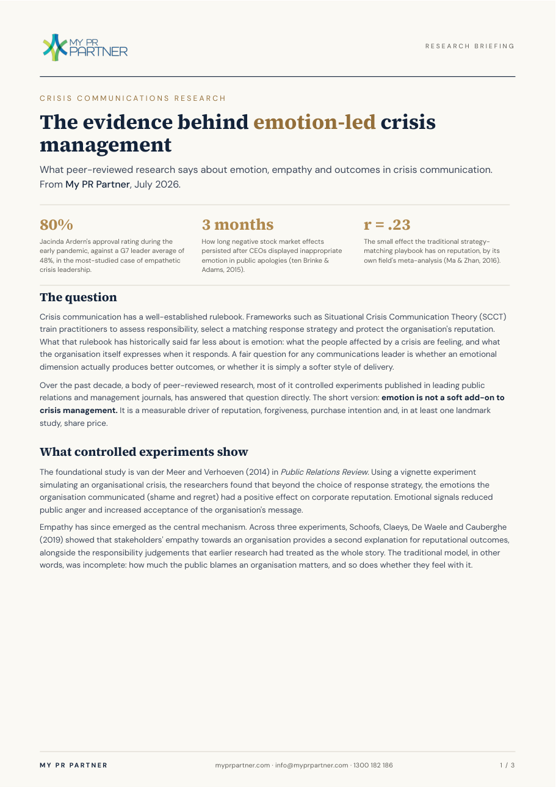
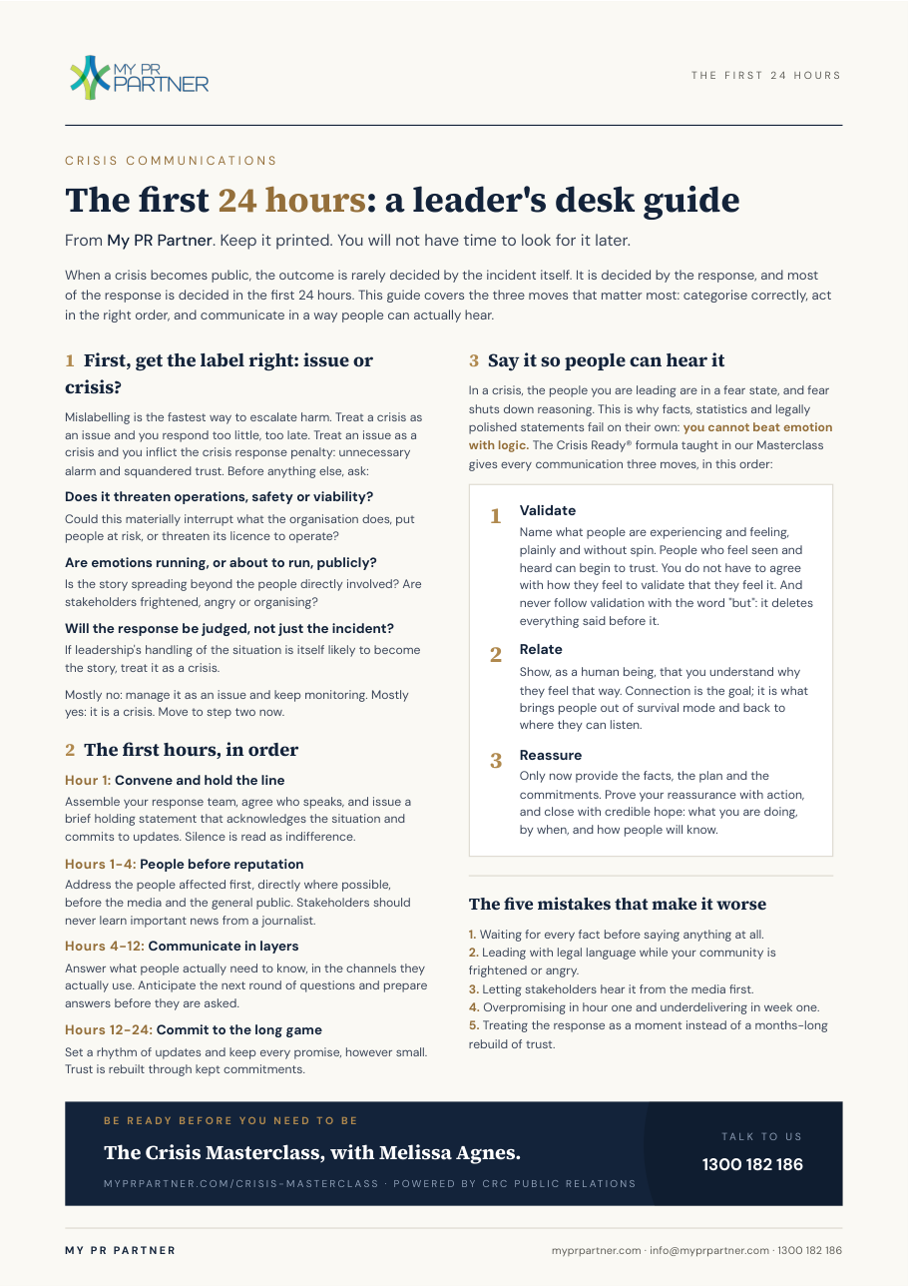
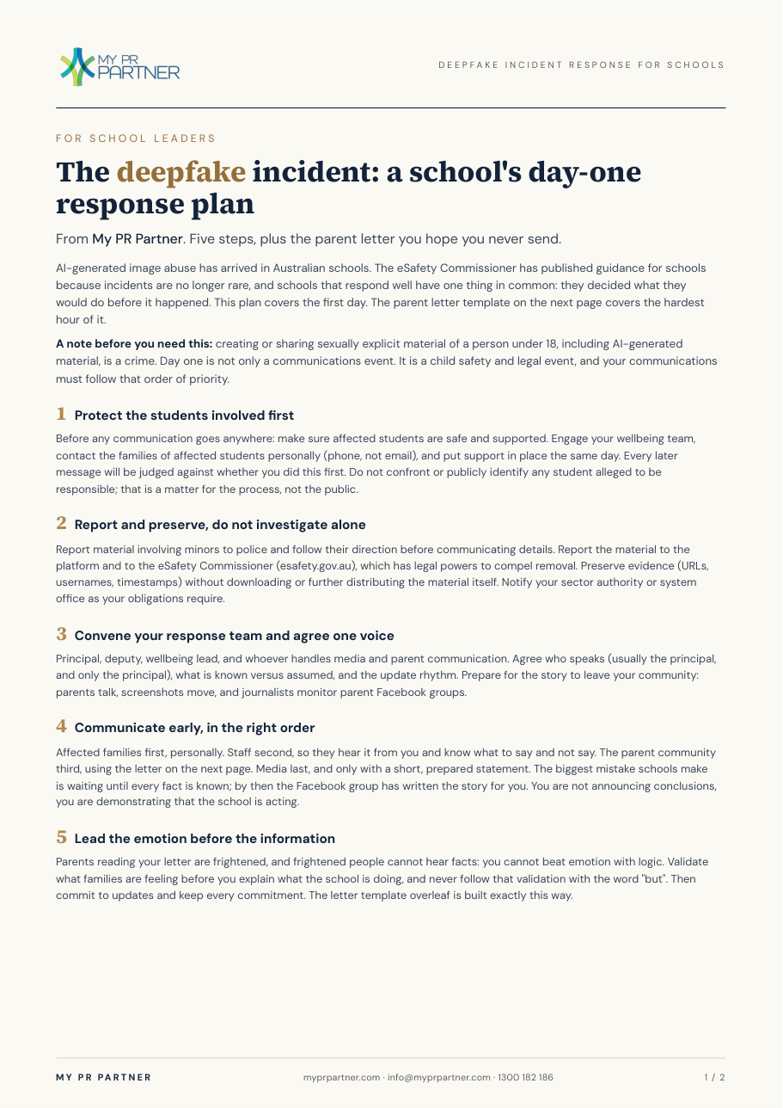
LEAD MAGNETS
Three new assets, built in your existing style
RESEARCH BRIEFING
The Evidence Behind Emotion-Led Crisis Management. 3 pages, fully referenced. For association and council CEOs who need a rational justification.
DESK GUIDE
The First 24 Hours. One page: issue-vs-crisis triage, the first-day order of operations, and the Validate, Relate, Reassure formula.
SCHOOLS TEMPLATE
Deepfake Incident Response. Five-step day-one plan plus the ready-to-adapt parent letter. Rides the most current fear in the sector.
3P Digital x My PR Partner | Crisis Masterclass EDM campaign | July 2026 8

Slide 10
THE SEQUENCES
Four emails per audience over ten days
Give value, no ask
Free lead magnet, no pitch. Earns the right to the next email.
Day 0
Story and gap
The first-24-hours truth, and why emotion beats logic. Course outline offered.
Day 3
Offer and anchor
The price comparison, what is included, and the enrolment link.
Day 7
Close the loop
One direct question, the last call, and (for associations) the partnership door.
Day 10
Sends Tuesday to Thursday, 7:30 to 9:00am in the recipient's state. Sender: Lyall Mercer. Every link tracked per audience and email. Replies answered personally: that is where cold email converts.
3P Digital x My PR Partner | Crisis Masterclass EDM campaign | July 2026 9

Slide 11
Sequence A: Schools
Four emails to principals. Sender: Lyall Mercer. Full copy for your review.
3P Digital x My PR Partner | Crisis Masterclass EDM campaign | July 2026 10

Slide 12
SCHOOLS SEQUENCE | EMAIL 1 OF 4
Subject: The other emergency plan, {{school_name}}
Preview: A 10-minute self-check most schools have never run.
Good morning {{first_name}},
Every school has an evacuation plan. Very few have a plan for the other kind of emergency: the parent Facebook group boiling over, an AI deepfake of a student, a reporter calling the office at 4pm on a Friday.
The ACU Principal Wellbeing Survey found 87.6% of principals now experience cyberbullying from parents or caregivers. The pile-on is no longer a rare event. It is a term-three certainty somewhere in Australia.
I have spent 25+ years in crisis PR, and my team has built a free Crisis Vulnerability Checklist: a 10-minute self-assessment across the areas where schools most often get caught out. No sign-up hoops, it is a direct download:
[Download the Crisis Vulnerability Checklist]
Run it with your leadership team this week. If it surfaces gaps, I will show you how other school leaders are closing them in my next note.
Lyall Mercer
Co-founder, My PR Partner | Lead Strategist, CRC Public Relations
3P Digital x My PR Partner | Crisis Masterclass EDM campaign | July 2026 11

Slide 13
SCHOOLS SEQUENCE | EMAIL 2 OF 4
Subject: The first 24 hours decide it
Preview: What separates a bad week from a resignation.
Good morning {{first_name}},
When a school crisis becomes national news, the difference between a bad week and a career-ending story is almost always the first 24 hours of communication. Not the incident itself. The response.
Here is what the research says, and it surprises most leaders: you cannot beat emotion with logic. When a school community is angry or frightened, facts and legal-approved statements do not land. Validation first, information second. There is a formula for this, and it is teachable.
That formula is one module of the Crisis Masterclass, the 12-month online program we built with Melissa Agnes of the Crisis Ready Institute (USA), exclusive to My PR Partner in Australasia. One session a month, self-paced, with a certificate your board can file as evidence of reputational risk management.
Here is exactly what the 12 months cover:
[Download the course outline]
Lyall
3P Digital x My PR Partner | Crisis Masterclass EDM campaign | July 2026 12

Slide 14
SCHOOLS SEQUENCE | EMAIL 3 OF 4
Subject: $340 a month, before. $10k a day, after.
Preview: What crisis help costs on either side of the incident.
Good morning {{first_name}},
A quick note on numbers, because school budgets are real.
When a crisis hits, external consultants cost thousands per day, and they arrive after the damage is done. A single external training day runs $7,000 to $15,000. The Crisis Masterclass is $340 a month (ex GST): a full year of structured training for your leadership team for less than one workshop day.
What you get: 12 monthly sessions with Melissa Agnes (Crisis Ready Institute) and Australian case studies from our CRC Public Relations team, fortnightly Spotlight emails, monthly live Q&A, and a certificate of completion.
Term 3 is when the savvier schools we work with do this: trained before the summer silly season, and in time to put the annual plan into the 2027 budget round.
[See the Crisis Masterclass and enrol]
If you would rather talk it through first, reply to this email and I will come back to you personally.
Lyall
3P Digital x My PR Partner | Crisis Masterclass EDM campaign | July 2026 13

Slide 15
SCHOOLS SEQUENCE | EMAIL 4 OF 4
Subject: Before I close the file, {{first_name}}
Preview: One question, then I will leave you be.
Good morning {{first_name}},
I will keep this short and then stop filling your inbox.
One question: if tomorrow morning a parent group, a journalist and a lawyer all had your school's name in their mouths, who on your team knows exactly what to say in the first hour?
If the answer is "we would work it out", that is the gap. It is the same gap nearly every principal tells us they have, and it is fixable for $340 a month.
[Enrol in the Crisis Masterclass] or [See the Schools Program]
The Schools Program (from $440/month) is the better fit if you want school-specific training for your whole leadership team, including media strategies and handling the hardest allegations.
Either way, keep the checklist, and my door stays open. Reply any time.
Lyall
3P Digital x My PR Partner | Crisis Masterclass EDM campaign | July 2026 14

Slide 16
Sequence B: Associations and councils
Four emails to CEOs and GMs. Council variants noted under each email.
3P Digital x My PR Partner | Crisis Masterclass EDM campaign | July 2026 15

Slide 17
ASSOCIATIONS SEQUENCE | EMAIL 1 OF 4
Subject: When your sector makes the news, {{org_name}} is the voice
Preview: The evidence on what actually works in a crisis.
Good morning {{first_name}},
Here is the uncomfortable part of running an association: you carry the reputation of every member. One member's scandal becomes the sector's headline, and the journalists do not call the member. They call you.
We have just published a research paper that most comms advisers have not caught up with yet: the peer-reviewed evidence on emotion-led crisis management. It covers why validation beats legal-speak, why markets punished insincere apologies for three months, and why Jacinda Ardern's crisis approval hit 80% while G7 leaders averaged 48%.
[Download: The Evidence Behind Emotion-Led Crisis Management]
It is a 10-minute read and it will change how you brief your board on reputational risk.
Lyall Mercer
Co-founder, My PR Partner | Lead Strategist, CRC Public Relations
Council variant: Subject becomes "The next pile-on won't wait for a comms hire". Opening cites the MAV/ANU report on rising disinformation and harassment aimed at councils, with the CEO or GM as de facto spokesperson.
3P Digital x My PR Partner | Crisis Masterclass EDM campaign | July 2026 16

Slide 18
ASSOCIATIONS SEQUENCE | EMAIL 2 OF 4
Subject: A comms team of one
Preview: Most association CEOs are the crisis plan.
Good morning {{first_name}},
Most associations run a comms team of one. Sometimes none, and then the CEO is the plan.
That works until the day it does not: a member scandal, an advocacy position that backfires, a sector-wide incident. On that day the difference is not budget, it is preparation.
The Crisis Masterclass is the 12-month online program we built with Melissa Agnes, CEO of the Crisis Ready Institute (USA) and one of the world's leading crisis communication authorities. It is exclusive to My PR Partner in Australasia. Monthly sessions, self-paced, live Q&A, certificate of completion endorsed by CRC Public Relations.
It exists precisely for leaders who are the spokesperson whether they chose it or not.
[See the full course outline]
Lyall
Council variant: "Most associations" becomes "most councils outside the capitals", and the incident list becomes: a flood, a censure motion, a social media pile-on.
3P Digital x My PR Partner | Crisis Masterclass EDM campaign | July 2026 17

Slide 19
ASSOCIATIONS SEQUENCE | EMAIL 3 OF 4
Subject: One workshop day, or a whole year
Preview: $340 a month against $1,195 a seat.
Good morning {{first_name}},
The going rate for crisis communications training in Australia is $1,195 per person for a two-day workshop, or $7,000 to $15,000 for a facilitator day. Then everyone goes back to work and forgets it by Christmas.
The Crisis Masterclass takes the opposite approach: $340 a month (ex GST) for 12 months of structured, expert-led capability building, with Australian case studies and personal access to the experts through monthly Q&A.
[Enrol in the Crisis Masterclass]
Happy to answer anything by reply. I read these personally.
Lyall
Council variant: Adds: "At this price the subscription sits within standard manager delegation at almost every council. No tender, no quote round, just a defensible monthly PD line."
3P Digital x My PR Partner | Crisis Masterclass EDM campaign | July 2026 18

Slide 20
ASSOCIATIONS SEQUENCE | EMAIL 4 OF 4
Subject: Two ways to do this, {{first_name}}
Preview: For you, or for your whole membership.
Good morning {{first_name}},
Last note from me, with two options on the table.
Option one: enrol yourself or your comms lead in the Crisis Masterclass. $340 a month, start immediately, certificate at the end.
[Enrol here]
Option two, and this is the conversation I would genuinely like to have: some associations are looking at the Masterclass as a member benefit. Your members get preferred access to world-class crisis training as part of their membership, your association adds a PD benefit and a non-dues revenue line, and we handle all delivery. If protecting your sector's reputation is on your board's agenda this year, this is a tidy way to lead it.
If option two is interesting, reply with a good time for a 20-minute call.
Either way, thanks for reading, and the research paper is yours to keep.
Lyall
Council variant: Option two becomes a group enrolment for the executive team and comms staff at a bulk rate.
3P Digital x My PR Partner | Crisis Masterclass EDM campaign | July 2026 19

Slide 21
Sequence C: Business pilot
Round 1 only for now. Emails 2 to 4 follow once round-1 results are in.
3P Digital x My PR Partner | Crisis Masterclass EDM campaign | July 2026 20

Slide 22
BUSINESS PILOT | EMAIL 1 | ROUND 1
Subject: Your crisis plan covers the fire. Not the Facebook post.
Preview: The first 24 hours decide it. One-page guide, free.
Good morning {{first_name}},
Every business has insurance for the fire, the flood and the break-in. Almost none has a plan for the crisis that actually arrives first: the one-star pile-on, the staff dispute that ends up on social media, the journalist calling about something a customer posted.
When that day comes, the first 24 hours decide whether it is a bad week or lasting damage. We have put the first day on one page: how to tell an issue from a crisis, who says what and in what order, and the communication formula that calms an angry public when facts alone will not.
It is free, and it is a direct download, no sign-up:
[Download The First 24 Hours desk guide]
Print it, keep it near the phone, and hope you never need it. In my next note I will show you what the businesses that handle these moments well do differently.
Lyall Mercer
Co-founder, My PR Partner | Lead Strategist, CRC Public Relations
Unnamed-contact variant: salutation becomes "Good morning," and the subject becomes "The plan {{business_name}} probably doesn't have".
3P Digital x My PR Partner | Crisis Masterclass EDM campaign | July 2026 21

Slide 23
EXECUTION
Round 1 to every segment this week
Tue 22 July
Sending infrastructure purchased today: 3 dedicated domains, 12 to 16 pre-warmed inboxes, authentication configured. Kept fully separate from your Kajabi account and main domain. All three lists cleaned and suppressed in parallel.
Wed 23 July
Councils: all 523 receive email 1 in one day. Schools begin the same day, biggest schools first.
Wed to Fri
Schools roll at 2,500 to 3,500 a day; business pilot (~5,000 named contacts) interleaved. Any remainder completes Monday. Follow-up emails fire automatically on the day-3, day-7, day-10 cadence.
Daily + August
Lyall answers replies personally; any inbox with rising bounces pauses instantly. August: wider business rollout guided by pilot results, association list launch, AuSAE and Associations Forum partnerships.
3P Digital x My PR Partner | Crisis Masterclass EDM campaign | July 2026 22

Slide 24
WHAT WE NEED FROM YOU
Three sign-offs and we send
1. Approve or redline the email copy.
Every word in this deck is editable. The emails go out under Lyall's name, so they need to sound like him. Mark up anything.
2. Approve the three lead magnets.
They are built, on brand, and ready to go live on myprpartner.com the moment you say yes.
3. Confirm the business pilot slice.
Round 1 hits councils, all schools and a 5,000-contact business pilot this week. Tell us which industries you want in that pilot (our pick: NDIS and healthcare, hospitality, real estate).
3P Digital | alex@3pdigital.com.au

