Slide 1
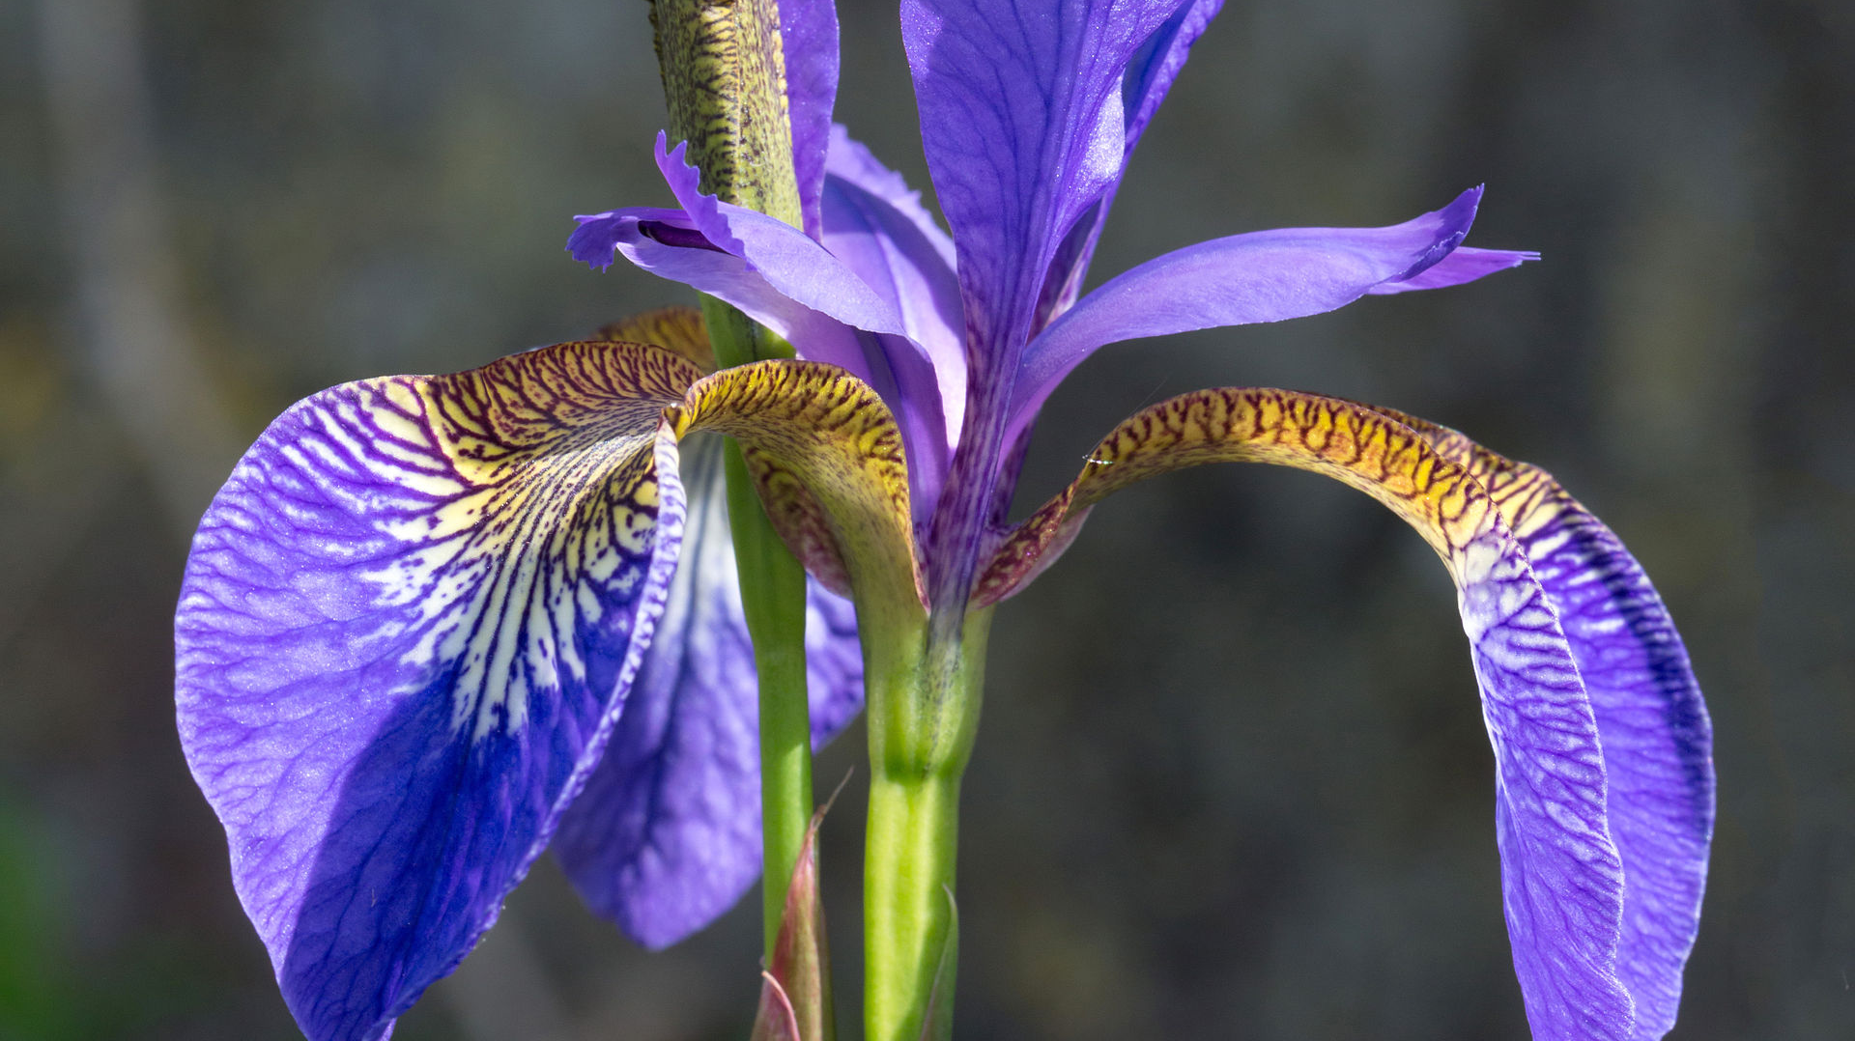
Iris Plant Analysis
By Shamar Morgan

Slide 2

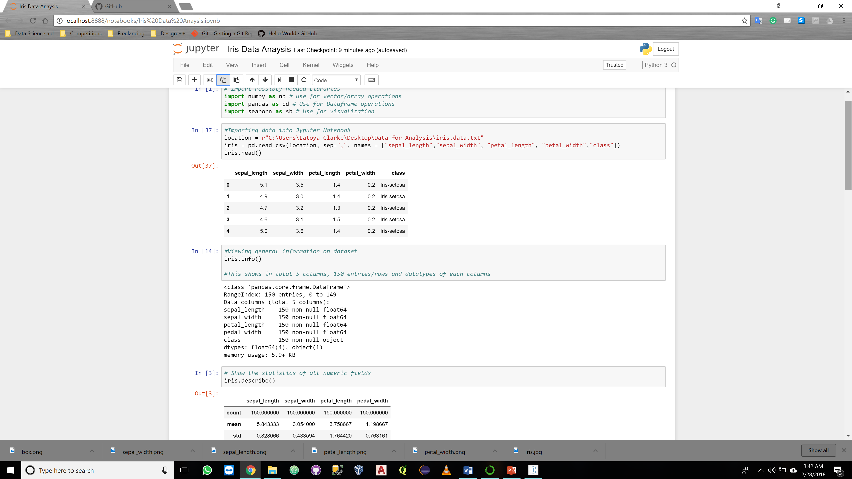
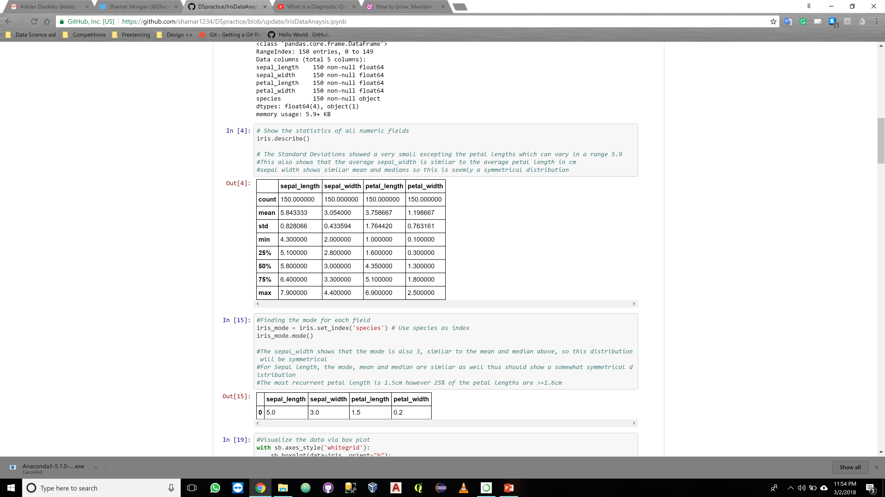
Iris Data Exploration
Dataset downloaded from University of California, Irvine:
https://archive.ics.uci.edu/ml/machine-learning-databases/iris/
The Dataset contains:
150 rows of data
5 Columns (Sepal length, Sepal width, Petal Length, Petal Width, Class)
3 Species of Iris (Setosa, Versicolor, Virginica) fifty (50) instances each
Immediate findings:
Sepal dimensions are symmetrical
Standard deviation is small thus variance is small
Petal length has largest range and greatest variance in values

Slide 3
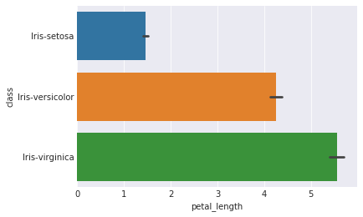
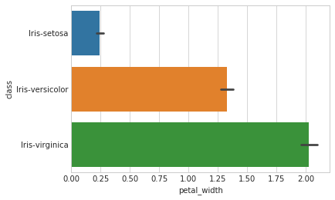
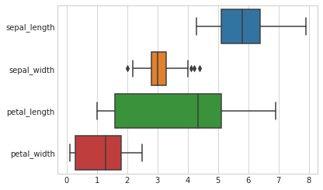
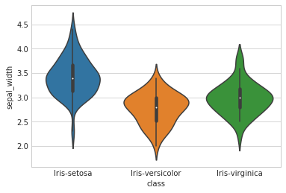
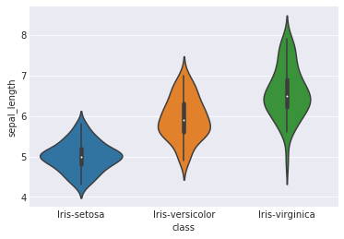
Iris Data Exploration Cont’d
Average Petal Length
Average Petal Width
Boxplot of Iris attributes
Average Sepal Width
Average Sepal Length

Slide 4
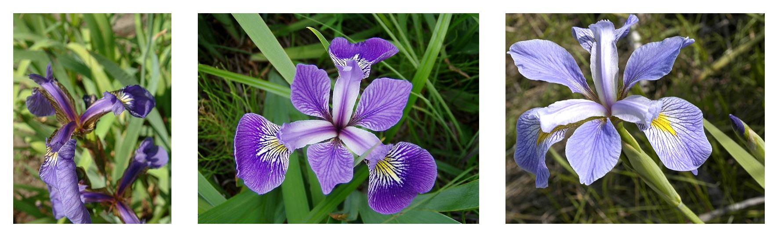
Iris Findings
Iris-Virginica has the largest petal dimensions and the longest sepals of average length of 6.5cm
Iris-Versicolor are shorter in all aspects to the Iris-virgincia having an average petal dimension of 4.2cm x 1.30cm
Iris-Setosas have the smallest petal dimensions but generally have wider sepals.

