Slide 1
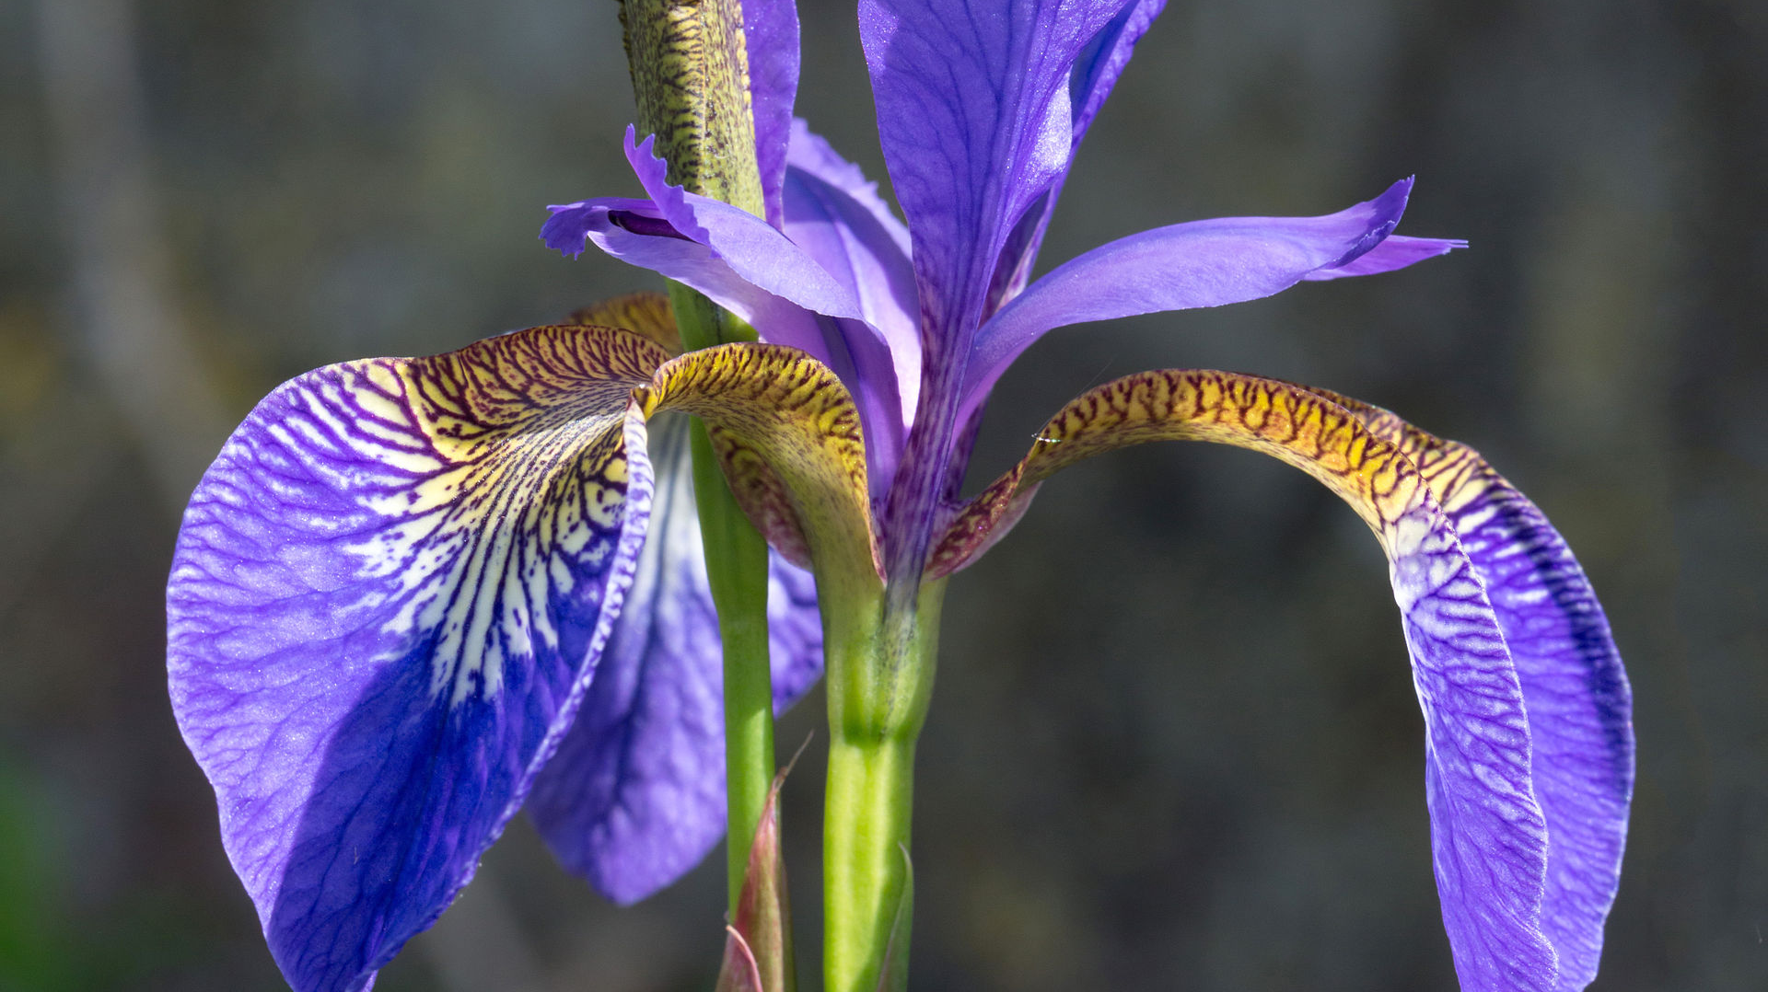
Iris Plant Analysis
By Shamar Morgan

Slide 2
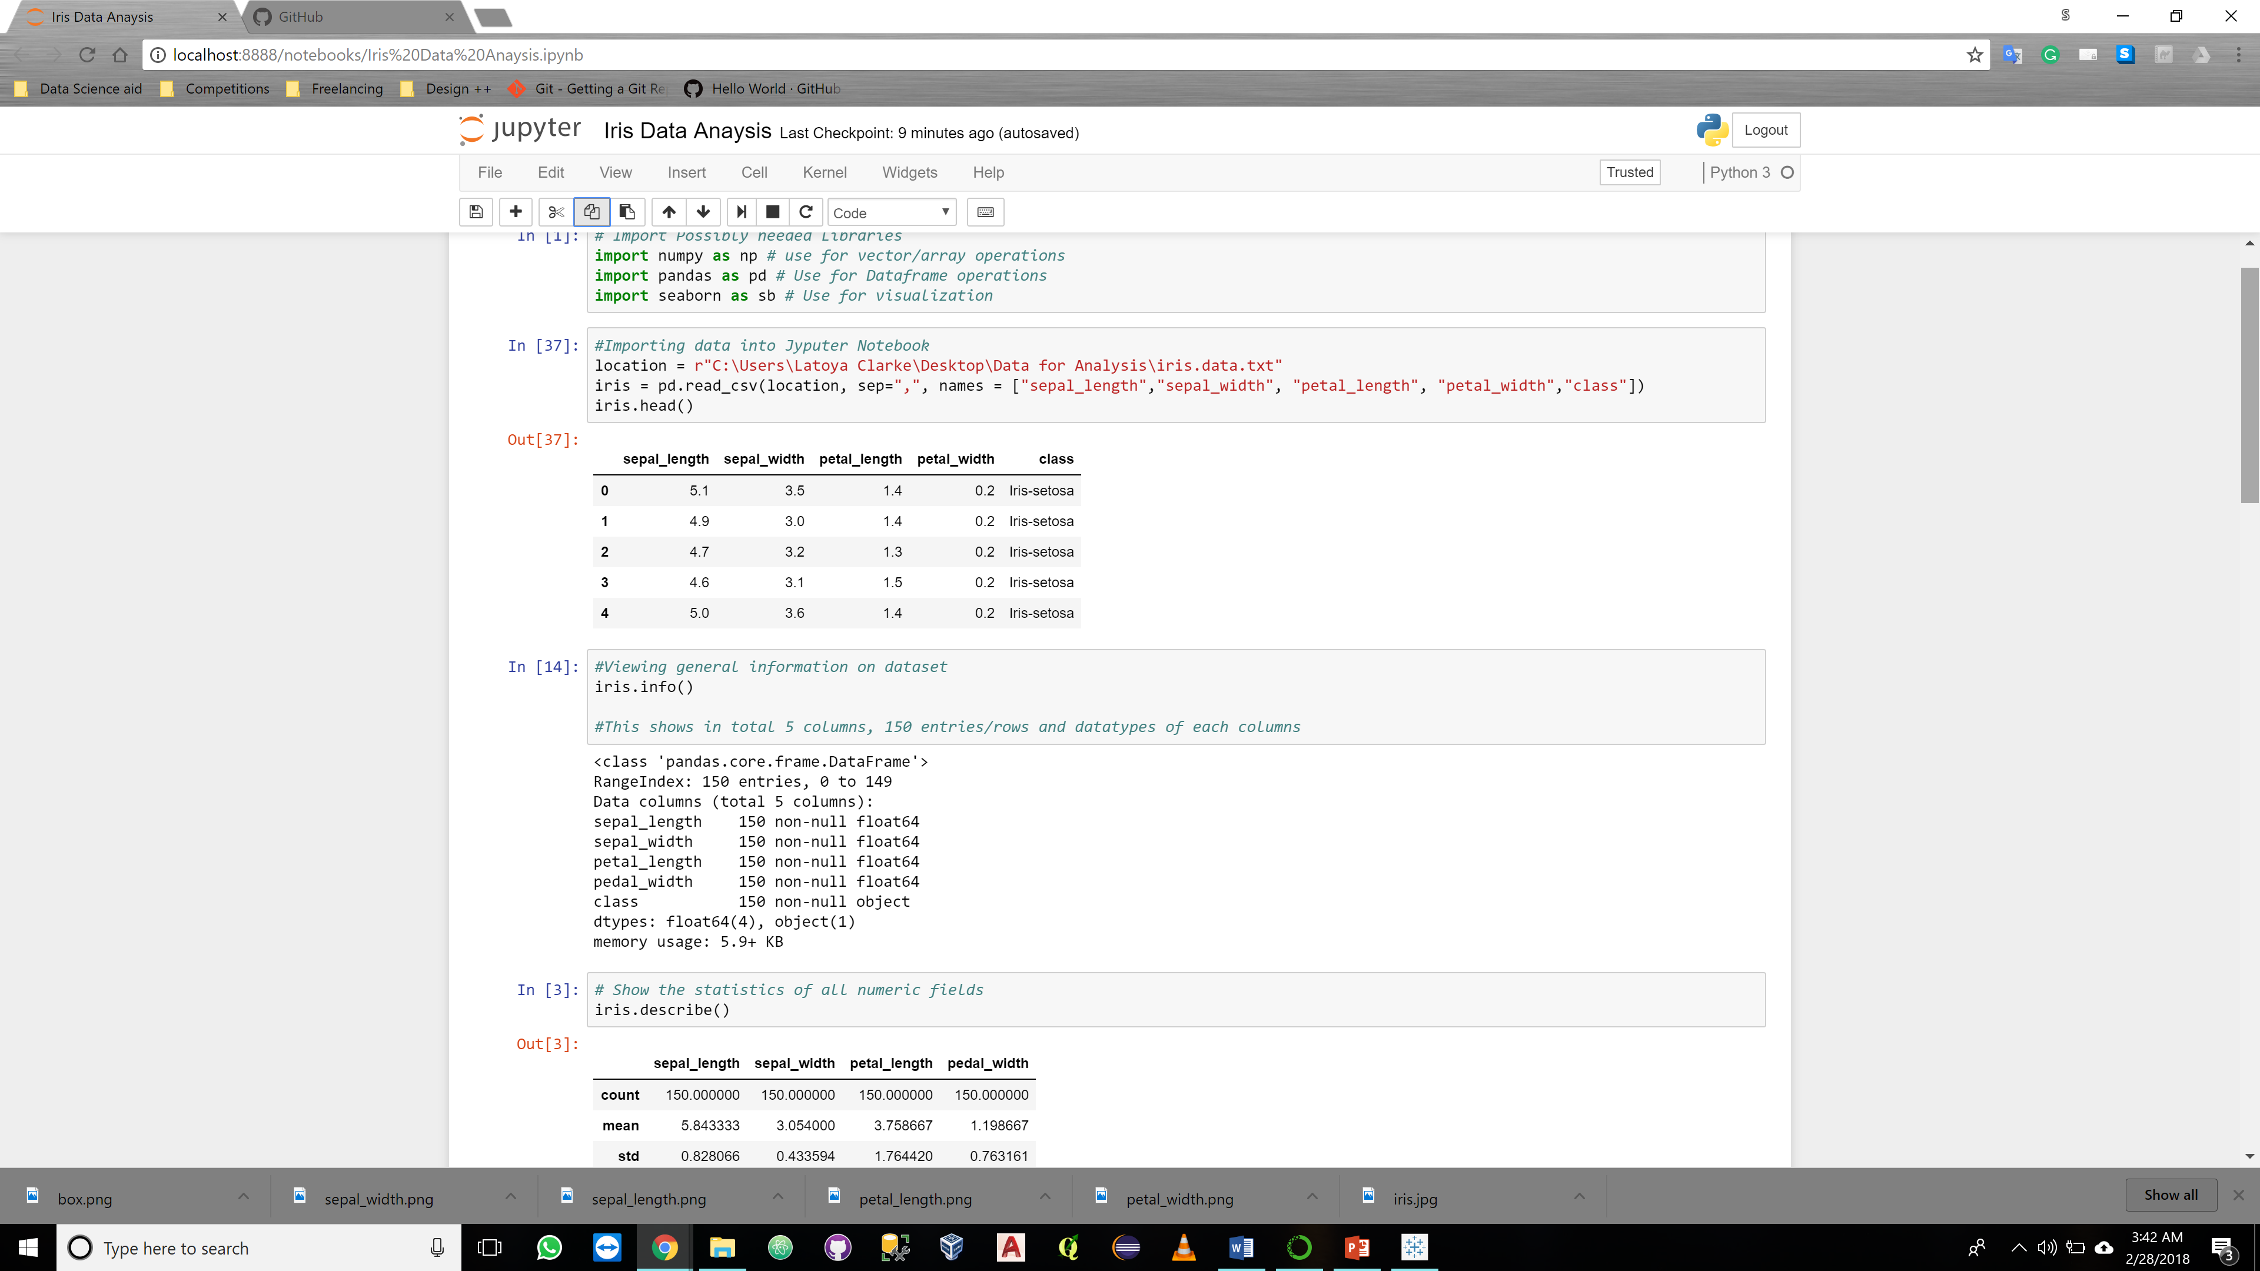
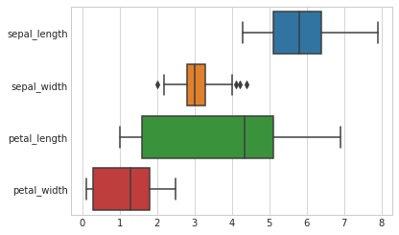
Iris Background & Data
Iris is a genus of a popular garden flowering plant and in flamboyant in color. It’s name comes from the Greek word for rainbow
Dataset downloaded from University of California, Irvine:
https://archive.ics.uci.edu/ml/machine-learning-databases/iris/
The Dataset contains:
150 rows of data
5 Columns (Sepal length, Sepal width, Petal Length, Petal Width, Class)
3 Species of Iris (Setosa, Vericolor, Virginica) fifty (50) instances each

Slide 3
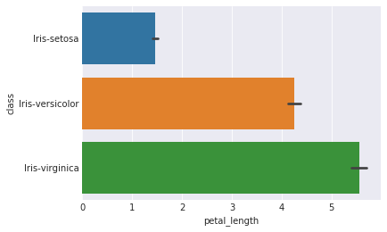
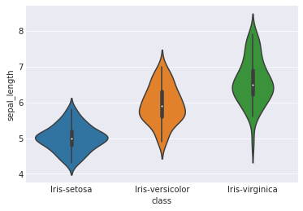
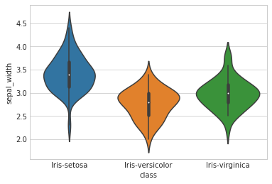
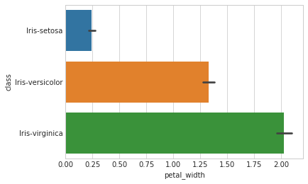
Analysis of Iris Data

Slide 4
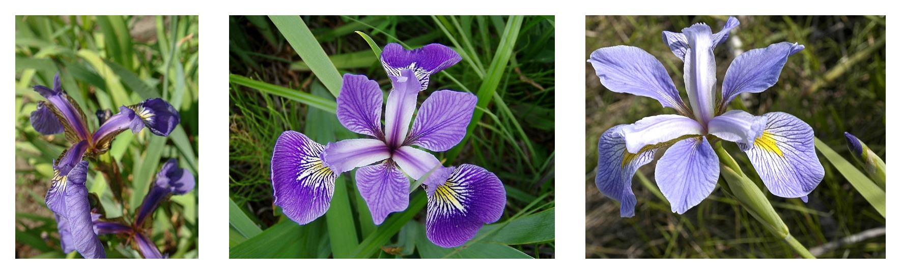
Iris Findings
Iris-Virginica flower has the greatest surface area of the 3 flowers examined.
Although Iris-Setosa flowers seem to have the widest sepals.

