Slide 1
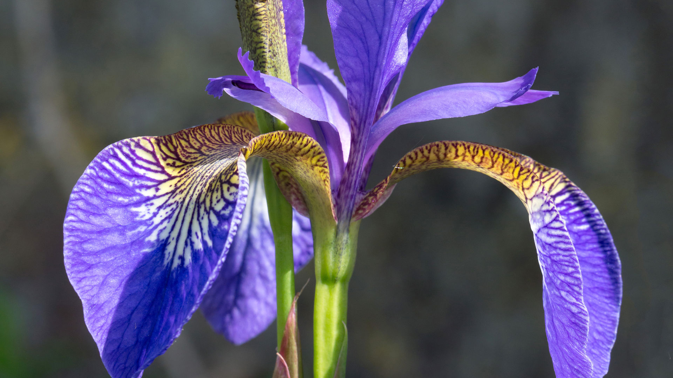
Iris Plant Analysis
By Shamar Morgan

Slide 2
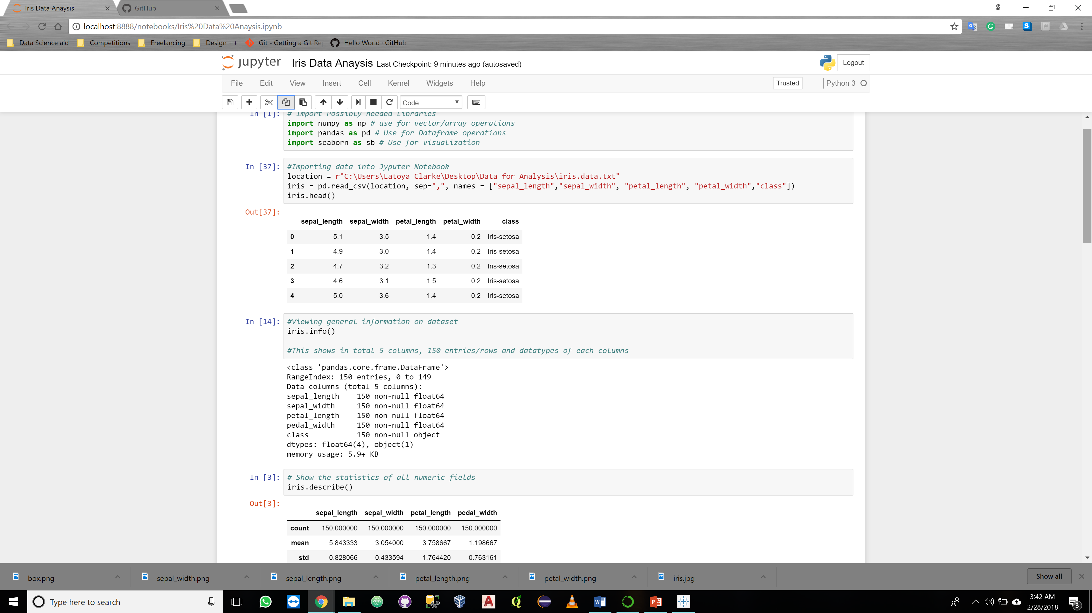
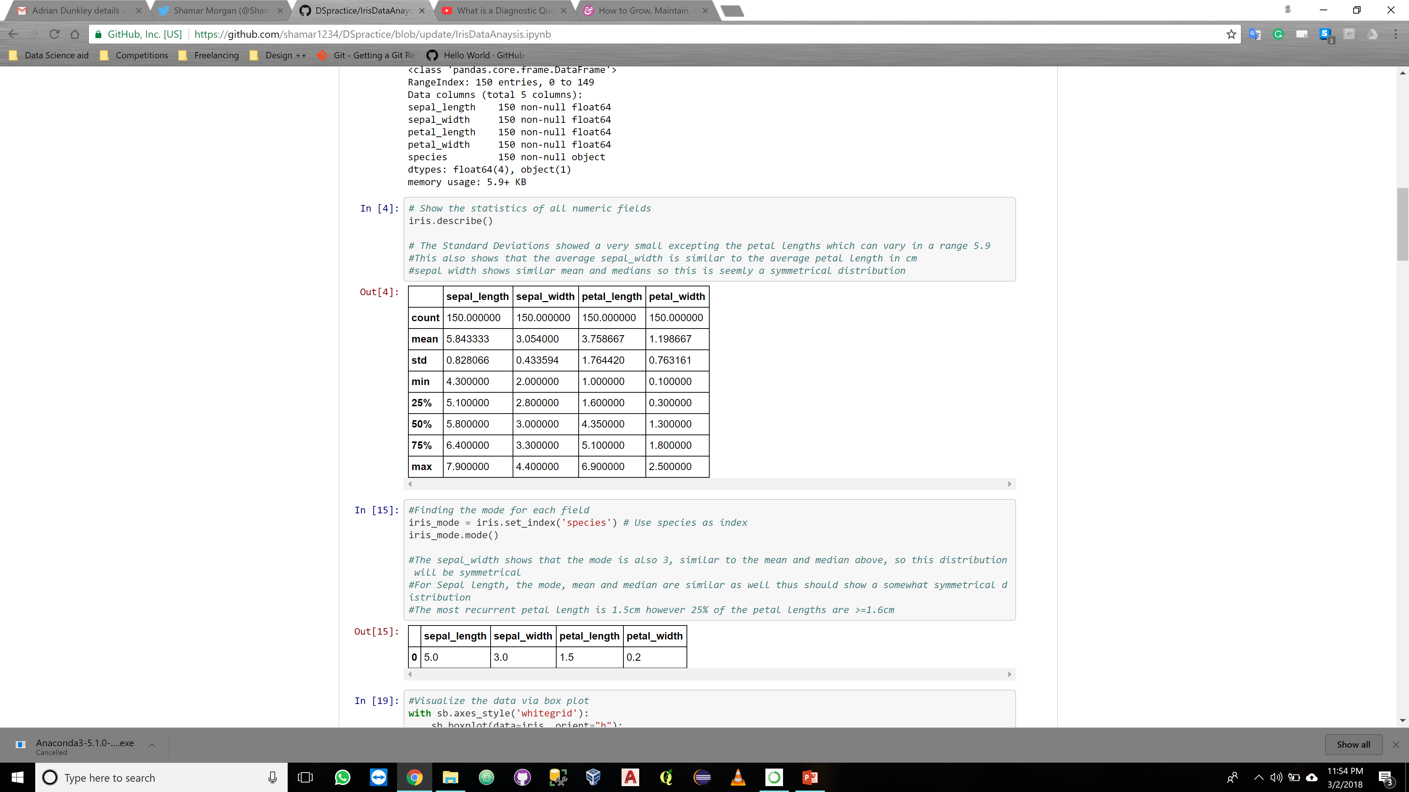
Iris Background & Data
Dataset downloaded from University of California, Irvine:
https://archive.ics.uci.edu/ml/machine-learning-databases/iris/
The Dataset contains:
150 rows of data
5 Columns (Sepal length, Sepal width, Petal Length, Petal Width, Class)
3 Species of Iris (Setosa, Vericolor, Virginica) fifty (50) instances each
Immediate findings:
Sepal dimensions are symmetrical
Standard deviation is small thus variance is small
Petal length has largest range and greatest variance in values

Slide 3
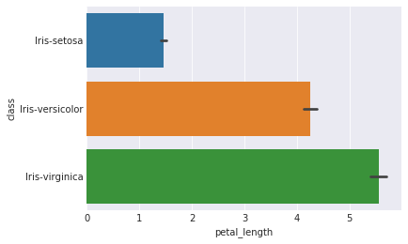
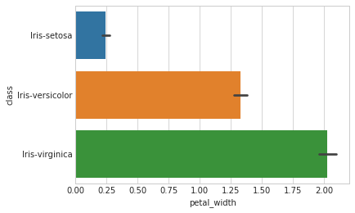
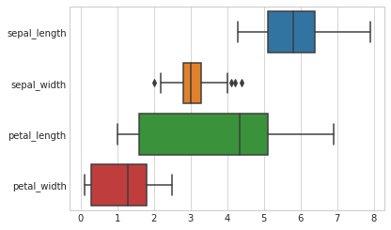
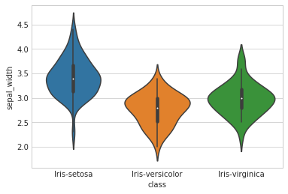
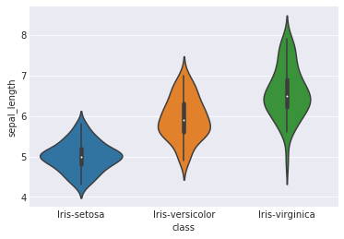
Visualization and Analysis of Iris Data

Slide 4
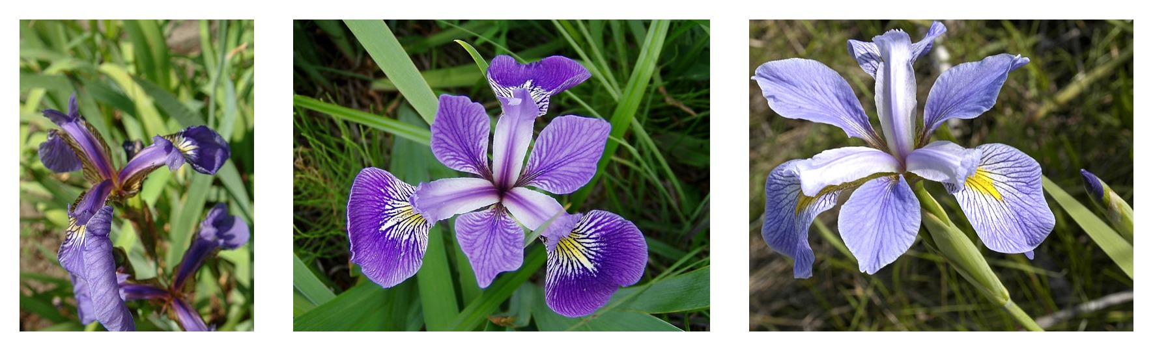
Iris Findings
Iris-Virginica has the largest petals and the longest sepals of average length of 6.5cm
Iris-Versicolor are shorter in all aspects than Iris-virgincia having an average petal dimension of 4.2cm x 1.30cm
Iris-Setosas have the smallest petal dimensions but generally have wider sepals.

