Slide 1
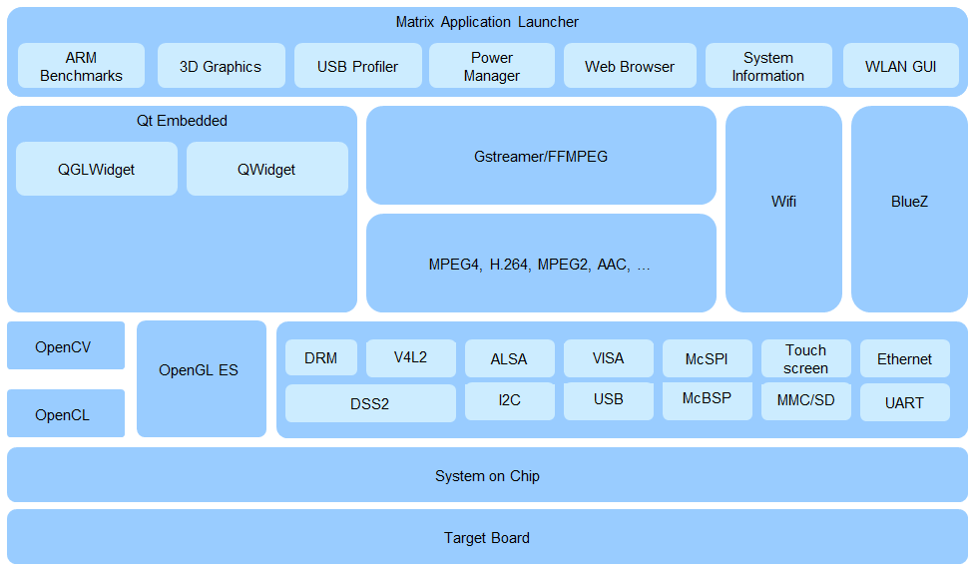
User-Space Application
Middleware and Framework
Processor Software Development Kit
Device Drivers and Linux Kernel

