Slide 1
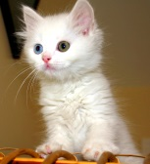
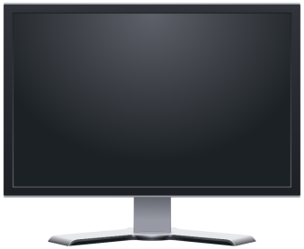

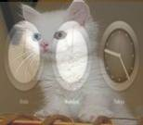

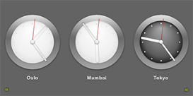
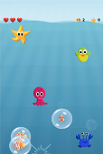
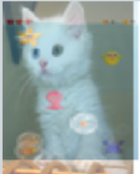
Camera input
V4L2 framework
QT framework : eglfs_kms QPA
VIP
1
DSS
2
Display 1
Vivante API
On the fly scaling, overlaying and alpha blending. Can take up to 4 video planes input and can drive up to 4 displays simultaneously
+
3
1
3
GC320
90⁰ rotation+stitching
SGX
3D Graphics accelerator
2
+
4
Graphics drawing Clocks using QT QML
4
Graphics drawing Maroon game using QT QML
Display 2

Slide 2
Acquire hardware planes for overlay from DSS
(create_plane)
Export the physical buffers for display to DRM device
(export_buffer)
Set the DSS hardware plane properties
(set_plane_properties)
Queue the video buffers to display
(queue_plane)
Begin display (start_disp_plane)
Initialize Resources
Dequeue the buffer already displayed
(waiting on user_call_back_handle)
Queue the video buffers to display
Quit App?
Yes
No
Free Resources
Free the video buffers from DRM device
(distroy_buffer)
Free the DSS hardware planes
(distroy_plane)

