Slide 1
IPC Lab 1
ex01_helloworld

Slide 2
Overview
This is the "Hello World" example for IPC.
Goals
Learn how to build an IPC example
Setup a CCS Target Configuration for Vayu
Load and run the processors
Use the RTOS Object Viewer (ROV) to inspect IPC modules

Slide 3
ex01_helloworld
This is a two processor example. You can build it for any two processors on your device, but only for two at a time.
You will assign one processor the role of “reader" and the other the role of "writer".
The reader will create a message queue and wait for messages.
The writer will open the message queue and send messages.
The heap in shared region #0 is used for the message pool.

Slide 4

Data Flow
DSP1
Reserved Header
DSP2
1
Heap
writer
reader
4
msg
msg
2
ReaderQ: MessageQ
3
msg

Slide 5
Step 1 — Work Area
Create a work folder for this lab
C:\TI_Demo
Extract the example into the work folder
<ipc_3_30_pp_bb>\examples\DRA7XX_bios_elf\ex01_hello.zip

Slide 6
Step 2 — Build Environment
Set the product install paths as defined by your physical environment.
Edit ex01_hello/products.mak
DEPOT = C:/Products IPC_INSTALL_DIR = $(DEPOT)/ipc_m_mm_pp_bb BIOS_INSTALL_DIR = $(DEPOT)/bios_m_mm_pp_bb XDC_INSTALL_DIR = $(DEPOT)/xdctools_m_mm_pp_bb
Set the tool paths (only need the ones you actually plan to use).
Edit ex01_hello/products.mak
CCS = C:/CCS/CCS_6_0_0_00190/ccsv6/tools/compiler gnu.targets.arm.A15F = $(CCS)/gcc_arm_none_eabi_m_m_p ti.targets.elf.C66 = $(CCS)/c6000_m_m_p ti.targets.arm.elf.M4 = $(CCS)/arm_m_m_p ti.targets.arp32.elf.ARP32_far = $(CCS)/arp32_m_m_p
Each example has its own products.mak file; you may also create a products.mak file in the parent directory which will be used by all examples.

Slide 7
Step 3 — Build Executables
Open a Windows Command Prompt
Start > Run cmd
TIP: Use the following command to create an alias for the make command
doskey make="C:\Products\xdctools_3_30_04_52\gmake.exe" $*
TIP: Use dosrc.bat to setup your build environment
<ipc_3_30_pp_bb>/examples/dosrc.bat — copy to your work folder
Edit dosrc.bat, set product paths
Run script in your command prompt
Build the example
cd ex01_hello make
The executables will be in their respective "bin" folders
ex01_hello\dsp1\bin\debug\hello_dsp1.xe66 ex01_hello\dsp2\bin\debug\hello_dsp2.xe66

Slide 8
Step 4 — CCS Target Configuration (1/2)
Create an empty project. We will use this to store the target configuration.
File > New > Project...
General > Project
Next
Project name: TargetConfiguration
Finish
Create a new target configuration file.
File > New > Target Configuration File
File name: DRA7xx_EVM
Use shared location > Unselect
Workspace...
Select the project you just created
OK
Finish

Slide 9
Step 4 — CCS Target Configuration (2/2)
Setup the new target configuration
Connection: Spectrum Digital XDS560V2 STM USB Emulator
Board or device: DRA7xx
Save
Lower JTAG clock speed (optional)
Advanced Setup > Target Configuration
Spectrum Digital XDS560V2 STM USB Emulator_0 > Select
JTAG TCLK Frequency > Automatic with legacy 10.368 MHz limit
Save

Slide 10
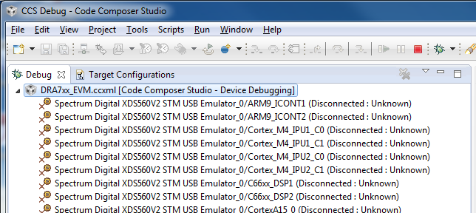
Step 5 — Launch Debug Session
Set new target configuration as default
Open Target Configuration view (View > Target Configurations)
Projects > TargetConfiguration > DRA7xx_EVM.ccxml
RMB > Set as Default
RMB > Launch Selected Configuration
Open Debug view. You should see a list of processors.

Slide 11
Step 6 — Group Processors (1/2)
You will need to use the non-debuggable processors. These are not visible by default.
In Debug View > RMB > Show all cores
Open the Non Debuggable Devices group
Group the following devices. These are used for system control.
Select IcePick_D, CS_DAP_DebugSS, CortexA15_0
RMB > Group cores
Group the processors used by your example.
Select C66xx_DSP1, C66xx_DSP2
RMB > Group cores
Hide the remaining processors. This removes clutter form the debug view.

Slide 12
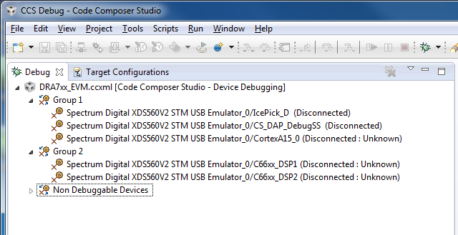
Step 6 — Group Processors (2/2)
Your Debug view should look like this.

Slide 13
Step 7 — Connect to Processors
I recommend you connect to the IpcPick first and issue a system reset.
Debug view > IcePick_D > RMB > Connect Target
Scripts > ICEPick_D_Utility > SystemReset
You must connect to the CortexA15_0 first. This will automatically run GEL scripts to enable the device.
Debug view > CortexA15_0 > RMB > Connect Target
Connect to DSP1
CortexA15_0 > Select
Scripts > DRA7xx MULTICORE Initialization > DSP1SSClkEnable_API
C66xx_DSP1 > RMB > Connect Target
Run > Reset > CPU Reset (or use toolbar icon, )
Repeat previous step for DSP2. Remember to select the CortexA15_0 before running the GEL script.

Slide 14
Step 8 — Load Processors
Run the host processor. This is required to enable the DSPs to reach main when loaded (timers are halted when host is halted).
Debug view > CortexA15_0 > Select
Run > Run (or use toolbar icon, )
Load DSP1 with the executable you just built.
Select C66xx_DSP1
Run > Load > Load Program (or use toolbar icon, )
Click Browse, select the DSP1 executable
C:\TI_Demo\ex01_hello\dsp1\bin\debug\hello_dsp1.xe66
You should see DSP1 run to main and then stop.
Load DSP2 using the same procedure. Be mindful to load the proper executable.
C:\TI_Demo\ex01_hello\dsp2\bin\debug\hello_dsp2.xe66

Slide 15
CCS Auto Run Configuration (optional)
By default, when you load a program, CCS will run to the function main and then stop. You can disable this with the Auto Run option. This comes in handy when there is a bug in the boot code.
Target Configurations
Projects > TargetConfiguration > DRA7xx_EVM.ccxml
RMB > Properties
Device (menu) > C66xx_DSP1
Auto Run and Launch Options > Select
Auto Run Options (group) > On a program load or restart > Unselect
Use the Device pull-down menu to select the next processor. Repeat for each processor.
The changes above will not effect the current debug session (only subsequent ones). Use these steps to modify the current session.
Debug View
Select C66x_0
Tools > Debugger Options > Auto Run and Launch Options
Auto Run Options (group) > On a program load or restart > Unselect
Click Remember My Settings to make this change permanent
Notes:
Does this slide need a screen shot?

Slide 16
Step 9 — Run to Main
If you disabled the Auto Run option, you should see the processor at the _c_int00 entry point. Run the processor to main.
Select the processor in the Debug view
Run > Go Main
Run both processors to main. You should see the source code in the editor view.

Slide 17
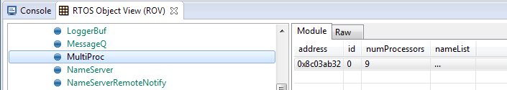
RTSC Object View (ROV)
Once you reach main, you can use ROV to inspect the target data.
Debug view > C66xx_DSP1 > Select
Tools > RTOS Object View (ROV)
TIP: Dock the ROV view along the bottom edge. Then maximize it.
Inspect the MultiProc module
Select MultiProc in the object browser (on the left)
Select the Module tab (on the right)

Slide 18
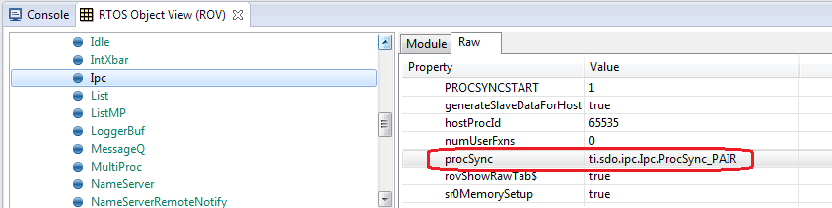
ROV — Ipc Module
Select the Ipc module in ROV. On the Module tab you will see a list of all the other processors in the system. Notice that the attached column shows 'false'. That is because we have not yet made it through Ipc_attach.
What is our Ipc attach mode? Click on the Raw tab. Expand the Configuration object. Use the Auto Fit tool bar button ( ) to adjust the column sizes. The information displayed here reflects the configuration for the module.
Scroll down and look for the procSync config param. You should see it was set to ti.sdo.ipc.Ipc.ProcSync_PAIR. This is a handy way to inspect your configuration values.

Slide 19
Step 10 — Break after Ipc_attach
Let’s use breakpoints to run each processor through Ipc_attach. In the Debug view, select main under C66xx_DSP1. Scroll down to the function App_taskFxn. Set a breakpoint in the source window just after the Ipc_attach loop. Observe the new breakpoint in the Breakpoints view. Use the pop-up context menu.
Do the same for DSP2.
TIP: It helps to name your breakpoints to keep track of them.
In Breakpoint view, RMB on breakpoint
Breakpoint Properties...
Edit the name field
Run DSP1. Notice it does not hit the breakpoint. It is spinning in the attach loop.
Run DSP2. After a short run, both processors will hit their respective breakpoints.
Inspect the Ipc module in ROV. In the attached column, you should see 'true' for the respective peer processor.
Notes:
Breakpoint double-click in the margin fails. Use pop-up context menu.

Slide 20
Step 11 — Run to Completion
Set a breakpoint on the last line of App_taskFxn. Do this for both processors.
Run both processors
Select the processor group in the Debug view
Run > Run (or use toolbar icon, )
After a short run, both processors should hit their breakpoints.

Slide 21
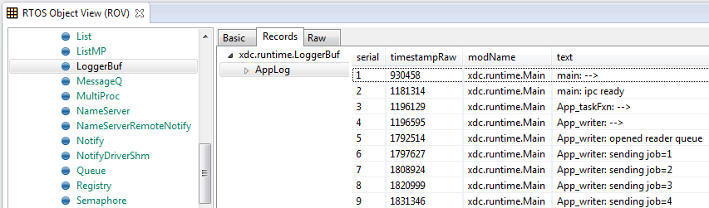
ROV — LoggerBuf Module
When the example completes, use ROV to inspect the LoggerBuf module to see the log events.
Debug view > C66xx_DSP1 > Select
RTOS Object View (ROV) > LoggerBuf > Select
Records (tab) > Select
AppLog > Select (don’t open it)
You will see a list of log events. Use the Auto Fit Columns ( ) button if necessary.

Slide 22
Example Reloaded
Use the following sequence to reload the example.
C66xx_DSP1 > Select
CPU Reset
Run > Load > Reload Program (or use toolbar menu, )
Repeat the previous step for DSP2
You are now ready to run the example again.

Slide 23
Rebuild with Different Processors
To rebuild the example with a different processor pair, you need to edit the top-level makefile. Modify the PROCLIST macro to specify which processors to build.
Edit ex01_hello/makefile
PROCLIST = dsp1 eve1
Next, you need to edit the source file for each processor and specify its role and name its peer.
Edit ex01_hello/dsp1/HelloDsp1.c
Int role = Role_WRITER; String peer = "EVE1"
Edit ex01_hello/eve1/HelloEve1.c
Int role = Role_READER; String peer = "DSP1";
Remember to delete the error directive.
#error Must define role and peer

Slide 24
Running on IPU Processor (1/3)
Load GEL file
Cortex_M4_IPU1_C0 > Select
Tools > GEL Files
GEL Files (view) > GEL Files Panel (right side) > RMB > Load GEL...
ex01_hello/ipu1/ex01_hello_ipu1.gel
Connect to IPU1
CortexA15_0 > Select
Scripts > DRA7xx MULTICORE Initialization > IPU1SSClkEnable_API
Cortex_M4_IPU1_C0 > RMB > Connect Target
Run > Reset > CPU Reset
Cortex_M4_IPU1_C1 > RMB > Connect Target
Run > Reset > CPU Reset
Program AMMU
Cortex_M4_IPU1_C0 > Select
Scripts > ex01_hello > ex01_hello_ipu1_ammu_config
Notes:
Note: With IPU, you connect before programming the AMMU, unlike with the EVE.

Slide 25
Running on IPU Processor (2/3)
Run host processor
CortexA15_0 > Select
Run > Run
Load IPU1_C0 with program
Cortex_M4_IPU1_C0 > Select
Run > Load > Load Program...
Click Browse, select the IPU1 executable
ex01_hello\ipu1\bin\debug\hello_ipu1.xem4
Load symbols on IPU1_C1. With SYS/BIOS SMP, you only need symbols on the second core.
Cortex_M4_IPU1_C1 > Select
Run > Load > Load Symbols...
Use same file as above. Usually, its already selected in dialog box.
Restart IPU1_C1
Run > Restart

Slide 26
Running on IPU Processor (3/3)
Run IPU1_C1. It will just spin until Core 0 calls BIOS_start.
Cortex_M4_IPU1_C1 > Select
Run > Run
Run IPU1_C0 to main
Cortex_M4_IPU1_C0 > Select
Run > Go Main
You are now ready to proceed with the example.

Slide 27
Running on EVE Processor (1/2)
Load GEL file. Needed for programming the MMU.
CS_DAP_DebugSS > Select (must show all cores to see the DebugSS)
Tools > GEL Files
GEL Files (view) > GEL Files Panel (right side) > RMB > Load GEL...
ex01_hello/eve1/ex01_hello_eve1.gel
Connect to EVE1
CortexA15_0 > Select
Scripts > DRA7xx MULTICORE Initialization > EVE1SSClkEnable_API
CS_DAP_DebugSS > Select
Scripts > EVE MMU Configuration > ex01_hello_eve1_mmu_config
ARP32_EVE_1 > RMB > Connect Target
Run > Reset > CPU Reset
Notes:
Note: With EVE, you program MMU before connecting, unlike with the IPU.

Slide 28
Running on EVE Processor (2/2)
Run host processor
CortexA15_0 > Select
Run > Run
Load program
ARP32_EVE_1 > Select
Run > Load > Load Program...
Click Browse, select the EVE1 executable
ex01_hello\eve1\bin\debug\hello_eve1.xearp32F
Run to main
ARP32_EVE_1 > Select
Run > Go Main
You are now ready to proceed with the example.
Note: Run EVE processor first, before running the peer processor.
Notes:
EVE startup bug requires it to run first. Might be fixed by IPC 3.30 GA release.

Slide 29
Running on HOST Processor
Connect to HOST
CortexA15_0 > RMB > Connect Target
Connect, load, and run to main the peer processor before loading program on HOST.
Load program
CortexA15_0 > Select
Run > Reset > CPU Reset
Run > Load > Load Program...
Click Browse, select the HOST executable
ex01_hello\host\bin\debug\hello_host.xa15fg
Run to main
CortexA15_0 > Select
Run > Go Main
Run HOST before running peer
Run > Run
You are now ready to proceed with the example.

Slide 30
Extra Credit
Here are some suggestions on extra credit tasks
Inspect the SharedRegion module in ROV. Note the cache setting for SR #0.
Inspect the MessageQ module in ROV. Use breakpoints before and after the reader creates the message queue. Look for the message queue in ROV.
Set a breakpoint after the reader has received the first message. Let the writer continue. Use ROV to observe the messages in the queue.

Slide 31
Congratulations! End of Lab 1

Slide 32
IPU Build Error
When building for IPU the first time, you are likely to run into the following link error.
warning: automatic library build: using library C:/CCS/CCS_6_0_0_00190/ccsv6/tools/compiler/arm_5.1.5/lib/rtsv7M4_T_le_eabi.lib for the first time, so it must be built. This may take a few minutes. >> ERROR: mklib: could not find program "unzip", required for building libraries. Modify the PATH environment variable to contain a directory containing this program.
To resolve this error, you need to add the XDCtools 'bin' folder to your path.
set xdctools=C:\Products\xdctools_3_30_04_52_core PATH=%PATH%;%xdctools%;%xdctools%\bin
Run the build again. This time it should build the new RTS library.

