Slide 1
Lab 3 IPC Scalability
ex13_notifypeer

Slide 2
Overview
This is an example of scaling IPC down to just Notify.
Goals
Add an EVE processor to an existing two processor application.
IPC scalability, Notify only
Use a SYS/BIOS Event object to wait on two input sources

Slide 3
ex13_notifypeer
Initial setup is for two processors; HOST and DSP1
HOST uses message queue to send jobs to DSP1.
You will modify DSP1 to forward the job to EVE1.
You will add EVE1 to application using only IPC Notify.

Slide 4

Initial Data Flow
SharedRegion
HOST
Heap
DSP1
Client
Server
Message
Pool
6
4
msg
1
msg
2
NULL: MessageQ
serverQ: MessageQ
3
msg
msg
5

Slide 5
Final Data Flow
HOST
DSP1
EVE1
Client
Server
8
Process
1
4
12
11
7
msg
2
msg
: Semaphore
: Semaphore
NULL: MessageQ
5
msg
NotifyCB
serverQ: MessageQ
6
13
3
10
msg
9
NotifyCB

Slide 6
Step 1 — Work Area
Create a work folder for this lab
C:\TI_Demo
Extract the example into the work folder
<ipc_3_30_pp_bb>\examples\DRA7XX_bios_elf\ex13_notifypeer.zip

Slide 7
Step 2 — Build Environment
Set the product install paths as defined by your physical environment.
Edit ex13_notifypeer/products.mak
DEPOT = C:/Products IPC_INSTALL_DIR = $(DEPOT)/ipc_m_mm_pp_bb BIOS_INSTALL_DIR = $(DEPOT)/bios_m_mm_pp_bb XDC_INSTALL_DIR = $(DEPOT)/xdctools_m_mm_pp_bb
Set the tool paths (only need the ones you actually plan to use).
Edit ex13_notifypeer/products.mak
CCS = C:/CCS/CCS_6_0_0_00190/ccsv6/tools/compiler gnu.targets.arm.A15F = $(CCS)/gcc_arm_none_eabi_m_m_p ti.targets.elf.C66 = $(CCS)/c6000_m_m_p ti.targets.arm.elf.M4 = $(CCS)/arm_m_m_p ti.targets.arp32.elf.ARP32_far = $(CCS)/arp32_m_m_p
Each example has its own products.mak file; you may also create a products.mak file in the parent directory which will be used by all examples.

Slide 8
Step 3 — Build Executables
Open a Windows Command Prompt
Start > Run cmd
TIP: Use the following command to create an alias for the make command
doskey make="C:\Products\xdctools_3_30_04_52\gmake.exe" $*
TIP: Use dosrc.bat to setup your build environment
<ipc_3_30_pp_bb>/examples/dosrc.bat — copy to your work folder
Edit dosrc.bat, set product paths
Run script in your command prompt
Build the example
cd ex13_notifypeer make
The executables will be in their respective "bin" folders
ex13_notifypeer\host\bin\debug\app_host.xa15fg ex13_notifypeer\dsp1\bin\debug\server_dsp1.xe66

Slide 9
CCS Auto Run Configuration
Disable Run to Main in your target configuration.
Target Configurations
Projects > TargetConfiguration > DRA7xx_EVM.ccxml
RMB > Properties
Device (menu) > C66xx_DSP1
Auto Run and Launch Options > Select
Auto Run Options (group) > On a program load or restart > Unselect
Use the Device pull-down menu to select the next processor. Repeat for each processor.
Notes:
Does this slide need a screen shot?

Slide 10
Step 4 — Load Processors
Load HOST with executable
Debug view > CortexA15_0 > Select
Run > Load > Load Program
Click Browse, select the HOST executable
ex13_notifypeer\host\bin\debug\app_host.xa15fg
Load DSP1 with executable
Debug view > C66xx_DSP1 > Select
Run > Load > Load Program
Click Browse, select the DSP1 executable
ex13_notifypeer\dsp1\bin\debug\server_dsp1.xe66

Slide 11
Step 5 — Run the Example
Run HOST processor
Debug view > CortexA15_0 > Select
Run > Resume
Run DSP1 processor
Debug view > C66xx_DSP1 > Select
Run > Resume
The example completes very quickly
Halt DSP1 processor
Debug view > C66xx_DSP1 > Select
Run > Suspend
Halt HOST processor
Debug view > CortexA15_0 > Select
Run > Suspend

Slide 12
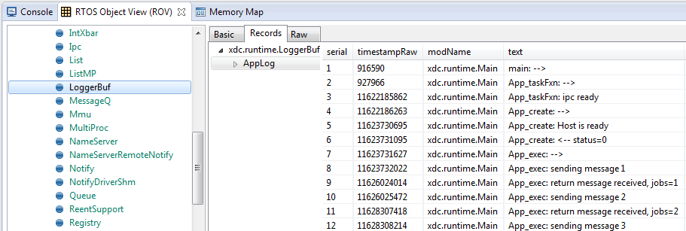
ROV — LoggerBuf Module
When the example completes, use ROV to inspect the LoggerBuf module to see the log events.
Debug view > CortexA15_0 > Select
RTOS Object View (ROV) > LoggerBuf > Select
Records (tab) > Select
AppLog > Select (don’t open it)
You will see a list of log events.

Slide 13
Step 6 — Adding EVE1 Processor
To build the EVE1 executable, you need to edit the top-level makefile. Add EVE1 to the PROCLIST macro.
Edit ex13_notifypeer/makefile
PROCLIST = dsp1 eve1 host
To enable DSP1 to EVE1 IPC communication, edit the server source file and uncomment the EVE macro.
Edit ex13_notifypeer/dsp1/Server.c
/* define the EVE peer */ #define EVE "EVE1"
Build the example
cd ex13_notifypeer make

Slide 14
Step 7 — Connect to EVE1 Processor
Load GEL file. Needed for programming the MMU.
CS_DAP_DebugSS > Select (must show all cores to see the DebugSS)
Tools > GEL Files
GEL Files (view) > GEL Files Panel (right side) > RMB > Load GEL...
ex13_notifypeer/eve1/ex13_notifypeer_eve1.gel
Connect to EVE1
CortexA15_0 > Select
Scripts > DRA7xx MULTICORE Initialization > EVE1SSClkEnable_API
CS_DAP_DebugSS > Select
Scripts > EVE MMU Configuration > ex13_notifypeer_eve1_mmu_config
ARP32_EVE_1 > RMB > Connect Target
Run > Reset > CPU Reset
Notes:
Note: With EVE, you program MMU before connecting, unlike with the IPU.

Slide 15
Step 8 — Load Processors
Reload HOST with executable
Reset HOST
Run > Load > Reload Program
Reload DSP1 with executable
Reset DSP1
Run > Load > Reload Program
Load EVE1 with executable
Debug view > ARP32_EVE_1 > Select
Run > Load > Load Program
Click Browse, select the EVE1 executable
ex13_notifypeer\eve1\bin\debug\alg_eve1.xearp32F

Slide 16
Step 9 — Run the Example
Run HOST processor
Debug view > CortexA15_0 > Select
Run > Resume
Run EVE1 processor
Debug view > ARP32_EVE_1 > Select
Run > Resume
Run DSP1 processor
Debug view > C66xx_DSP1 > Select
Run > Resume
The example completes quickly. Halt all three processors.

Slide 17
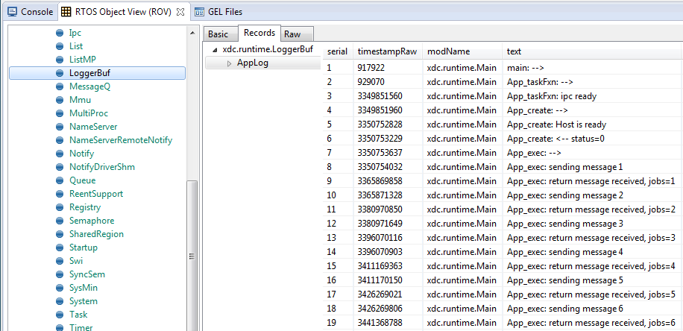
Inspect the Logs
Use ROV to inspect the logs from each processor.
The HOST logs should look identical.

Slide 18
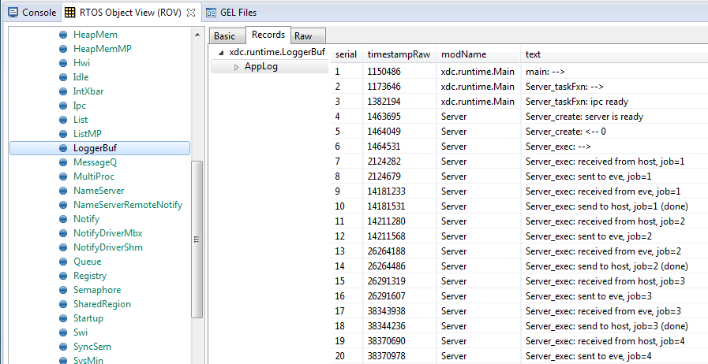
Inspect the Logs
The DSP1 logs will contain additional EVE notifications.

Slide 19
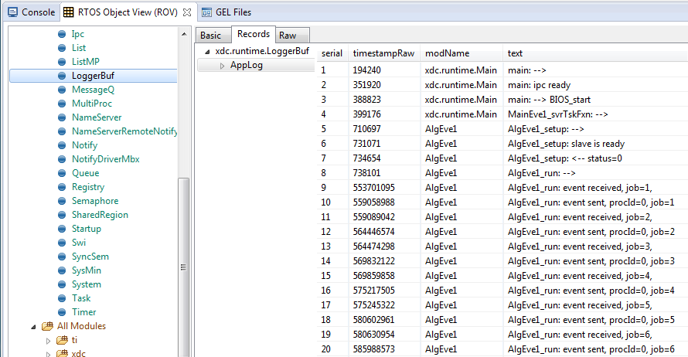
Inspect the Logs
The EVE logs contain the jobs messages.

Slide 20
IPC Notify Scalability
Need only two modules
xdc.useModule('ti.sdo.ipc.Notify'); xdc.useModule('ti.sdo.utils.MultiProc');
Configure notify to use mailbox driver
/* configure the notify driver */ var NotifySetup = xdc.useModule('ti.sdo.ipc.family.vayu.NotifySetup'); NotifySetup.connections.$add( new NotifySetup.Connection({ driver: NotifySetup.Driver_MAILBOX, procName: "EVE1" }) );
Attach has no handshake
/* setup IPC-notify with eve processor */ Notify_attach(Module.eveProcId, 0);

Slide 21
Waiting on Two Input Sources
The DSP is blocked, waiting on input from two sources.
Source 1: Waiting on the message queue for a new message.
Source 2: Waiting on the semaphore for a post event.
How is this possible?
We use a SYS/BIOS Event instance. The event object has a binding to both the message queue and the semaphore.

Slide 22
SYS/BIOS Event Object
DSP1
Server
1
: Event
2
: Semaphore
5
serverQ: MessageQ
4
: Sync
3
: Semaphore

Slide 23
SYS/BIOS Event Object
DSP1
Server
: Event
serverQ: MessageQ
: Sync
: Semaphore
NotifyCB

Slide 24
Create Phase
Create event object
Event_Params_init(&eventP); event = Event_create(&eventP, NULL);
Create the message queue with sync and semaphore objects
Semaphore_Params_init(&semP); semP.event = event; semP.eventId = Event_Id_01; /* message queue */ semP.mode = Semaphore_Mode_BINARY; sem = Semaphore_create(0, &semP, NULL); SyncSem_Params_init(&syncSemP); syncSemP.sem = sem; sync = SyncSem_create(&syncSemP, NULL); MessageQ_Params_init(&msgQueP); msgQueP.synchronizer = (Void *)sync; messageQ = MessageQ_create("ServerQue", &msgQueP);

Slide 25
Execute Phase
Notify callback will post the event object directly.
Event_post(event, Event_Id_00);
Server task will pend on event object.
mask = Event_Id_01 | Event_Id_00; evts = Event_pend(event, Event_Id_NONE, mask, BIOS_WAIT_FOREVER); if (evts & Event_Id_00) { /* get payload from the notify queue */ job = Server_dequeueEvent(&Module.notifyQ); } if (evts & Event_Id_01) { /* get message from message queue */ MessageQ_get(Module.messageQ, (MessageQ_Msg *)&msg, BIOS_NO_WAIT); }

Slide 26
Congratulations! End of Lab 3

