Slide 1
Computer Scams
By Alrica Avila

Slide 2
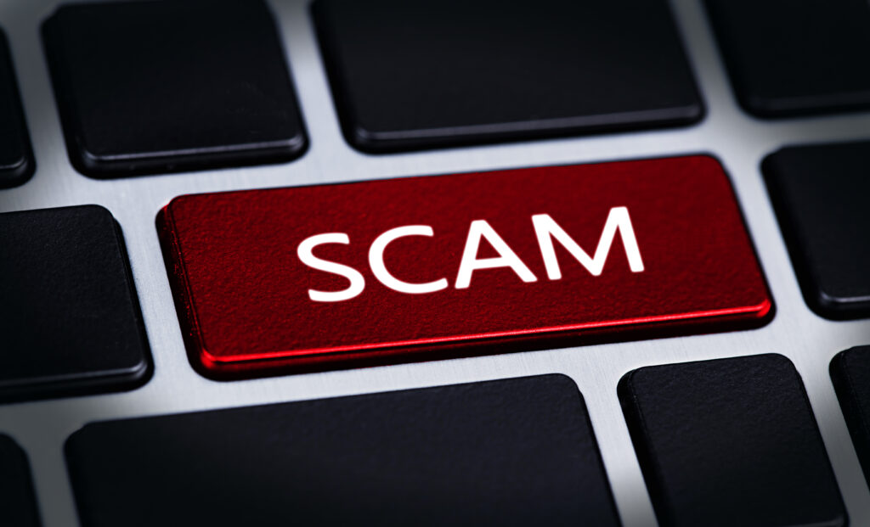
What is a Scam?
A scam is committed by a person known as a fraudster, a con artist, or a scammer. Scammers commit any action meant to fool their victim, then mark, and acquire illicit profit. A mark could be a singular individual or an entire organization.
Typically targeted towards older people and people with disabilities

Slide 3
Scamming Through the Years
Scamming has changed throughout time; individuals deceived others with alterations of policies or identities to earn more than losses; thanks to the internet and fast-acting computers, there are more opportunities for these money-hungry tricksters to con.
Two merchants from Greece forced people to give up their belongings if they forgot to settle their obligations with interest behind the sales they acquired as part of their insurance method. (Fraud.com, 2022)
This deception was the first recorded scheme, approximately 400 years ago.
a noteworthy example is that the Ponzi scheme peaked cheque and identity fraud. Charles Ponzi, a bank employee, utilized his position to execute illicit efforts

Slide 4
The Early Days
Beforehand, tricksters would seemingly appear out of the blue in person and try to offer their false services or products
With advanced technology, like printers, these criminals could publish their sham and reach more victims or print to forge a bogus identity
when computers came, hackers would pop up advertisements, emails, and websites to hook their marks into surrendering their information without ever meeting in person
Finally, the creation of phones produces more effortless routines for talking to people via calls or texts, which instantly accomplishes a hoax. (Mineo, 2024)

Slide 5
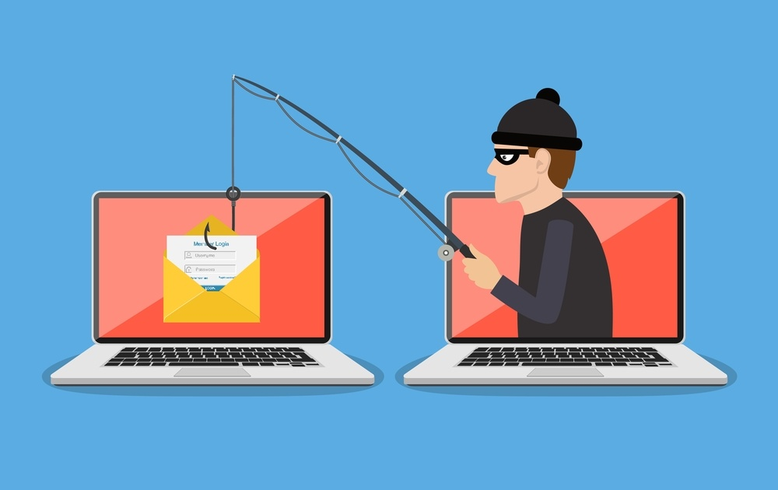
Types of Scams: Phishing Scams
Fake emails, websites, and links that look like trusted ones but can actually steal your information or login to accounts if clicked on

Slide 6
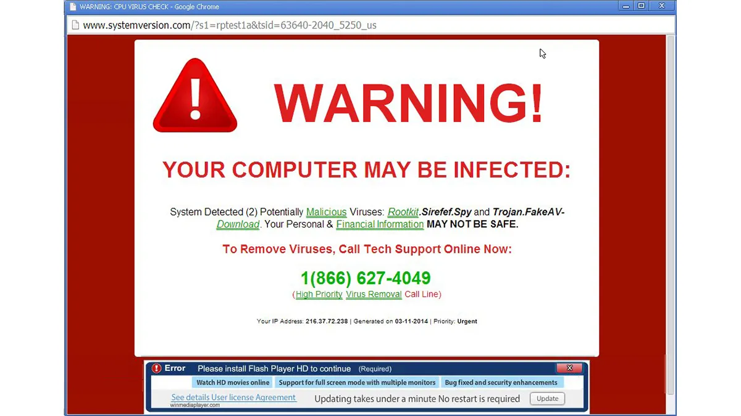
Types of Scams: Tech Support Scams
Pretend to be from a large company like Microsoft or Amazon in order to get someone to call for “help” and obtain access to their computer and personal info

Slide 7
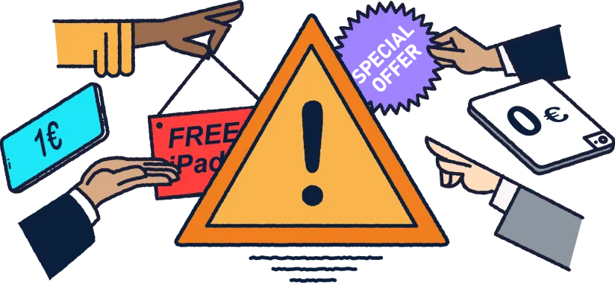
Types of Scams: Online Shopping Scams
Websites that have fake products that can be purchased by consumers with no intention of the company sending out an item.

Slide 8
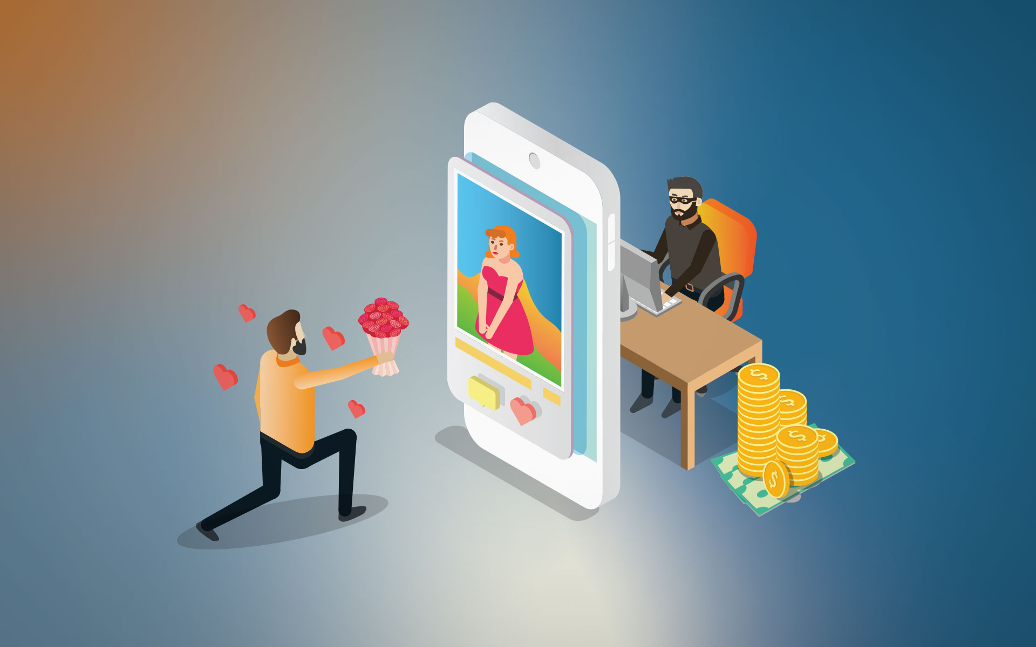
Types of Scams: Romance Scams
Using a fake profile to build trust and a romantic relationship with people and asking for money to help them out, guilt tripping them if needed

Slide 9
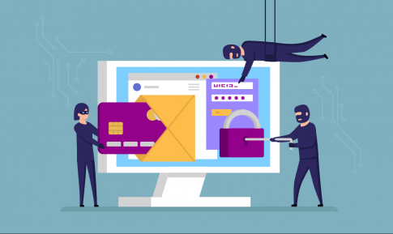
Types of Scams: Investment Scams
Fake crypto markets, Ponzi schemes, False stock market tips
“Invest” in a fake website with fake numbers and then have to pay to take their money out

Slide 10
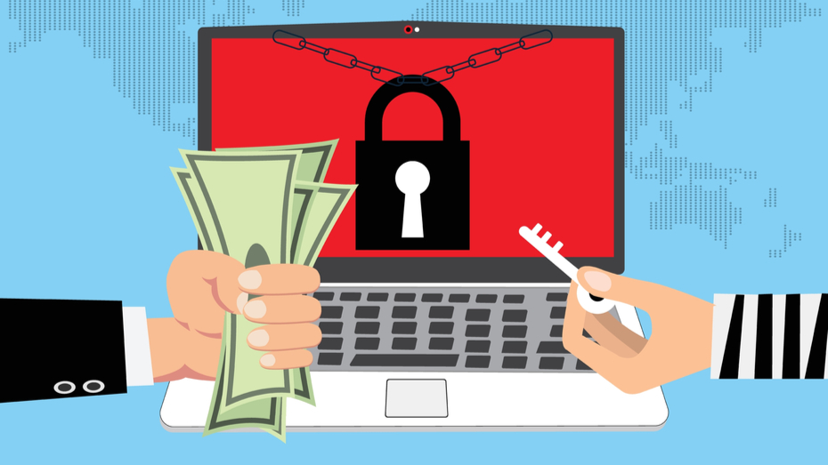
Types of Scams: Ransomware/Malware
Tricking people into downloading harmful software that can overrun or take control of a person’s computer in order to get information

Slide 11
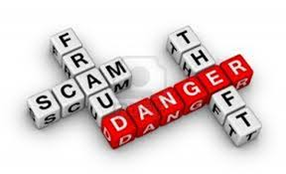

Effect of Scams on People
Victims lose their money, livelihood, personal data like location, jobs or businesses.
“Cybercrime… costs passing $1 trillion since 2018. This includes both the financial losses from cybercrime, estimated at $945 billion, and the $145 billion spent on cybersecurity annually.” (Adorjan & Colaguori, 2023).
Romance scams which take advantage of a person’s want or need for a romantic relationship/love can have a massive toll on someone giving them emotional trauma

Slide 12
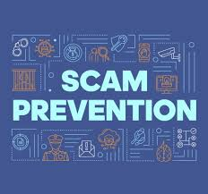
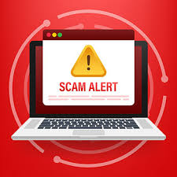
Scam Prevention
Awareness is key to prevention, but it doesn’t mean you’re 100% safe
There is always an opportunity to be caught off guard
Don’t give out any personal information
Don’t click on any links from suspicious emails or texts
Report any suspected scams you come across to the appropriate authorities

Slide 13


Conclusion
Whether it is phishing, romance hoax, or a ransomware attack, the effects of scams cause ruin on a personal, emotional, and financial level. The relationship between scams and computers is not just one of convenience for scammers—it reflects how much society now relies on digital platforms for everyday life.
Be aware, be alert, be cautious

Slide 14
References
Adorjan, M., & Colaguori, C. (2023). Scams, fraud, and cybercrime in a globalized society. Crime, Deviance, and Social Control in the 21st Century: A Justice and Rights Perspective, 407, 407-437.
Federal Bureau of Investigation. (n.d.). Spoofing and phishing. FBI. https://www.fbi.gov/how-we-can-help-you/scams-and-safety/common-frauds-and-scams/spoofing-and-phishing
International, Fraud. com. (2022, July 30). The history and evolution of fraud. https://www.fraud.com/post/the-history-and-evolution-of-fraud
Legal Information Institute. (n.d.). Computer and internet fraud. Cornell Law School. https://www.law.cornell.edu/wex/computer_and_internet_fraud
Mineo, L. (2024, September 27). You’d never fall for an online scam, right? Harvard Gazette. https://news.harvard.edu/gazette/story/2024/09/youd-never-fall-for-an-online-scam-right/
Scamwatch. (2024, August 16). Types of scams. https://www.scamwatch.gov.au/types-of-scams

