Slide 1
Project With C++
Online Restaurant

Slide 2




Team Member
Ahmed Mohamed Abdel-Aty
Anas Shaaban Ibrahim
Student
Student
Khaled Abdel-Naser
Khaled Ayman Farouk
Student
Student

Slide 3
About Submission
The Course Title : Project With C++
The Group Number : 16
The Project Title : Online Restaurant
The Submission Date : 26/12/2022

Slide 4
Introduction

Slide 5
Introduction
"Online Restaurant" is considered as an increasingly used application in restaurant management. Just a few years ago, people used to spend long time waiting for a table to be ready for them at a restaurant. And after that, they would wait longer time to order their food There was no surprise that the food took too long to be prepared. In short, the whole enjoyment of eating did eventually result in boredom and tiredness for customers. From another side, this is the restaurant management and staff who used to stand much pressure to handle a lot of customers at the same time. With great technology in general and the internet in specific, customers can be happy by using online food ordering and reservation. This facilitates the work of restaurant managers and staff. The system will make the entire process for the restaurant manager much easier and faster compared with traditional methods.

Slide 6
Project goals

Slide 7
Project goals
It’s just one click away
Today, more than ever, people can easily order online thanks to the smartphones and tablets. Whether on a break, stuck in traffic, or riding the bus, virtually anyone will place an order quickly and painlessly.
In fact, this is a better, and highly desirable alternative to waiting until getting home and placing the order over the phone.

Slide 8
Basic Functions
To exit from the program
Enter
allow user to choose an option from four Main 5 options(each one Is a function)
Login
is a function to compare the entered data with the saved one in user file
Register
Is a function which save the data in the user file
which by entering your username it shows you your username and password if you forgot it
Exit
Forget password
1
2
3
4
5
6
For admins only
To delete , display and search about member

Slide 9
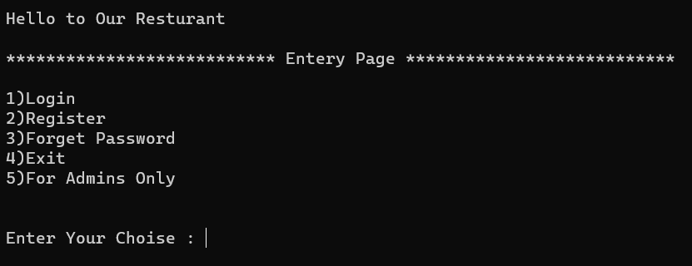
The program start with function (Enter)
We are shown 5 options
We have already explained the role of the basic functions.

Slide 10
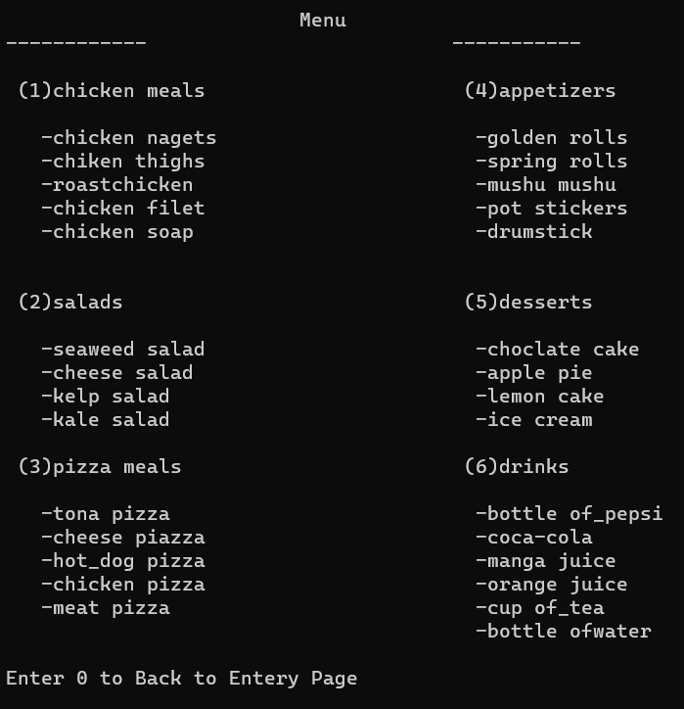
After logging in or registeration
Shows you the menu which allows you to choose your order
Every option of the shown 6 option is a function that will be used to show prices so you can make your order with the quantity you want and also show the prices then it shows you the list of your order

Slide 11
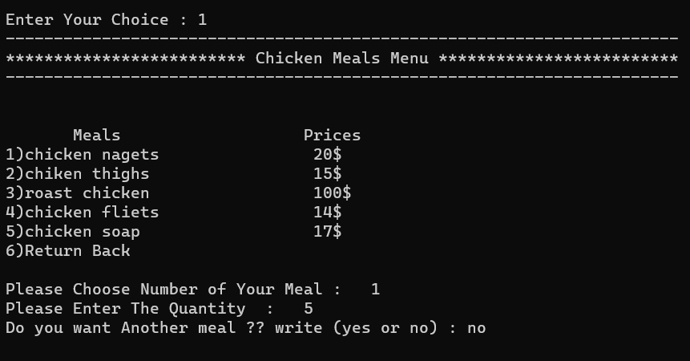
For example we will work in chicken meals
The same list of order and prices will appear to you , you can choose what you want , the quantity you want and ask you if you want another things.

Slide 12
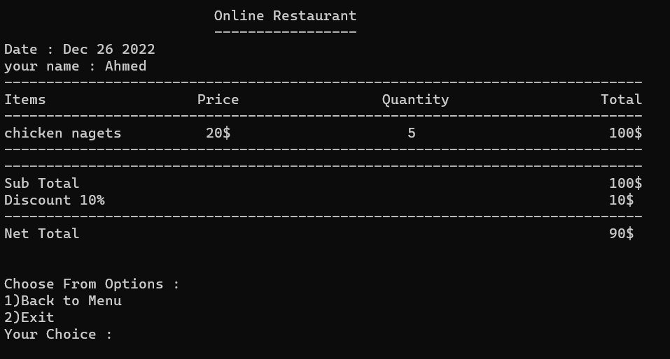
There is a function called account that shows the Items of your order , Price , number of items you ordered , discount and the sum price.

Slide 13
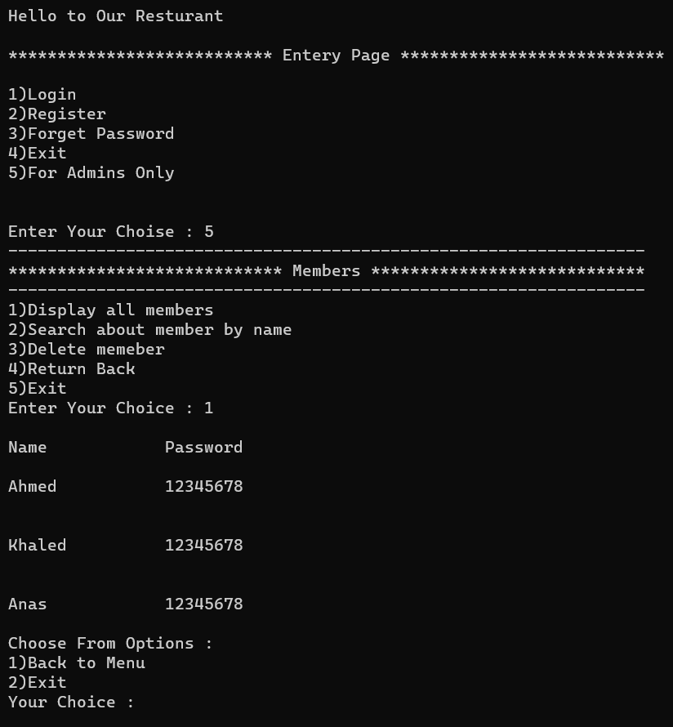
5) the last option is for admins only and it has 5 option which are
1-Display all members : that shows all the names and passwords of users in the screen
It appears that four members have been registered in the program
Now we will go back by entering 1 which calls the screen before the one or we can exit by entering 2

Slide 14
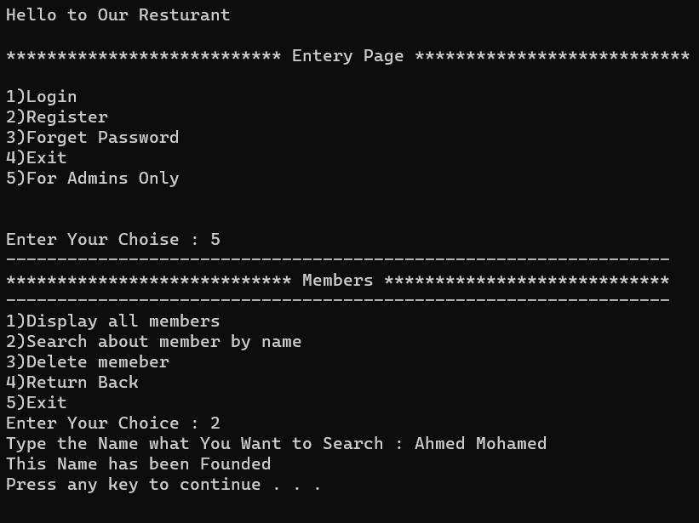
2- Search about member by name : is a function that ask user to enter name to search it in the file and tells user if the name is founded or not founded

Slide 15
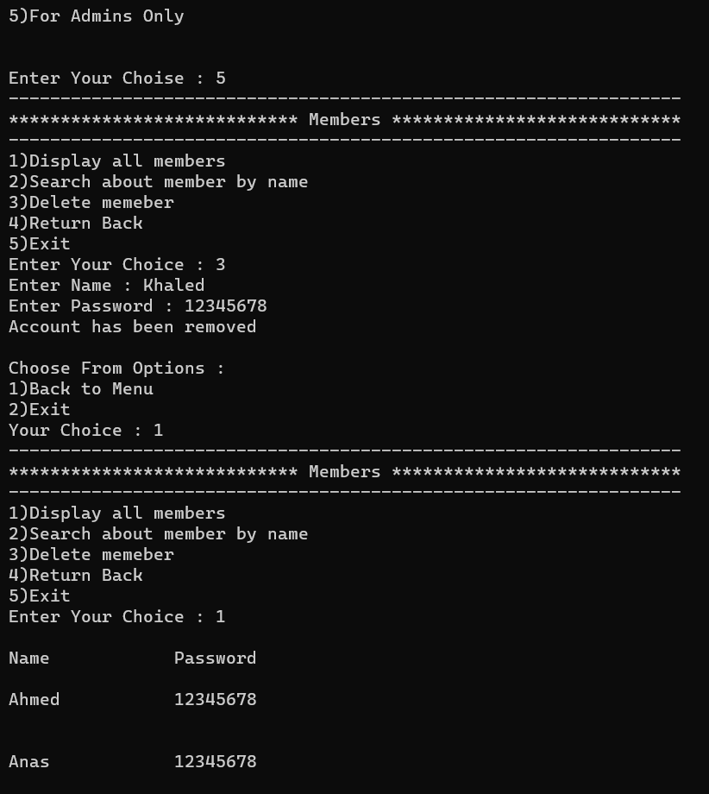
3- Delete member : that function allow the user to delete his account by asking the user to insert his name and password and compare to the data in the file if it’s found it will be deleted
Now let’s display all members to make sure that the account has been deleted

Slide 16
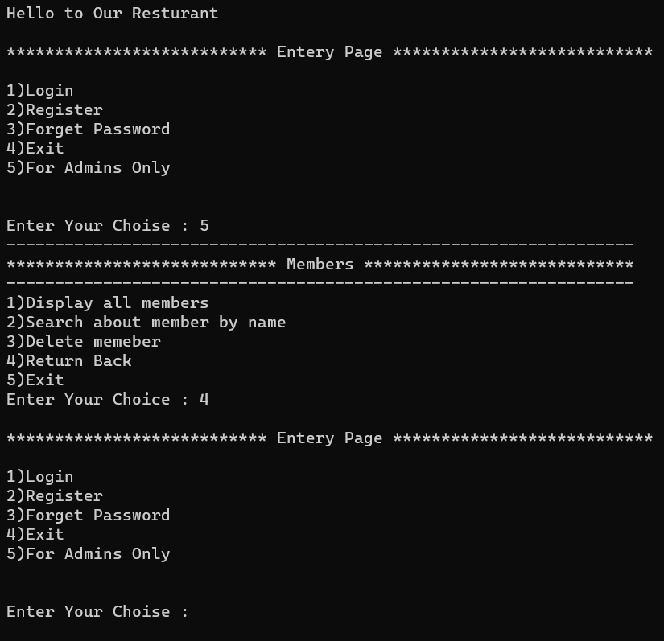
4- Return back : which return to the screen before it
The user is shown the following options :
1)Login
2)Register
3)Forget Password
4)Exit
5)For Admins Only

Slide 17
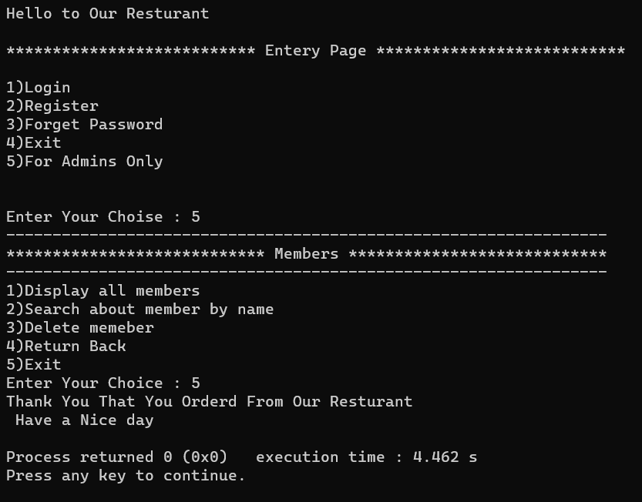
5- Exit : to close the program
At this point , the program is
over

Slide 18
Thank you

