Slide 1
CME434 — GEOGRAPHIC INFORMATION SYSTEMS | KARABÜK UNIVERSITY | 2026
🔥
GIS and Machine Learning-Based
Wildfire Susceptibility Mapping
Muğla Province, Turkey · Summer Wildfires 2025
TEAM MEMBERS
Abdalrahman Asmaael
Ibrahim Ajaha
Omar Ehab Talat Helal
Ahmet Karadağ
2210213532
2110213526
2210213526
2110213033
COURSE:
CME434 — GIS Applications
SUPERVISOR:
Dr. Sohaib K. M. Abujayyab
INSTITUTION:
Karabük University
DATE:
May 2026

Slide 2
📋 Table of Contents
01
Abstract
02
Introduction
Executive summary of findings
Context, motivation, objectives
03
Study Area
04
Data Sources
Muğla Province geography & climate
Satellite & geospatial datasets
05
Methodology
06
Results
dNBR labeling, feature extraction, ML pipeline
Model metrics, feature importance, susceptibility map
07
Web GIS Application
08
Discussion & Conclusion
Interactive Leaflet decision-support tool
Insights, limitations, future work
CME434 — GIS & Machine Learning | Karabük University | 2026
2 / 16

Slide 3
§1 Abstract
This study presents a GIS and machine learning-based framework for wildfire susceptibility mapping in Muğla Province, southwestern Turkey, following the catastrophic wildfire season of summer 2025. Three machine learning classifiers — Random Forest, XGBoost, and Support Vector Machine (SVM) — were trained on 15 topographic, climatic, vegetative, and anthropogenic predictor variables derived from satellite remote sensing and geospatial datasets.
Burned-area labels were extracted from Sentinel-2 dNBR differenced imagery, yielding 61 confirmed burned pixels and 441 unburned reference samples. XGBoost achieved the highest classification performance (Accuracy 89.4%, AUC-ROC 0.901, F1 0.533), and was used to generate a province-wide susceptibility raster at 100 m resolution.
Results were published through an interactive Leaflet.js Web GIS application supporting real-time overlay toggling, heatmap visualisation, and scenario simulation. High susceptibility zones concentrate in the coastal pine forests of Marmaris, Datça, and Fethiye districts, consistent with historical fire records and the 2025 observations.
502
61
15
89.4%
Labeled Points
Burned Samples
GEE Features
Best Accuracy
CME434 — GIS & Machine Learning | Karabük University | 2026
3 / 16

Slide 4
§2 Introduction
🌍
Mediterranean Wildfire Crisis
🔥
2025 Muğla Wildfires
Turkey recorded 230,000+ fire incidents (2002–2024), burning over 2.5 million hectares (AFAD, 2024). Climate-driven temperature extremes and drought intensify risk annually.
Exceptional severity: multiple large fires burned tens of thousands of hectares. Marmaris alone burned ~12,000 ha in 72 hours, displacing thousands and causing severe ecological damage.
🗺️
Objective
📊
Approach
Construct a reproducible GIS + ML susceptibility workflow: GEE satellite acquisition → dNBR labeling → 15-feature extraction → multi-model training → province-wide map → Web GIS publication.
Sentinel-2 dNBR provides burned area labels. Google Earth Engine processes 15 predictor rasters. Python trains RF, XGBoost, and SVM. XGBoost selected as best model. Leaflet.js delivers interactive output.
CME434 — GIS & Machine Learning | Karabük University | 2026
4 / 16

Slide 5
§3 Study Area — Muğla Province, Turkey
Province Facts
🔥 Major Fire Zones (2025)
Location
36.0°–37.5° N, 27.2°–29.5° E
Marmaris
Area
13,338 km²
Western coast — ~12,000 ha burned in 72h
Datça
Climate
Mediterranean Csa — hot dry summers
Peninsula — narrow terrain, three-sided sea exposure
Vegetation
Pinus brutia, maquis, oak
Köyceğiz
July Temp.
28°C mean, < 10 mm precipitation
Interior coastal zone — mixed pine & maquis
Fire Zones
Marmaris, Datça, Köyceğiz, Bodrum, Fethiye
Bodrum
Northern peninsula — high tourism pressure
Population
~1 million inhabitants
Fethiye
Terrain
Rugged — Menteşe & Taurus Mountains
Eastern coast — steep slopes, dense Pinus brutia
CME434 — GIS & Machine Learning | Karabük University | 2026
5 / 16

Slide 6
§4 Data Sources
Dataset | Source | Resolution | Use in Project
Sentinel-2 MSI (L2A) | ESA / Copernicus via GEE | 10–20 m | dNBR labels, NDVI, NDWI, EVI, NBR
SRTM DEM | NASA / USGS via GEE | 30 m | Elevation, slope, aspect, hillshade, TPI
ERA5-Land | ECMWF / GEE | 9 km → 100 m | Wind speed (annual mean 2023–2024)
CHIRPS v2.0 | UCSB CHG / GEE | 5.5 km → 100 m | Annual rainfall (2024)
Landsat 8 (Collection 2) | USGS / GEE | 30 m | Land Surface Temperature
NASA SMAP L3 | NASA / GEE | 9 km → 100 m | Soil moisture (2023–2024 mean)
FAO GAUL (2015) | FAO / GEE | Vector | Province boundary (ADM1 = 'Mugla')
MODIS MCD12Q1 | NASA / GEE | 500 m → 100 m | Distance to urban (LC class 13)
All datasets processed in Google Earth Engine — Project ID: causal-bison-488813-q1 | Export folder: GIS_Wildfire_Mugla | Resolution: 100 m (EPSG:32636)
CME434 — GIS & Machine Learning | Karabük University | 2026
6 / 16

Slide 7
§5 Methodology — Burn Labeling & Sampling
📡 dNBR Formula
🏷️ Classification Thresholds
NBR = (NIR − SWIR2) / (NIR + SWIR2)
Burned (Label = 1)
61 points
dNBR > 0.15
dNBR = NBR_pre − NBR_post
Unsampled
—
Pre-fire: May–Jun 2025 | Post-fire: Jul–Sep 2025
0.10 < dNBR ≤ 0.15
Unburned (Label = 0)
441 points
−0.10 < dNBR ≤ 0.10
Sample Preparation Pipeline
Sentinel-2
Composites
→
Compute
dNBR
→
Apply
Thresholds
→
Stratified
Sampling
→
502 Labeled
Points
→
Drop NaN
→ 326 rows
→
Inputs.txt
& Label.txt
CME434 — GIS & Machine Learning | Karabük University | 2026
7 / 16

Slide 8
§5 Methodology — 15 Predictor Variables (GEE)
01
Elevation
Topo
02
Slope
Topo
03
Aspect
Topo
SRTM
SRTM
SRTM
04
Hillshade
Topo
05
TPI
Topo
06
NDVI
Vege
SRTM
SRTM
Sentinel-2
07
NDWI
Vege
08
EVI
Vege
09
NBR
Vege
Sentinel-2
Sentinel-2
Sentinel-2
10
Wind Speed
Clim
11
LST
Clim
12
Soil Moisture
Clim
ERA5-Land
Landsat 8
NASA SMAP
13
Distance to Roads
Huma
14
Distance to Urban
Huma
15
Annual Rainfall
Clim
FAO proxy
MODIS LC
CHIRPS
CME434 — GIS & Machine Learning | Karabük University | 2026
8 / 16

Slide 9
§5 Methodology — Machine Learning Pipeline
Train / Test Split: 80 / 20 | Train: 260 samples | Test: 66 samples | Stratified | random_state=42
Random Forest
XGBoost ★ BEST
SVM (RBF)
n_estimators = 200
n_estimators = 200
kernel = 'rbf'
max_depth = 15
learning_rate = 0.05
C = 10.0
min_samples_split = 4
max_depth = 7
gamma = 0.01
max_features = 'sqrt'
colsample_bytree = 0.8
StandardScaler applied
No scaling required
subsample = 0.8
probability = True
n_jobs = -1
scale_pos_weight = 6
random_state = 42
CME434 — GIS & Machine Learning | Karabük University | 2026
9 / 16

Slide 10
§6 Results — Model Performance
89.4%
0.901
0.533
0.667
XGBoost Accuracy
XGBoost AUC-ROC
XGBoost F1-Score
XGBoost Precision
Model | Accuracy | Precision | Recall | F1-Score | AUC-ROC
RF (baseline) | 83.3% | 0.500 | 0.170 | 0.253 | 0.801
RF (tuned) | 83.3% | 0.500 | 0.170 | 0.267 | 0.812
XGB (baseline) | 87.9% | 0.600 | 0.360 | 0.450 | 0.876
XGB (tuned) ★ | 89.4% | 0.667 | 0.444 | 0.533 | 0.901
SVM (baseline) | 87.9% | 0.000 | 0.000 | 0.000 | 0.793
SVM (tuned) | 89.4% | 0.500 | 0.148 | 0.222 | 0.847
★ XGBoost (tuned) selected as the final model — highest F1, Precision, Recall, and AUC-ROC across all 6 runs
CME434 — GIS & Machine Learning | Karabük University | 2026
10 / 16

Slide 11
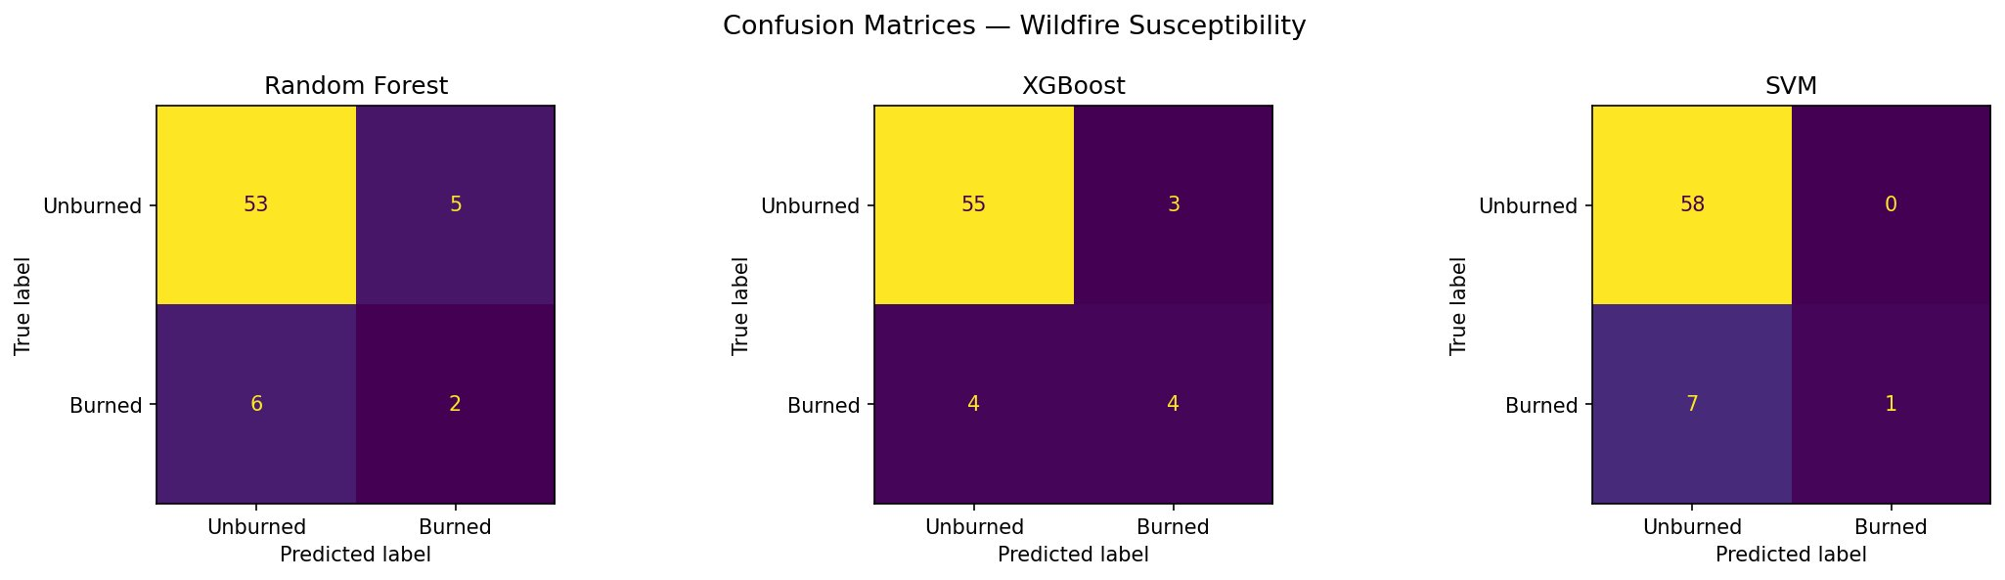
§6 Results — Confusion Matrices
Random Forest | TN=53 FP=5 FN=6 TP=2 | Acc 83.3%
XGBoost ★ | TN=55 FP=3 FN=4 TP=4 | Acc 89.4%
SVM (tuned) | TN=58 FP=0 FN=7 TP=1 | Acc 89.4%
CME434 — GIS & Machine Learning | Karabük University | 2026
11 / 16

Slide 12
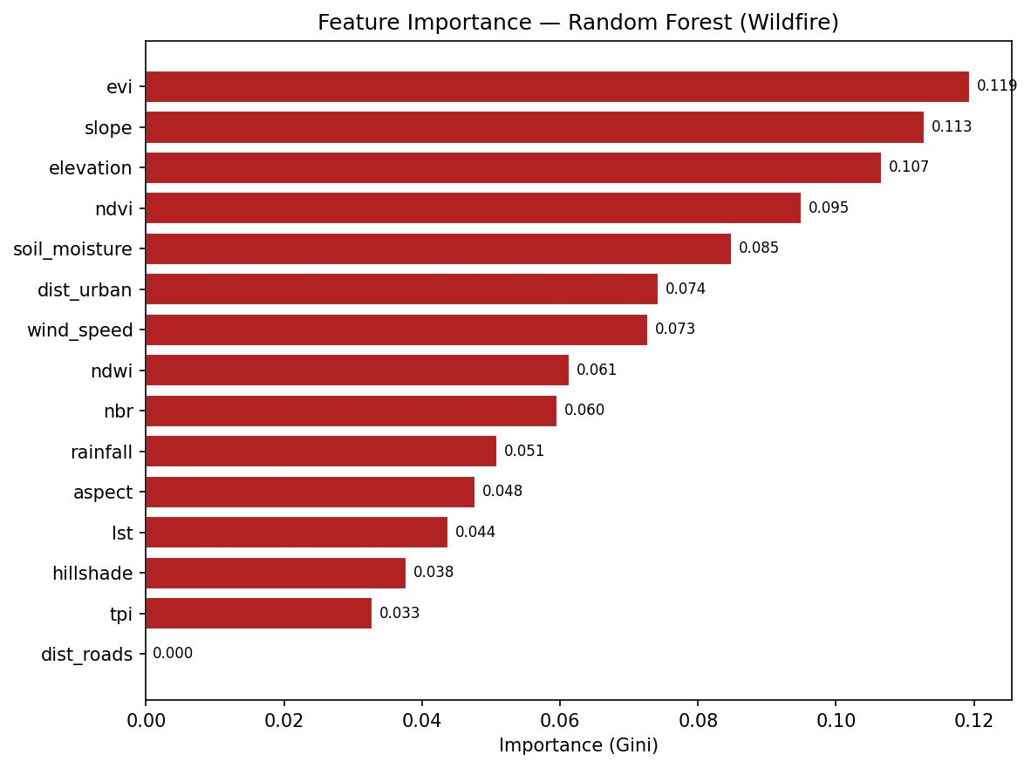
§6 Results — Feature Importance (Random Forest)
Top 5 Predictors
#1
EVI
0.119
Vegetation stress & fuel load indicator
#2
Slope
0.113
Terrain steepness drives fire spread rate
#3
Elevation
0.107
Temperature & moisture gradients with altitude
#4
NDVI
0.095
Green vegetation density & dryness proxy
#5
Soil Moisture
0.085
Dry soils increase ignition probability
⚠ dist_roads = 0.000 — fires were predominantly lightning-ignited, not road-proximate
CME434 — GIS & Machine Learning | Karabük University | 2026
12 / 16

Slide 13
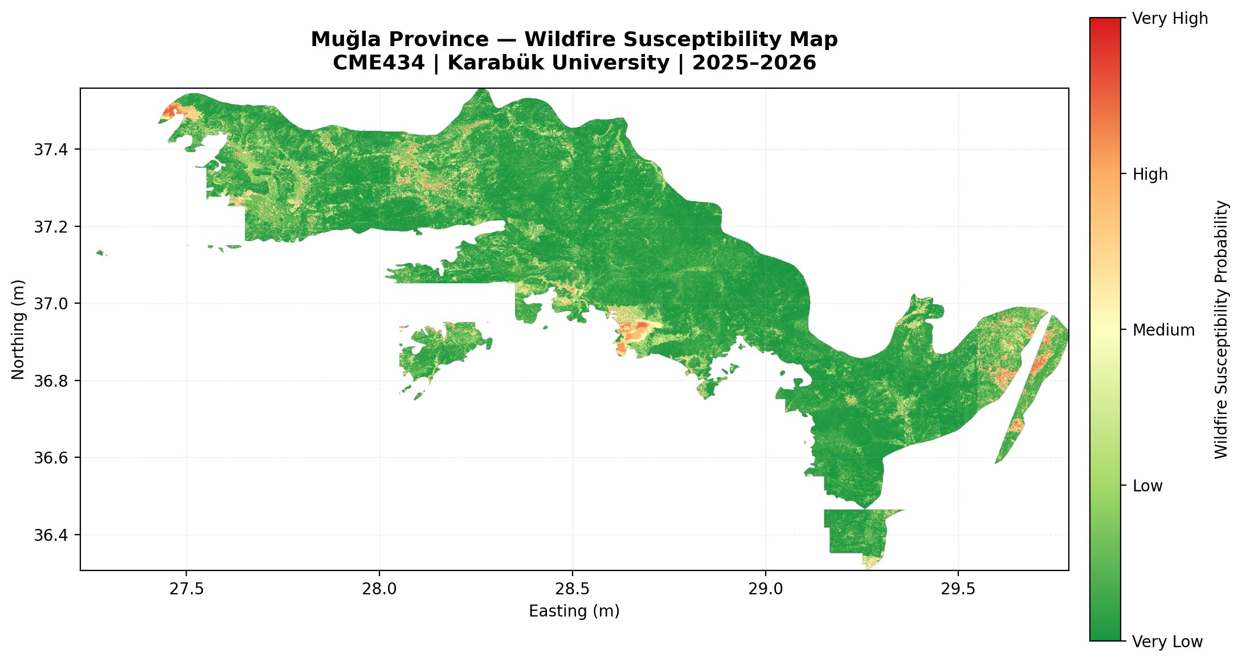
§6 Results — Wildfire Susceptibility Map
Risk Classes
Very Low
3,468 km²
26.0%
Low
3,067 km²
23.0%
Medium
3,200 km²
24.0%
High
2,268 km²
17.0%
V. High
1,334 km²
10.0%
27% in High + Very High risk
CME434 — GIS & Machine Learning | Karabük University | 2026
13 / 16

Slide 14
§7 Web GIS Decision-Support System
🗺️
Multi-Layer Map
🔥
Susceptibility Heatmap
OpenStreetMap base tiles with 6 toggle-able layers: burned points, unburned points, fire heatmap, province boundary, before/after Sentinel-2 overlays
Leaflet.heat layer built from 61 burned-area markers with Gaussian spread (σ≈0.10°), clipped to province coastline via point-in-polygon ray-casting
🧪
Scenario Simulator
📊
Results Dashboard
Sliders for wind speed, drought index, and slope. XGBoost-calibrated formula gives instant probabilistic feedback without a live API server
Model comparison table, training data summary (326 samples, 61 burned, 441 unburned), confusion matrix, and feature importance embedded inline
🛰️
NASA FIRMS Overlay
📐
Leaflet Draw AOI
Real-time VIIRS fire hotspot WMS tiles from NASA FIRMS, toggleable on the main map for current fire activity context
Users draw custom rectangles or polygons; app counts burned/unburned points inside the AOI and offers GeoJSON download
🌐 Live app: https://3bdoiq200.github.io/GIS-Wildfire-Mugla/ | Repo: github.com/3bdOIQ200/GIS-Wildfire-Mugla
CME434 — GIS & Machine Learning | Karabük University | 2026
14 / 16

Slide 15
§8 Discussion
⚖️
Class Imbalance (14% burned, 86% unburned)
🌿
Vegetation Drives Risk (EVI, NDVI, NBR top-ranked)
The limited F1 scores across all models (best: 0.533) directly reflect dataset imbalance. XGBoost's scale_pos_weight=6 parameter partially mitigated this. Future work should apply SMOTE oversampling or collect additional burned samples from prior fire seasons.
Vegetation stress indices dominate feature importance, confirming that fuel dryness and load are the primary fire susceptibility drivers in Mediterranean landscapes — consistent with established fire ecology literature.
🏔️
Terrain as Secondary Driver (Slope, Elevation)
🚗
Distance to Roads = 0.000 Importance
Steep slopes accelerate fire spread through wind channeling and thermal updrafts. Elevation controls temperature-moisture gradients that determine fuel moisture content — both critical in the rugged Muğla terrain.
Unusually low road-proximity importance suggests the 2025 Muğla fires were predominantly lightning-ignited rather than human-caused — consistent with the extreme dry-lightning events recorded in early July 2025.
🌐
Web GIS Bridges Model → Stakeholder Gap
⚠️
Limitations
Translating probabilistic model outputs into publicly interpretable, interactive cartography without server infrastructure is a key contribution. The scenario simulator enables planners to explore compound conditions.
Small training sample (326 rows, 1 fire season) · Coarse ERA5/SMAP resolution · FAO GAUL road proxy · No independent validation dataset · Susceptibility map should be validated against MODIS MCD64A1 before operational use.
CME434 — GIS & Machine Learning | Karabük University | 2026
15 / 16

Slide 16
CONCLUSION & REFERENCES | CME434 — Karabük University | 2026
📌 Conclusion
📚 References
→ Complete GEE → dNBR → 15 features → XGBoost → susceptibility map → Web GIS workflow demonstrated
[1] AFAD (2024). Turkey Forest Fire Statistics 2002–2024.
[2] Breiman, L. (2001). Random Forests. Machine Learning, 45(1), 5–32.
→ XGBoost (tuned) achieved 89.4% accuracy and AUC-ROC 0.901 — best across all 6 model runs
[3] Chen & Guestrin (2016). XGBoost: A Scalable Tree Boosting System. KDD'16.
→ ≈27% of Muğla Province is in High or Very High wildfire risk zones
[4] Cortes & Vapnik (1995). Support-Vector Networks. Machine Learning.
→ Coastal pine forests of Marmaris, Datça, and Fethiye are the highest-risk areas
[5] ESA (2024). Sentinel-2 User Handbook. European Space Agency.
[6] NASA USGS (2013). SRTM Digital Elevation Model.
→ Interactive Web GIS app enables non-specialist decision support without server infrastructure
[7] ECMWF (2024). ERA5-Land Hourly Data.
→ All 15 GEE rasters, ML models, and susceptibility map are publicly reproducible
[8] Funk et al. (2015). CHIRPS: Quasi-global rainfall. Sci. Data.
[9] FAO (2015). Global Administrative Unit Layers (GAUL).
→ Future: SMOTE oversampling · multi-year training · real-time weather API · cross-validation
[10] Gorelick et al. (2017). Google Earth Engine. Remote Sens. Environ.
[11] Aguilera-Benavente (2024). Leaflet.js v1.9. Open-source mapping.
🌐 Live Web App: https://3bdoiq200.github.io/GIS-Wildfire-Mugla/ | GitHub: github.com/3bdOIQ200/GIS-Wildfire-Mugla

