Slide 1

Explainable AI for Autonomous Vehicles
Making Self-Driving Decisions Transparent and Trustworthy
[Mohamed Alkhozendar], [Abdullah Alshobaki], [Masa Bokhary], [Mohamed Allabani], [Abdullah Shaher]
Date 8/1/2026
Department of Artificial Intelligence Engineering

Slide 2
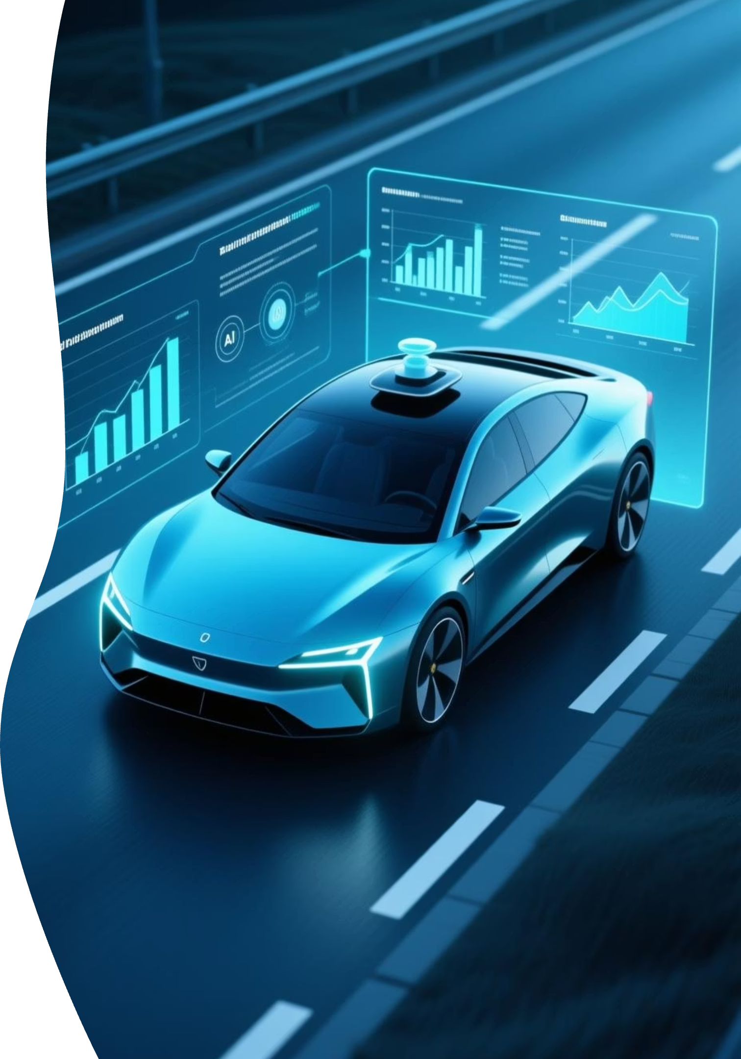
The Black Box Problem in Autonomous Vehicles
WHY did the car suddenly brake?
Opaque AI Decisions
AI systems often operate as "black boxes," making decisions without providing human-understandable reasoning.
Tesla Autopilot Incidents
High-profile accidents highlight the critical need for transparency in autonomous driving systems.
Public Distrust
A significant portion of the public (73%) distrusts autonomous vehicles due to this lack of transparency.
Validation Challenges
Without understanding the underlying logic, it's impossible to fully validate or debug AI behavior.

Slide 3
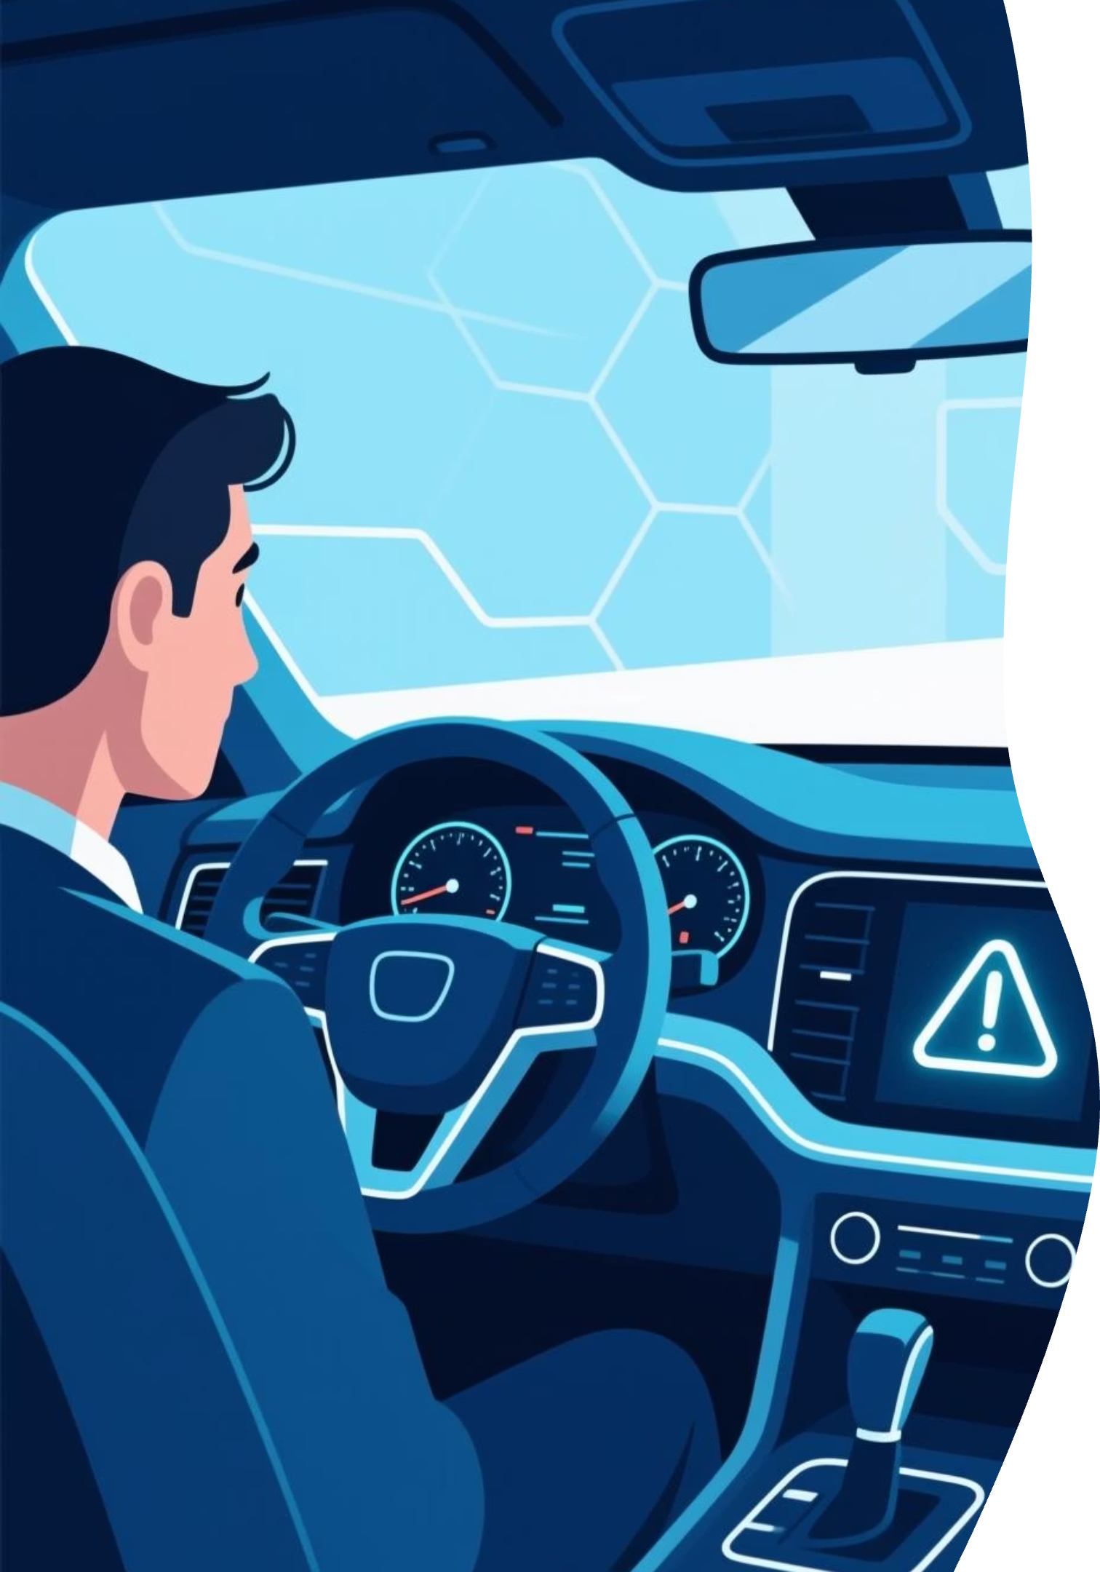




Four Pillars of Explainable AI for AVs
Safety Assurance
Explainability allows validation of reasoning, crucial for identifying and mitigating
potential failure modes in complex scenarios.
Regulatory Compliance
Emerging regulations, like the EU AI Act, mandate transparency, making
explainability a prerequisite for market approval.
Public Trust & Acceptance
Understanding how AVs make decisions is key to building consumer confidence and accelerating adoption beyond the current 73% distrust.
Liability & Accountability
In the event of an accident, an auditable trail of AI decision-making is essential for determining responsibility and improving future systems.

Slide 4
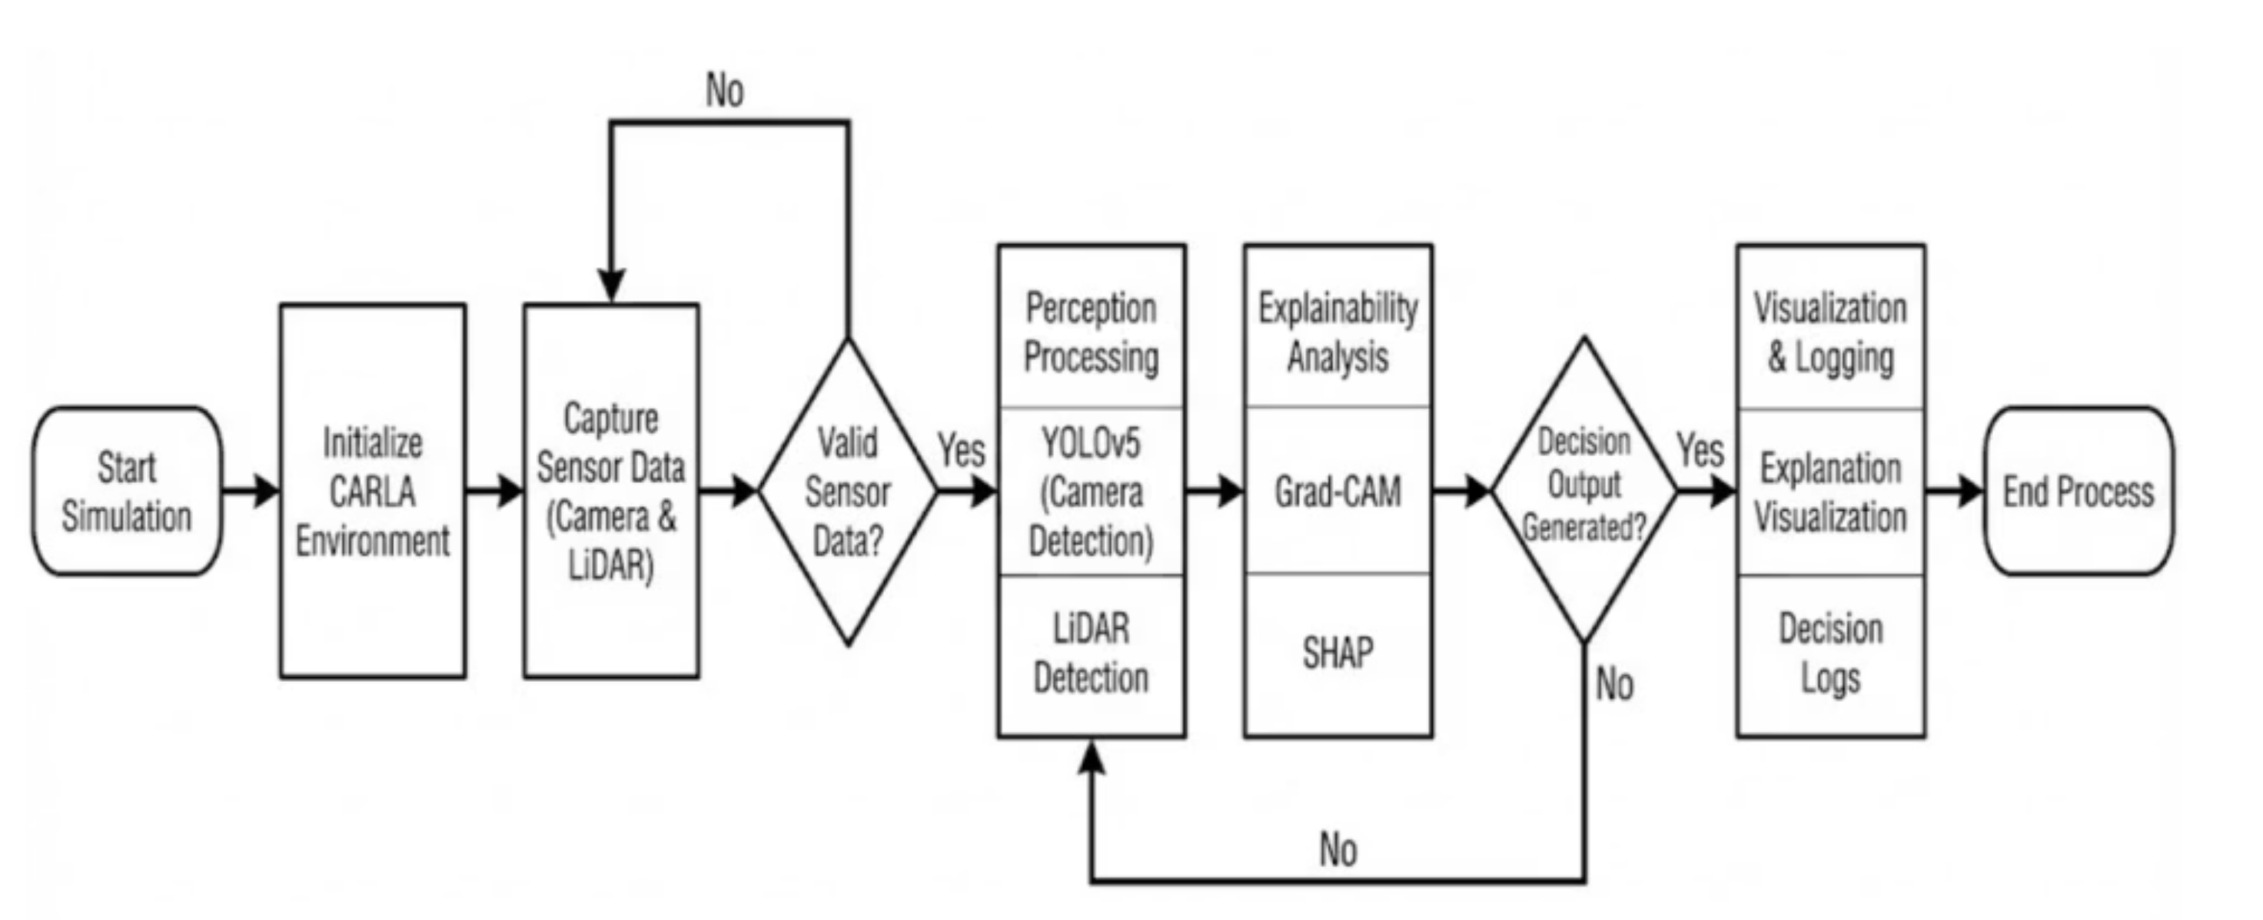
Our Explainable AI System Architecture
System Overview
Key Features
Our architecture integrates perception, explainability, and real-time visualization within the CARLA simulation environment, specifically using a Tesla Model 3 with Autopilot capabilities.
Multi-modal sensor fusion
Multiple XAI techniques
Real-time operation (5-8 FPS)

Slide 5
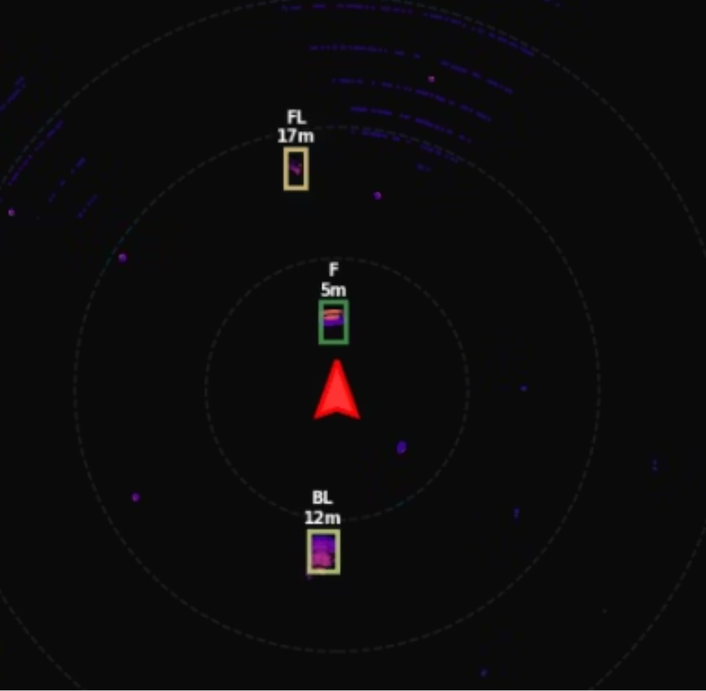
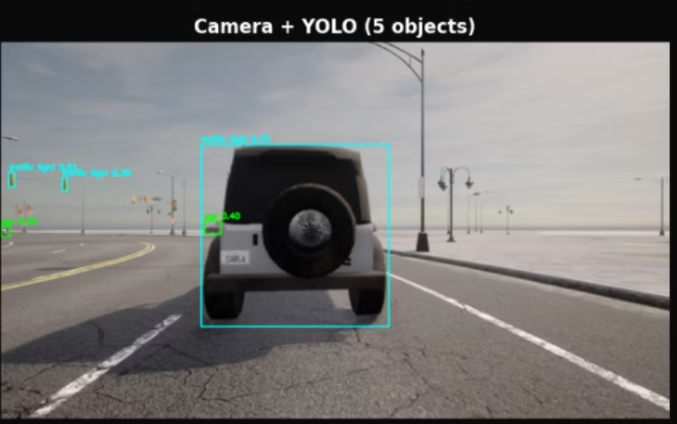

Sensor Fusion: LiDAR + Camera
Combining the strengths of disparate sensor modalities to achieve robust environmental perception.
LiDAR Data
Camera Vision
Fusion Output
Object at 8.2m, 1.8m wide
CAR detected (85% conf)
CAR at 8.2m ahead
✅ Precise geometry (< 1m error)
✅ Object identification
Our fusion algorithm synthesizes these inputs, providing the "best of both worlds": accurate localization with rich semantic context.
❌ No semantic information
❌ No precise distance

Slide 6

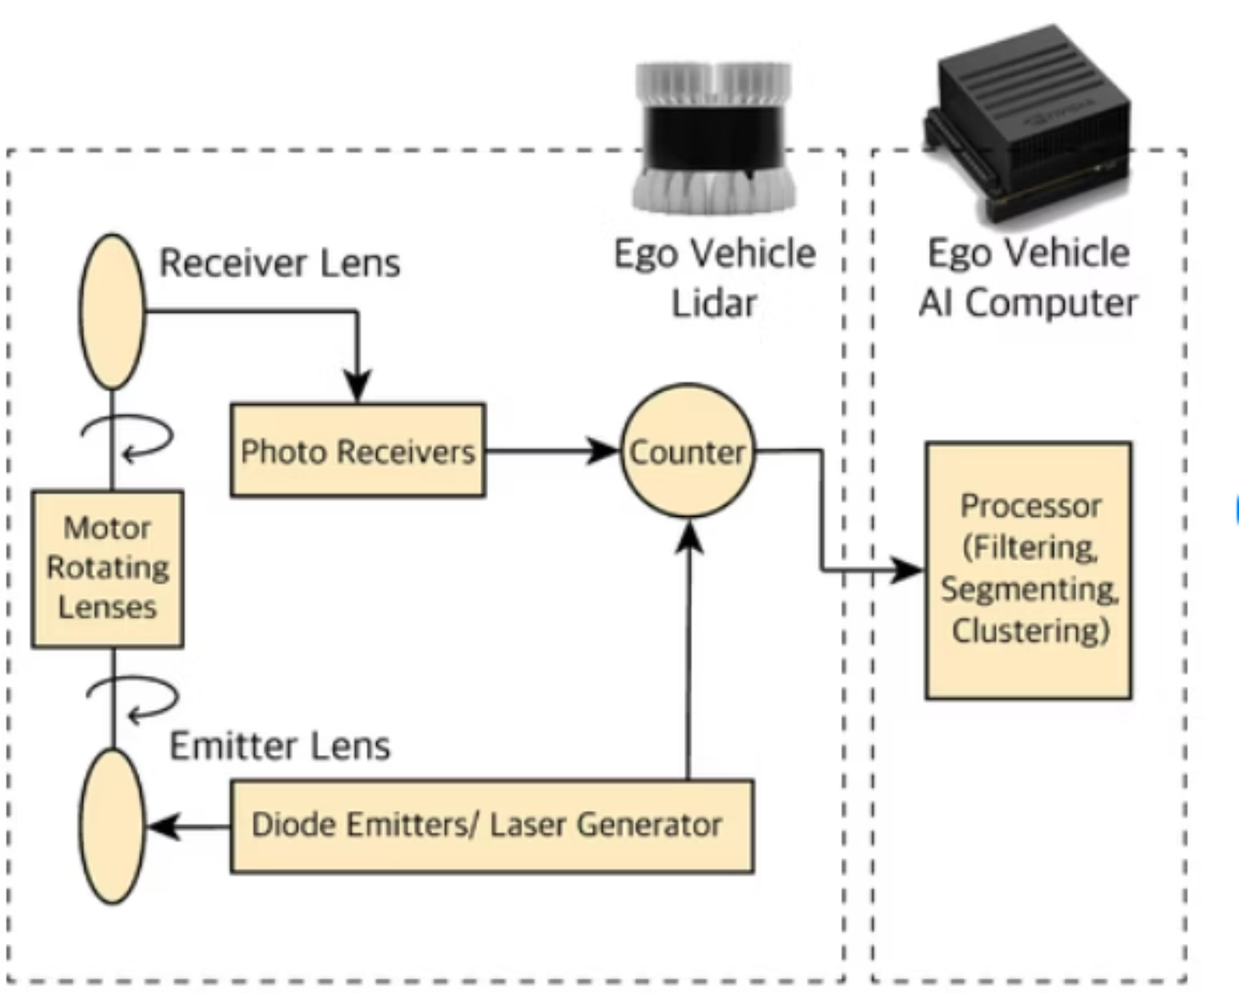
360° LiDAR Detection Pipeline
Specifications
Processing Pipeline
Channels: 64 (Velodyne HDL-64E equivalent)
Range: 80m, 500,000 points/second
Frequency:
10Hz rotation
Coverage: Rolling buffer of 10 frames for full 360° view

Slide 7
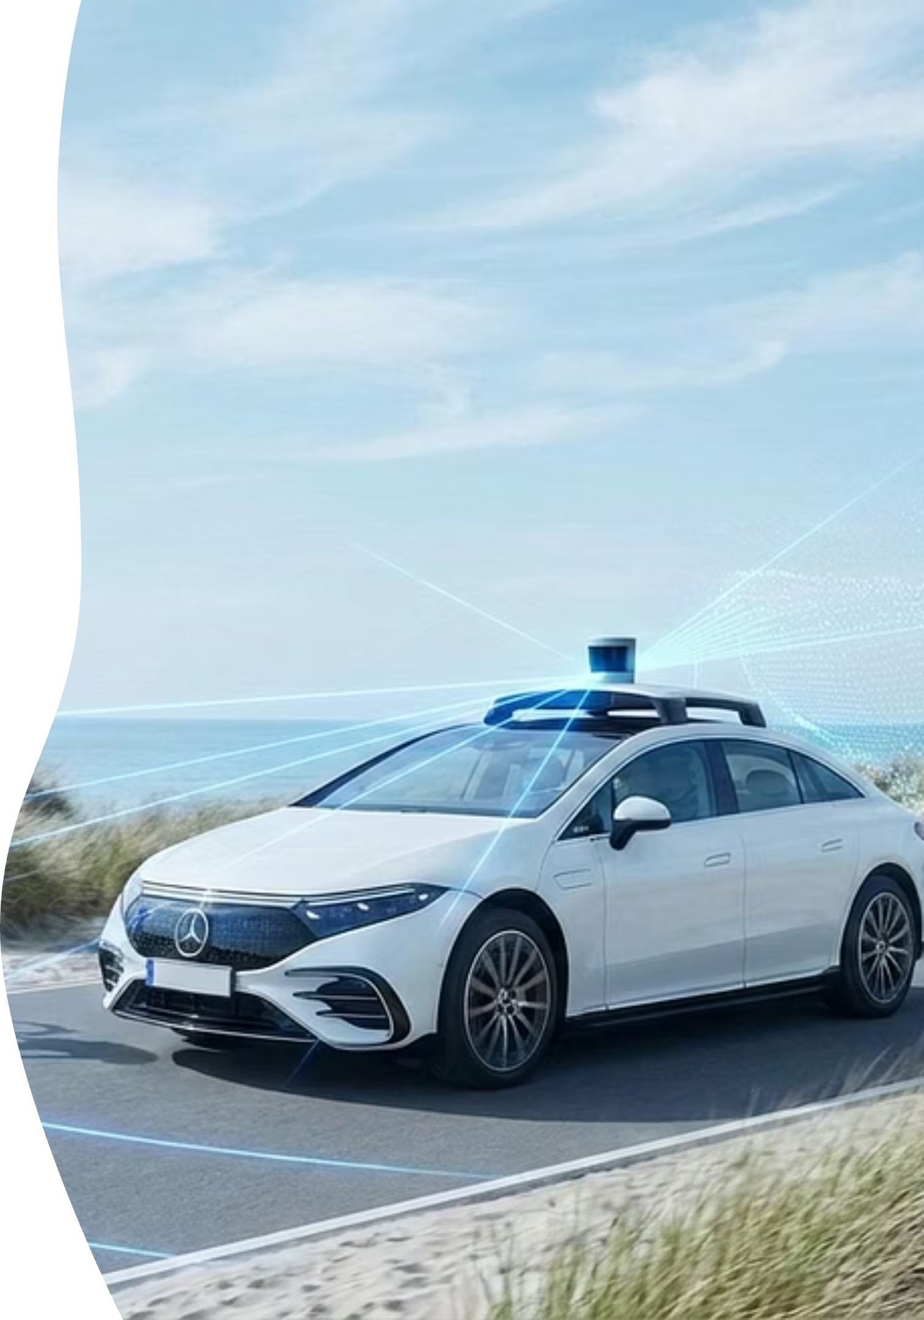

LiDAR Accuracy & Performance
Example: Vehicle detected at 8.2m (Ground truth: 8.2m) ✓
Detection Metrics
Distance Accuracy: < 1m error (mean: 0.8m)
Our LiDAR system consistently delivers precise and reliable object detection, crucial for safe autonomous navigation.
Detection Rate: 95% within 20m
False Positives: < 5%

Slide 8
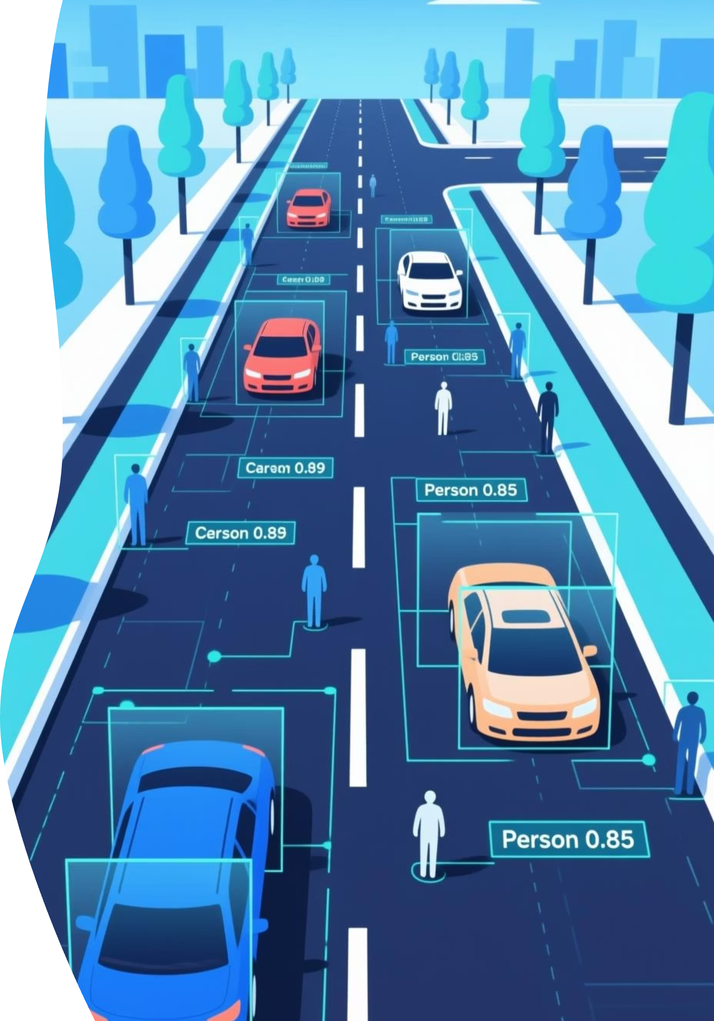
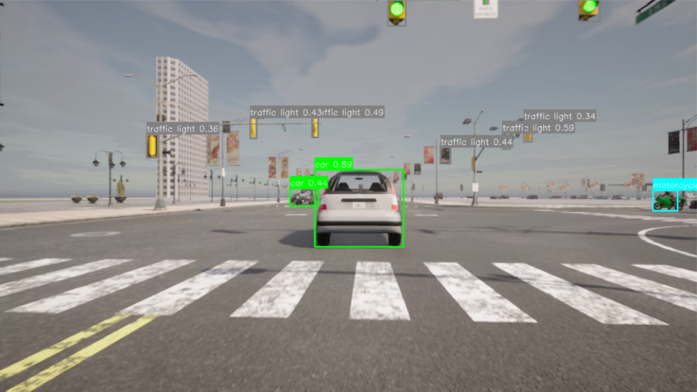



Camera-Based Semantic Understanding with YOLOv5
Yolo in Action
Detected Object Classes
Vehicles
Cars, Trucks, Buses
Vulnerable Road Users
Pedestrians, Cyclists
This efficient architecture enables real-time processing at 30+ FPS with an impressive 28ms inference time.
Traffic Signals
Traffic Lights, Stop Signs

Slide 9
Detection Accuracy Results
Model
Accuray
FPS
YOLOV5n
82%
41
YOLOV5s
89%
33
YOLOV5m
96%
21
Fine-tuned YOLOV5s
96%
31
Inference: 28ms (GPU)
After multiple test a YOLOV5s model was fine-tuned on hundred of real world + Carla simulator road images to have the perfect balance between accuracy and FPS

Slide 10
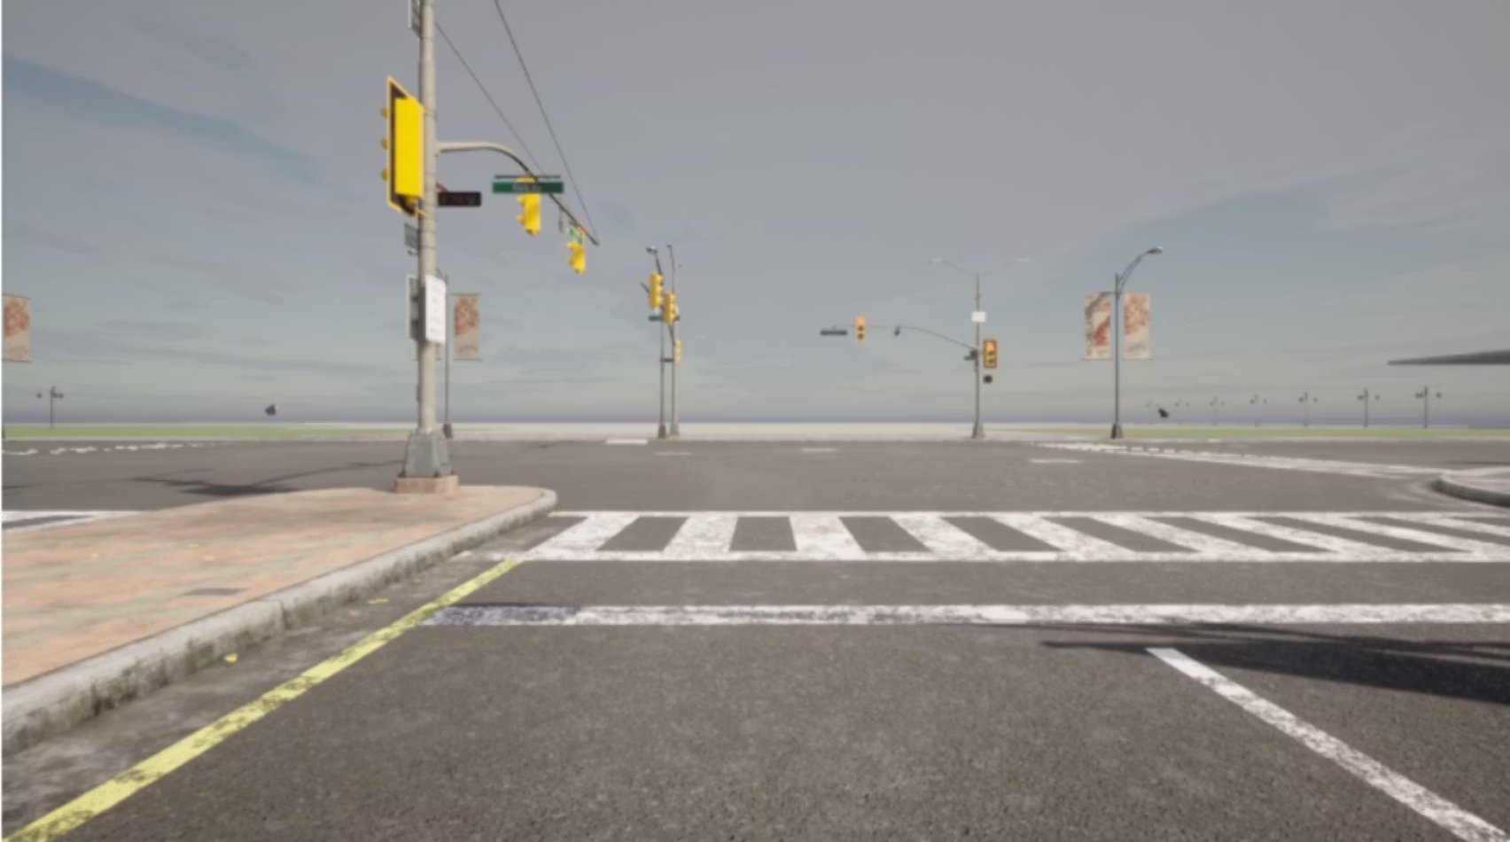

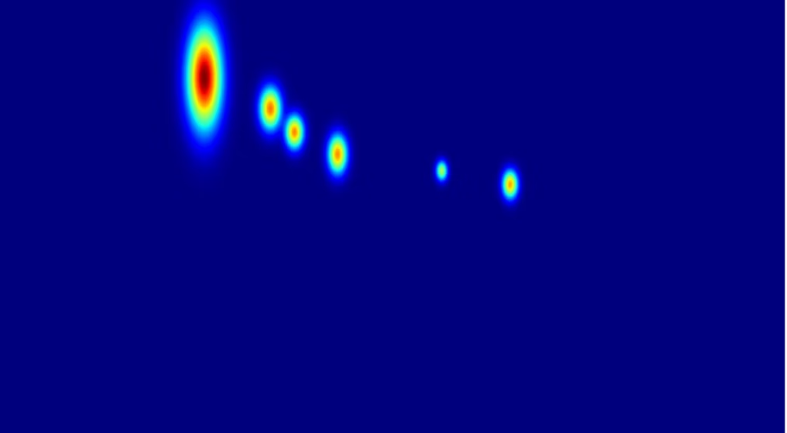
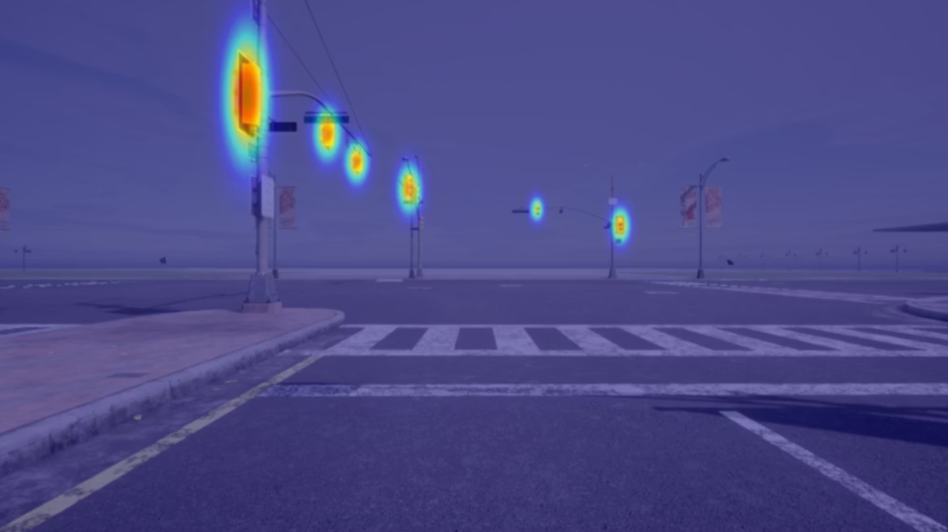

WHERE Does the Model Look? Grad-CAM Attention
Original Input Image
Saliency Map
Attention Map
Detection Attention Map
Attention Overlay
The heatmap is overlaid on the original image, visually explaining which specific regions the model focused on for its detection.
Gradient-weighted Class Activation Mapping (Grad-CAM)
Grad-CAM helps us understand the spatial locations in an image that are most critical for the Convolutional Neural Network's predictions, providing transparency into the model's decision-making process.

Slide 11
Our Grad-CAM Approach: Detection-Based Attention
Methodology
01
02
03
Gaussian Heatmap
Confidence Weighting
Combine Detections
Generate a Gaussian heatmap centered around each detected object.
Weight each heatmap by the detection's confidence score from YOLOv5.
Aggregate all individual object heatmaps into a single attention map.
04
05
Gaussian Blur
Colormap Overlay
Apply a 31x31 Gaussian blur for smoother visual representation.
Overlay the final heatmap with a jet colormap (blue to red) onto the original image.
This detection-based approach to Grad-CAM is engineered for real-time capability, providing visually intuitive insights into the model's focus. It processes visual inputs efficiently, allowing for immediate feedback on critical scene elements.

Slide 12
Grad-CAM Validation & Limitations
Validation Metrics
✅ 100% attention focuses on detected objects: Confirmed that the heatmap consistently highlights relevant entities.
✅ Closer/larger objects → higher attention: The model prioritizes objects of immediate relevance and size.
✅ User study: 85% agreement 'makes sense': Subjective evaluation by users found the explanations largely intuitive.
✅ Real-time capable (< 15ms per frame): Demonstrates practical applicability for autonomous systems.
This method presents a crucial trade-off: while less rigorous than some interpretability techniques, its practicality and intuitive visual explanations are invaluable for real-world autonomous vehicle applications.

Slide 13



WHY Does the Model Decide? SHAP Analysis
While Grad-CAM reveals where the model focuses, SHAP (SHapley Additive explanations)
elucidates why the model arrives at a particular decision. It transitions from visual attention to causal attribution of input features.
Grad-CAM
SHAP
WHERE does the model look?
WHY does the model decide?
Feature Engineering for Interpretability
Raw sensor data
Lidar, camera, IMU inputs
Interpretable Feature Pipeline
interpretable features
Derived Features
safe_distance_front
Engineered, human-readable
Vehicle State
LiDAR Features
speed, throttle, brake, steering
closest_front, closest_back
Our approach involves reducing millions of raw sensor data points into 14 highly interpretable features. This strategic feature extraction significantly lowers complexity while maintaining clarity and relevance for decision-making.

Slide 14
Decision Model + SHAP Explainability
Decision Model: Random Forest Classifier
SHapley Additive exPlanations (SHAP)
100 trees, maximum depth of 10 for balanced performance.
SHAP employs a game-theoretic approach to fairly attribute the contribution of each feature to the model's output. It assigns a SHAP value to each feature for a given prediction.
Trained on 600 diverse driving samples with an 80/20 split.
Achieved 92% accuracy on the training set and 85% on the test set.
Positive SHAP value → pushes prediction TOWARD the decision.
Negative SHAP value → pushes prediction AWAY from the decision.
BRAKE
Magnitude of SHAP value → indicates the strength of contribution.
ACCELERATE
MAINTAIN

Slide 15
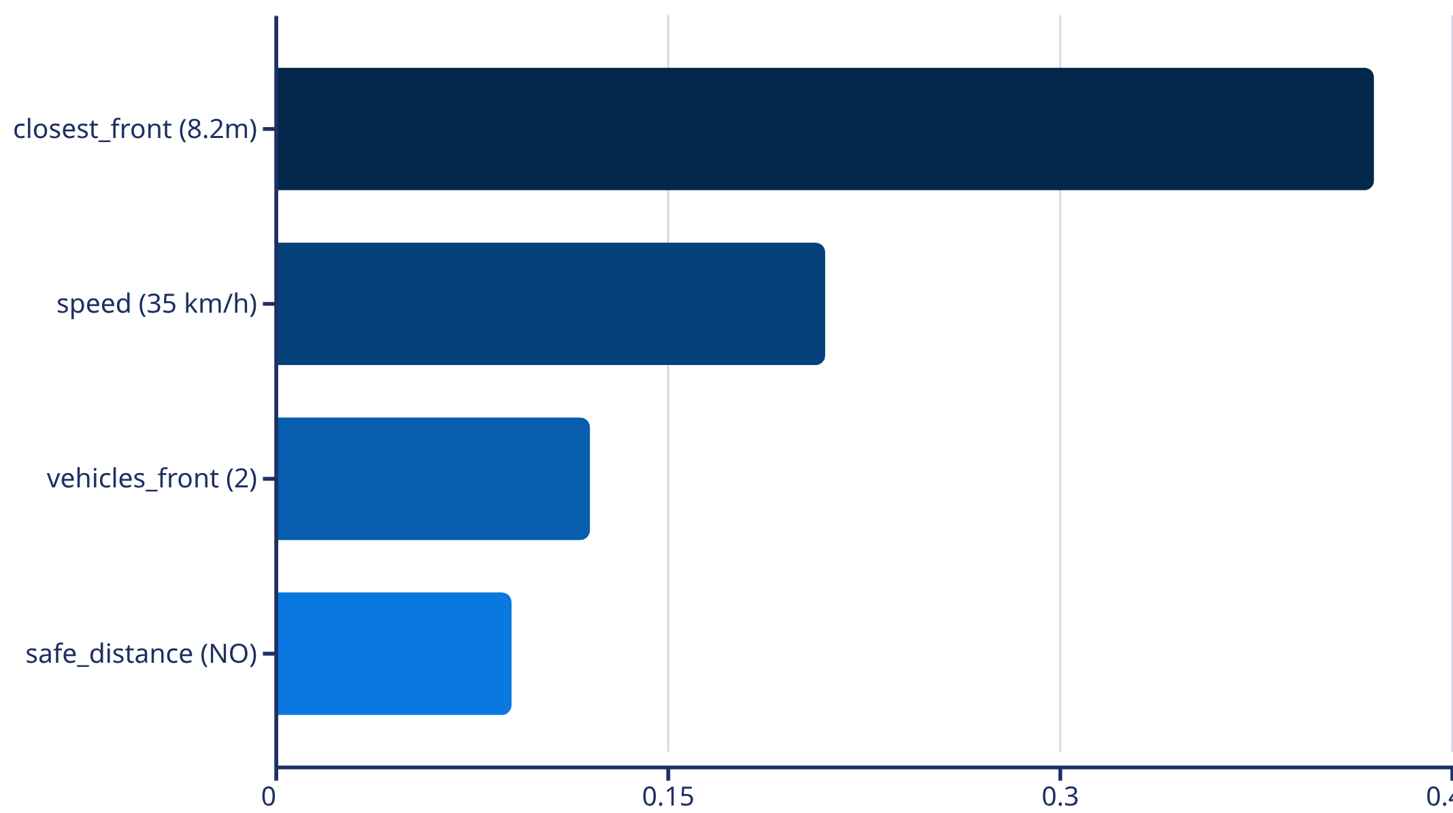

SHAP Explanation Example: Braking Decision
A real-world scenario demonstrating how SHAP attributes feature contributions to a critical braking decision.
Decision: BRAKE (Confidence: 89%)
The system is braking because a vehicle is dangerously close at only 8.2 meters (main factor), combined with a high speed of 35 km/h. The safe following distance rule is violated. This reasoning is correct and appropriate, demonstrating clear, actionable insights for autonomous operation.

Slide 16
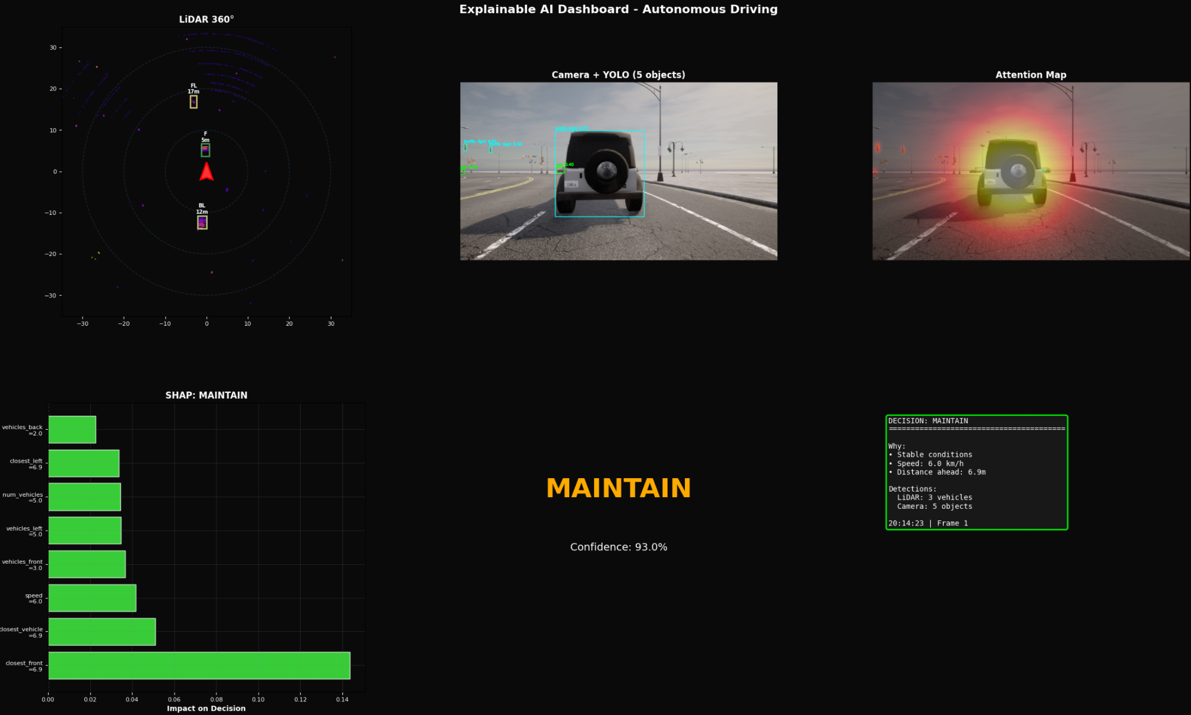
Integrated Real-Time XAI Dashboard
This dashboard updates at 5-8 frames per second, with all components synchronized, offering a comprehensive, real-time understanding of the autonomous system's perception and decision-making process. We are prepared for a LIVE DEMO to showcase its capabilities.

Slide 17
Results, Impact & Future Directions
Quantitative Results
1
LiDAR Performance
<1m error, 95% detection accuracy
2
YOLOv5 F1-Score
96% object detection reliability
3
Decision Model Accuracy
94% correct predictions on test set
4
SHAP Expert Rating
4.2/5 for interpretability and usefulness
5
Real-time Processing
5-8 frames per second on current hardware

Slide 18




Key Impact Areas
Safety Validation
Regulatory Compliance
Validates AI reasoning before deployment, enhancing system reliability.
Meets evolving EU AI Act transparency requirements for autonomous systems.
Passenger Trust
Development Efficiency
Increases passenger confidence through understandable vehicle behavior.
Facilitates faster debugging and improvement cycles for AI models.
Future Work
Current Limitations
Limited to 5-8 FPS (not production-ready)
GPU acceleration to achieve 30+ FPS
LiDAR range currently limited to 30 meters
Develop steering explanation capabilities
Conduct extensive real-world vehicle testing
The future of autonomous vehicles is TRANSPARENCY.
We've proven explainable AI is achievable in real-time—making every decision understandable, verifiable, and trustworthy.
THANK YOU

