Slide 1
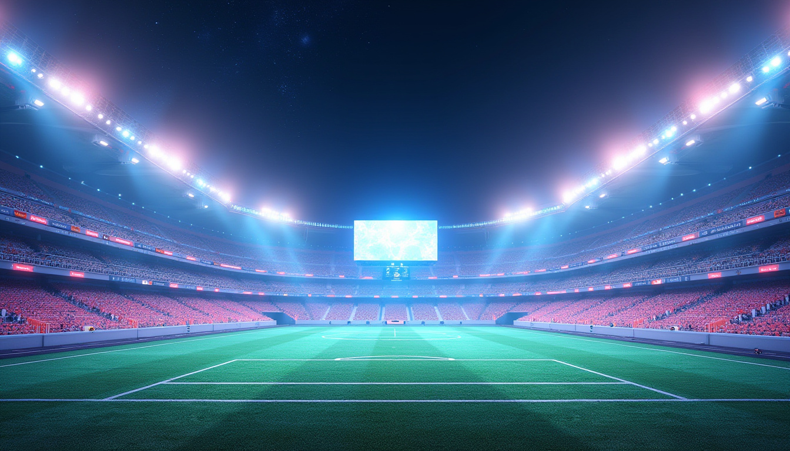
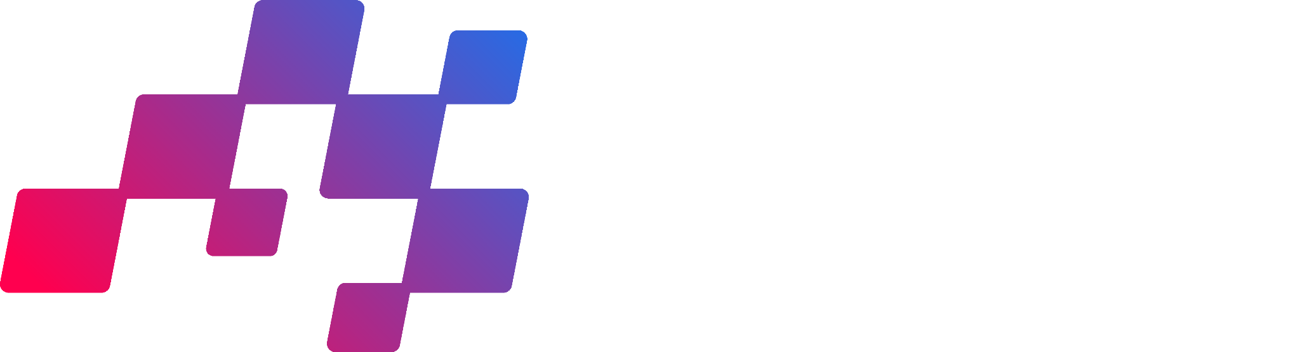
Marsad - مَرْصَد

Slide 2
Team Members
Abdullah Al-Shobaki - AI Engineer
Masa Bokhary – AI Engineer
Abdullah Salamoun – AI Engineer

Slide 3
Contents:
01
Team Members
05
All Data Used (Textual and Non-Textual)
02
The Problem and Its
Solution
06
How These Data Are Provided and Utilized
03
Idea Description
07
Summary
Technologies Used
04

Slide 4
The Problem and its solution
Mass gatherings such as stadium events, festivals, and religious seasons face serious crowd safety challenges. Our project provides an AI-powered monitoring system that detects risks in real time, ensuring safety and enhancing the overall experience through smart, predictive technology.
Innovative solutions
We developed an AI-powered crowd monitoring system that detects congestion and risk patterns in real time using computer vision. Unlike traditional security systems, our solution proactively prevents crowd-related incidents through predictive alerts and intelligent analysis.
Stay ahead of trends
Our solution leverages the latest advancements in computer vision, machine learning, and edge computing. As smart infrastructure and AI safety systems become essential in large events, our project positions itself as a forward-thinking safety tool for future-ready venues.
Seasonal spikes
The system is ideal for managing massive crowds during seasonal events like Hajj, Ramadan, national celebrations, and football finals. These periods experience high crowd density, and our solution ensures safety, order, and faster response times when it's needed most.

Slide 5

Used data
We collected and utilized both textual and visual data to train and test our AI model, ensuring accurate crowd detection, risk analysis, and system validation.
20%
20%
1st quarter
2nd quarter
Collected textual data such as incident reports and safety protocols to train our risk classification logic.
Sourced open datasets of crowd images and video clips from platforms like Kaggle and UCF-QNRF.
35%
25%
3rd quarter
4th quarter
Focused on annotating and labeling video data to train the computer vision model using YOLOv8.
Used test videos for validation and created real-time simulations to test system performance and accuracy.
Throughout our project, we used a combination of textual and non-textual data. In the early stages, we collected open-source crowd footage and safety documents. As the project progressed, we focused more on labeling data and testing the model in real-time scenarios. This diverse dataset helped us build a robust and reliable AI system.

Slide 6
Technologies Used
We built an AI-based system for real-time crowd monitoring and risk detection using live video feeds and machine learning models. This solution enhances safety and response efficiency during large gatherings.
YOLOv8 (for crowd detection)
Python & OpenCV (for image processing)
TensorFlow/Keras (for deep learning models)
Streamlit/Dash (for dashboard UI)
Google Colab & NVIDIA GPU (for model training)
Event organizers and public safety authorities often face delayed responses to overcrowding, leading to dangerous situations. Manual monitoring is not scalable or accurate in real time.
Our system uses AI to detect abnormal crowd formations and predicts risks before they happen. This allows for fast intervention by security teams, reducing accidents.
Our system provides instant alerts, heatmaps, and predictions of potential crowd hazards, all powered by AI — enabling fast decisions and preventing incidents before they escalate.
The global crowd monitoring tech market is growing due to smart city initiatives and safety regulations. While some tools exist, most lack real-time AI insights or predictive alerts — giving our solution a key edge.
We aim to allocate funding toward access to real-time video datasets, cloud GPU resources, and integration tools with existing camera infrastructures for real-world testing.
With your support, we aim to deploy our system in live pilot events, improve model accuracy, and scale to real-world environments for greater social impact.

Slide 7

Marsad - مَرْصَد
AI-Powered Smart Stadium Safety & Fan Experience System
Marsad - “مَرْصَد” is an AI-based system designed to ensure real-time crowd safety and enhance fan engagement inside stadiums and event venues. The system uses computer vision to monitor crowd density, identify high-risk formations, and alert security teams instantly. In parallel, it gathers live fan engagement insights to enhance the experience via smart interactions. By integrating predictive analytics, edge AI, and responsive dashboards, our solution not only prevents accidents but also elevates the overall event atmosphere — all while being scalable, cost-efficient, and easy to deploy.

Slide 8
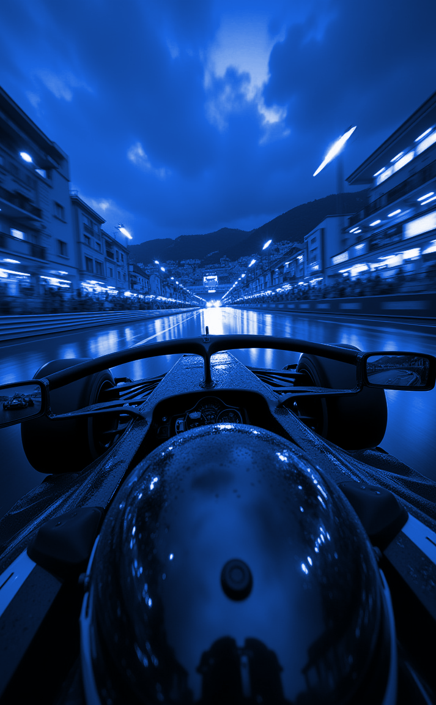
How the Data Is Provided and Utilized
We sourced visual data from open datasets such as UCF-QNRF and Crowd Surveillance footage, then annotated and preprocessed it to train our AI model for crowd detection and risk assessment. This data was key to building and validating our system's real-time prediction capabilities.

Slide 9
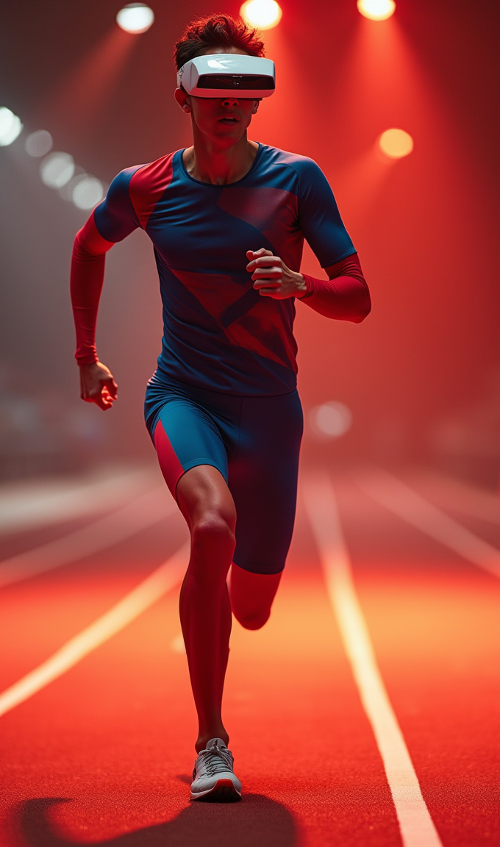
Goal Alignment:
Our project directly aligns with the competition’s goals by combining artificial intelligence with real-time video analytics to enhance stadium safety and fan experience. It improves operational performance by detecting dangerous crowd patterns early, boosts safety through predictive alerts, and enriches fan engagement with data-driven insights — making it a holistic smart stadium solution.

Slide 10
Summary
Our project aims to revolutionize crowd safety in stadiums through AI-powered real-time monitoring and risk prediction. We developed a working prototype that detects crowd density and abnormal patterns using computer vision and provides live alerts to help prevent incidents. Early testing shows promising results, and we’re now working on expanding data sources, improving model accuracy, and integrating the system into live environments.

Slide 11
Testing/Validation:
We tested our AI-based crowd monitoring system on a dataset of 50+ annotated video clips, simulating real-life congestion and movement patterns. The model achieved over 85% accuracy in detecting crowd density levels and identifying potential risk zones in real-time video streams.

Slide 12
Challenges & Future Work
Challenges:
Limited access to real-world, high-resolution surveillance footage for training and testing, model accuracy affected by variations in lighting and camera angles, and computational limits during real-time testing due to lack of high-end GPUs.
What You Need Help With:
Access to real-time video feeds or simulated stadium footage, cloud-based GPU support (e.g., access to NVIDIA A100 or T4 instances), and mentorship in real-time deployment and optimization strategies for edge devices.
Future Works:
Expand dataset with more diverse crowd scenes, improve model robustness for night and low-light environments, build and test live dashboard prototype with alert system, and deploy an early-stage demo in a controlled simulated environment.

Slide 13
Thank You

